Slide 1

AI Companion System: Emotion-Aware Voice Conversations
The AI Companion system offers a sophisticated backend architecture designed for emotion-aware voice conversations, merging real-time analysis with deep learning insights. This presentation breaks down the system's architecture, implementation, and scaling considerations, providing a comprehensive overview of its capabilities. We will explore the core components, data management strategies, error handling mechanisms, security measures, and scalability solutions that underpin this innovative system. Join us as we delve into the intricacies of this architecture and its potential to revolutionize human-computer interaction.

Slide 2

Problem Statement: Building Emotionally Intelligent AI
The primary challenge is to create an AI system capable of engaging in natural voice conversations while understanding and responding appropriately to human emotions. This requires:
Real-time voice processing and speech recognition.
Advanced emotional intelligence and profiling.
Persistent data storage for user profiles.
Seamless external integrations and services.

Slide 3
Key Features & Solutions
Features:
Solutions:
Real-time Voice Interface: Processes audio and recognizes speech.
Robust error handling and caching for voice processing.
Basic Analysis Engine: Performs sentiment analysis and escalation detection.
Sentiment thresholds and configurable keyword dictionaries.
LLM Processing: Uses Groq API for deep sentiment analysis.
Batch processing and fallback mechanisms for LLM analysis.
Profile Generation: Creates user profiles with mood evolution.
Rotation policies and compression for data management.
Knowledge Base: Integrates with ElevenLabs for context-aware responses.
Asynchronous processing and connection pooling for performance.
Mood Tracker: Visualizes historical emotional trends.

Slide 4
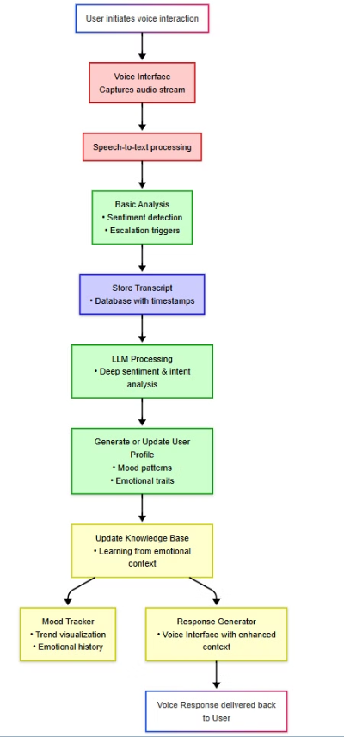
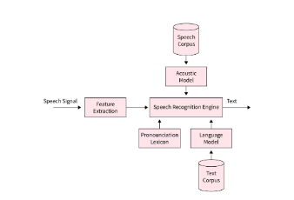
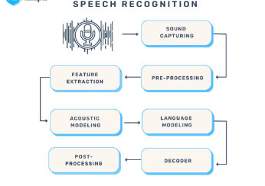
System Architecture Flow

Slide 5

Core Components & Tech Stack
Live Agent
ElevenLabs conversational ai, PyAudio, TextBlob
Watcher/Processor
ElevenLabs API, Groq API, Python
Mood Tracker
Flask, Matplotlib, JSON
LLM
Llama 4 ,using grok api
Data Stores
File System (transcripts, user profiles, processed IDs, mood evolution)
The system leverages a modular design with Python as the core language. Key technologies include ElevenLabs for voice processing, Groq API for advanced LLM analysis, and Flask for the Mood Tracker web service. Data is managed using JSON and stored in the file system, ensuring a flexible and scalable architecture.

Slide 6
Implementation Considerations
Core Components: Implement error handling, caching, and voice activity detection.
LLM Processing: Use batch processing, prompt pattern caching, and fallback mechanisms.
Storage and Performance Optimization: Implement rotation policies, compression, and caching layers.
Asynchronous Processing: Use queue systems and connection pooling.
Error Handling and Monitoring: Implement retry mechanisms, detailed logs, and API response time monitoring.
Data Integrity: Validate API responses, implement checksum verification, and regular backups.

Slide 7

Scaling Considerations
To handle increasing demand, the system is designed for horizontal scaling. This involves:
Distributing voice processing across multiple instances.
Implementing load balancing for API endpoints.
Using distributed caching mechanisms.
Dynamic resource allocation based on load.
Containerization for easier scaling.
Auto-scaling policies.

