Slide 1
Saliency based coding for Omnidirectional Videos
Week 4: BHISHMA DEDHIA

Slide 2
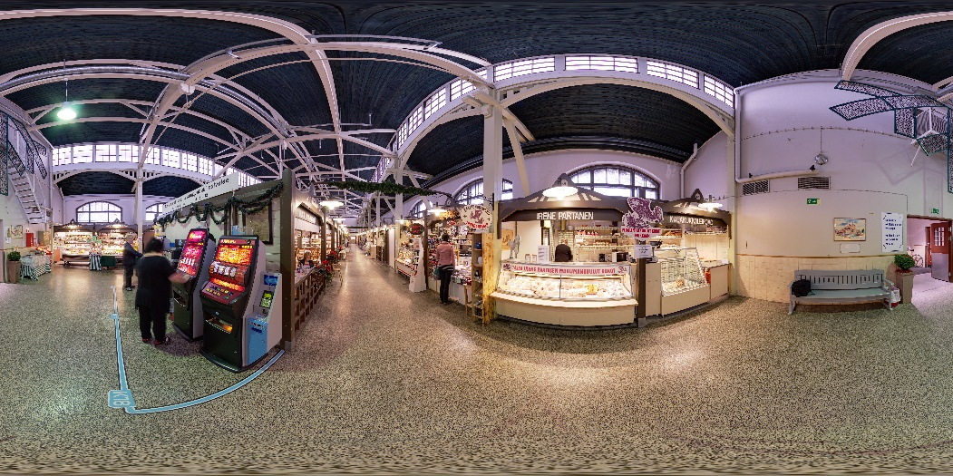
TESTCASES AND RESULTS
PICTURE:29

Slide 3
SUMMARY OF RESULTS
Angle of Rotation | Weight of VLIM | Correlation coefficient | KD entropy
45 | 0.7 | 0.6354 | 0.4909
45 | 0.5 | 0.6803 | 0.4580
45 | 0.3 | 0.6965 | 0.4595

Slide 4
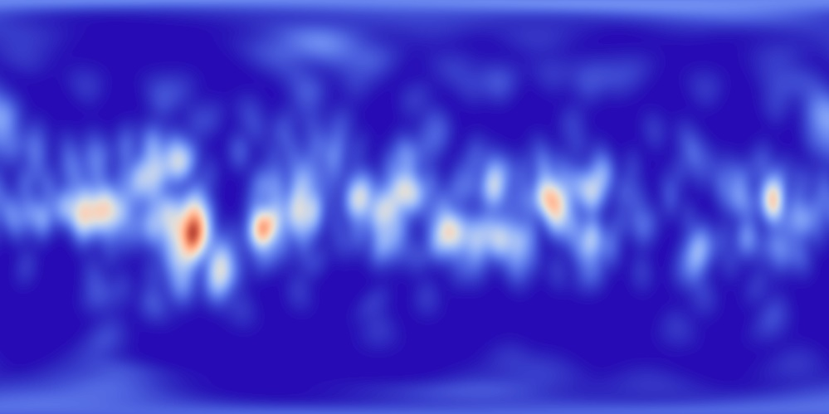

GROUND TRUTH vs BEST PERFORMING

Slide 5
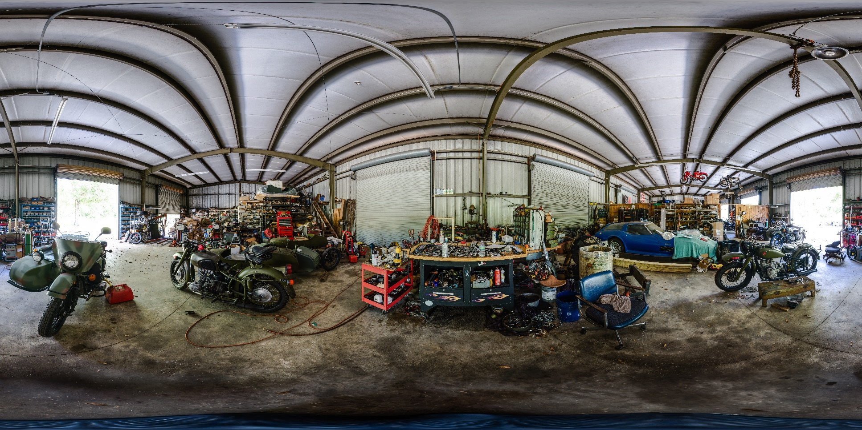
PICTURE 33

Slide 6
SUMMARY OF RESULTS
Angle of Rotation | Weight of VLIM | Correlation Coefficient | KD entropy
45 | 0.7 | 0.51 | 0.5612
45 | 0.5 | 0.5257 | 0.5589
45 | 0.3 | 0.5082 | 0.5831
30 | 0.7 | 0.4732 | 0.6585
30 | 0.5 | 0.5018 | 0.6173
30 | 0.3 | 0.4965 | 0.6143

Slide 7
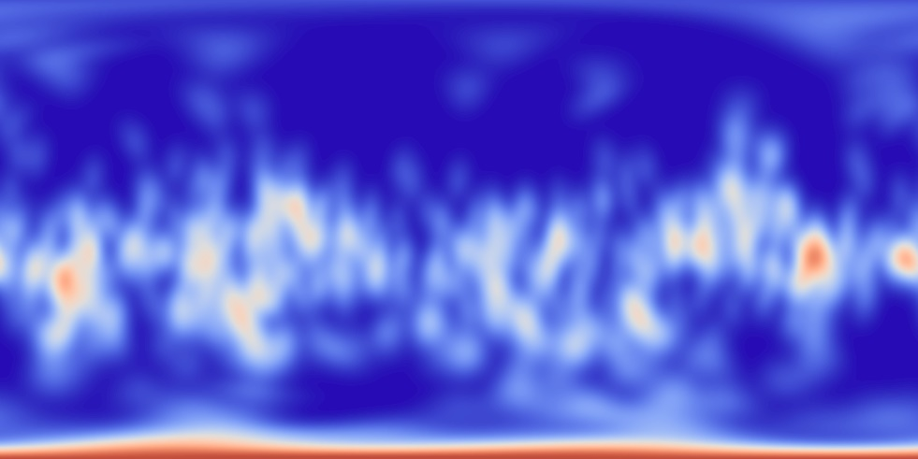

GROUND TRUTH vs BEST PERFORMING

Slide 8
OBSERVATIONS
The results were not upto the mark for 30 degree rotation
Experimentally ~0.5 weight of VLIM gives the best results for the final Saliency map.
Overall results for Picture 29 were much better than the best average of the competition.

Slide 9
APPROACH: COMBINED METHOD
Use Cube map projections for saliency prediction only for the Top and Bottom faces (Poles) where distortion is the most.
For the middle part use 2D saliency predictors.
Combine both to get a resultant saliency map using winner takes all.

Slide 10
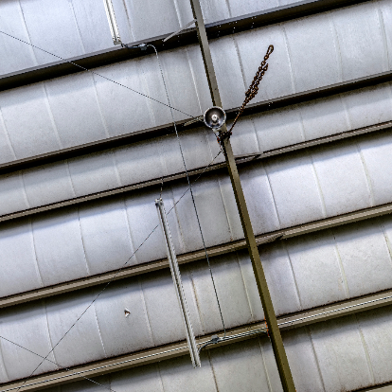
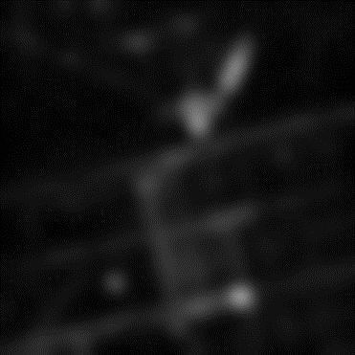
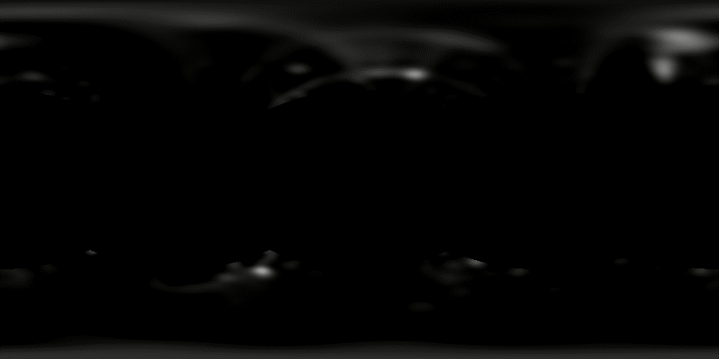
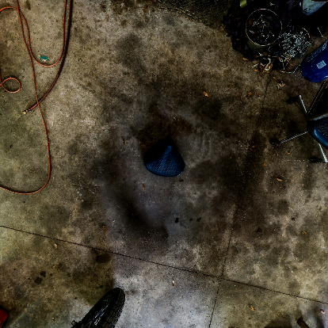
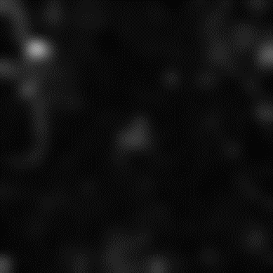
RESULTS
Top
Bottom

Slide 11
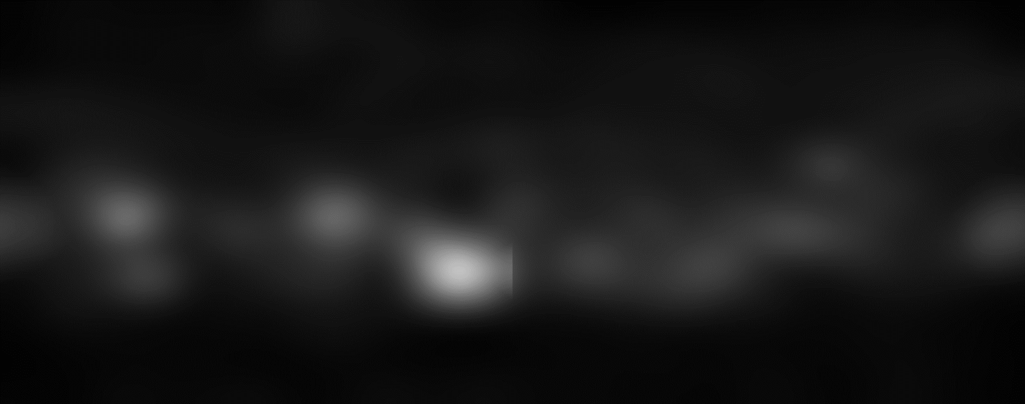
MIDDLE PORTION (DIRECTLY APPLYING THE 2D SALIENCY PREDICTOR: BMS)

Slide 12
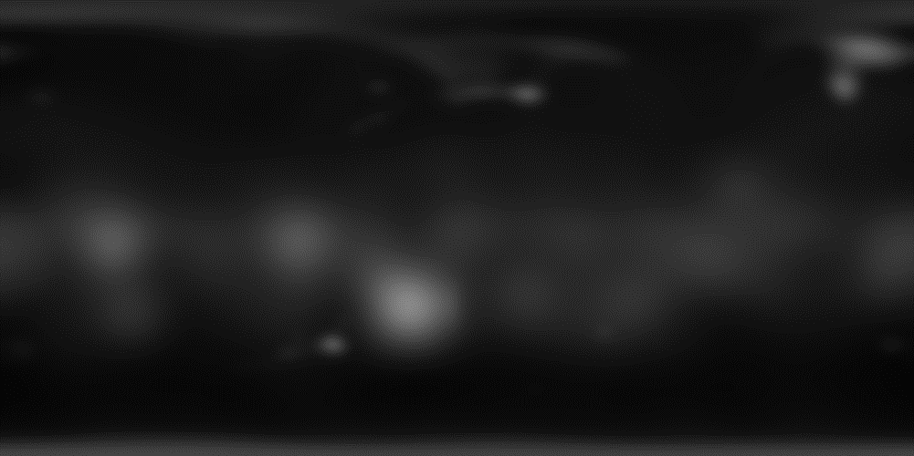
RESULTANT SALIENCY MAP (After blurring)(w=0.7)

Slide 13
EVALUATION (BMS)
Weight of VLIM | CC | KD entropy
0.7 | 0.4973 | 0.5871
0.5 | 0.5258 | 0.5838
0.3 | 0.5156 | 0.5942

Slide 14

RESULTANT SALIENCY MAP (After blurring)(w=0.5)

Slide 15
EVALUATION (DeepGaze2)
Weight of VLIM | CC | KD entropy
0.7 | 0.5177 | 0.5535
0.5 | 0.5360 | 0.5590
0.3 | 0.5193 | 0.5810

