Slide 1
Saliency based compression of Omidirectional Videos
Bhishma Dedhia

Slide 2
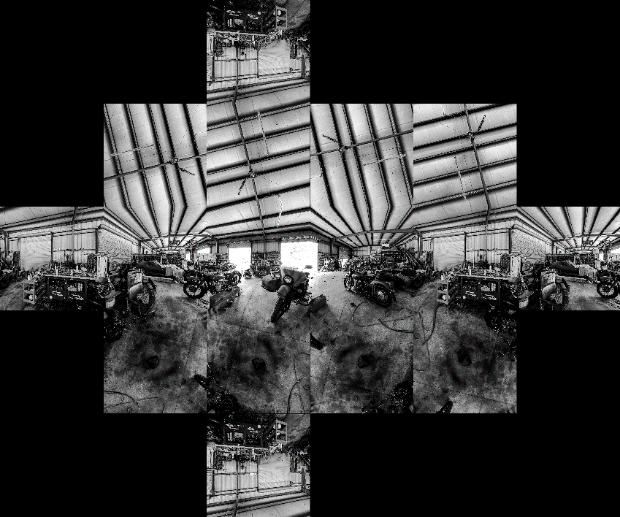
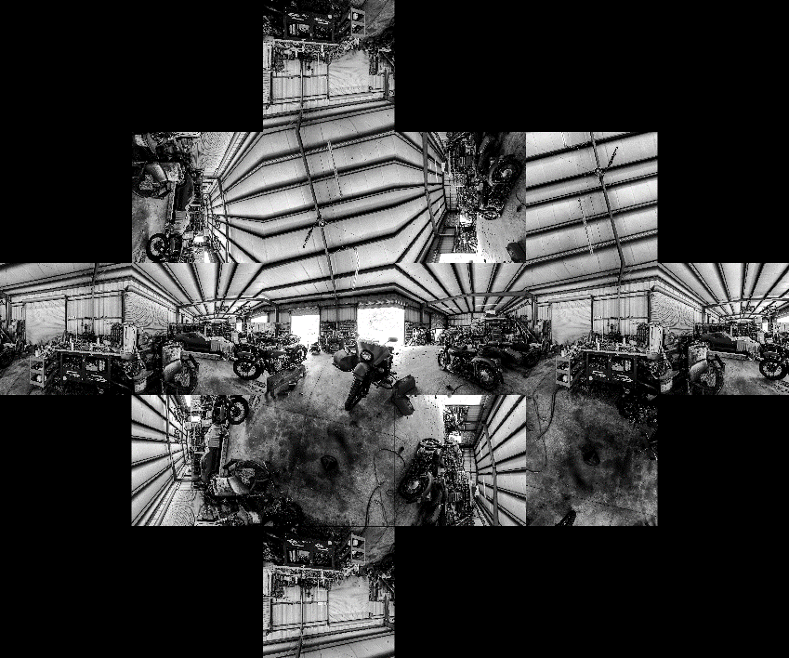
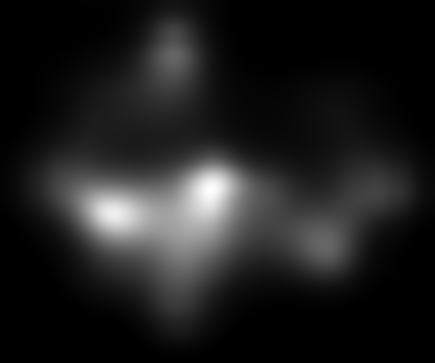
Approach 1
Selecting faces from the extended map cut such that every face is continuous around its surrounding.
Extended cube Map
Saliency prediction

Slide 3
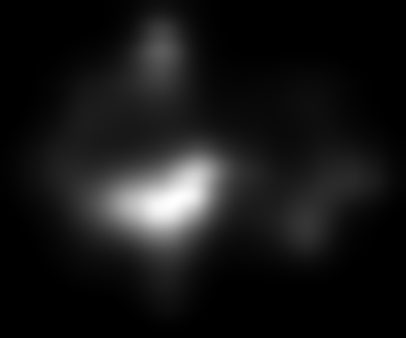
Extended cube Map
Saliency prediction

Slide 4
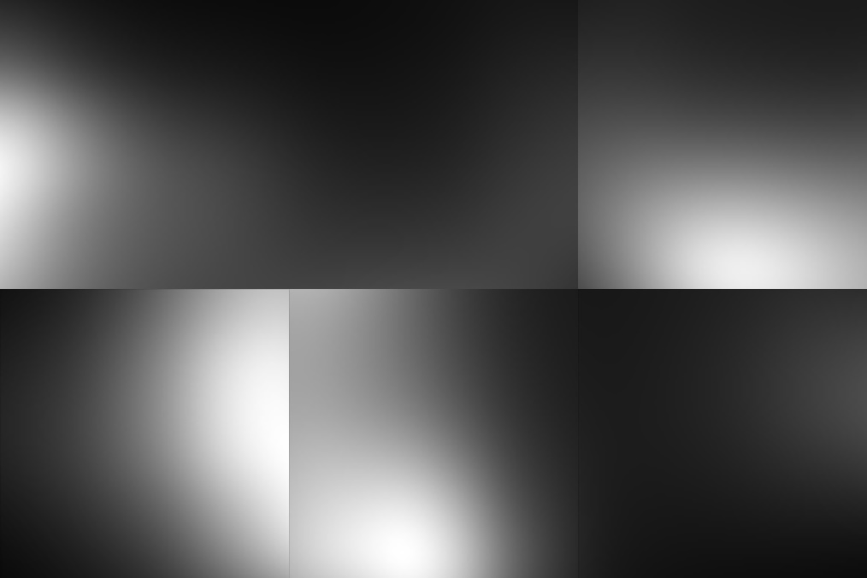
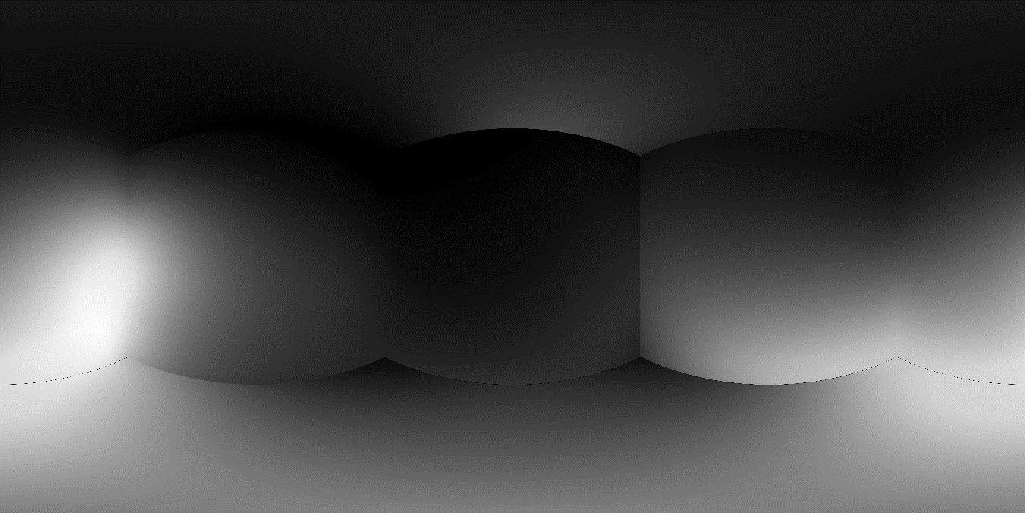
(0,0,0)

Slide 5
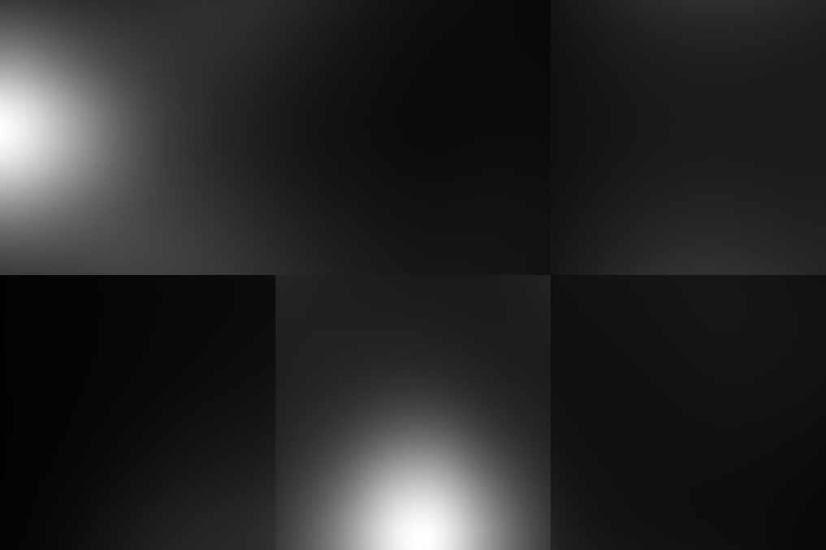
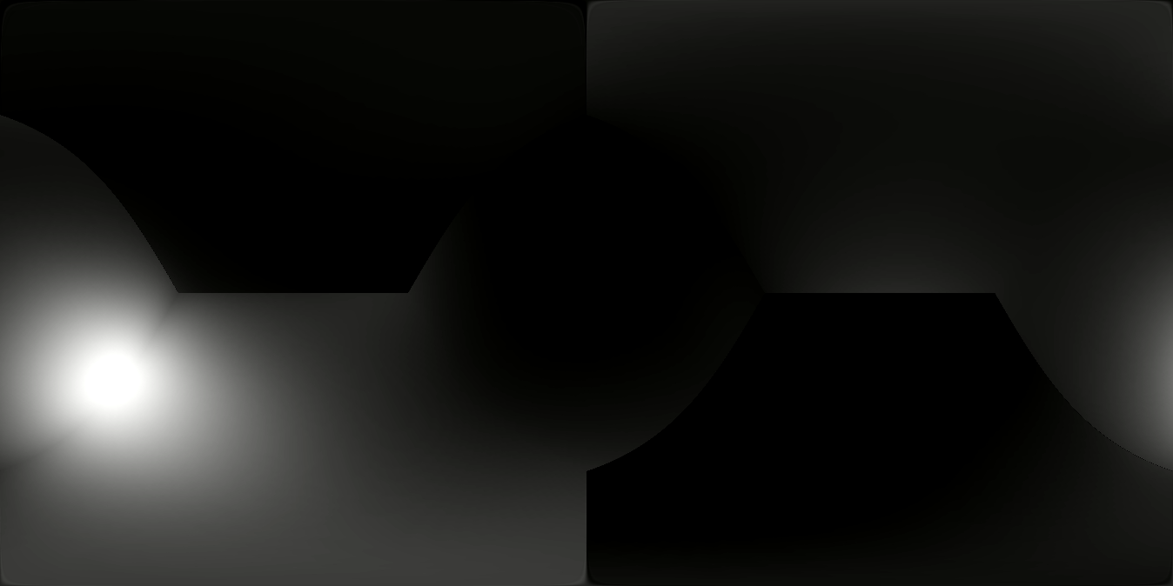
(0,0,45)

Slide 6
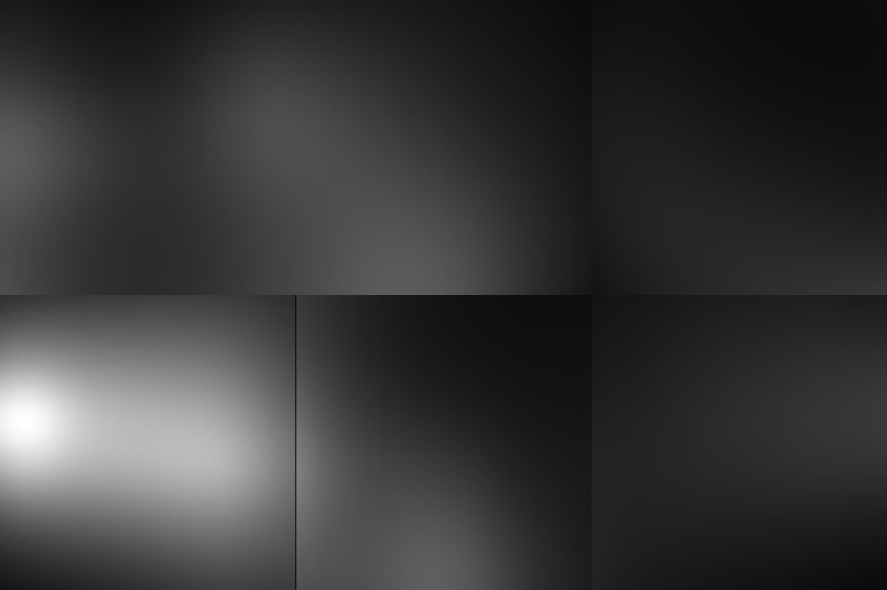
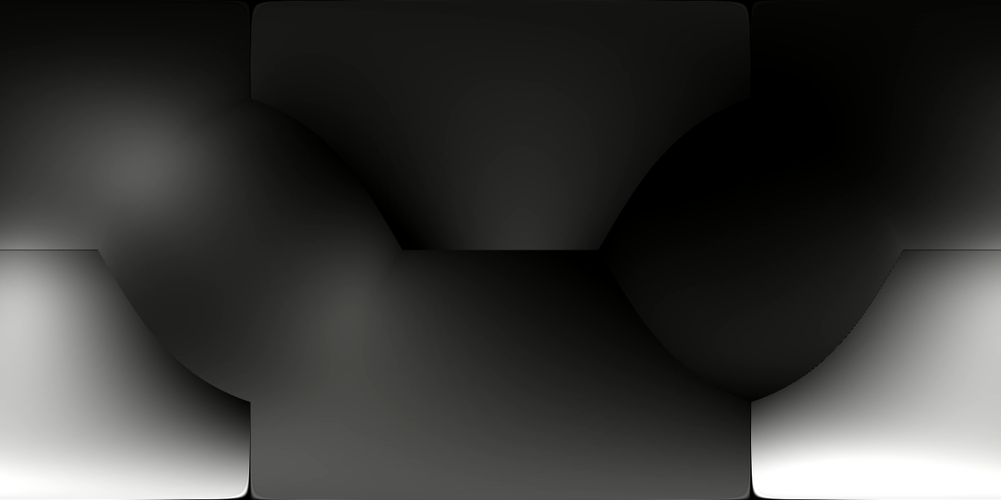
(0,45,0)

Slide 7
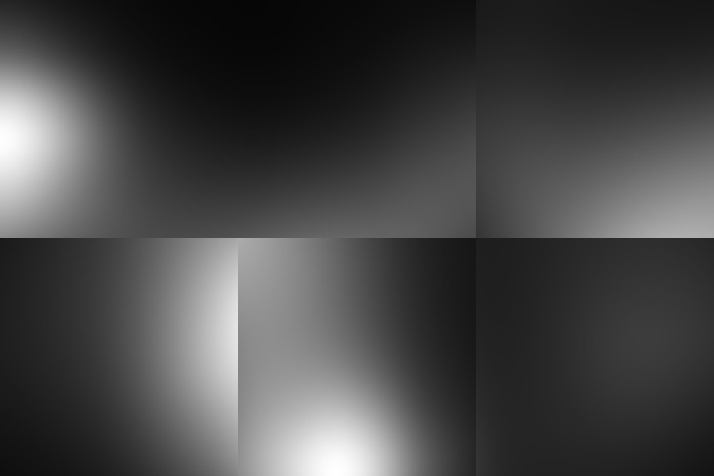
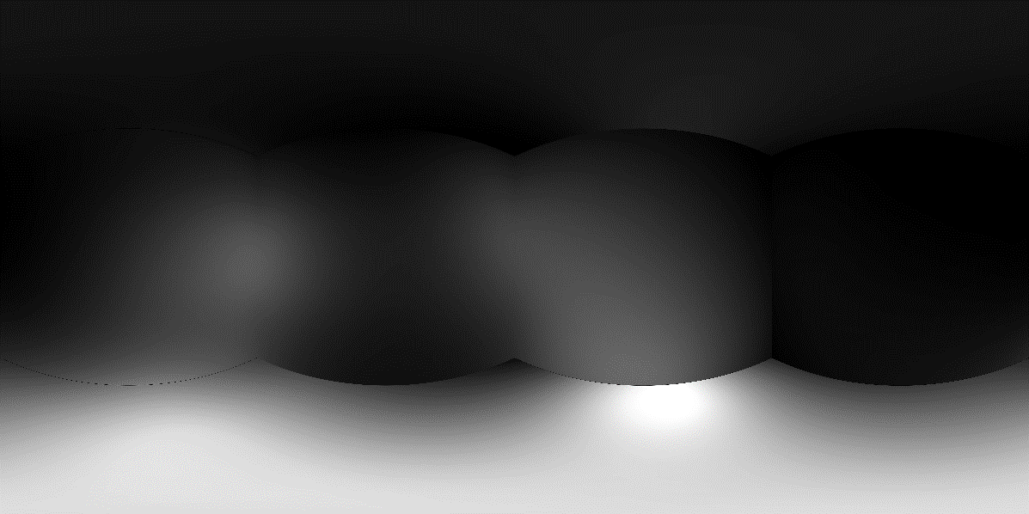
(45,0,0)

Slide 8
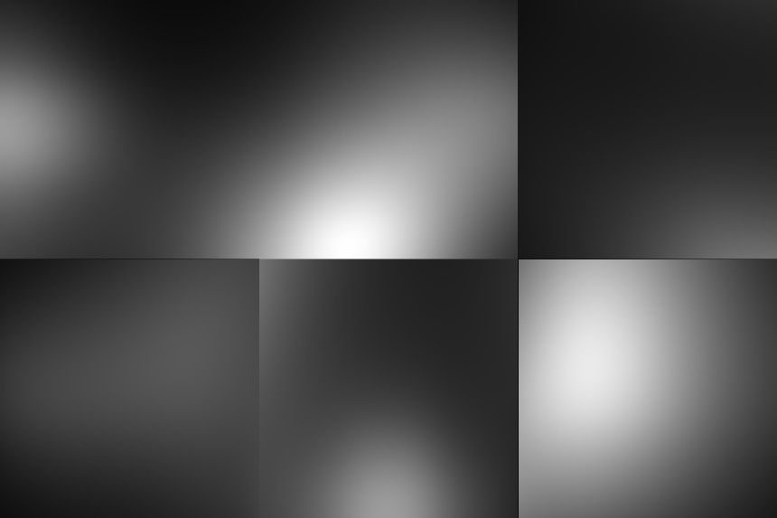
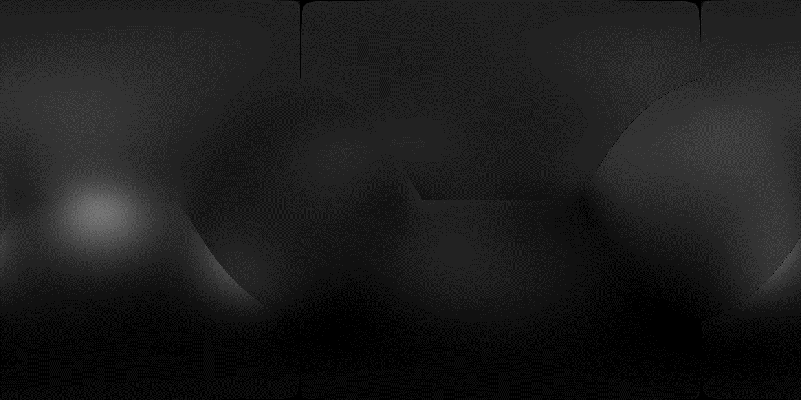
(45,45,0)

Slide 9
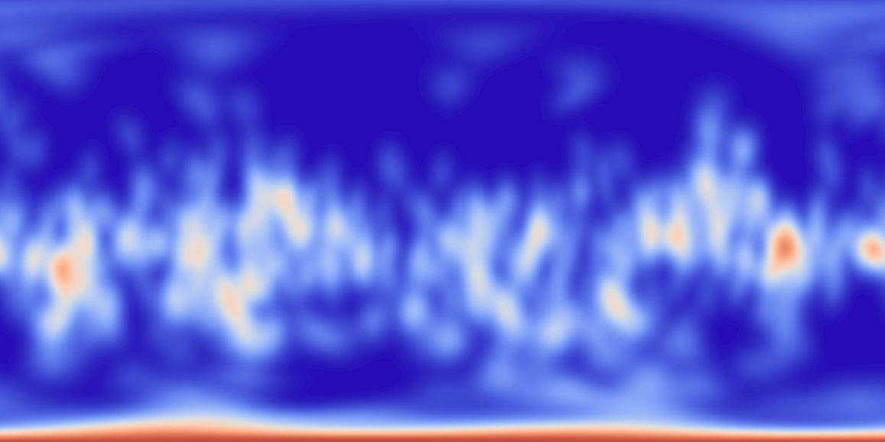

Final Saliency Map using Average
KLD = 0.7198 Correlation-coefficient= 0.4167

Slide 10

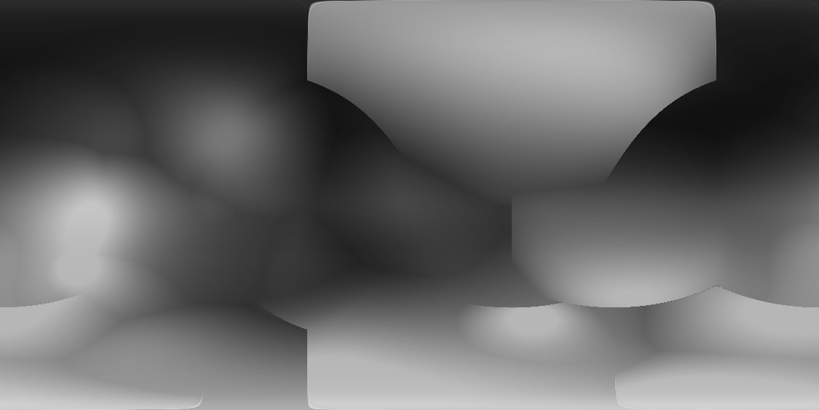
Final Saliency Map using Maximum
KLD = 1.0123 Correlation-coefficient= 0.0405

Slide 11

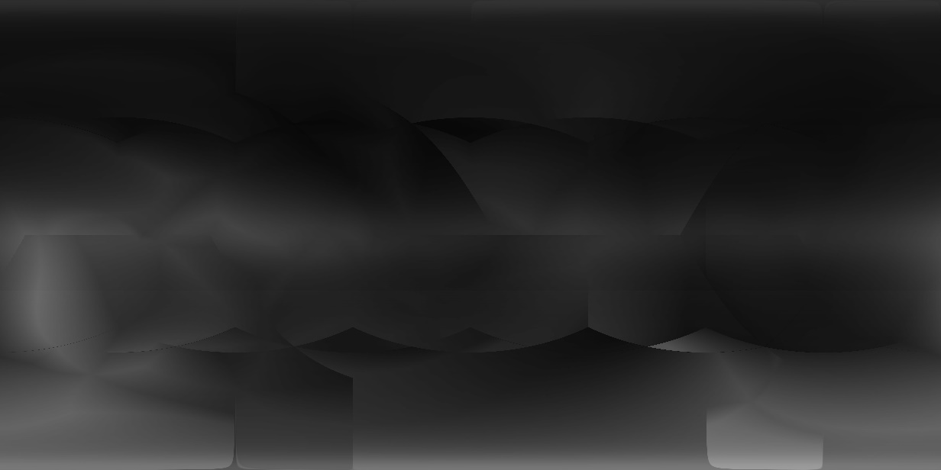
Final Saliency Map using Median
KLD = 0.6488 Correlation-coefficient= 0.3470

Slide 12
Observations
Poor results obtained using this method.
Ground truth Saliency map is much more finer than the predicted saliency map. The predicted Saliency map fails to predict the smaller features of the ground truth saliency map.
Alternative method required!

Slide 13
Combined method
Use cube map projections to predict Saliency map near the poles.
Use 2D predictors for the central part. Use several different point of view and combine all together using: Average, Maximum, Median
Combine with the pole saliency map and smoothen the ODI by formulating an optimization problem.

Slide 14
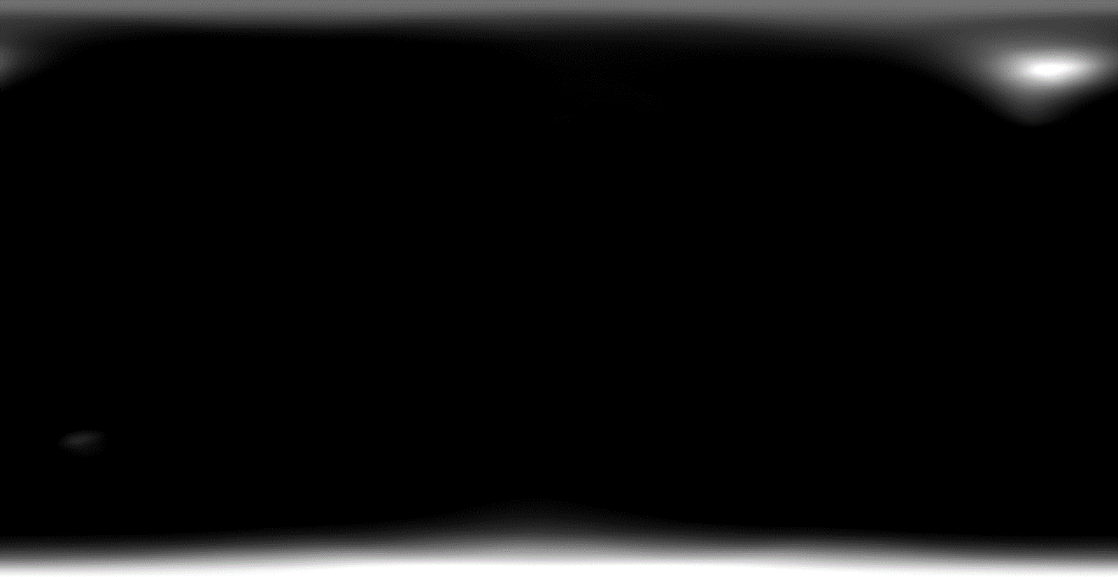
Saliency Map for poles

Slide 15


Final Saliency maps for Middle portion (Number of views = 2)
Combined using average
Combined using maximum

Slide 16
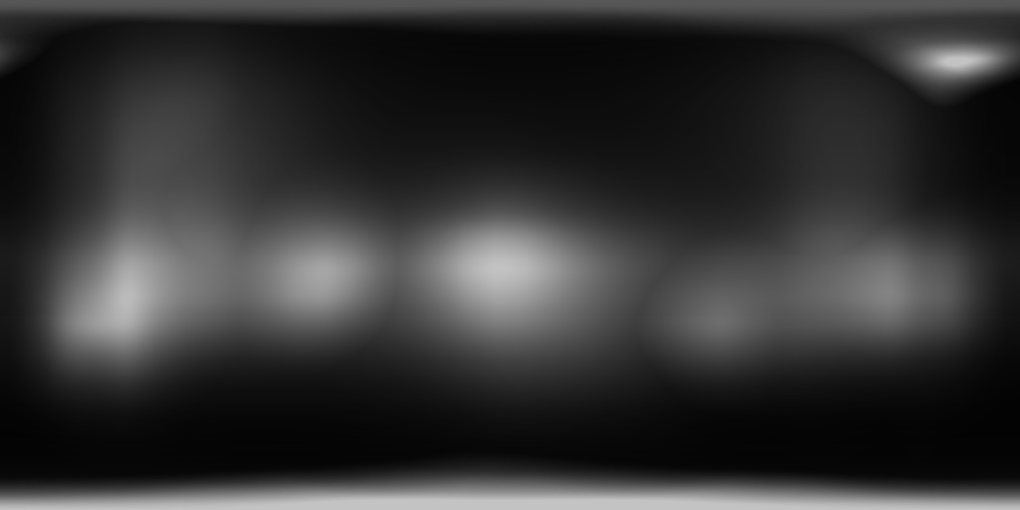
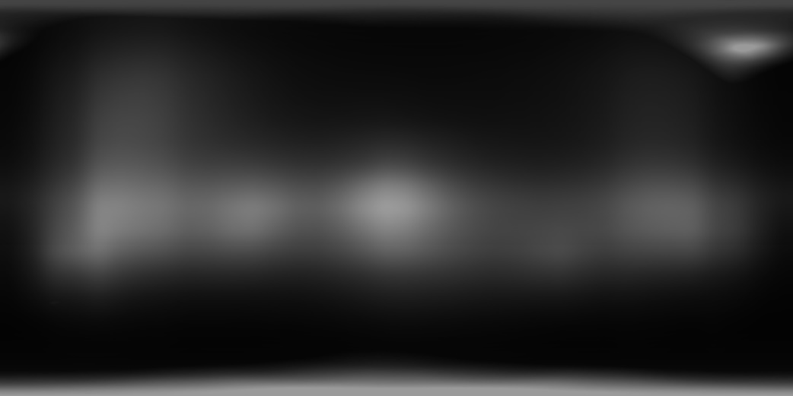
Combining the two: Using maximum

Slide 17
Optimizing the Saliency Map
Fast Global Image Smoothing Based on Weighted Least Squares (Edge preserving smoothening)
This approach smoothens the image by optimizing a global objective function
defined with a data constraint and a smoothness prior.
This method is fast and efficient. Graphcut is time consuming for high number of labels and takes many iterations to converge.

Slide 18


Final Map (Average)
KLD = 0.548 CC = 0.5223 NSS = 0.7332

Slide 19


Final map (Maximum)
KLD = 0.4989 CC = 0.5922 NSS = 0.6839

Slide 20
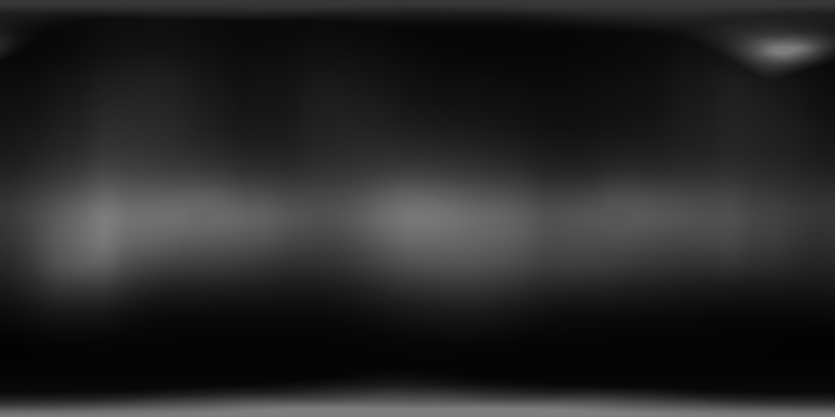
Final Saliency maps for Middle portion (Number of views = 4)
Average:
KLD = 0.5677 CC = 0.5601 NSS = 0.7644

Slide 21
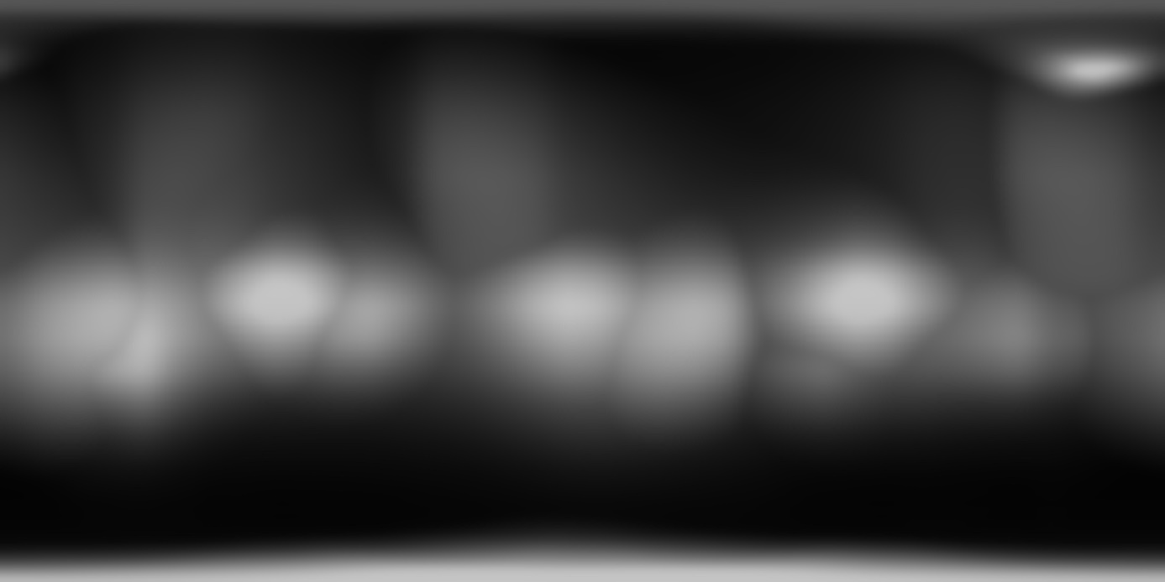
Final map (Maximum)
KLD = 0.6252, CC=0.5643, NSS = 0.7933

Slide 22
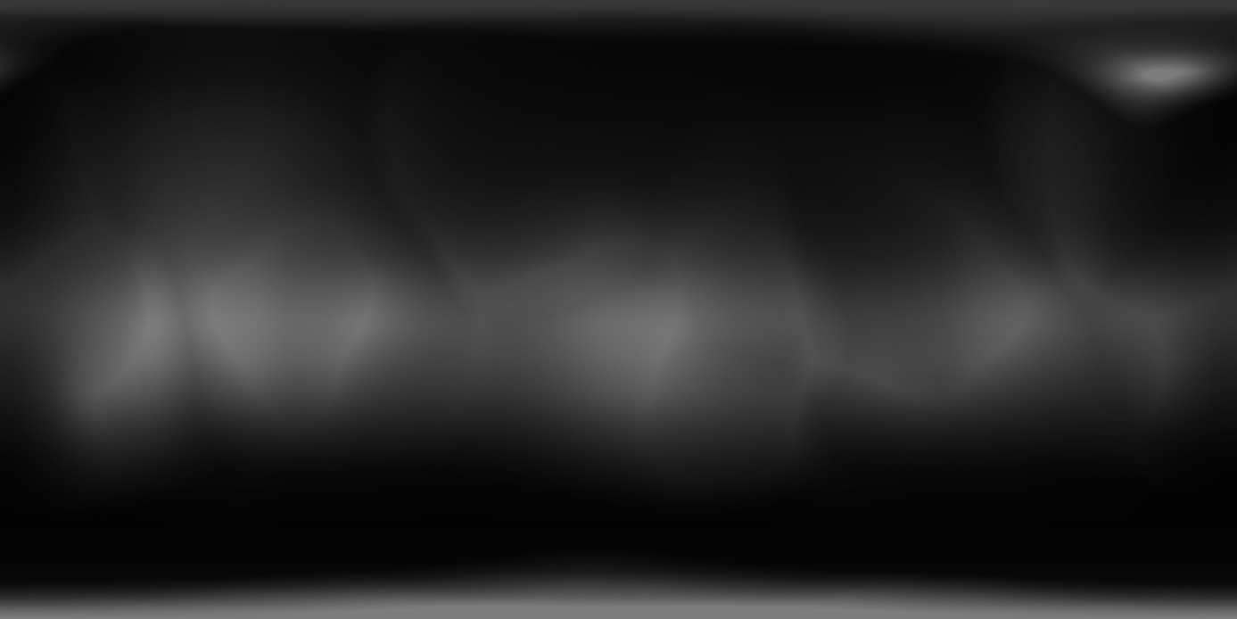
Final map (Median)
KLD = 0.5326 CC = 0.5654 NSS = 0.774

Slide 23
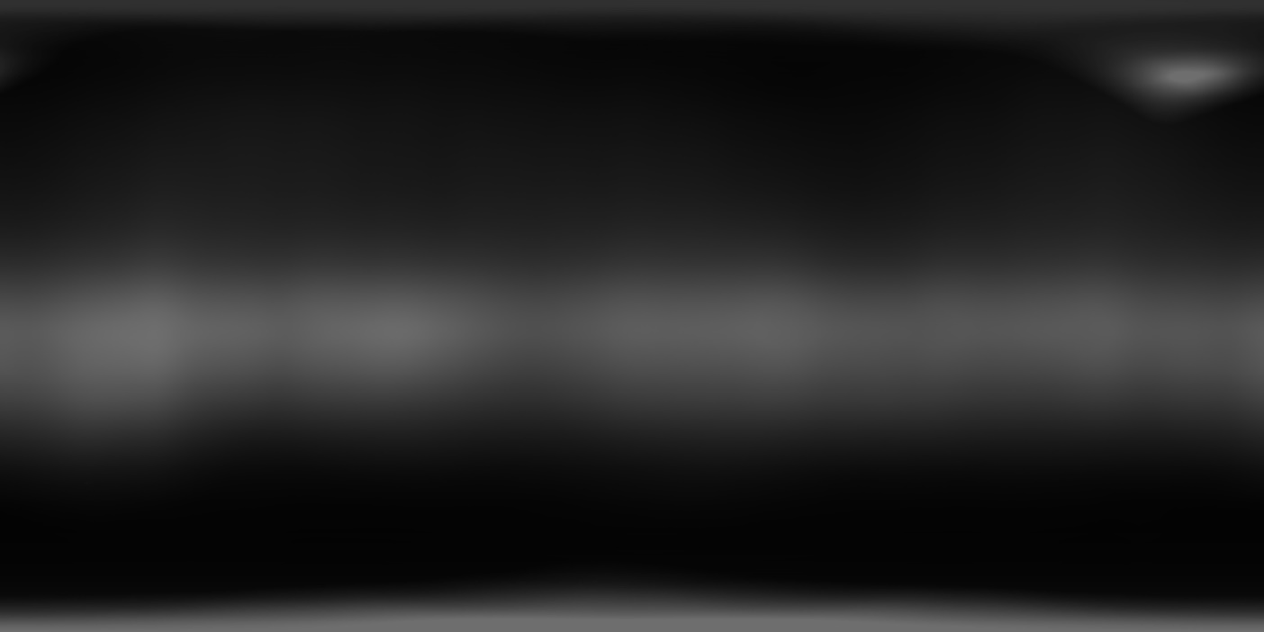
Final Saliency maps for Middle portion (Number of views = 8)
Average:
KLD = 0.5413 , CC = 0.6016 , NSS = 0.8594

Slide 24
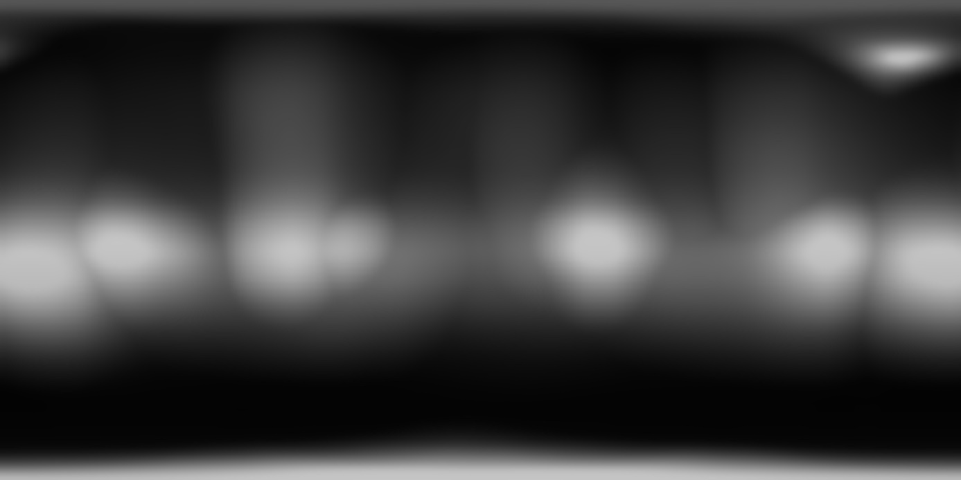
Final map (Maximum)
KLD = 0.5948, CC = 0.5645, NSS = 0.7788

Slide 25
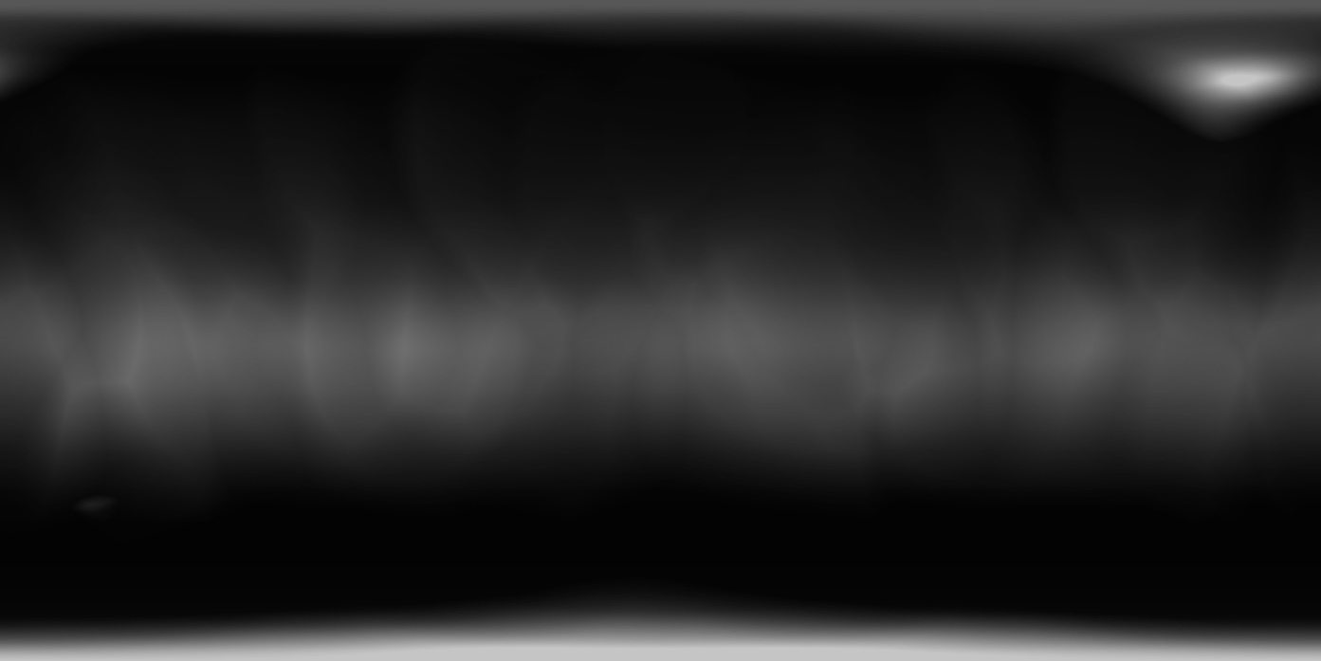
Final map (Median)
KLD = 0.5488, CC = 0.5554, NSS = 0.512

Slide 26
Observations:
Results significantly improved over the previous methods. The results are almost equal to that of the winner of the Salient360! Competition.
However the Saliency map still fail to predict the smaller details of the ground truth map.
Cube map method was successful at predicting the finer details. Hence an average can be taken with the cube map approach Saliency map.

Slide 27
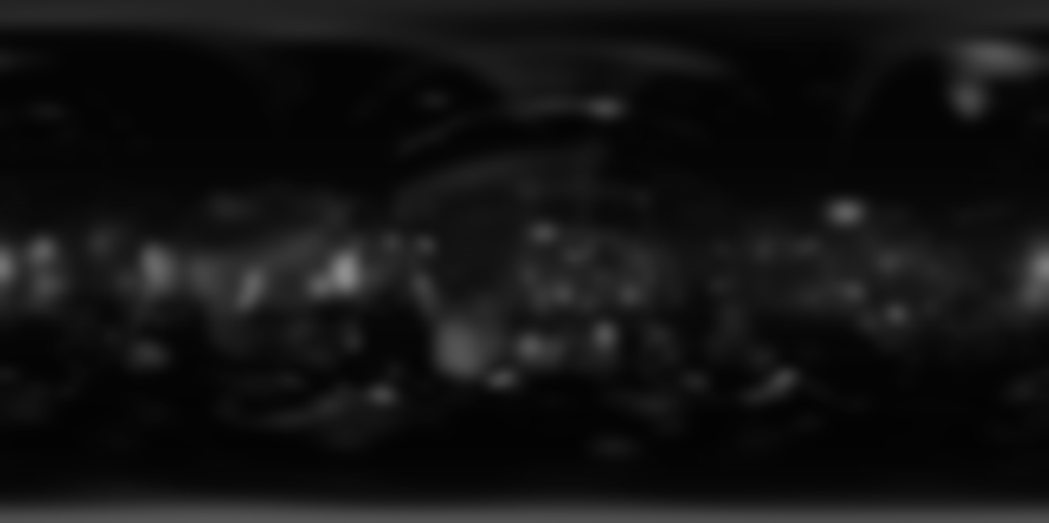
Saliency Map predicted by Cube map (BMS)

Slide 28
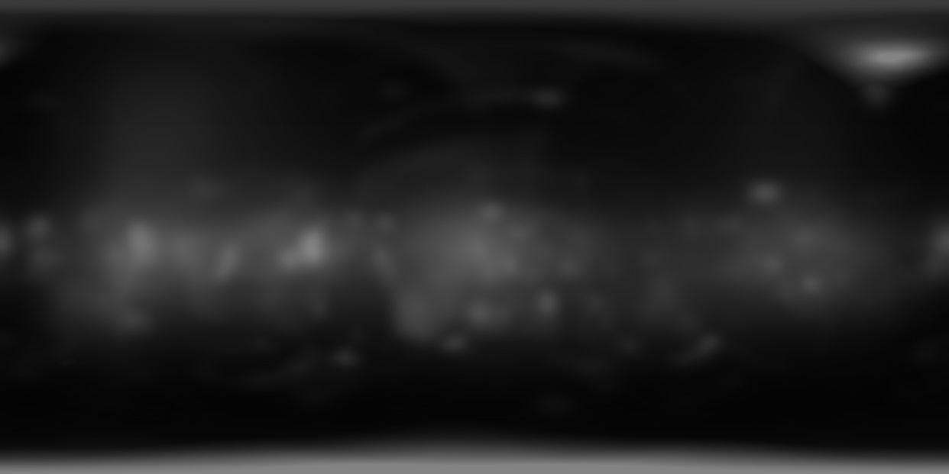
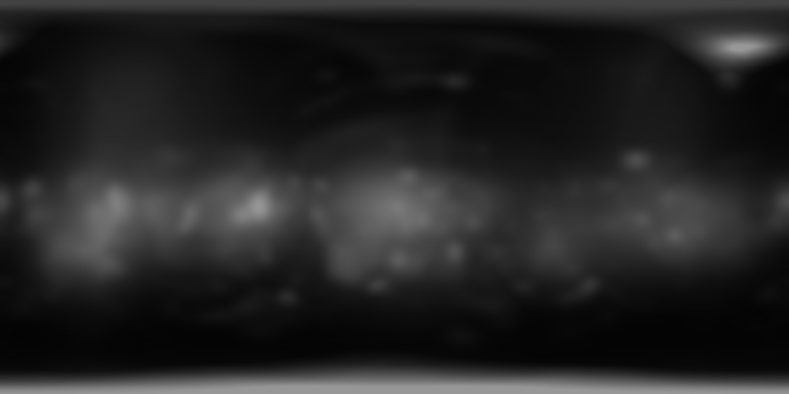
Results for 2 rotations
Average
Maximum

Slide 29
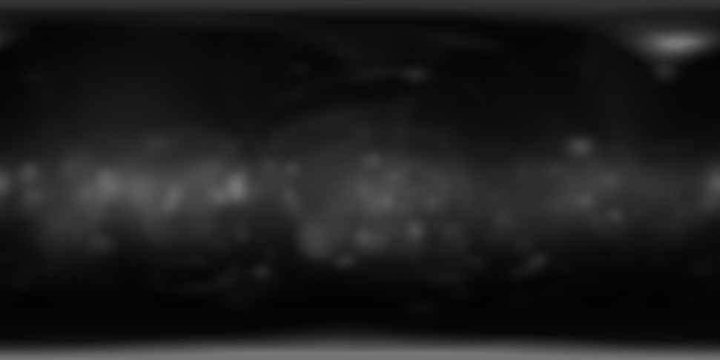
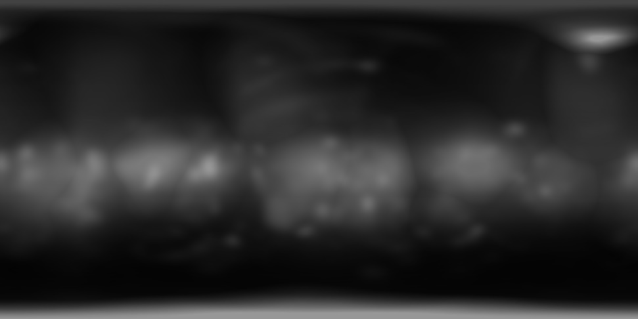
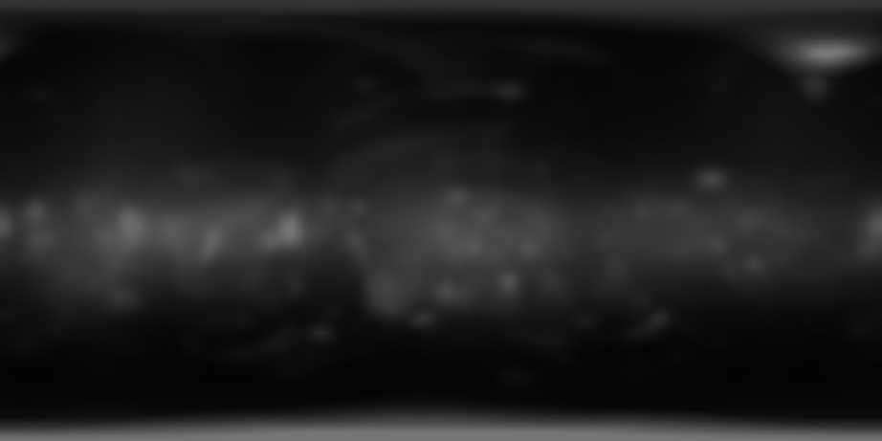
Results for 4 rotations
Average
Maximum
Median

Slide 30
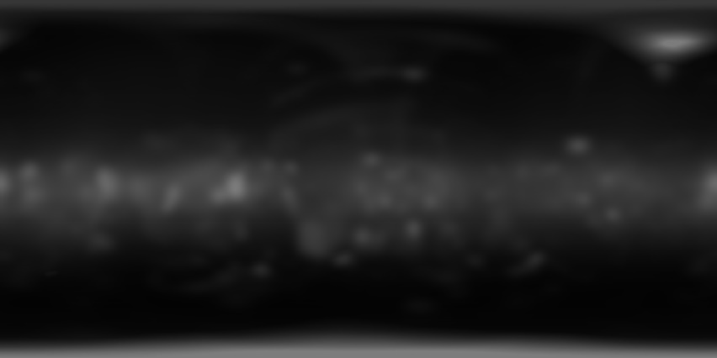
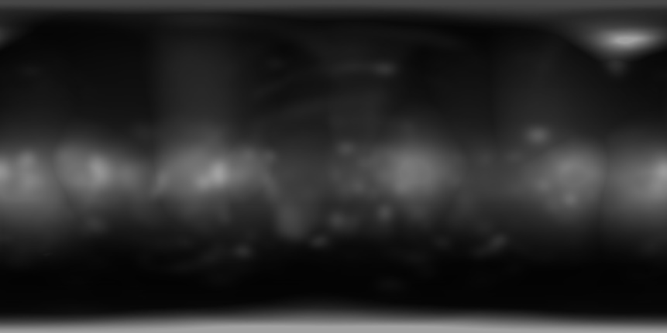
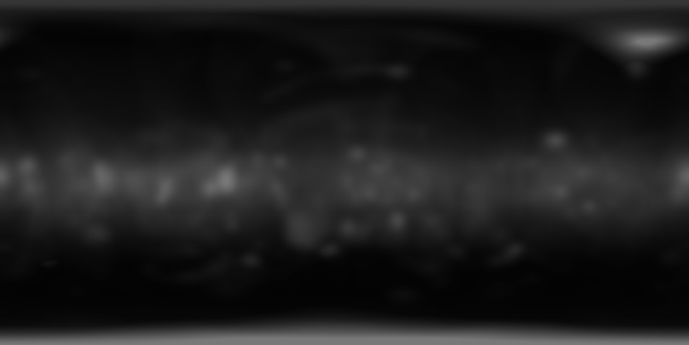
Results for 8 rotations
Average
Maximum
Median

Slide 31
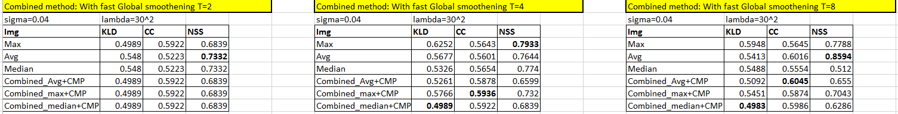
Summary of Results:

