Slide 1
Time series forecasting USING LSTM AND SARIMA
An example of vehicle trip records prediction in New York to investigate linear and nonlinear models

Slide 2
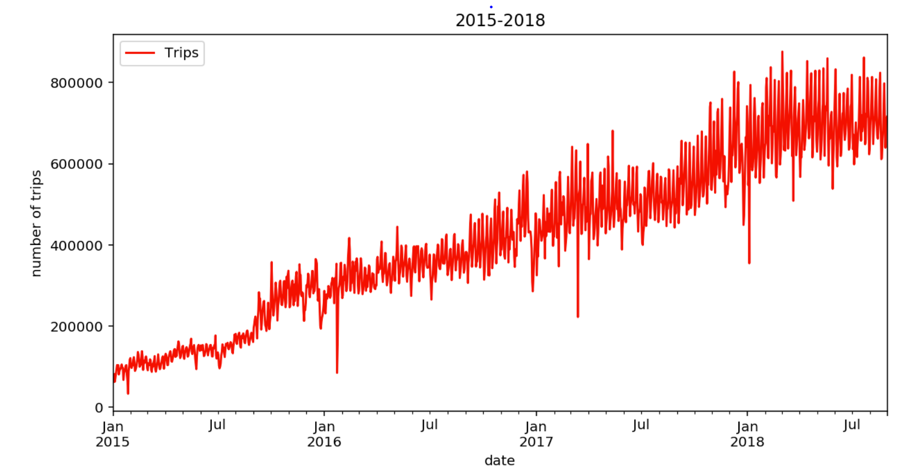
Data Introduction
The dataset used for time-series prediction are 1463 New York daily For-Hire Vehicle (“FHV”) trip records from year 2015 to mid 2018. Data in late 2018 are dropped due to two obvious spikes, the two outliers can be replaced by mean value to get more data.

Slide 3
SARIMA
Seasonal Auto Regressive Integrated Moving Average
SARIMA is actually a class of models that ‘explains’ a given time series based on its own past values, that is, its own lags and the lagged forecast errors, so that equation can be used to forecast future values.
Any time series that exhibits patterns and is not a random white noise can be modeled with SARIMA models.
Is the data stationary?
no trend or seasonality
Dickey Fuller test -- to determine "d“
“d” is the number of differencing required to make the time series stationary
ACF and PACF plots -- to determine "p" and "q"
“p”/”q” is the order of AR/MA term

Slide 4
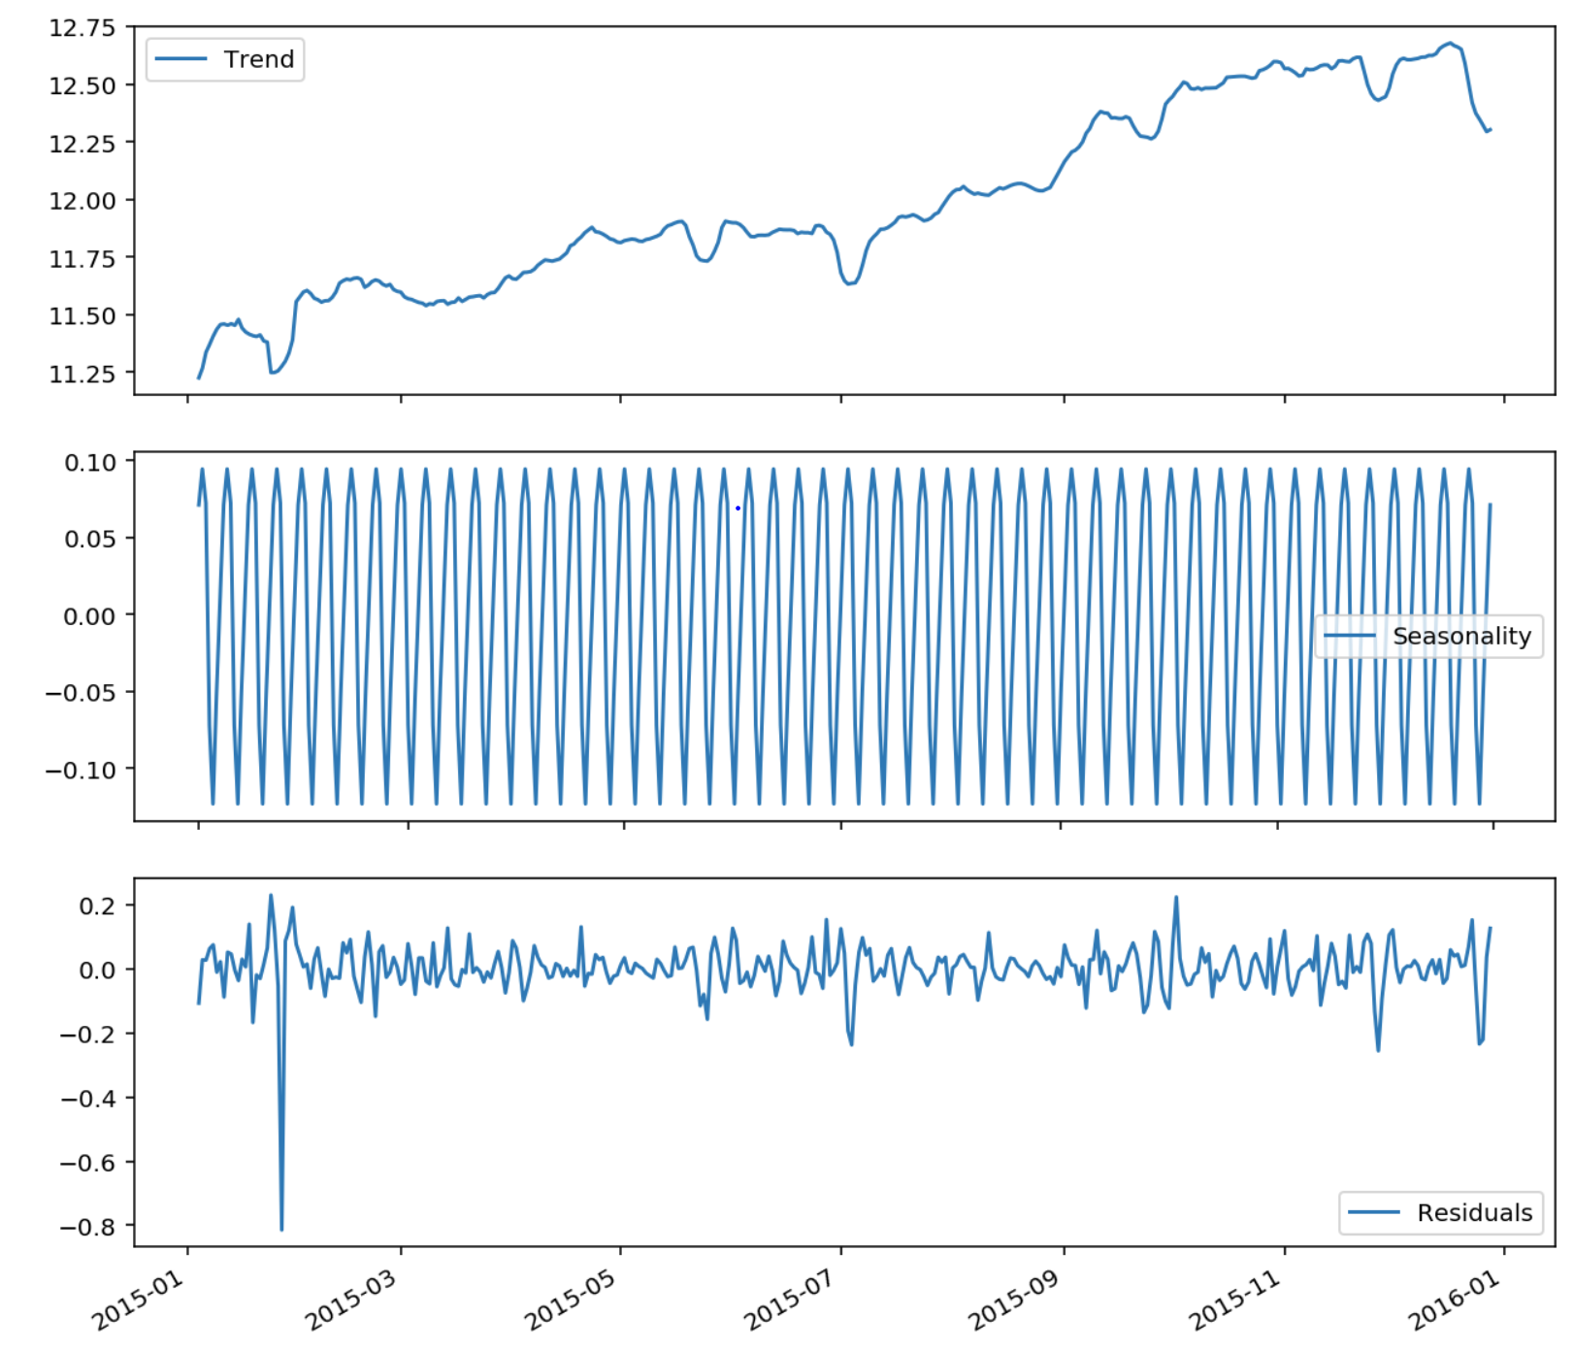
SARIMA
Seasonal Auto Regressive Integrated Moving Average
Is the Data Stationary?
Not stationary even after normalized to log scale, need seasonality decomposition and differencing
7 days cycle

Slide 5
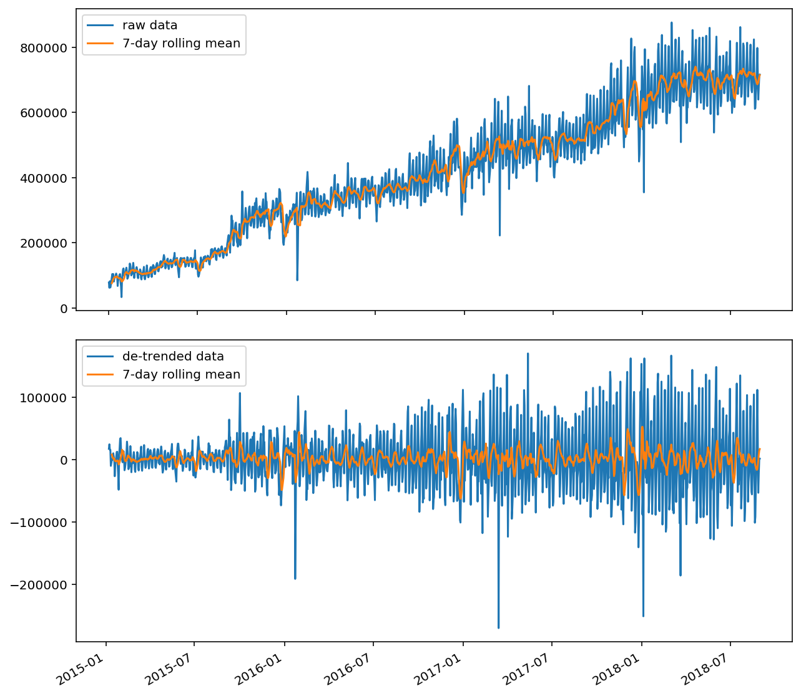
SARIMA
Seasonal Auto Regressive Integrated Moving Average
Dickey Fuller test -- to determine "d“
no trend or seasonality after subtracting 7-day moving average
d = 1

Slide 6
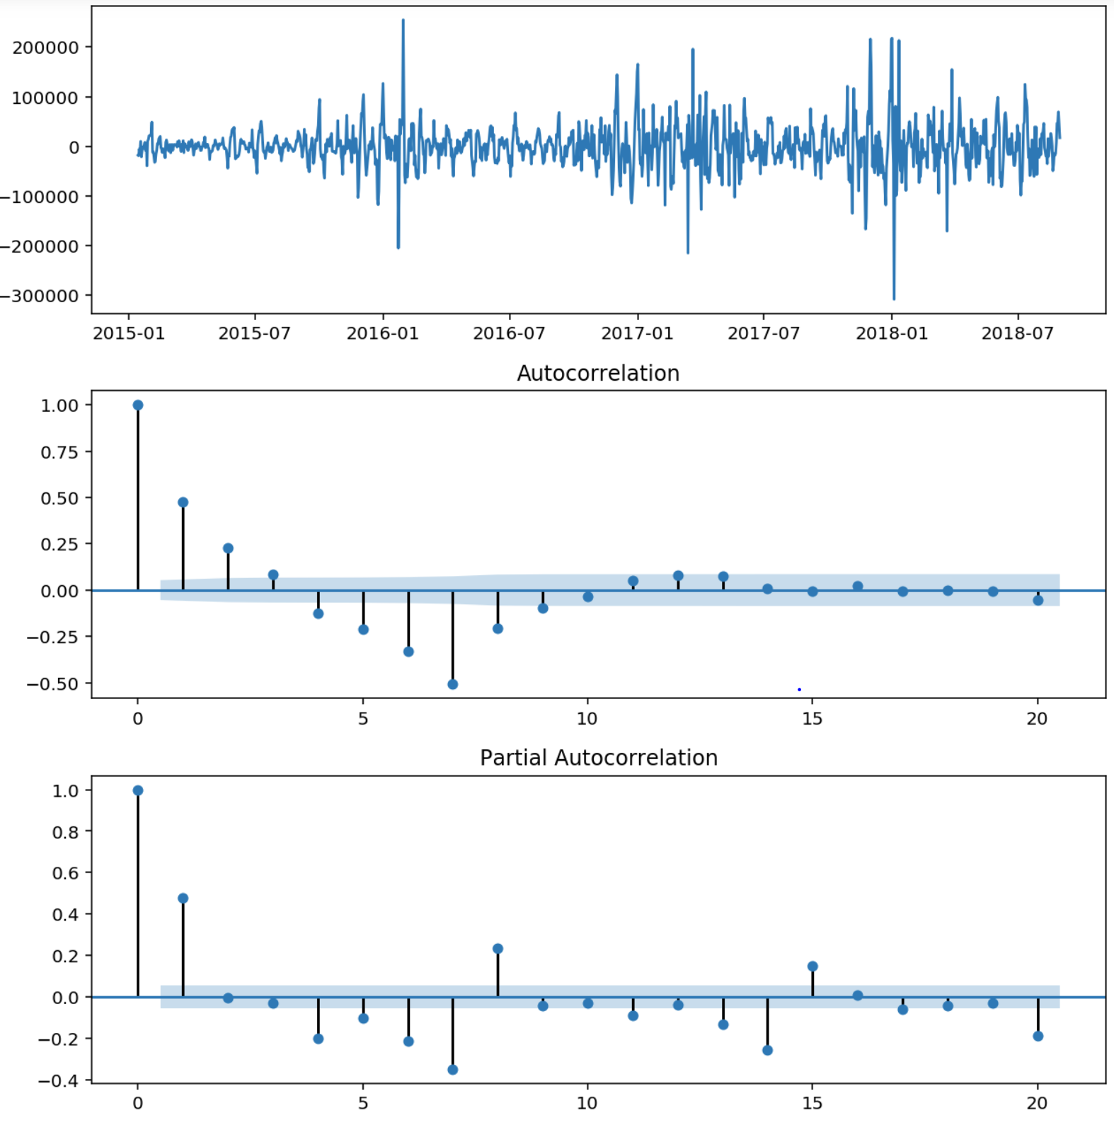
SARIMA
Seasonal Auto Regressive Integrated Moving Average
ACF and PACF plots -- to determine "p" and "q"
p = 2, q = 1

Slide 7
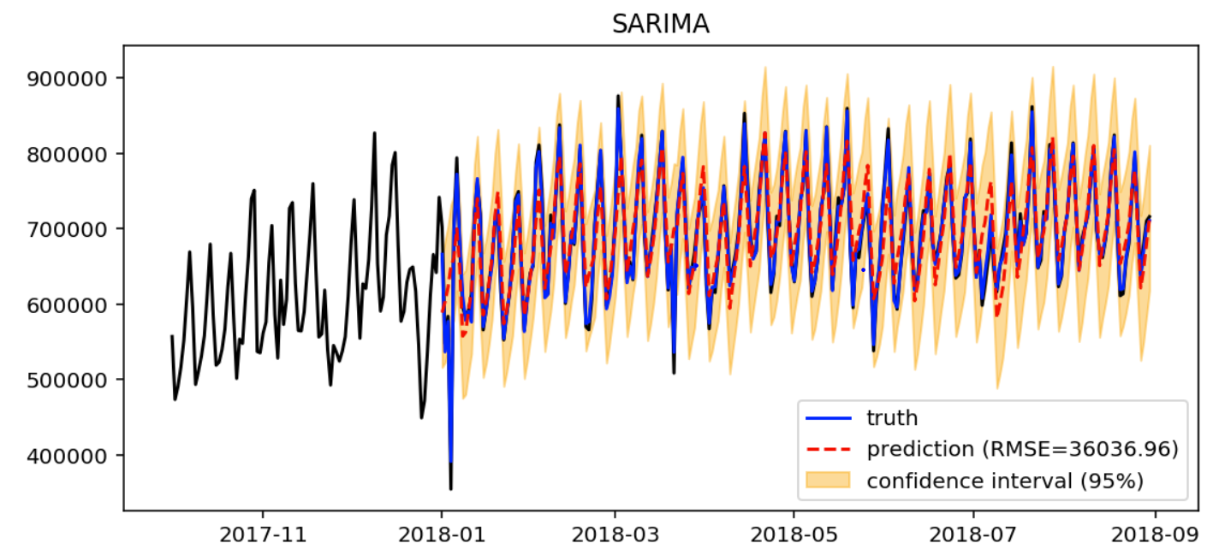
SARIMA
Seasonal Auto Regressive Integrated Moving Average
Performance

Slide 8
LSTM
Long-short Term Memory network
LSTM is a type of recurrent neural network designed to overcome problems of basic RNNs, such as gradient vanishing and exploding, so the network can learn long-term dependencies
Adding nonlinear features
extreme events and holidays
Model structure
Bayesian neutral network for confidence intervals

Slide 9
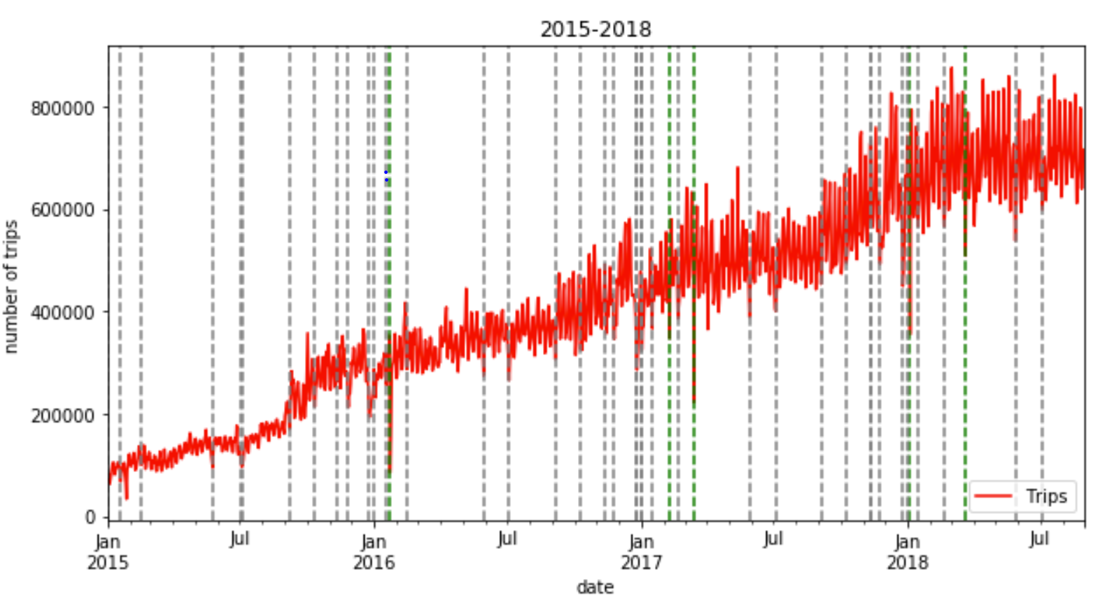
LSTM
Long-short Term Memory network
Adding nonlinear features
extreme events and holidays
Extreme events (green)
Holidays (gray)

Slide 10
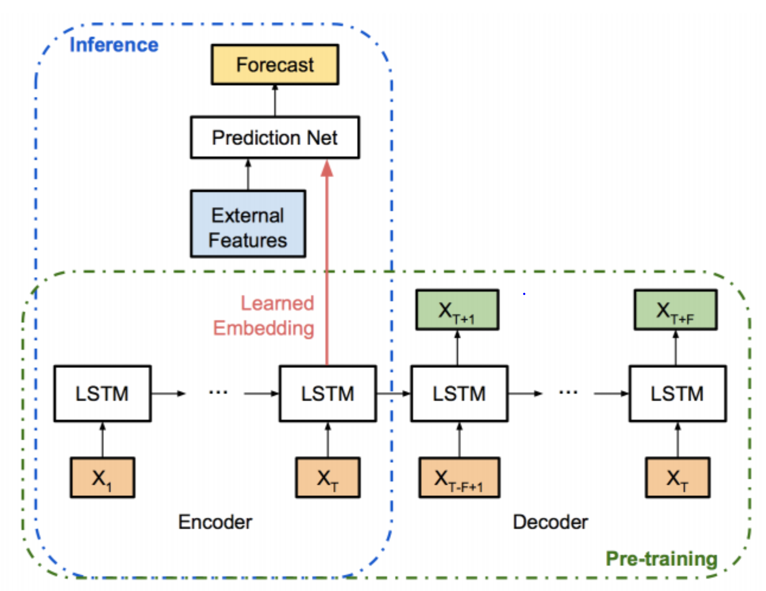
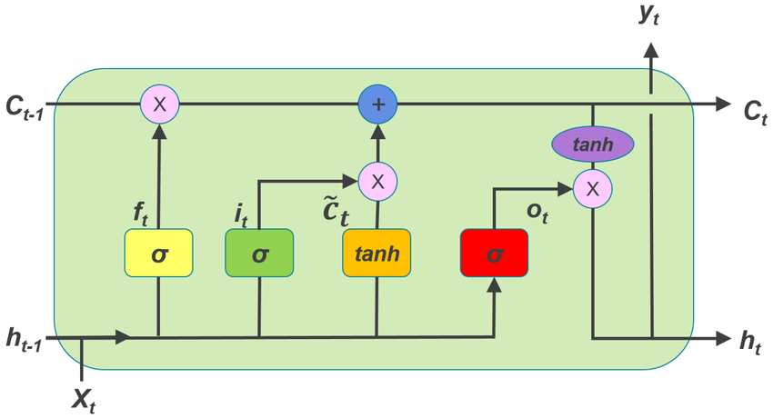
LSTM
Long-short Term Memory network
Model structure
2 LSTM layers with 128 units and 32 units, respectively. Then a fully connected layer with 1 output
dropout is added after each layer for BNN

Slide 11
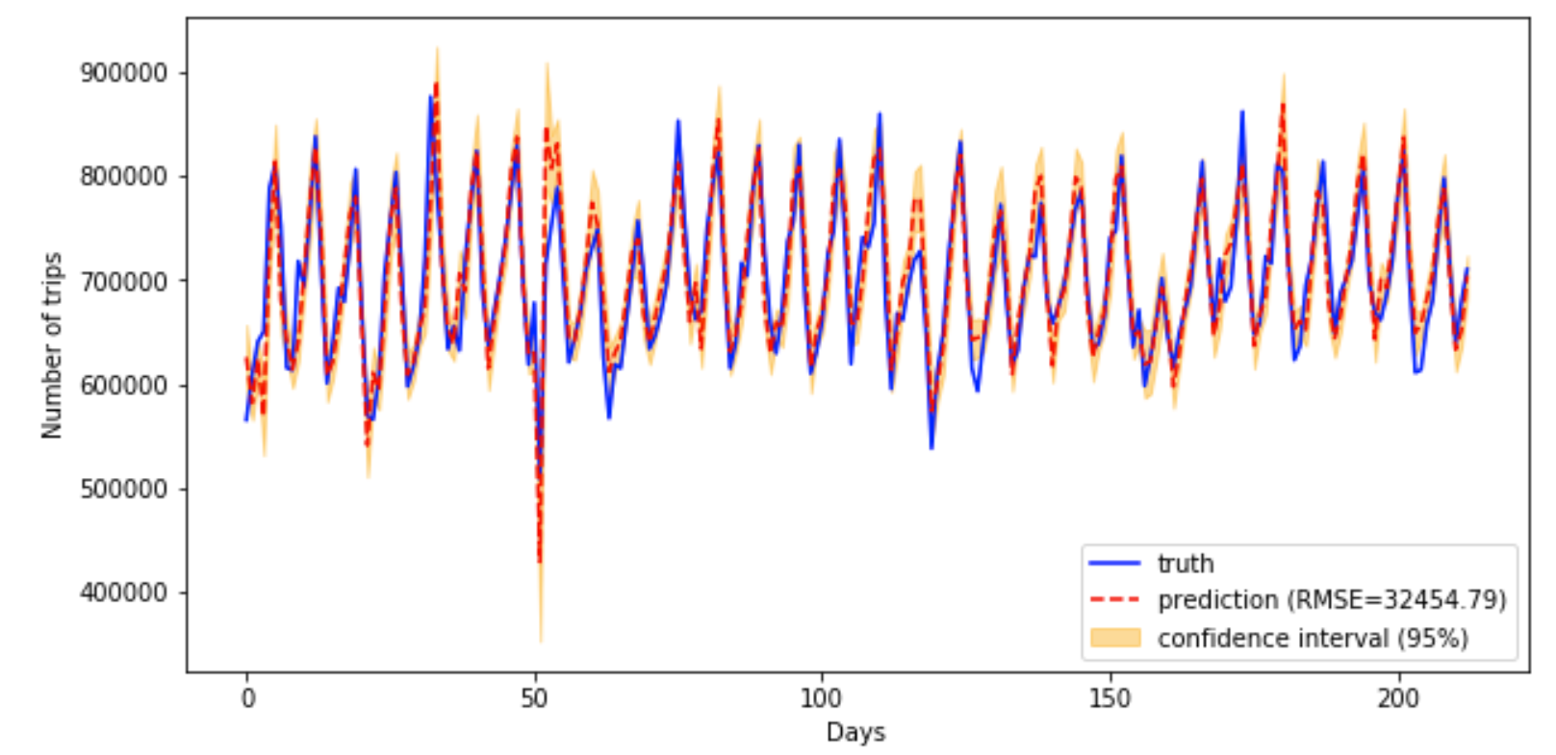
LSTM
Long-short Term Memory network
Performance

Slide 12
CONCLUSION
SARIMA and LSTM performances
SARIMA
LSTM
LSTM has an overall better performance based on the "evaluation" table
LSTM can deal with nonlinear problems (spikes are well captured in LSTM), in this case, the extreme weather events and holidays
LSTM gives a narrower confidence interval
LSTM is best for long-term predictions

Slide 13
FUTURE WORK
Something that are not included in the present work
For SARIMA, gridsearch and AIC value should be used to find the best (d, p, q). This technique can be used for batch processing
LSTM has more possible structures to fit the model, cross-validation is necessary to obtain a more robust result
Other nonlinear factors may also affect the performance, e.g., policy, price…

