Slide 1
Data analysis using R and Quarto
Student 296356

Slide 2
Table of contents
1. Quarto project
2. Most common crime types
3. Areas most affected by crime
4. Victim age analysis
5. Geographical distribution of crime
6. Crime distribution by area
7. Crime types by time of day

Slide 3
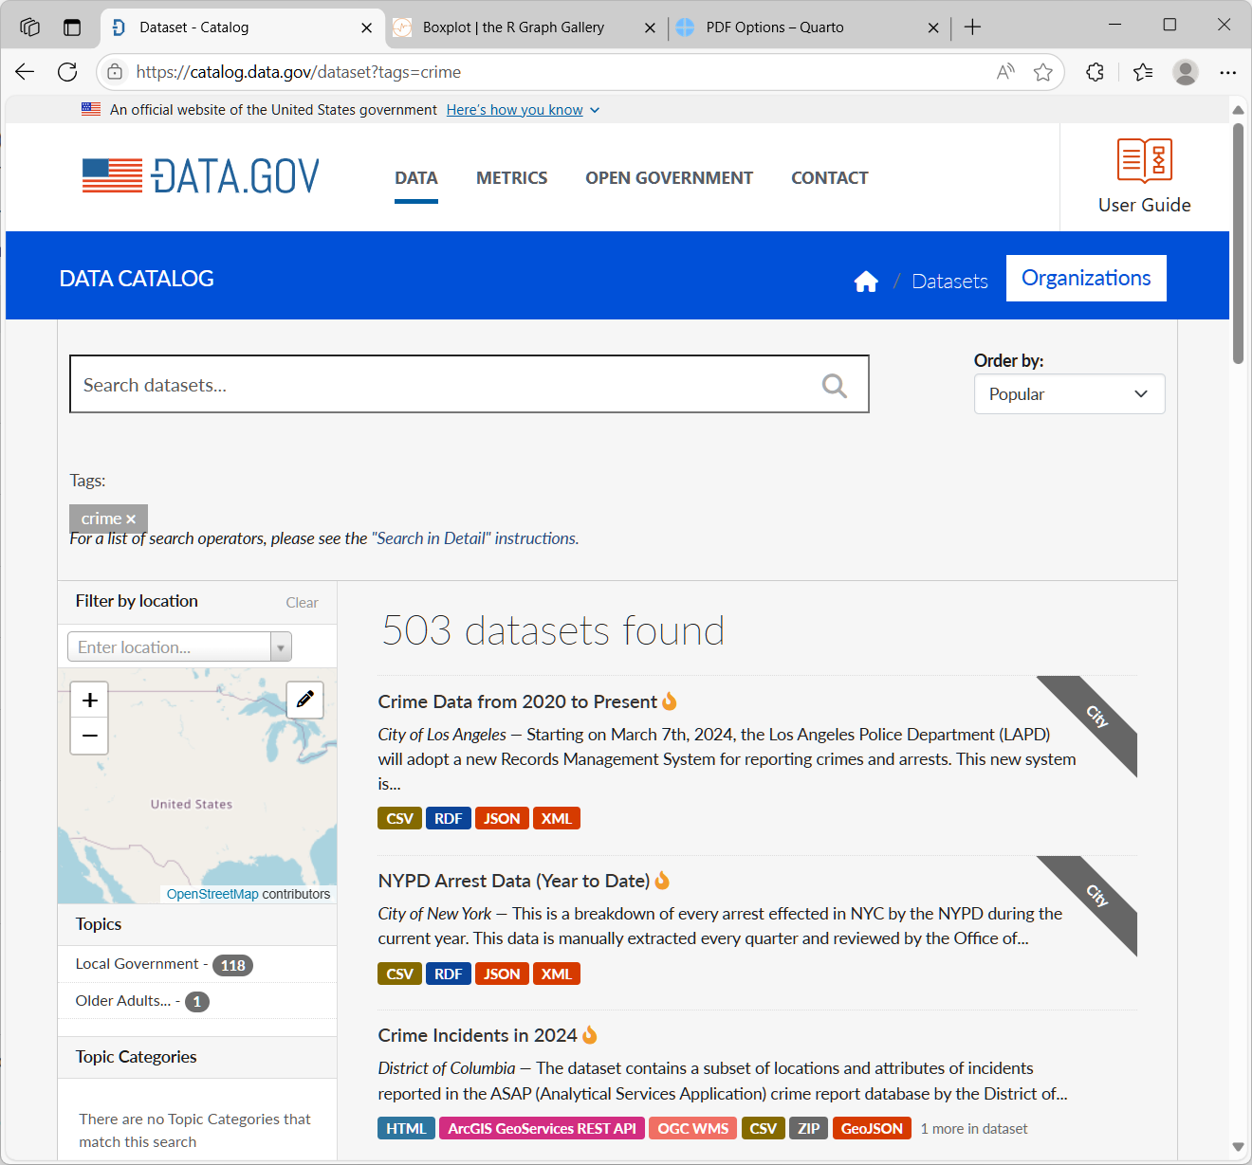
1. Quarto project
Project title: Data analysis using R and Quarto
Author: Student 296356
Subject: Statistical analysis of Los Angeles crime reports
Data source: Los Angeles crime types (based on 2024 data) (https://catalog.data.gov/dataset?tags=crime)

Slide 4
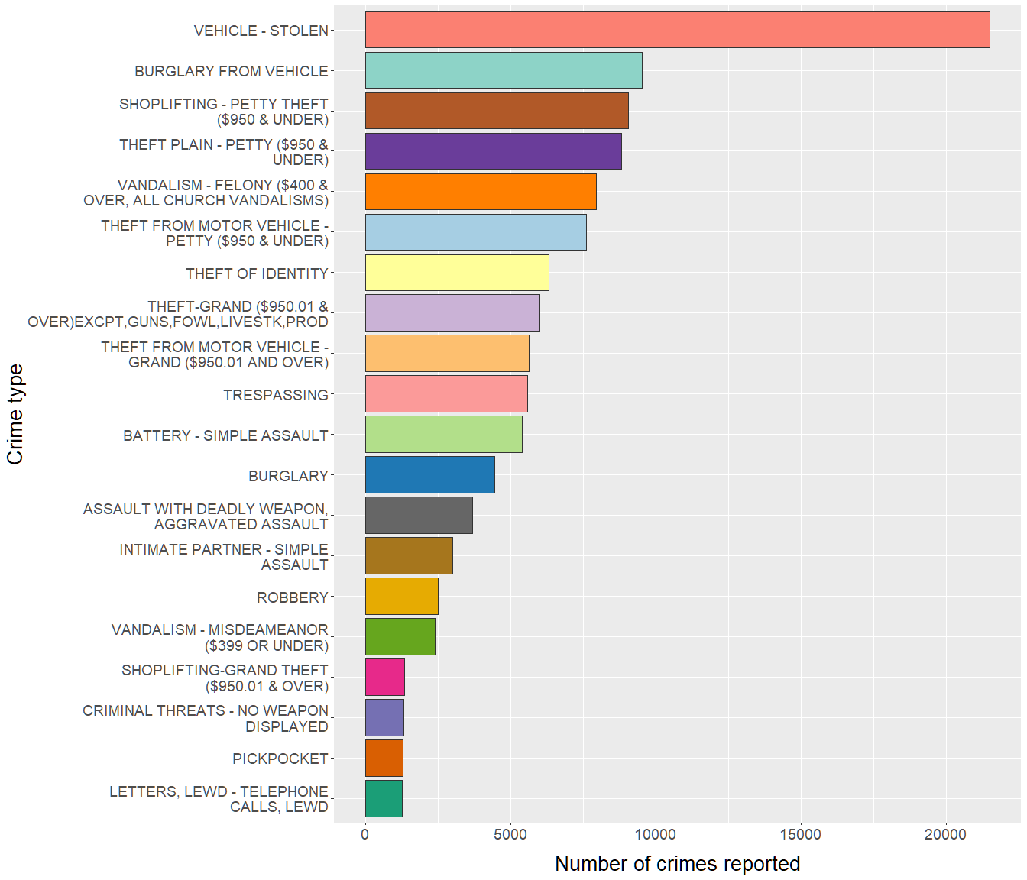
2. Most common crime types
The chart below shows an analysis of Los Angeles crime types in 2024 by frequency.
Twenty most common offences are presented.
Conclusion:
The most common crime type in the LA area in 2004 was vehicle theft (an outstanding number of over 20,000 cases reported). The remaining types of offences are less variable in frequency, and none of them exceeded 10,000.

Slide 5
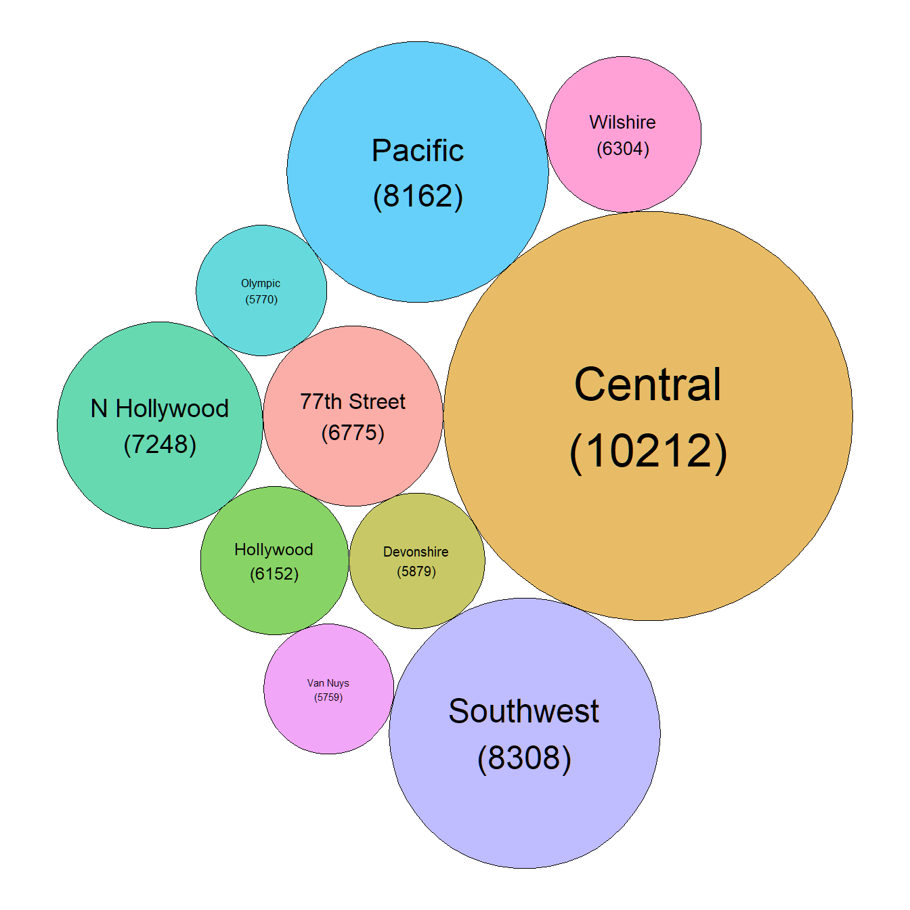
3. Areas most affected by crime
The chart below shows 10 areas with the highest crime rate.
Conclusion:
The diameters of the circles are approximately proportional to the number of reported crimes in the respective areas. Most reports are from the Central area, followed by Southwest and Pacific.

Slide 6
4. Victim age analysis
Variable | NotNA | Mean | Median | Sd | Min | Pctile[25] | Pctile[75] | Max
Victim age | 76839 | 39 | 36 | 15 | 2 | 27 | 49 | 99
This section presents the results of victim age analysis. Only male and female genders are presented (other/unknown categories are omitted due to low sample size).
Histogram plot – total population:
Conclusion: This chart present the entire population. Most victims are adults aged 20–40 years. The data seems to be distributed normally, as confirmed below in a statistical test.
Histogram plot – victim age distribution by sex:
Conclusion: This chart presents overimposed histograms of the age for male and female victims. The sex-specific histograms are very similar and nearly overlap, although male victims are slightly older.
Summary stastistics:

Slide 7
Conclusion: The yougest victim was 2 years old, and the oldest 99 years old. Median victim age was 36 years.
Test for normal distribution:
Shapiro-Wilk normality test data: head(data_prep$Vict.Age, n = 5000) W = 0.95593, p-value < 2.2e-16
Conclusion: The p value in Shapiro-Wilk test is very low, confirming normal distribution of the data.

Slide 8
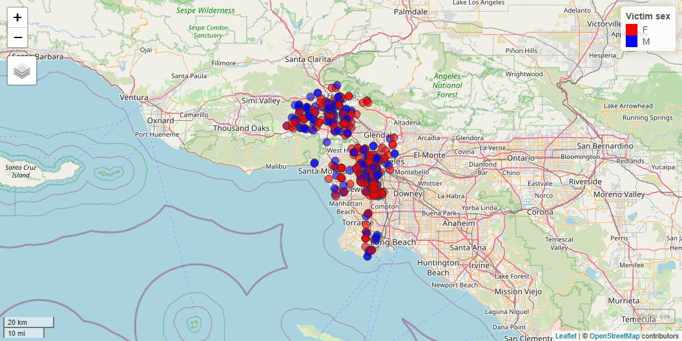
5. Geographical distribution of crime
Certain offences usually exhibit a heterogeneous geographical distribution. To illustrate this, the map below displays the locations of reported cases of physical assault involving minors in 2024. Colors indicate victim sex.
Conclusion:
The map clearly shows two large and two smaller clusters corresponding to areas where the majority of these offences (assaults on minors) occur, indicating where preventive measures in this regard should be intensified.
No clear pattern is evident regarding the victims’ sex.

Slide 9
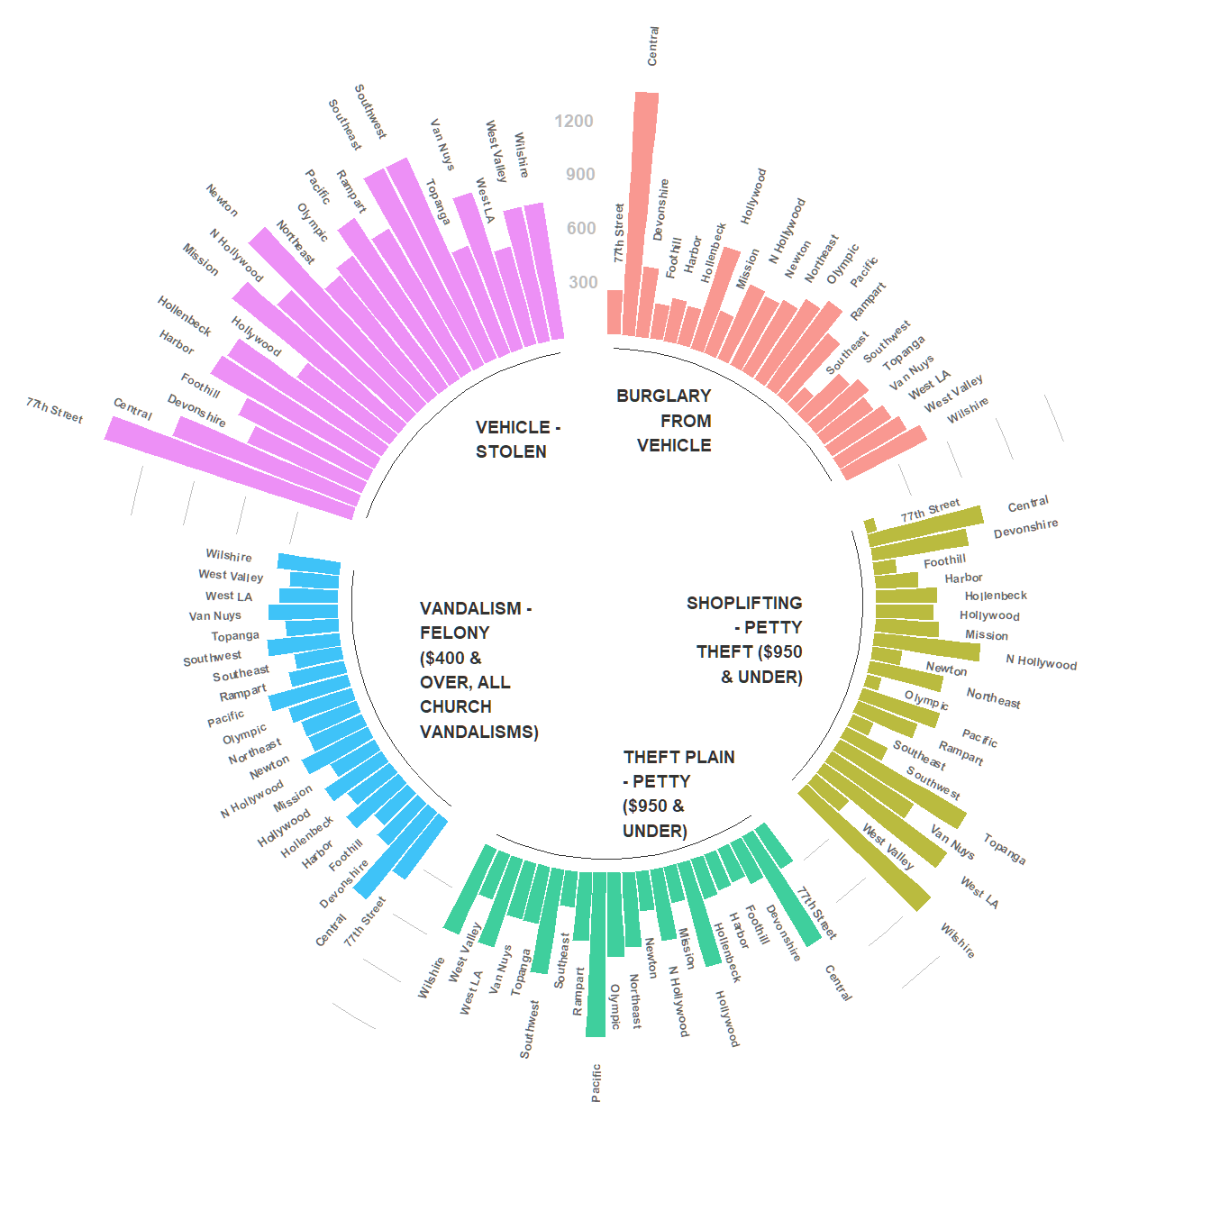
6. Crime distribution by area
The chart below shows crime distribution in the LA region by area. Five most common offences are presented.
Conclusion:
For certain crimes there are marked differences in the number of reports depending on area. For instance, “BURGLARY FROM VEHICLE” occurred overwhelmingly in the “Central” area (with more than twice as many reports as in any other area). Other offences show more homogeneous distribution (e.g. “VANDALISM”).

Slide 10
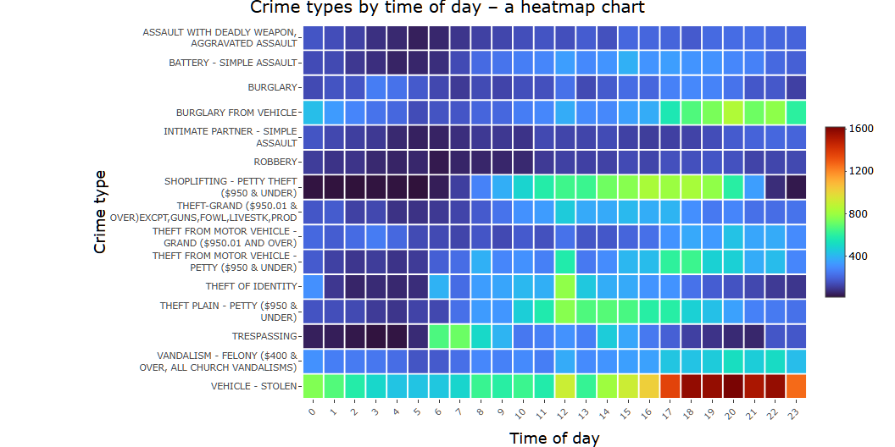
7. Crime types by time of day
The chart below shows a heatmap of the likelyhood of specific crimes depending on time of day. Fifteen most common offences are presented.
Conclusion:
Vehicle-related crimes (stealing or burglary from vehicle) are committed significantly more often during evening hours, starting around 5:00 PM. Most cases of theft occur in the middle of the day, whereas trespassing is clearly limited to early morning hours. Offences such as burglary are equally distributed throughout the day.

