Slide 1
Data analysis using R and Quarto
Student 296356

Slide 2
Table of contents
1. Information on the Quarto project
2. Most common crime types
3. Victim age analysis
4. Geographical distribution of crime
5. Areas most affected by crime
6. Crime distribution by area
7. Crime types by time of day

Slide 3
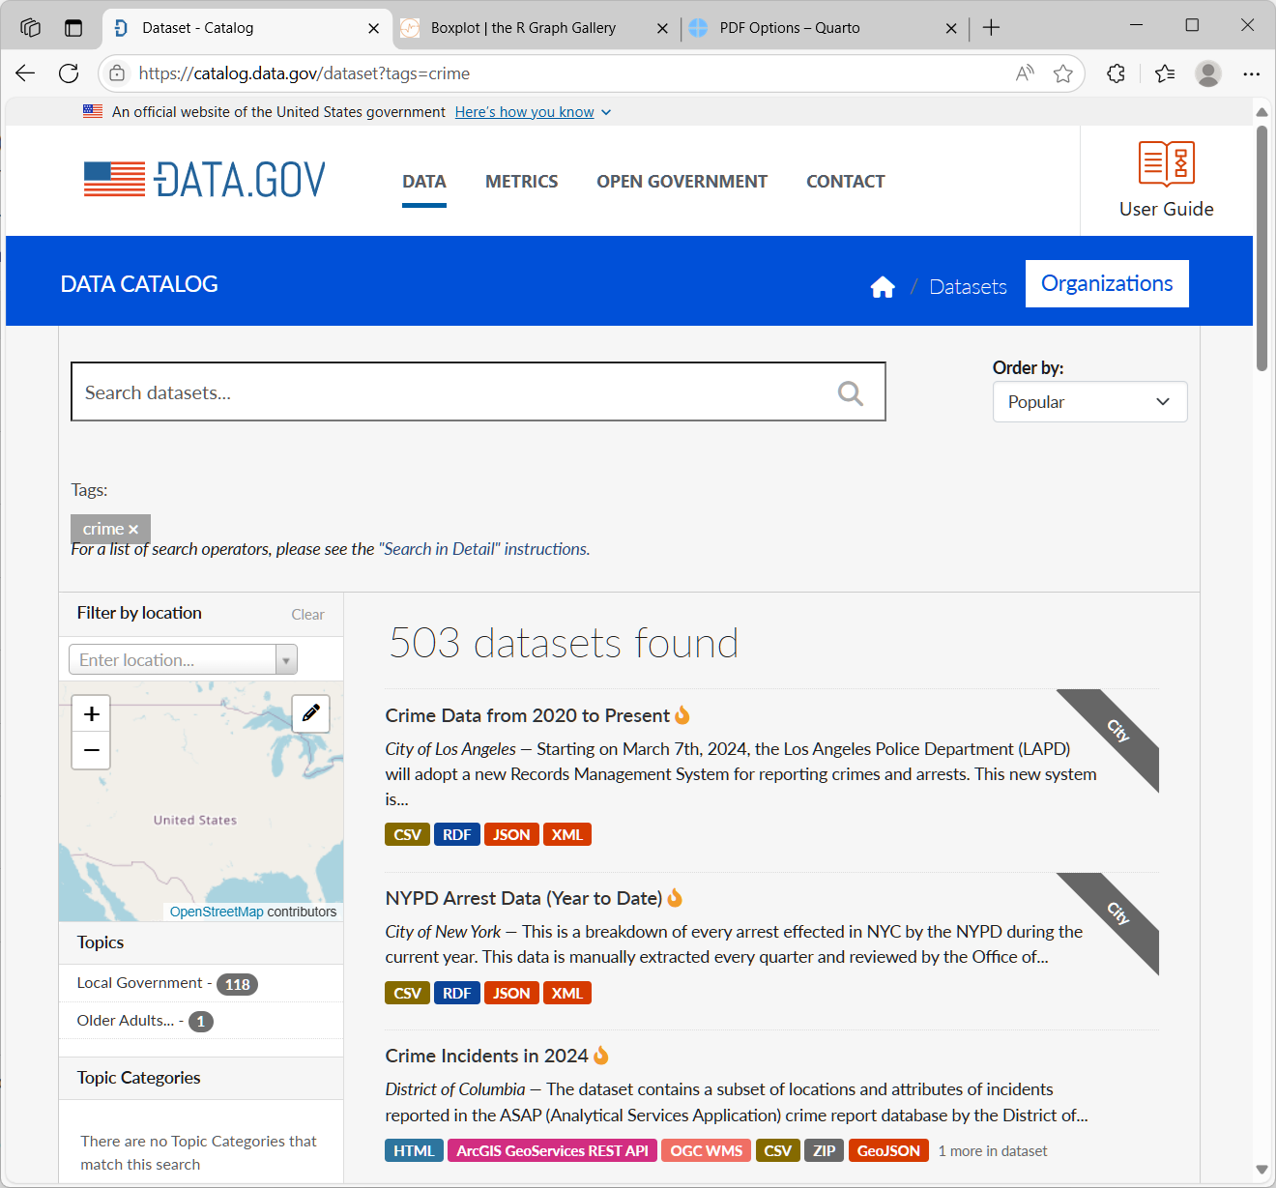
1. Information on the Quarto project
Project title: Data analysis using R and Quarto
Author: Student 296356
Subject: Statistical analysis of Los Angeles crime reports
Data source: Los Angeles crime types (based on 2024 data) (https://catalog.data.gov/dataset?tags=crime)

Slide 4
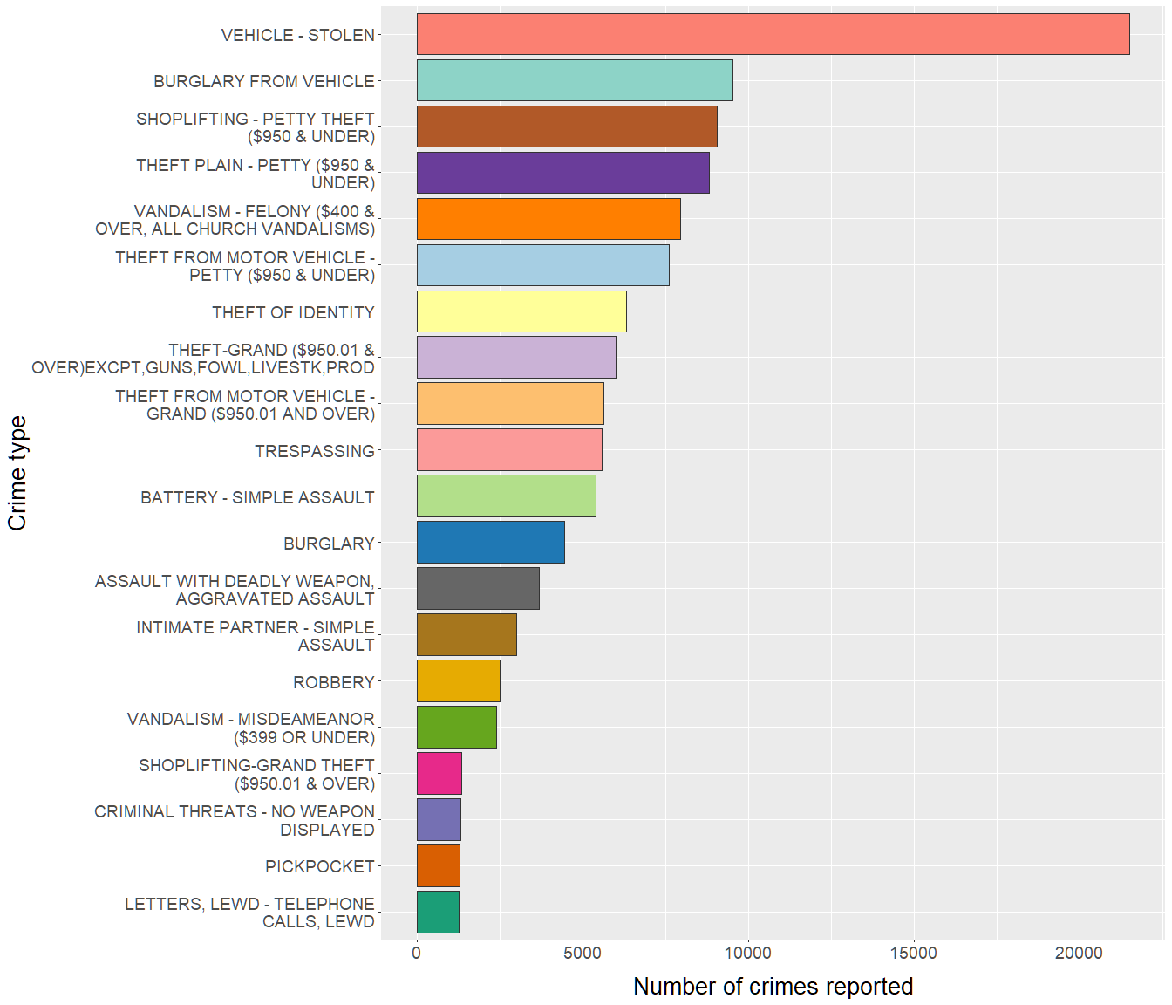
2. Most common crime types
This chart shows an analysis of Los Angeles crime types in 2024 by frequency.
Twenty most common offences are presented.
Conclusion:
The most common crime type in the LA area in 2004 was vehicle theft (an outstanding number of over 20,000 cases reported). The remaining types of offences are less variable in frequency, and none of them exceeded 10,000.

Slide 5
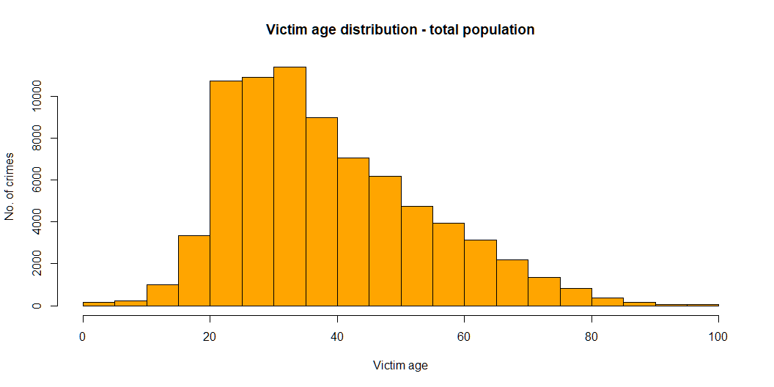
3. Victim age analysis
Victim age structure: entire sample
Conclusion: This chart presents age distribution in the entire population. Most victims are adults aged 20–40 years. The data seems to be distributed normally, as confirmed below in a statistical test.

Slide 6
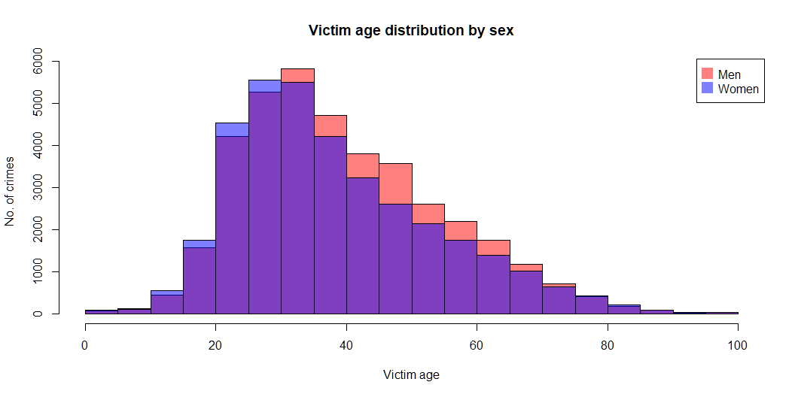
Victim age structure: by age
Conclusion: This chart presents overimposed histograms of the age for male and female victims. The sex-specific histograms are very similar and nearly overlap, although male victims are slightly older. Only male and female genders are included (categories other/unknown were omitted due to low sample size).

Slide 7
Summary stastistics
N: 76839
Min: 2
25th perc.: 27
Mean: 39
Median: 36
SD: 15
75th perc.: 49
Max: 99
Conclusion: The youngest victim was 2 years old, and the oldest 99 years old. Median victim age was 36 years.
Test for normal distribution:
Shapiro-Wilk normality test data: head(data_prep$Vict.Age, n = 5000) W = 0.95593, p-value < 2.2e-16
Conclusion: The p value in Shapiro-Wilk test is very low, confirming normal statistical distribution of the data.

Slide 8
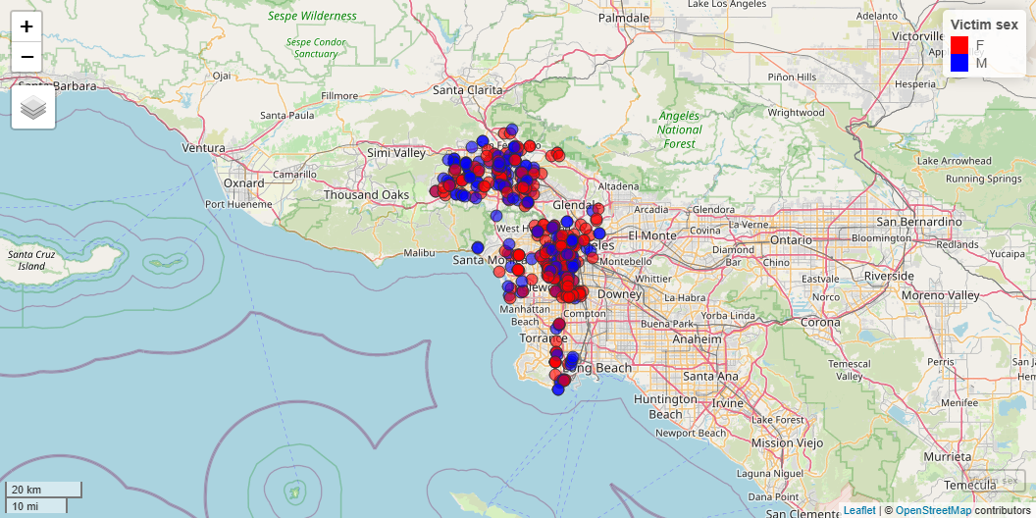
4. Geographical distribution of crime
Certain offences may exhibit a heterogeneous geographical distribution. To illustrate this, information on the geographical location of assaults on minors was extracted from the dataset, thereby yielding a smaller subset of data that can be clearly displayed on a map. Colors indicate victim sex.
Conclusion:
The map clearly shows two large and two smaller clusters corresponding to areas where the majority of these offences (assaults on minors) occur, indicating where preventive measures in this regard should be intensified. No clear pattern is evident regarding the victims’ sex.

Slide 9
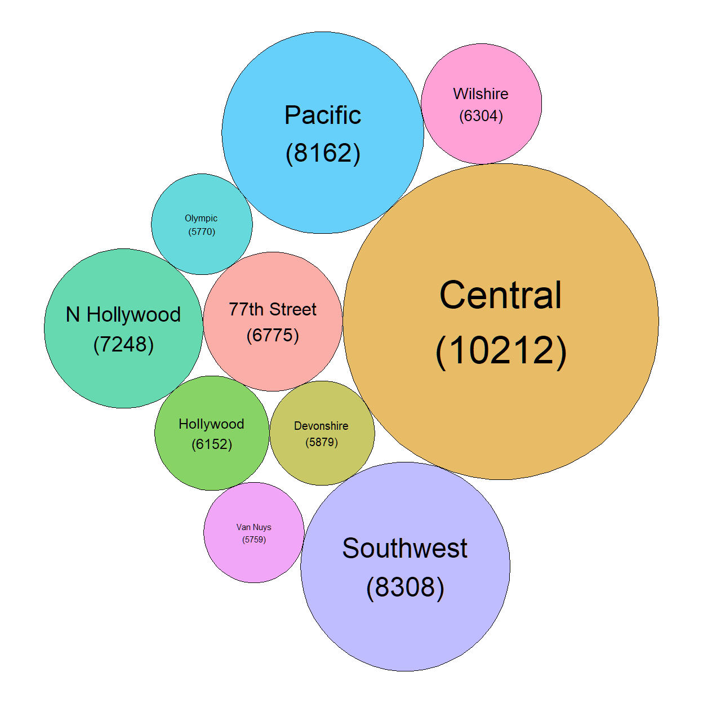
5. Areas most affected by crime
This chart shows 10 areas with the highest crime rate. The diameters of the circles are proportional to the number of reported crimes in the respective areas. Exponential transformation was applied to better highlight the differences.
Conclusion:
Most reports are from the Central area, followed by Southwest and Pacific.

Slide 10
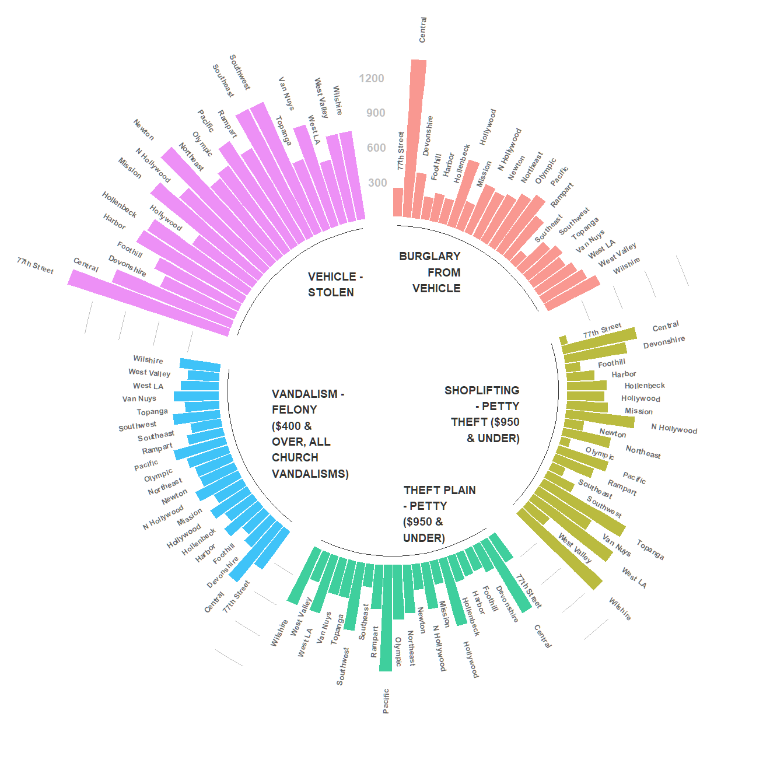
6. Crime distribution by area
The chart below shows crime distribution in the LA region by area. Five most common offences are presented.
Conclusion:
For certain crimes there are marked differences in the number of reports depending on area. For instance, “BURGLARY FROM VEHICLE” occurred overwhelmingly in the “Central” area (with more than twice as many reports as in any other area). Other offences show more homogeneous distribution (e.g. “VANDALISM”).

Slide 11
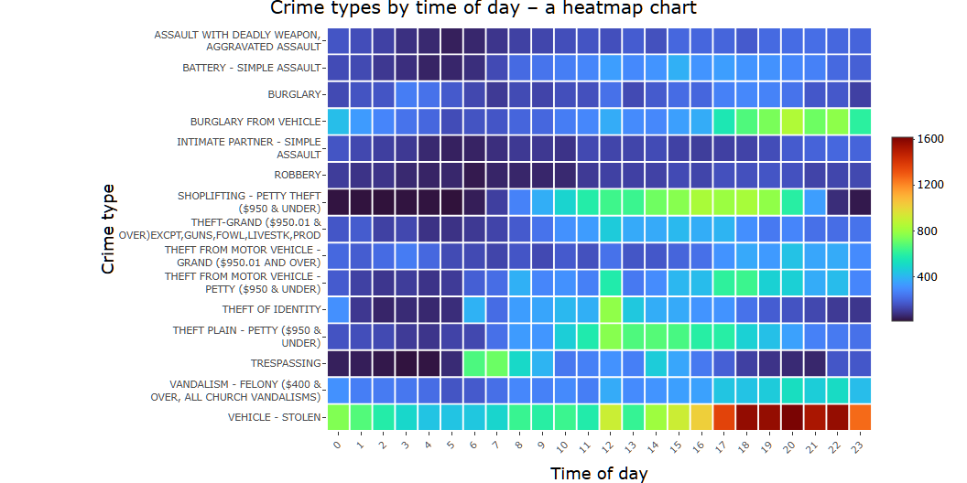
7. Crime types by time of day
The chart below shows a heatmap of the probability of specific crimes depending on time of day. Fifteen most common offences are presented.
Conclusion: • Vehicle-related crimes (stealing or burglary from vehicle) are committed significantly more often during evening hours, starting around 5:00 PM. • Most cases of theft occur in the middle of the day. • Trespassing is clearly limited to early morning hours. • Offences such as burglary are equally distributed throughout the day.

