Slide 1

Functional Verification of
Dynamically Reconfigurable Systems
(Version 2.3b)
Mr. Lingkan (George) Gong, Dr. Oliver Diessel
The University of New South Wales, Australia

Slide 2
Outline
Objectives & Motivation
Challenges in Verifying Dynamically Reconfigurable Systems (DRS)
Proposed Solution: The ReSim Library
Example Designs
Conclusions

Slide 3
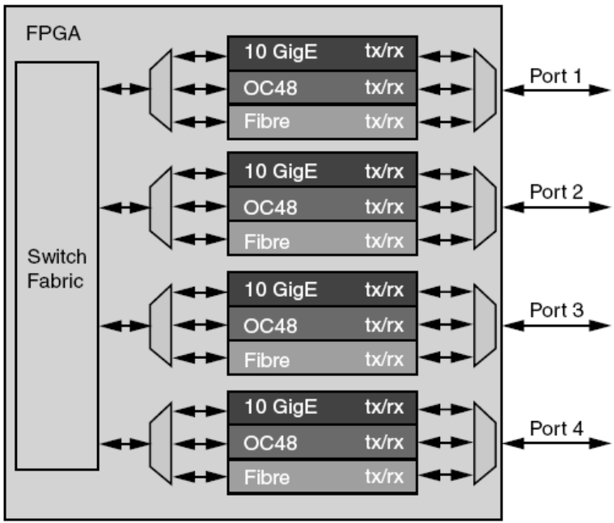
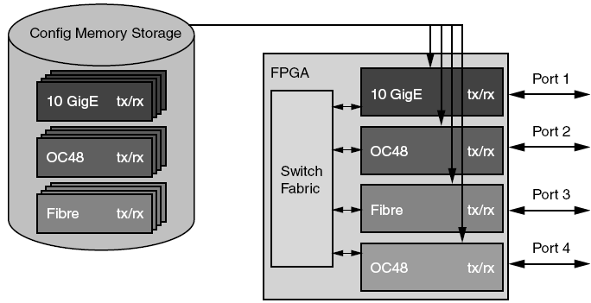
Objectives & Motivation
Dynamically Reconfigurable Systems (DRS)
  Improved flexibility
  Better resource utilization

Slide 4
Objectives & Motivation
Functional Verification
  Bottleneck of all hardware designs
  Most costly bugs occur in system integration stage
  DRS designs Involve activities that don’t exist in static designs (e.g., module swapping, … )
It is essential to perform simulation-based verification of
Dynamically Reconfigurable Systems (DRS)
1 bug/6 lines of RTL code

Slide 5
Objectives & Motivation
“Partial Reconfiguration itself can not be simulated … ”
  Xilinx UG702 (Partial Reconfiguration User Guide)
  Can simulate Static + A; Static +B; But not the process of swapping out A and swapping in B
Objective
  Support the simulation of the reconfiguration process
  Support the simulation and functional verification of integrated Dynamically Reconfigurable Systems (DRS)
Dynamically Reconfigurable
System (Static part)
Dynamic part:
Module A
Dynamic part:
Module B
Dynamic part:
Module B

Slide 6
Objectives & Motivation
Focus on detecting functional bugs
  e.g. Cycle mismatch
  Assuming there is no timing violation, no errors in the bitstream, no glitch in the reconfiguration process
Focus on systematic verification
  Correctly verified sub-systems, while necessary, are not sufficient
  Recommend to simulate the design BEFORE running it on the target device

Slide 7
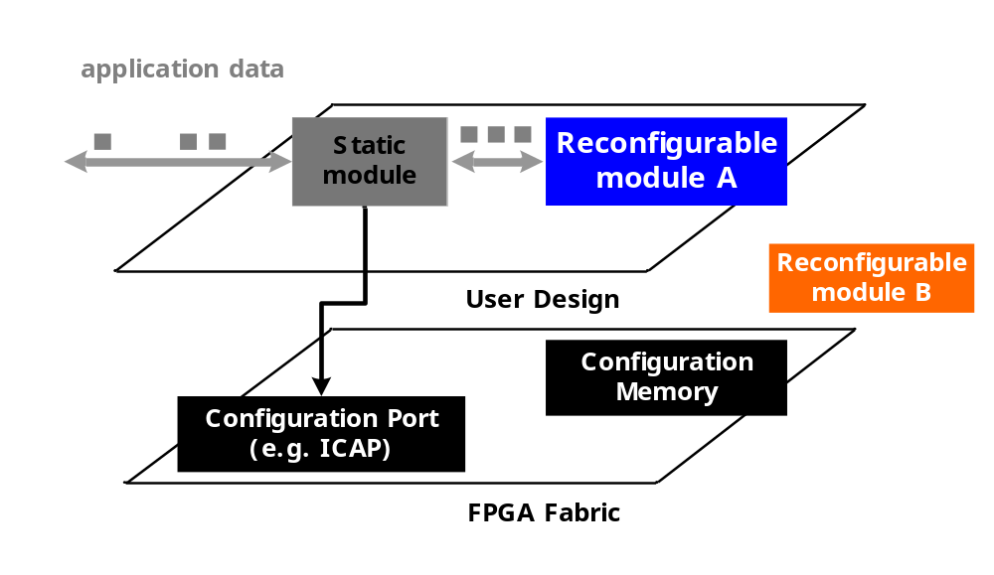
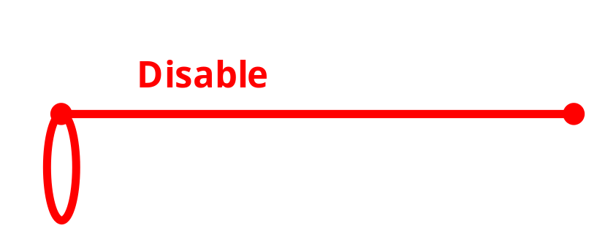
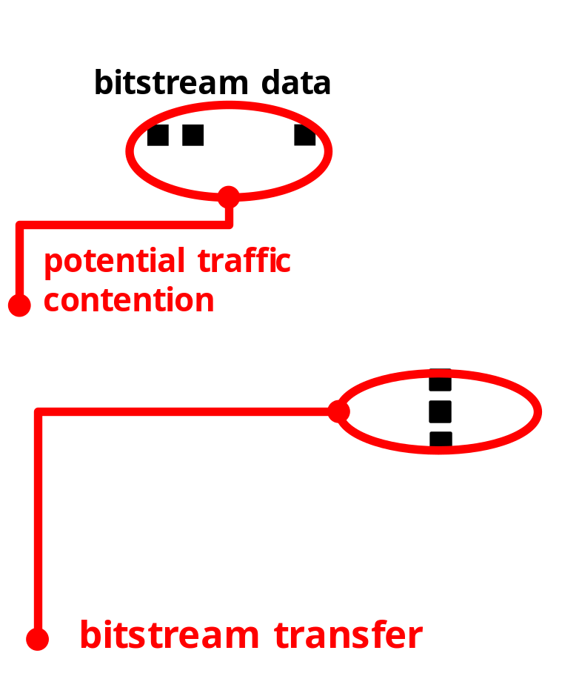


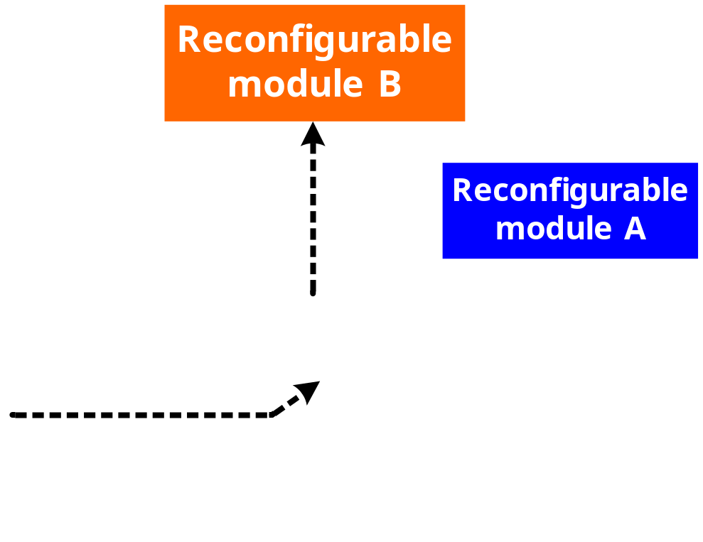
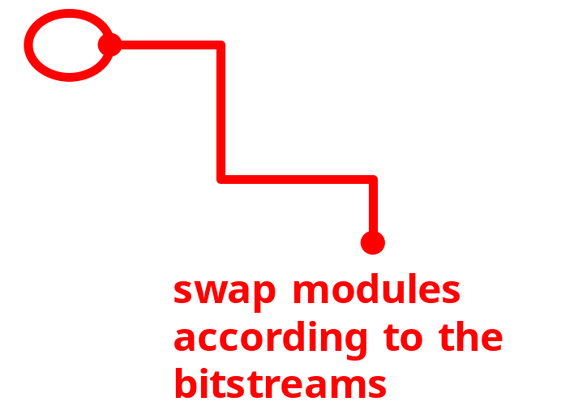
Challenges in Verifying DRS
DRS-specific design considerations

Slide 8
Challenges in Verifying DRS
DRS-specific bugs
  BEFORE Reconfiguration
    ☹ Handshake errors (e.g., deadlock)
    ☹ Fail to save module state
    ☹ …
  DURING Reconfiguration:
    ☹ Errors in bitstreams (e.g., if a design “assemble” bitstreams at run time, bugs can be introduced to the generated bitstreams)
    ☹ Errors in transferring bitstreams (e.g., traffic contention, encryption …)
    ☹ Fail to isolate the module undergoing reconfiguration
    ☹ …
  AFTER Reconfiguration
    ☹ Errors in resetting the module
    ☹ Errors in state restoration
    ☹ …

Slide 9
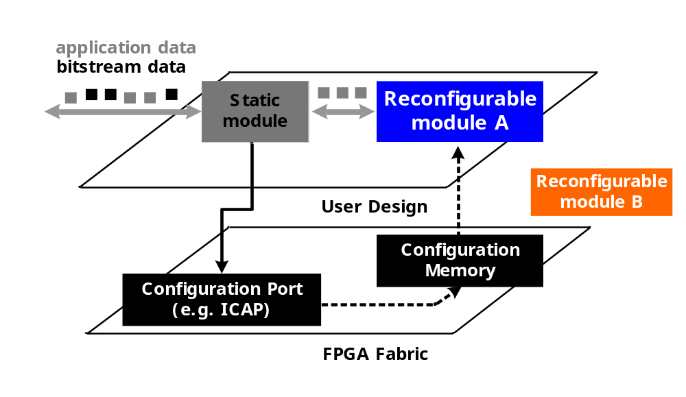

Challenges in Verifying DRS
Accuracy v.s. Productivity
  Simulation accuracy ➔ Modeling the entire FPGA fabric
☹ Models for the FPGA fabric not available
☹ Even if available, it is not efficient to simulate the FPGA fabric (Low Productivity)

Slide 10
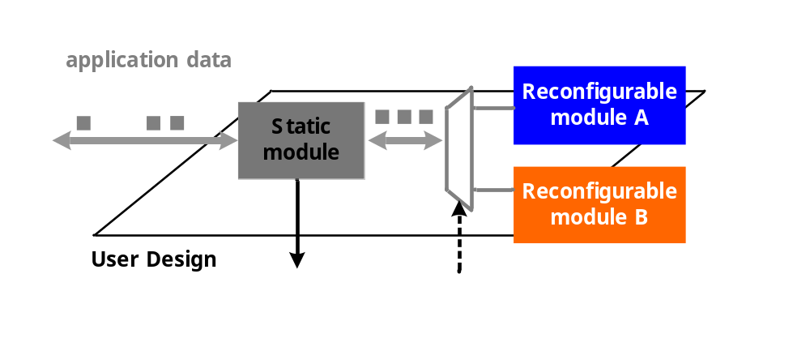




Challenges in Verifying DRS
Accuracy v.s. Productivity
  Simulation productivity ➔ DO NOT model the FPGA fabric
☹ Does not model bitstream traffic
☹ Assume zero or constant reconfiguration delay
☹ Does not trigger module swapping
☹ Does not model spurious module outputs
☹ Low accuracy

Slide 11
Challenges in Verifying DRS
Accuracy v.s. Productivity
  Simulation accuracy ➔ DO model the FPGA fabric
  Simulation productivity ➔ DO NOT model the FPGA fabric
It is essential to balance “accuracy” & “productivity” when simulating partial reconfiguration

Slide 12
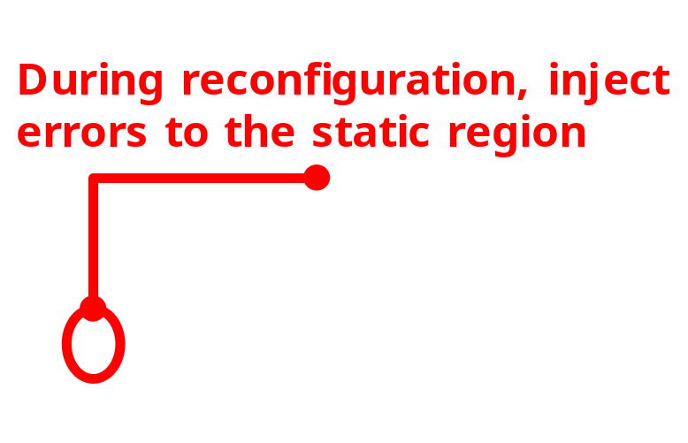
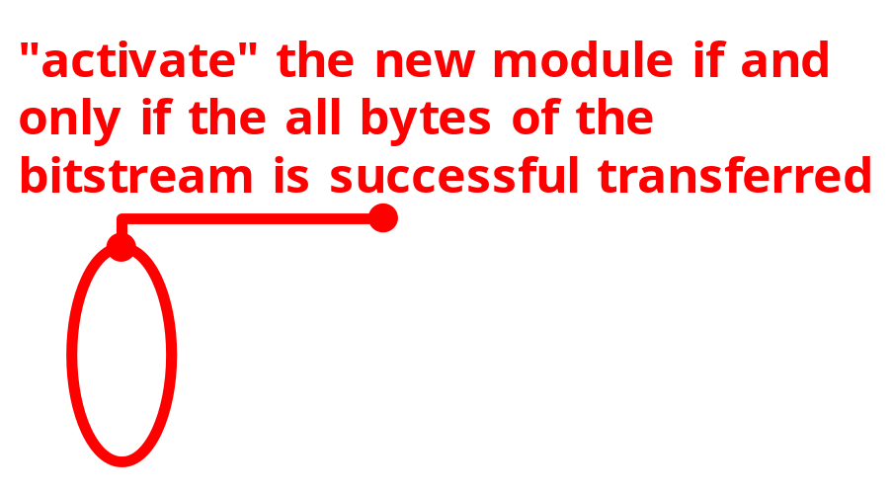
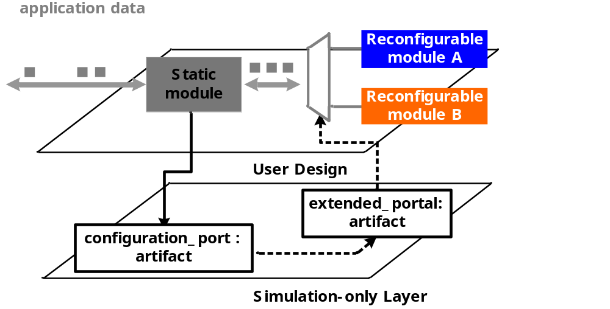
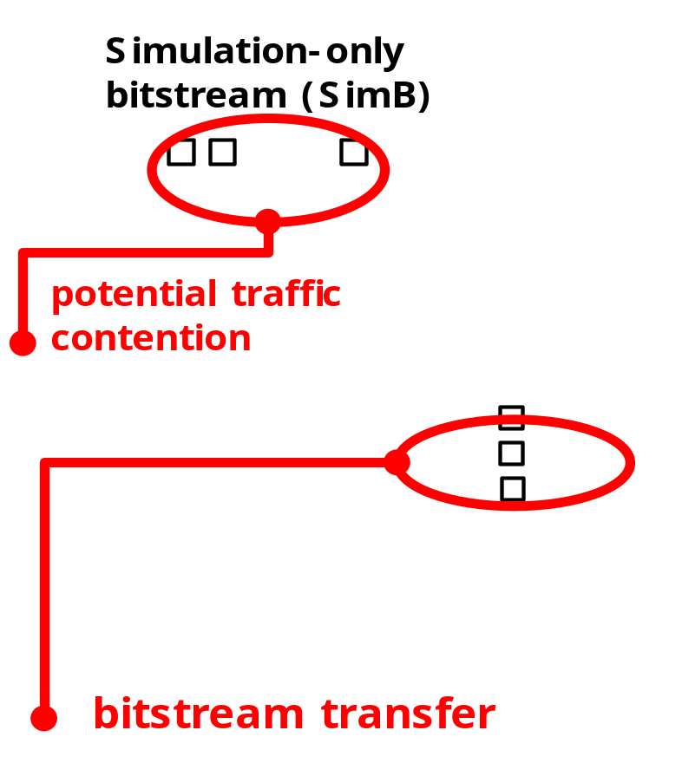

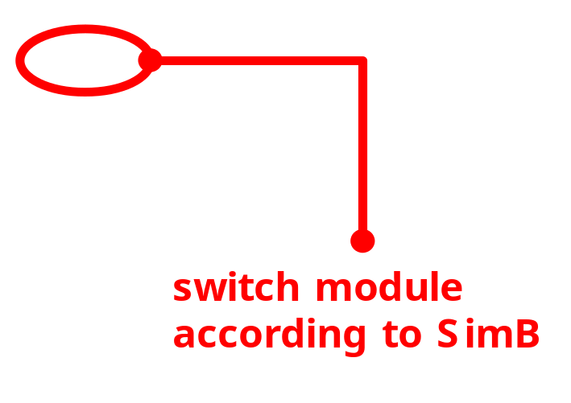
ReSim
Core idea
  Model the fabric at such a level of detail that is just enough for RTL simulation of DRS

Slide 13
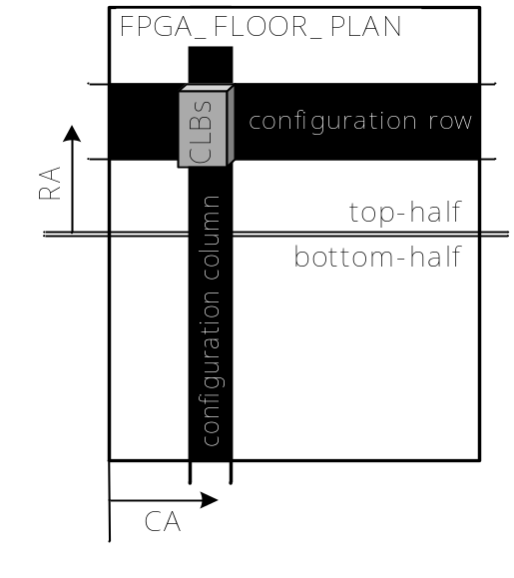
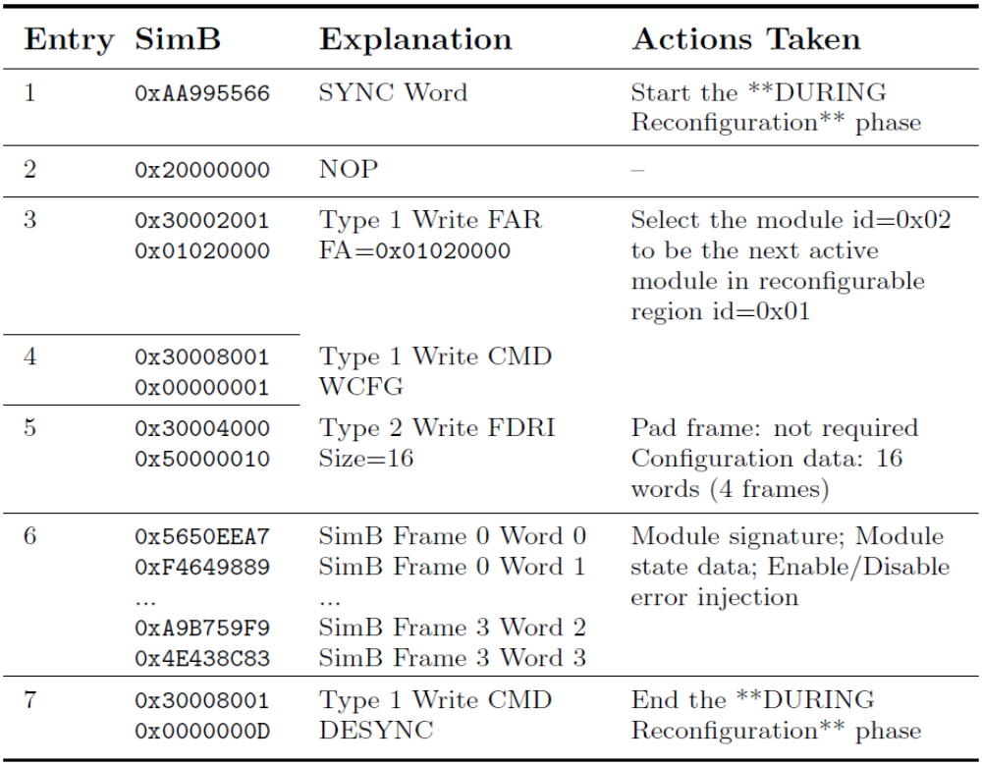

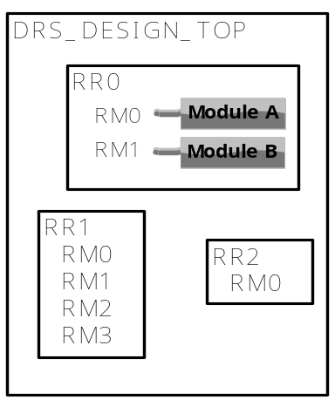

ReSim
Simulation-only bitstreams (SimB)
  Capture the essence of a real bitstream, but with reduced size

Slide 14
ReSim
Capabilities and Limitations
  BEFORE Reconfiguration
    ☹ Handshake errors (e.g., deadlock)
    ☹ Fail to save module state
    ☹ …
  DURING Reconfiguration:
    ☹ Errors in bitstreams (e.g., if a design “assemble” bitstreams at run time, bugs can be introduced to the generated bitstreams)
    ☹ Errors in transferring bitstreams (e.g., traffic contention, encryption …)
    ☹ Fail to isolate the module undergoing reconfiguration
    ☹ …
  AFTER Reconfiguration
    ☹ Errors in resetting the module
    ☹ Errors in state restoration
    ☹ …
RED: Only on Target device
BLUE: Only by ReSim
GRAY: More Efficient by ReSim

Slide 15
ReSim
Capabilities and Limitations
  ReSim assists in testing fabric-independent part of the design
  After simulation, test & debug fabric-dependent part on the target device (using Chipscope)

Slide 16
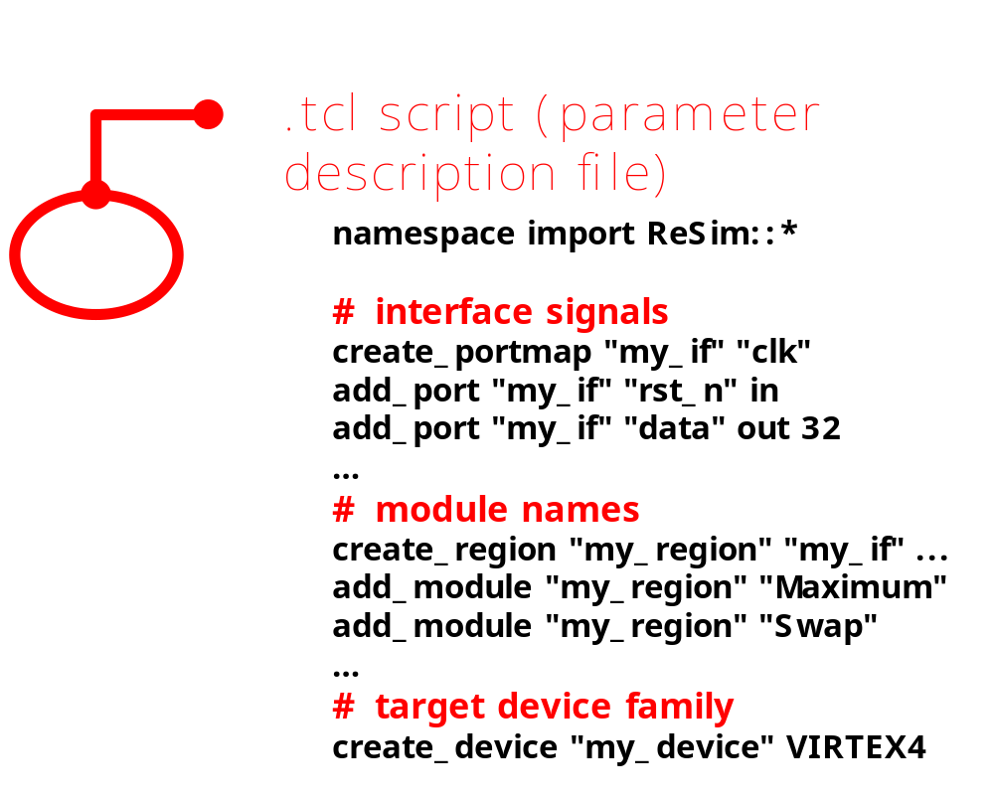
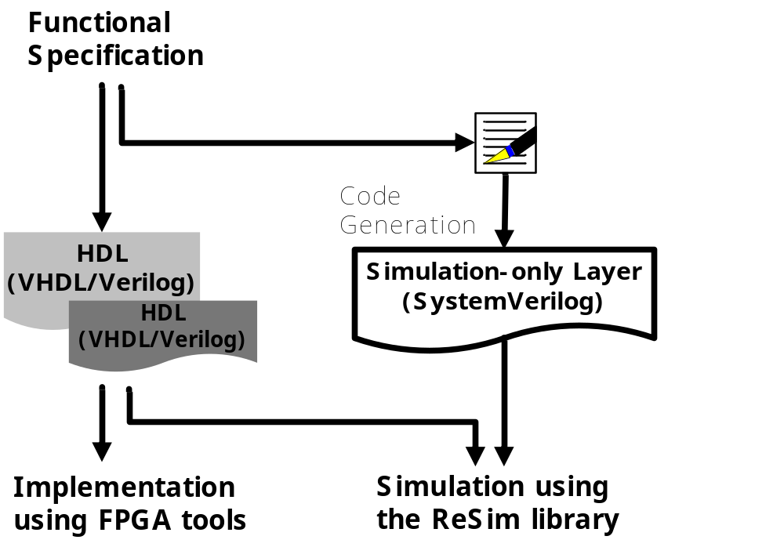
ReSim
Reusability
  Codegen: automatic generation of artifacts
  OO: override the default behavior of artifacts

Slide 17
Example Designs
Example Designs
  XDRS.QUICKSTART
  XDRS.SINGLE
  XDRS.MULTIPLE
  FPCIe
  State_Migration
Derived from ReSim case studies
  See “ReSim Case Studies” for more information on development progress, bugs detected and lessons learned.

Slide 18
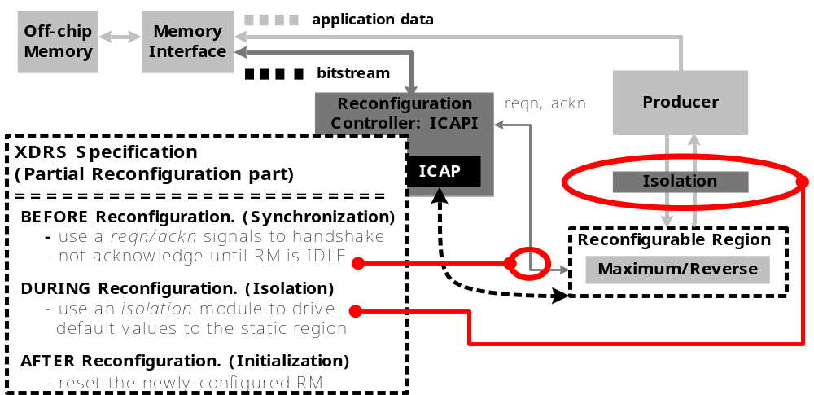
Example Design: XDRS
XDRS: a generic DRS computing platform
  Similar to Erlangen Slot Machine, a general-purpose reconfigurable compute engine (Bobda et al. FCCM 2005)

Slide 19
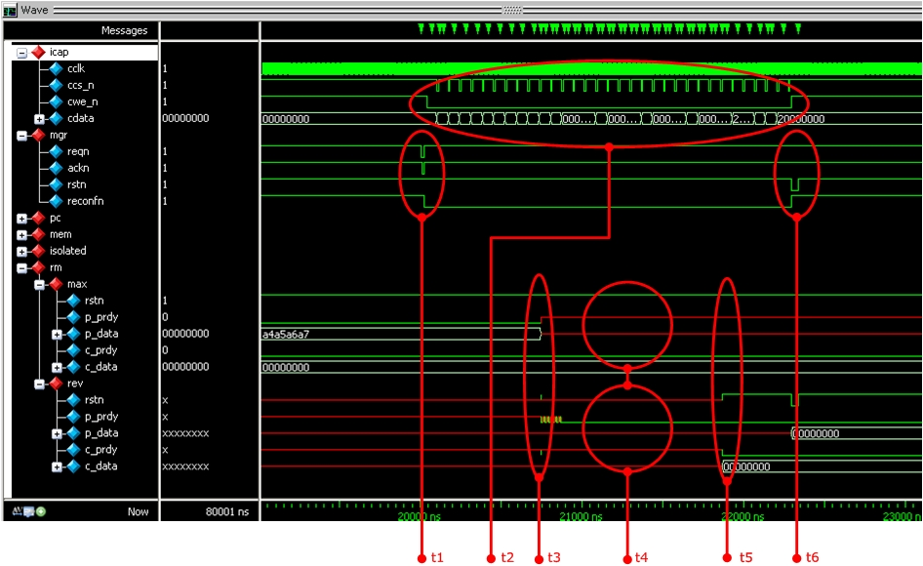
Example Design: XDRS
Example simulation waveform
  @t1: Sync, @t2: Transfer a bitstream, @t3: Extract RRID/RMID
  @t4: Inject errors, @t5: Swap module, @t6: Reset

Slide 20
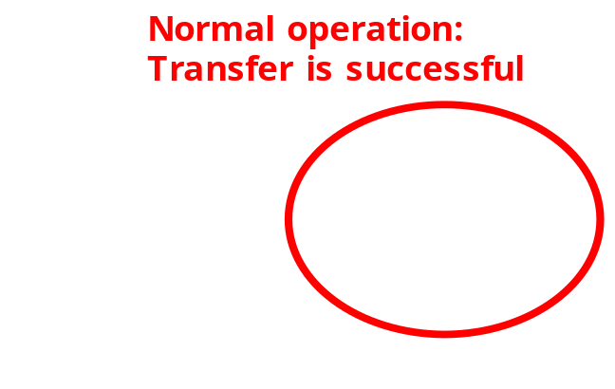
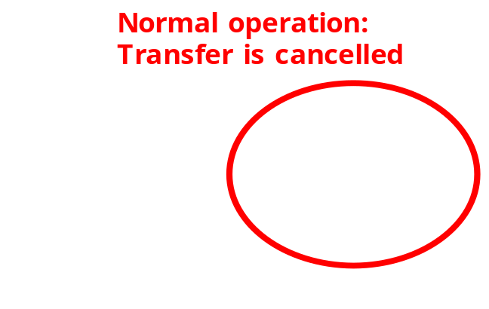
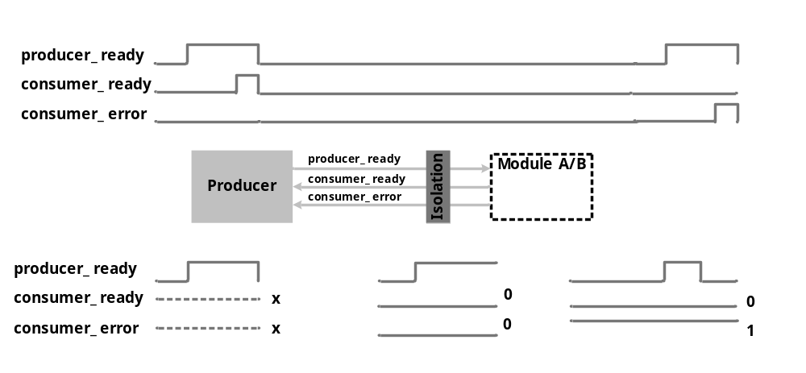
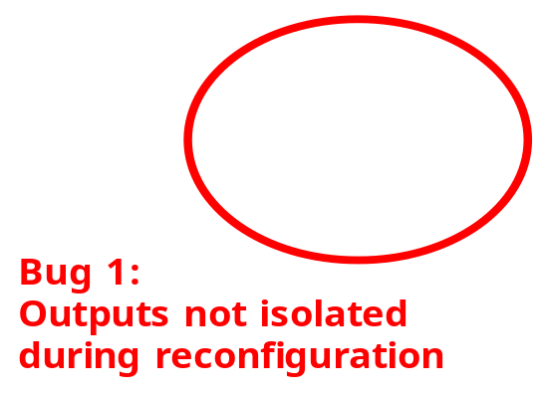
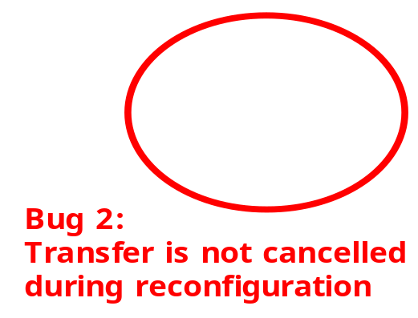
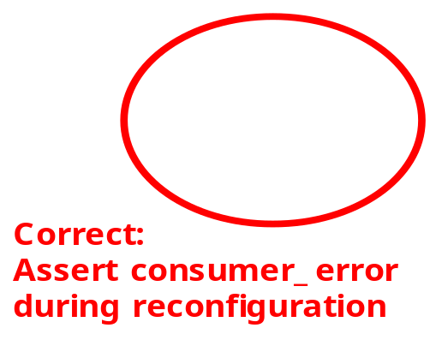
Example Design: XDRS
Example bug that was detected
  Hold the "reset" signal of a module during reconfiguration

Slide 21
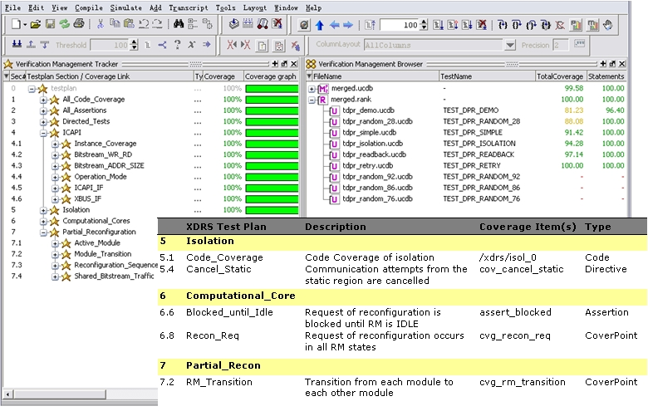
Example Design: XDRS
Regression and coverage analysis

Slide 22
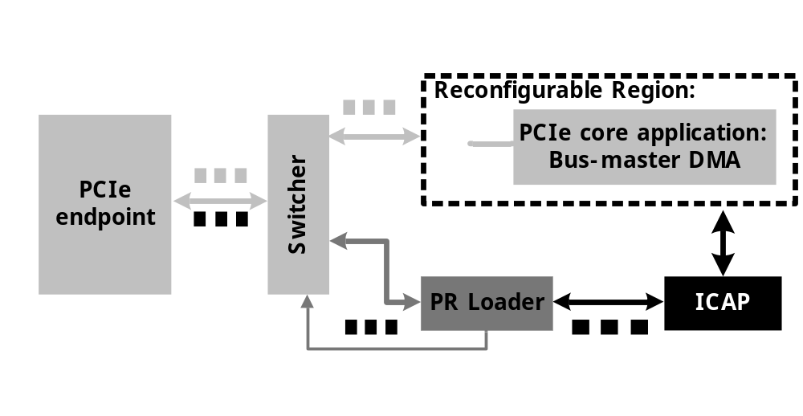
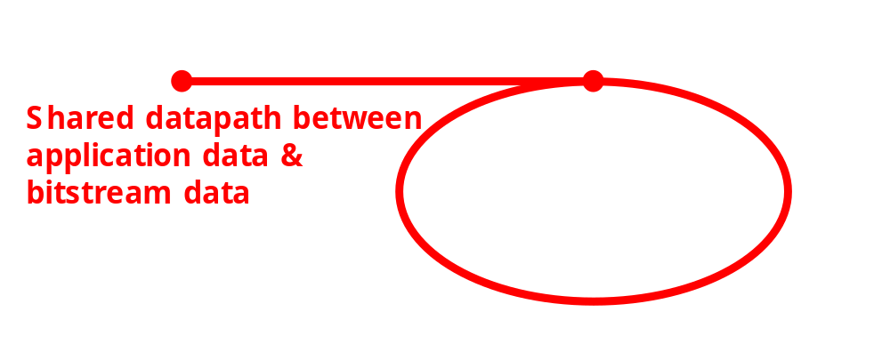
Example Design: FPCIe
FPCIe
  Derived from Fast PCIe configuration (XAPP883)
    ~3500 lines of Verilog code + Coregen code (the PCIe endpoint)
  Integrate ReSim with the original testbench
    150 lines of Tcl script (120 IO signals)
    10 lines of Verilog code to instantiate the generated artifacts
    110 lines of Verilog code to send SimBs to the DUT

Slide 23
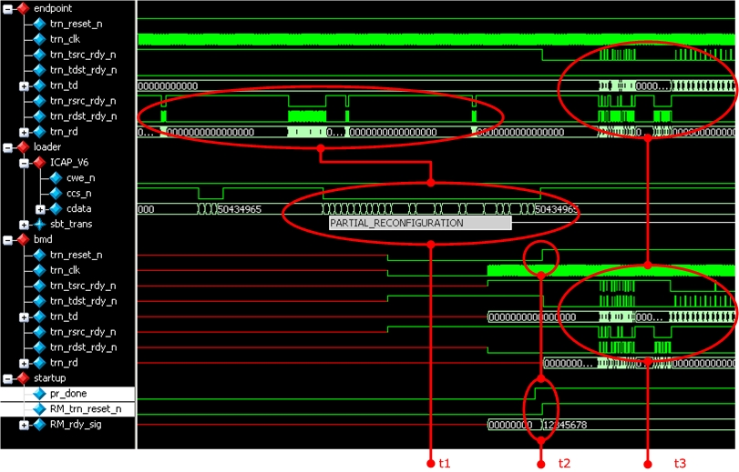
Example Design: FPCIe
Example simulation waveform
  @t1: Transfer a bitstream over PCIe, @t2: Swap module,
  @t3: Application logic starts operating

Slide 24
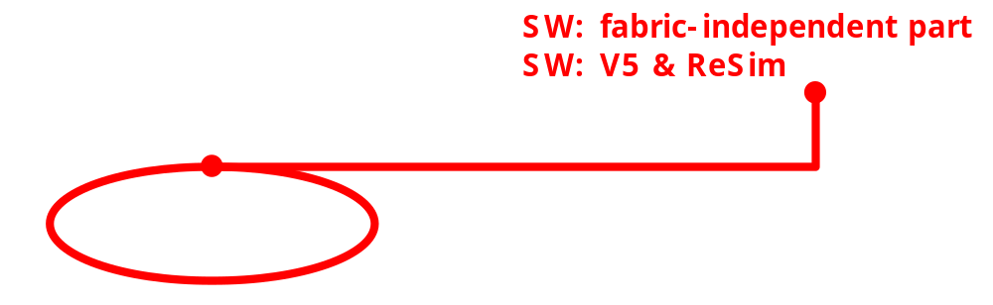
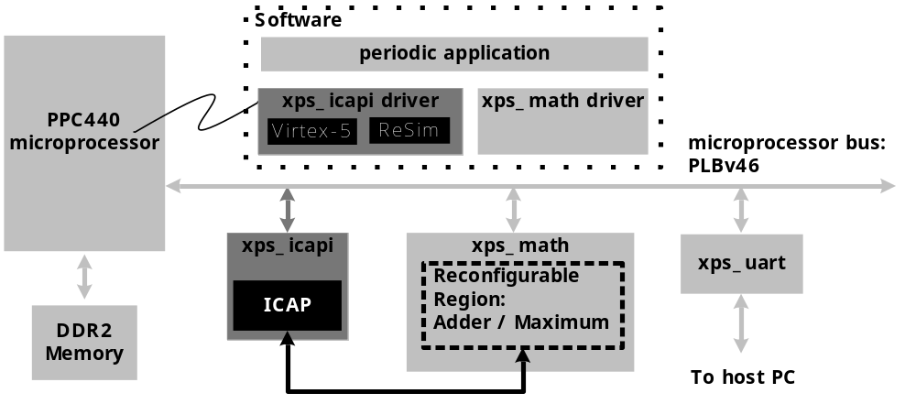
Example Design: State_Migration
State_Migration
  Derived from Microprocessor Peripheral reconfiguration (UG744)
  Modified the hardware to use PPC440 & xps_icapi
  Modified the software to save RM state via ICAP
    The modified software is composed of fabric-independent C code and fabric-dependent C code

Slide 25
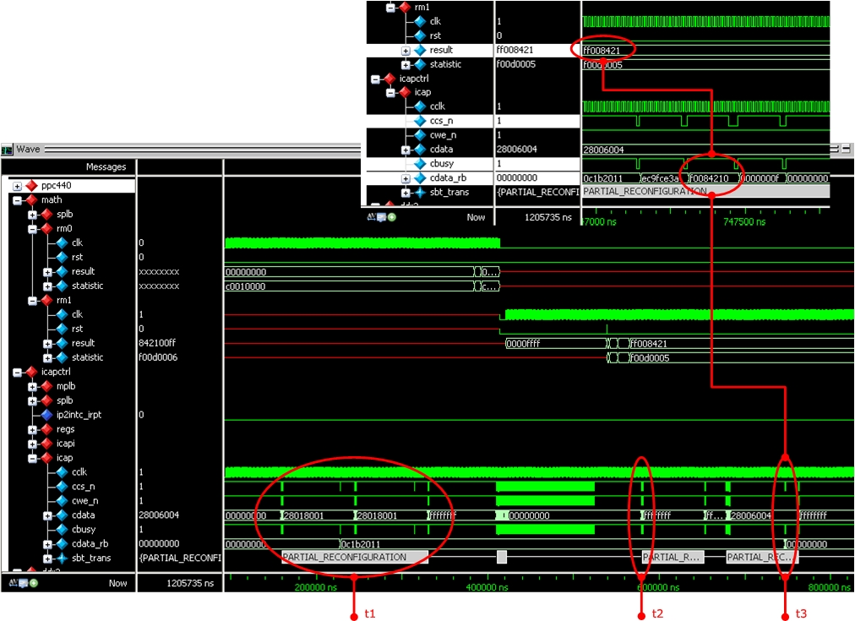
Example Design: State_Migration
Example simulation waveform
  @t1: Read ICAP IDCODE (ReSim’s IDCODE=0x0c1b2011)
  @t2: Issue GCAPTURE
  @t3: Configuration readback

Slide 26
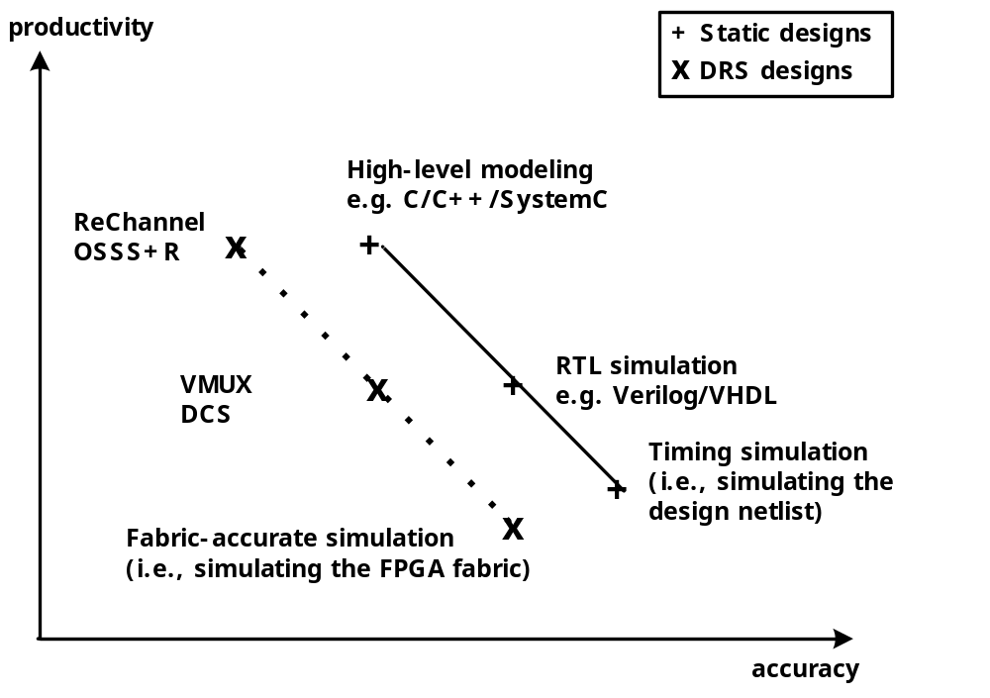
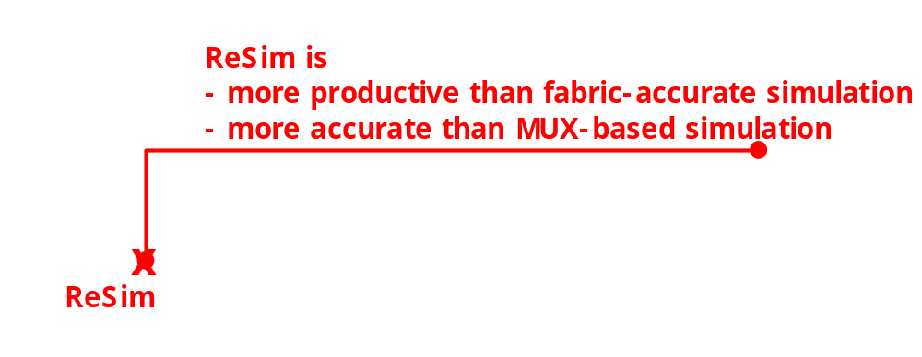
Conclusions
Accuracy v.s. Productivity

Slide 27
Conclusions
It is essential to simulate partial reconfiguration
  Activities such as bitstream traffic, triggering condition, state saving and restoration, isolation of the reconfigurable region, …
It is essential to balance accuracy & productivity
  Modeling the FPGA fabric is not productive
  MUX-based simulation is not accurate
ReSim
  Models the fabric at such a level of detail that is just enough for RTL simulation of DRS
  A reusable simulation library

Slide 28
More Infomation
ReSim Home Page
  http://code.google.com/p/resim-simulating-partial-reconfiguration/
ReSim Document
  ReSim User Guide
  ReSim Case Studies
Contact
  Mr. Lingkan Gong, http://code.google.com/p/resim-simulating-partial-reconfiguration/wiki/Lingkan_Gong
  Dr. Oliver Diessel, http://www.cse.unsw.edu.au/~odiessel/

Slide 29
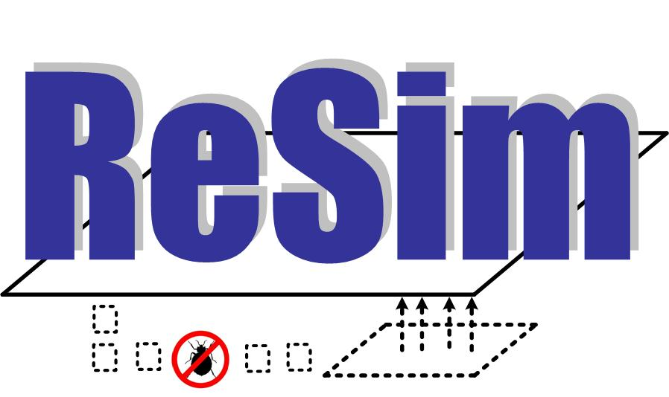
Thank you

