Slide 1
Project
Routes
Switchboards
Accessory decoders
Feedback encoders
Route elements
Outputs
Inputs
Connections
Connections
Elements
Sounds
Actions

Slide 2
OTC SENSOR ACTIVATION FLOW
PHISICAL SENSOR ACTIVATION
MANUAL SENSOR ACTIVATION
IFeedback.SetFeedbackStatus()
Digital System
Element Set Status
XpressNet
Project.FeedbackStatusChanged
OTC System
IFeedback.SetFeedbackStatus()
Switchboard Command Control
Element Set Status
Project.FeedbackStatusChanged
Switchboard Command Control

Slide 3
OTC ACCESSORY CHANGE FLOW
EXTERNAL ACCESSORY ACTIVATION
OTC ACCESSORY ACTIVATION
Switchboard
Control.MouseUp
Digital System
Element Set Status
XpressNet
IAccessory.AccessoryStatusChanged
OTC System
Switchboard Command Control
System.AccessoryStatusChanged
Project
IAccessory.SetAccessoryStatus()
Element Set Status
Project.AccessoryStatusChanged
Switchboard Command Control

Slide 4
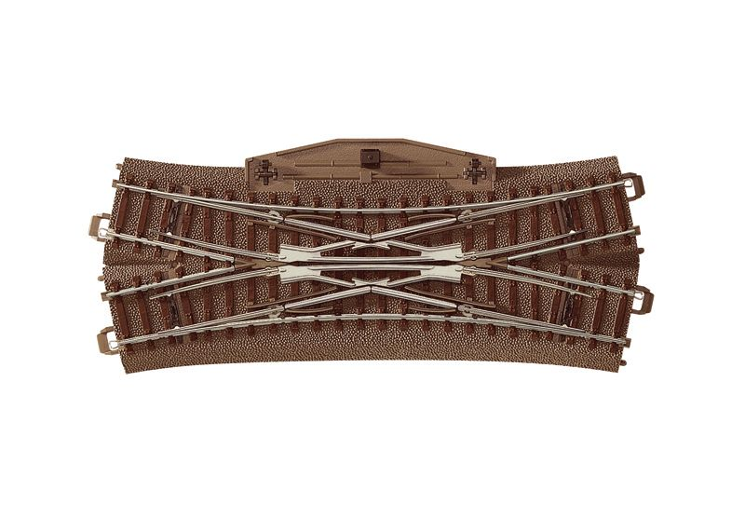
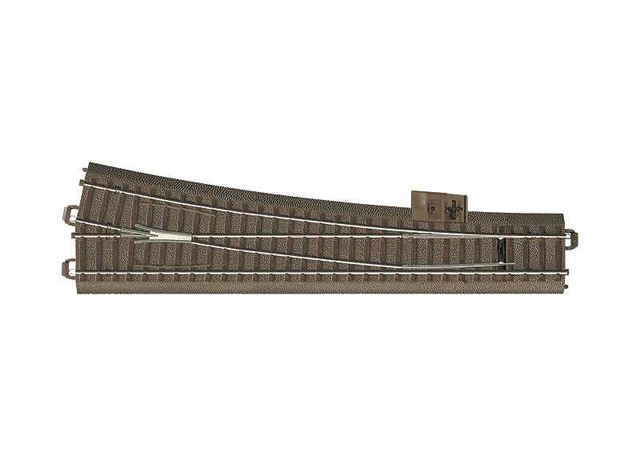
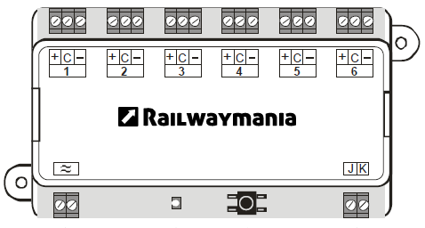
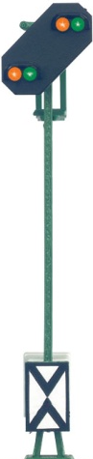
Accessory Decoder
Accessory Decoder

Slide 5
Destination block
FROM
Traffic block
Route B
Route A
BLOCK B1
BLOCK B2
Route F
Route C
BLOCK B3
Route G
Route H
BLOCK B4
BLOCK B5
BLOCK B6
Route I
Route D
Route L
BLOCK B3
FROM
Route J
BLOCK B2
Route K
FROM

