Slide 1

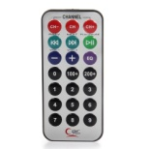









alexa
itag.sh
ir.sh
sphinx.sh
fifo.cgi
config.cgi
askpi.sh
index.cgi

