Slide 1
Computer Architecture Project
Performance Analysis of a Multi-thread K-Means solution
Antonio Patimo
Guillaume Quint
A.Y. 2022/23

Slide 2
Product presentation
Scenario: International Bank wants to identify client groups based on their monthly income and expenditure to propose personalized investment plans
Typical use case: 10M users, 5 groups
Product: customer clustering software for personalized advertisement
Algorithm: parallelized K-means clustering

Slide 3
Parallel K-Means
The main thread initializes the centroids randomly and splits the dataset between all threads, so that each of them works on its own partition
Each thread associates every point to one of the current centroids
Each thread computes the number and the sum of coordinates of the points associated to each centroid
The main thread updates the centroids based on threads’ results and continues until convergence

Slide 4
Hardware Specifications
Intel i7-6700HQ
CPU cores | 4
Threads | 8
L1 cache | 4 x 32 KB 8-way set associative instruction caches 4 x 32 KB 8-way set associative data caches
L2 cache | 4 x 256 KB 4-way set associative caches
L3 cache | 6 MB 12-way set associative shared cache

Slide 5
Execution Time

Slide 6
Speedup
With a small dataset, increasing the number of threads reduces the speedup
With larger datasets, increasing the number of threads yields an improved speedup with progressively diminishing returns until a threshold
With a larger dataset the speedup increases

Slide 7
Speedup (da ricontrollare) (sparisce) (per davvero)
Notes:
Non ci ricordiamo la lore

Slide 8
1. With a small dataset, increasing the number of threads reduces the speedup
Using the VTune profiler, we observe that the CPU time spent waiting for thread termination goes from an average of 0,046s using 2 threads to 0,362s using 15 threads
Because the dataset is small, the total time spent by working threads in both cases is negligible
Therefore, with an increasing overhead we see an increase in execution time and so a reduction in speedup

Slide 9
2. With larger datasets, increasing the number of threads yields an improved speedup with progressively diminishing returns until a threshold
With larger datasets, dividing the work among more threads is much more beneficial than the overhead introduced.
For example, considering 10M points dataset, doubling the number of threads from 8 to 16 brings an average execution time from 212ms to 137ms. Meanwhile the overhead only increases from 26ms to 49ms. Therefore, the total iteration time is reduced from 239ms to 186ms.
To observe a substantial reduction in performance due to overhead, we must increase a lot the number of threads or consider much smaller datasets.

Slide 10
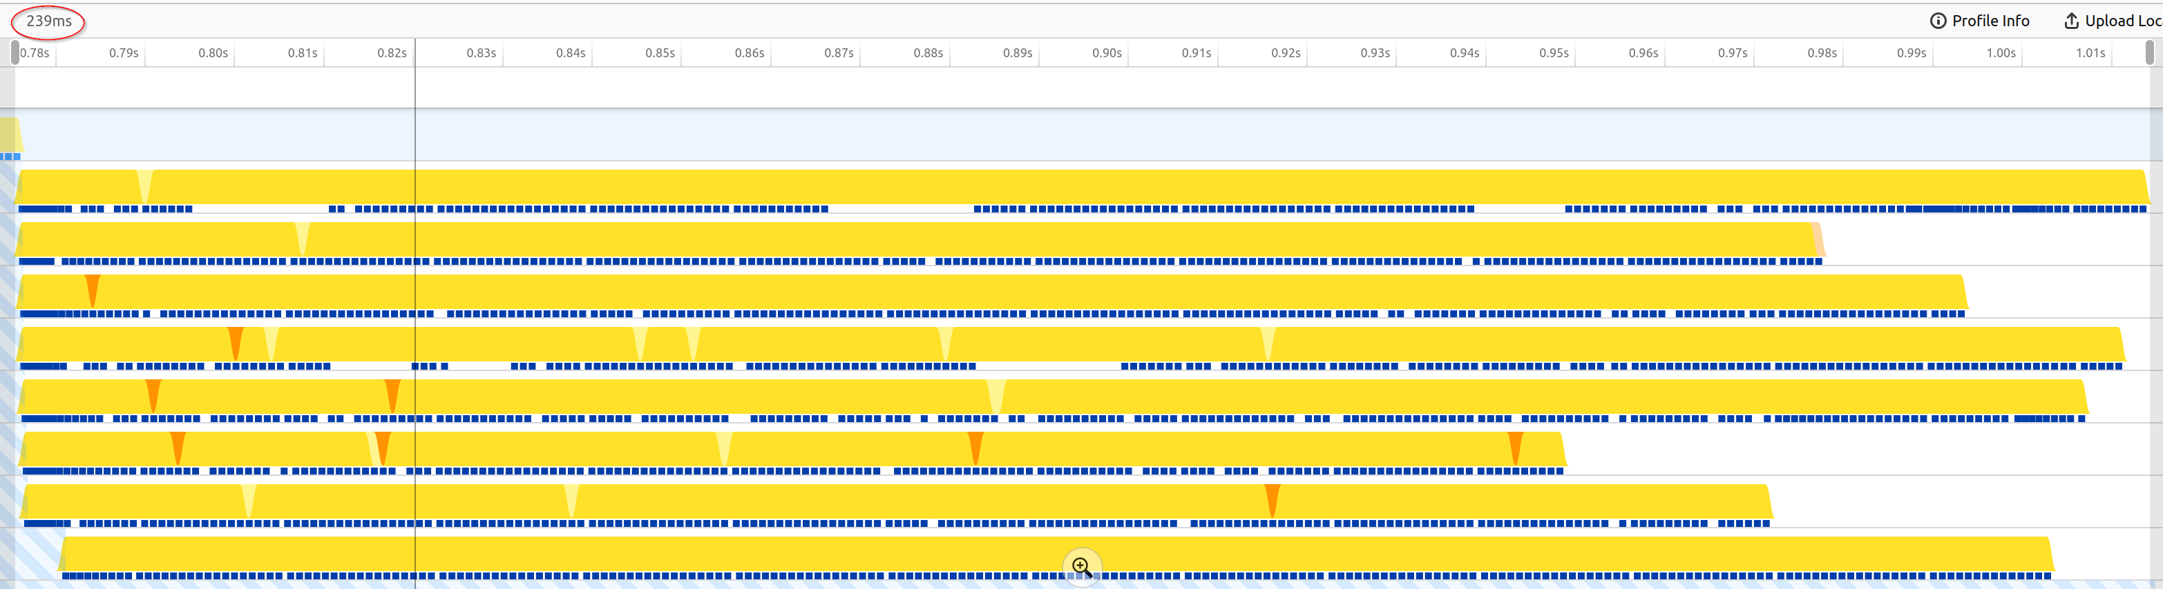
2. With larger datasets, increasing the number of threads yields an improved speedup with progressively diminishing returns until a threshold
239ms

Slide 11
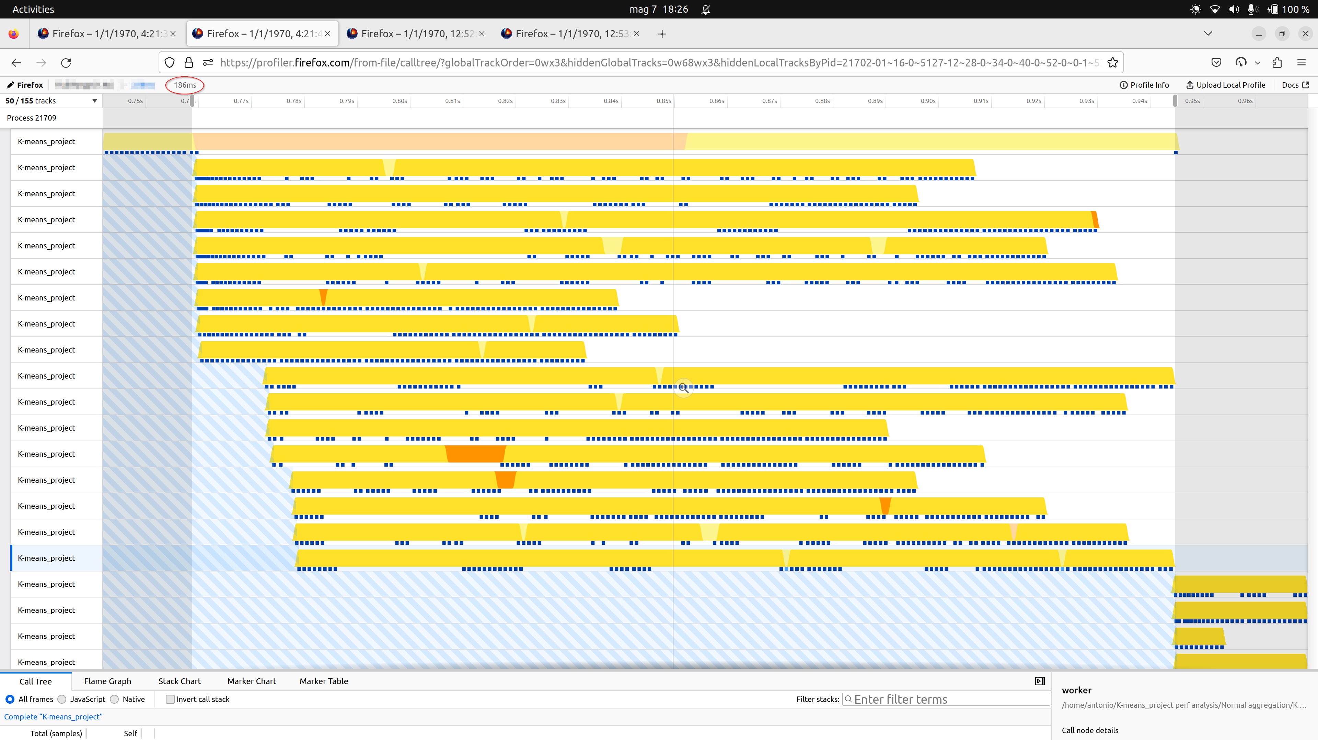
2. With larger datasets, increasing the number of threads yields an improved speedup with progressively diminishing returns until a threshold
186ms

Slide 12
2. To observe a substantial reduction in performance due to overhead, we must increase a lot the number of threads or consider much smaller datasets

Slide 13
3. With a larger dataset the speedup increases
The sequential part of the application is almost constant with respect to the dataset size. Meanwhile, with a larger dataset, the work done in parallel increases
Therefore, the ratio between CPU Time and Elapsed Time increases

Slide 14
Performance Optimization

Slide 15
Performance Optimization

Slide 16
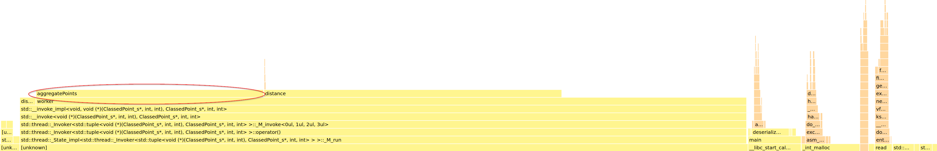
Performance Optimization
Inside the worker function, we found that aggregatePoints took much more time to execute than initially expected

Slide 17
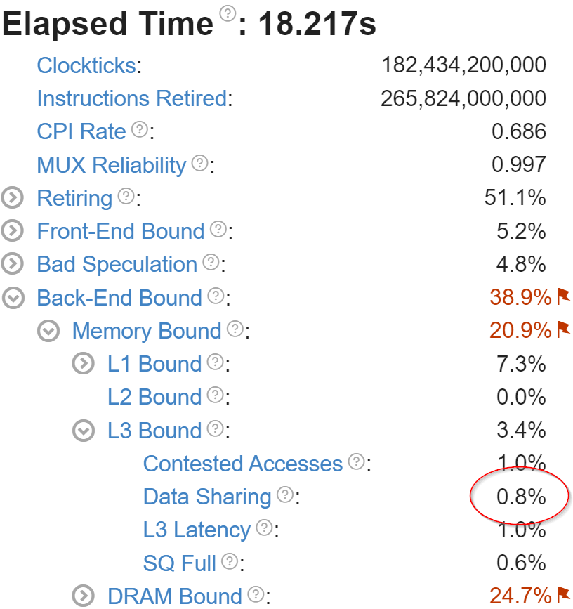
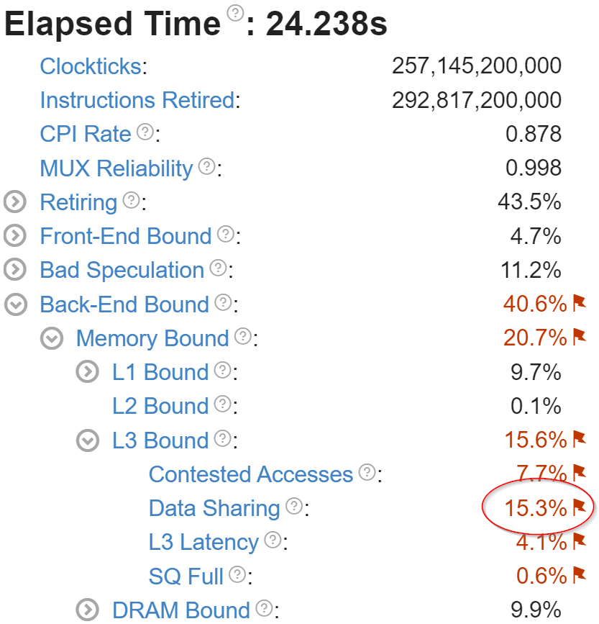
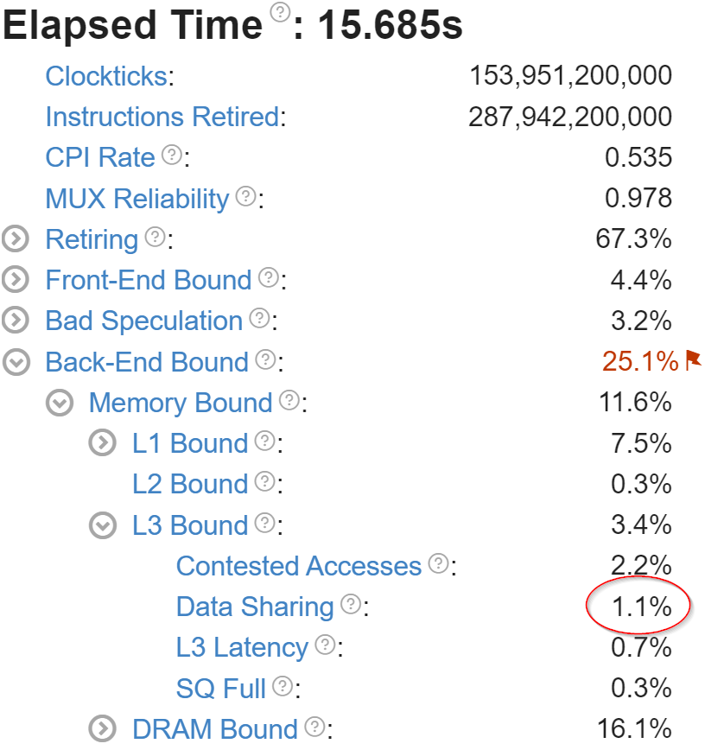
Performance Optimization
We factored the work done by the aggregatePoints inside the threads’ worker function but we experienced a decrease in performances, mainly due to an increased in data sharing among threads.
Normal
1° optimization
2° optimization

Slide 18
Performance Optimization
We used local data structures for each thread to store partial results in order to avoid mutual cache invalidations
Normal
1° optimization
2° optimization

Slide 19
Hardware Specifications
NVIDIA GeForce GTX 1050
Architecture | Pascal |  | Single Precision FLOP/s | 1,911 TeraFLOP/s
Cuda Cores | 640 |  | Double Precision FLOP/s | 59,72 GigaFLOP/s
Multiprocessors | 5 |  | Constant Memory Size | 64 KiB
Clock rate | 1,493 GHz |  | L2 Cache Size | 512 KiB
Global Memory Size | 3,946 GiB |  | Global Memory Bandwidth | 112,128 GB/s

Slide 20
GPU execution time

Slide 21
GPU speedup
With a small dataset, increasing the number of threads reduces the speedup
With larger datasets, increasing the number of threads yields an improved speedup
With a very high number of threads speedup diminishes

Slide 22
1. With a small dataset, increasing the number of threads reduces the speedup
Due to kernel’s local memory allocations, on a small dataset the overhead introduced becomes relevant on the overall execution time
With many threads, this overhead effect increases, resulting in longer runs, and consequently a reduced speed-up
Specifically, we observe an increase in local memory overhead from 2,81% with 32 threads to 60,06% with 8192 threads

Slide 23
2. With larger datasets, increasing the number of threads yields an improved speedup.
Considering the 10M dataset, increasing the number of threads reduces kernel’s executing time. This correlates with a higher GPU utilisation, shown by the achieved occupancy.
Threads | Avg time | Occupancy
32 | 7,212s | 0,016
2048 | 165,44ms | 0,200

Slide 24
3. With a very high number of threads speedup diminishes
4x the number of threads gives a higher overhead, increasing execution time and reducing warp efficiency
Threads | Avg time | Occupancy | Warp efficiency
2048 | 165,44ms | 0,200 | 99,5%
8192 | 189,26ms | 0,452 | 95,5%

Slide 25
Speedup of optimization

Slide 26
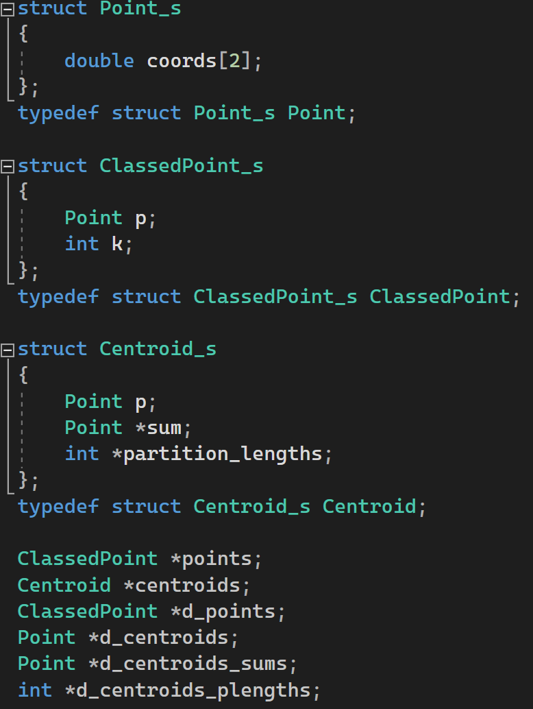
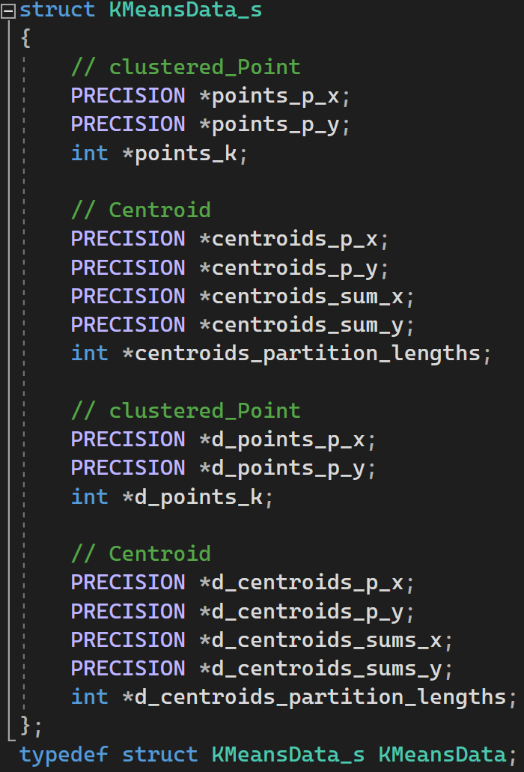
Global Memory access pattern optimization
Array of structs
Struct of arrays
Struct of arrays optimizes memory access patterns: data is adjacent for threads in a warp, which translates into fewer memory accesses

Slide 27
CPU vs GPU

