Slide 1
Large-Scale and Multi-Structured Databases Project Design Fresh Potatoes
Fabio Piras
Giacomo Volpi
Guillaume Quint

Slide 2
Application Highlights
Fresh Potatoes is a hub to find information and reviews about movies written by everyone, from press & top critics to your average Joe:
Movie pages show details and basic information about the film like: - plot summary - date of distribution - cast and crew with relative roles - a general critic consensus - votes of the critics and of the public
Register user are divided between normal one and top critics
Top critics can write “top critic review”
Normal uses can follow top critic to keep track with their liking
Normal user can write reviews too
Guess user can also view movies details and read their review
The system highlights the top critic reviews when showing movies details

Slide 3
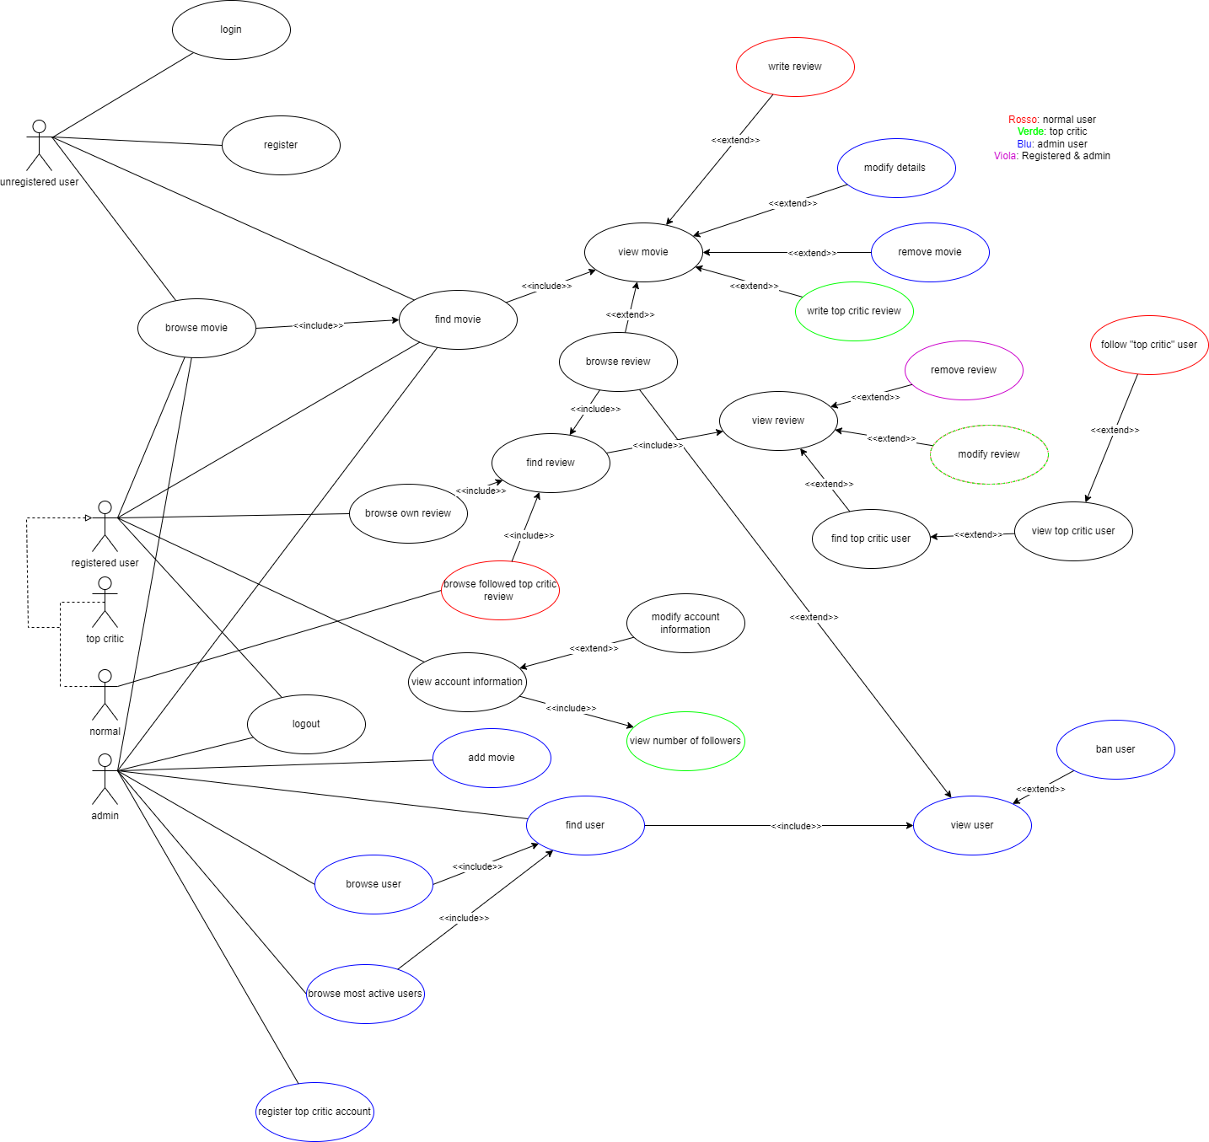
Actors and main supported functionalities

Slide 4
Dataset Description
Source: Rotten Tomatoes (Kaggle) and IMDB (IMDB)
Description: From IMDB dataset -> basic information about the movies like the title, the cast and crew with roles, the year of release, the runtime and the production houses. From Rotten Tomatoes -> reviews and scores for the movies divided between top critics and audience.
Volume: ~174MB
Variety: IMDB’s dataset used to retrieve information about the films and Rotten Tomatoes’ one used to obtain the reviews about the movies

Slide 5
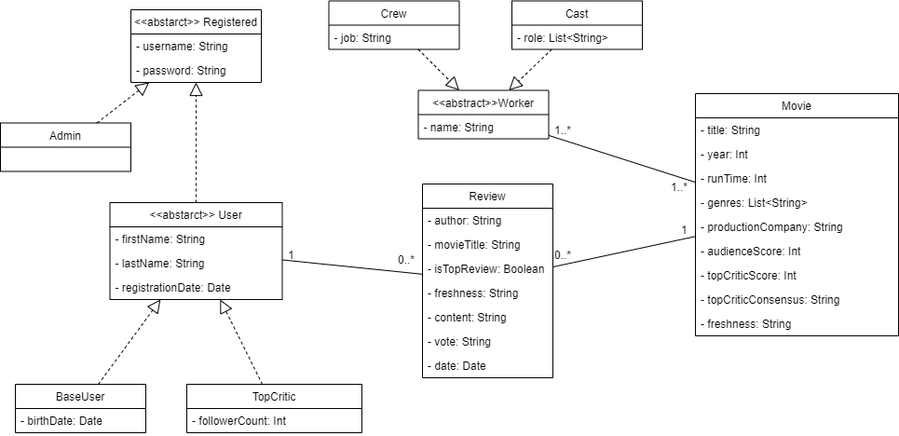
Preliminary UML Class Diagram

Slide 6
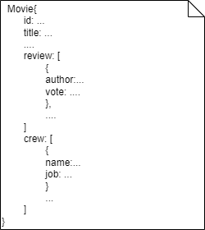
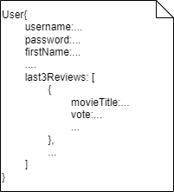
Requirements and Entities handled by Document DB
Entities: Movie, User
Queries:
Most positive reviewed movies for each genres
Most positive reviewed movies for each year
Most divisive movies
Most positive reviewed movies in a timeframe
Most active users in terms of review

Slide 7
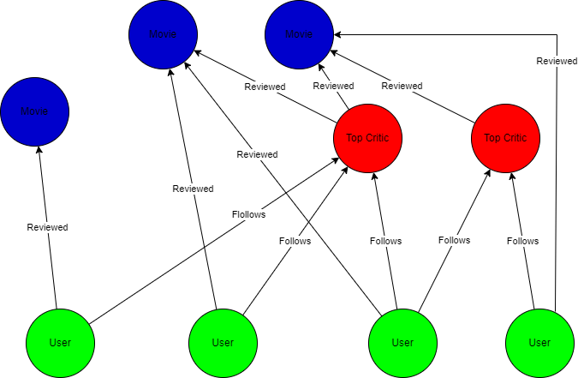
Requirements and Entities handled by Graph DB
Entities:
User
Movie
TopCritic
Queries:
Most followed top critic
Affinity with followed top critic

Slide 8
Software Architecture Preliminary Idea TO FINISH
Include also the frameworks and tools that the group would like to use (programming languages, DBMSs, etc..)
Programming languages:
Python
DBMS:
MongoDB
Neo4j
Tools for data analysis and preparation of the dataset:
Google Colab
Pandas library
Microsoft Excel

