Slide 1
Large-Scale and Multi-Structured Databases Project Design Rotten Movies
Fabio Piras
Giacomo Volpi
Guillaume Quint

Slide 2
Application Highlights
Rotten Movies is a hub to find information and reviews about movies written by everyone, from press and top critics to any movie enthusiast:
Movie pages show details and basic information about the film like: - plot summary - date of distribution - cast and crew members with relative roles - a general critic consensus - votes from the critics and from the public
Registered users are divided between normal and top critics
Top critics can write a “top critic review”
Normal users can follow top critic to keep track with their liking
New reviews are shown in a personal feed timeline
Normal users can write reviews too
Guest users can also view movie details and read their reviews
The system highlights the top critic reviews when showing movies details

Slide 3
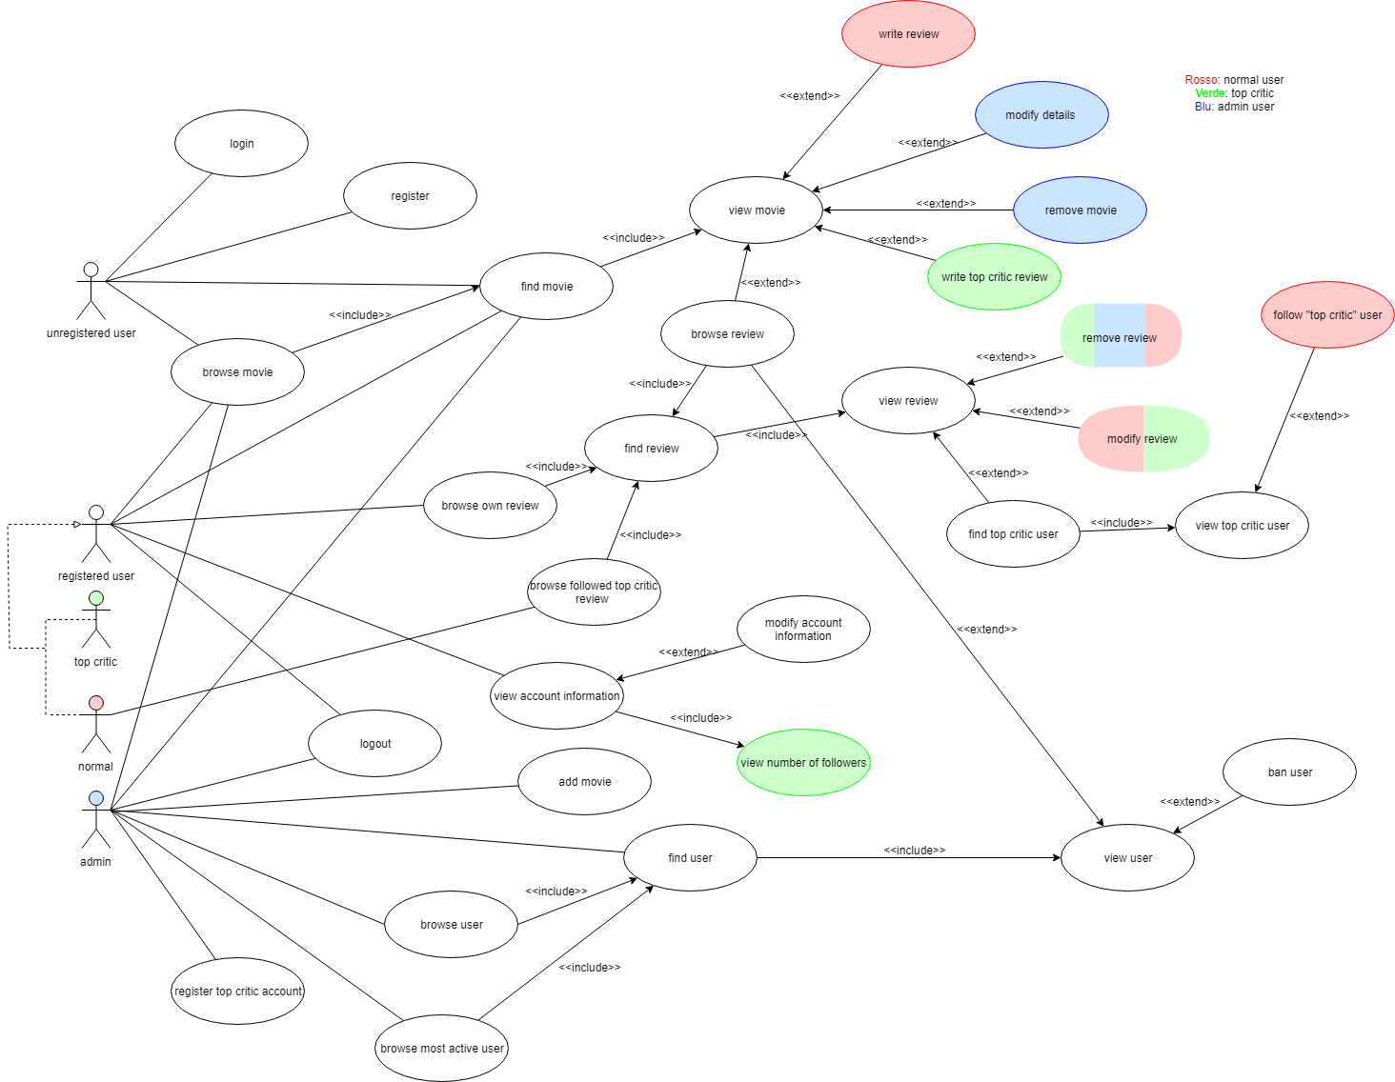
Actors and main supported functionalities

Slide 4
Dataset Description
Source:
Rotten Tomatoes (Kaggle) https://www.kaggle.com/datasets/stefanoleone992/rotten-tomatoes-movies-and-critic-reviews-dataset
IMDB (IMDB) https://datasets.imdbws.com/
RandomUser https://randomuser.me/
Description:
From IMDB dataset
basic information about movies like title, cast and crew with roles, year of release, runtime and production houses
From Rotten Tomatoes dataset
reviews and ratings for movies divided between top critics and audience
Volume: ~260MB (+ generated user info)
Variety: IMDB’s dataset is used to retrieve information about films and Rotten Tomatoes’ is used to obtain the reviews about movies

Slide 5
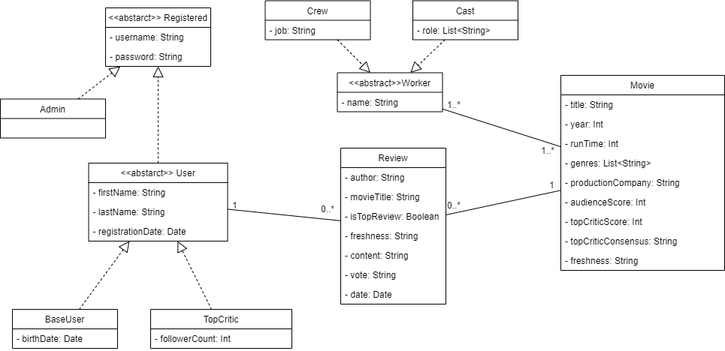
Preliminary UML Class Diagram

Slide 6
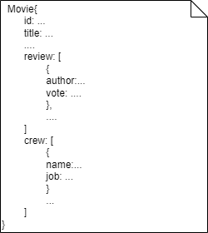
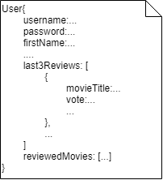
Requirements and Entities handled by Document DB
Entities: Movie, User
Queries:
Most positive reviewed movies for each genre
Most positive reviewed movies for each year
Most divisive movies
Most active users in terms of reviews

Slide 7
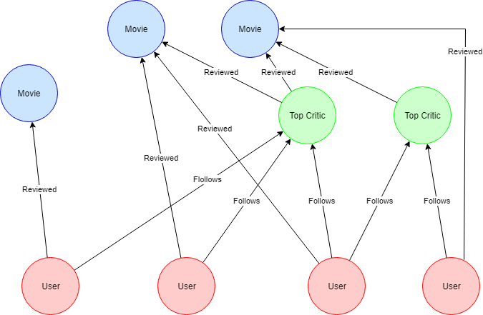
Requirements and Entities handled by Graph DB
Entities:
User
Movie
TopCritic
Queries:
Most followed top critics
Last reviews of followed top critics
Suggest critics to follow based on affinity

Slide 8
Software Architecture Preliminary Idea
Programming languages and frameworks:
Python for data scraping and cleaning
Java for application logic
(Java Spring and JSP for web gui)
DBMS:
MongoDB
Neo4j
Tools for data analysis and preparation of the dataset:
Google Colab
Pandas library
Microsoft Excel

