Slide 1
Large-Scale and Multi-Structured Databases Project Design Rotten Movies
Fabio Piras
Giacomo Volpi
Guillaume Quint
Notes:
hi everyone!
our project is called Rotten Movies.
It takes inspiration from Rotten Tomatoes

Slide 2
Application Highlights
Rotten Movies is a hub to find information and reviews about movies written by everyone, from press and top critics to any movie enthusiast:
Movie pages show details and basic information about the film like: - plot summary - date of distribution - cast and crew members with relative roles - a general critic consensus - votes from the critics and from the public
Registered users are divided between normal and top critics
Top critics can write a “top critic review”
Normal users can follow top critic to keep track with their liking
New reviews are shown in a personal feed timeline
Normal users can write reviews too
Guest users can also view movie details and read their reviews
The system highlights the top critic reviews when showing movies details
Notes:
For those that don't know it, it's a platform where users can read and write reviews about the latest movies.
So, our application should allow unregistered users to browse movies and see their details, like plot, genre, cast.. and read all the associated reviews.
Those reviews come from other registered users or top critic reviewers and the aggregated general rating is kept separated between these two groups, in order to highlight possible alignments or disagreements between top critics and the audience.
Registered users can "follow" a top critic reviewer that they find interesting to keep track with their recent updates: this is because all recent reviews written by followed top critic appear in a feed timeline of a registered user.

Slide 3
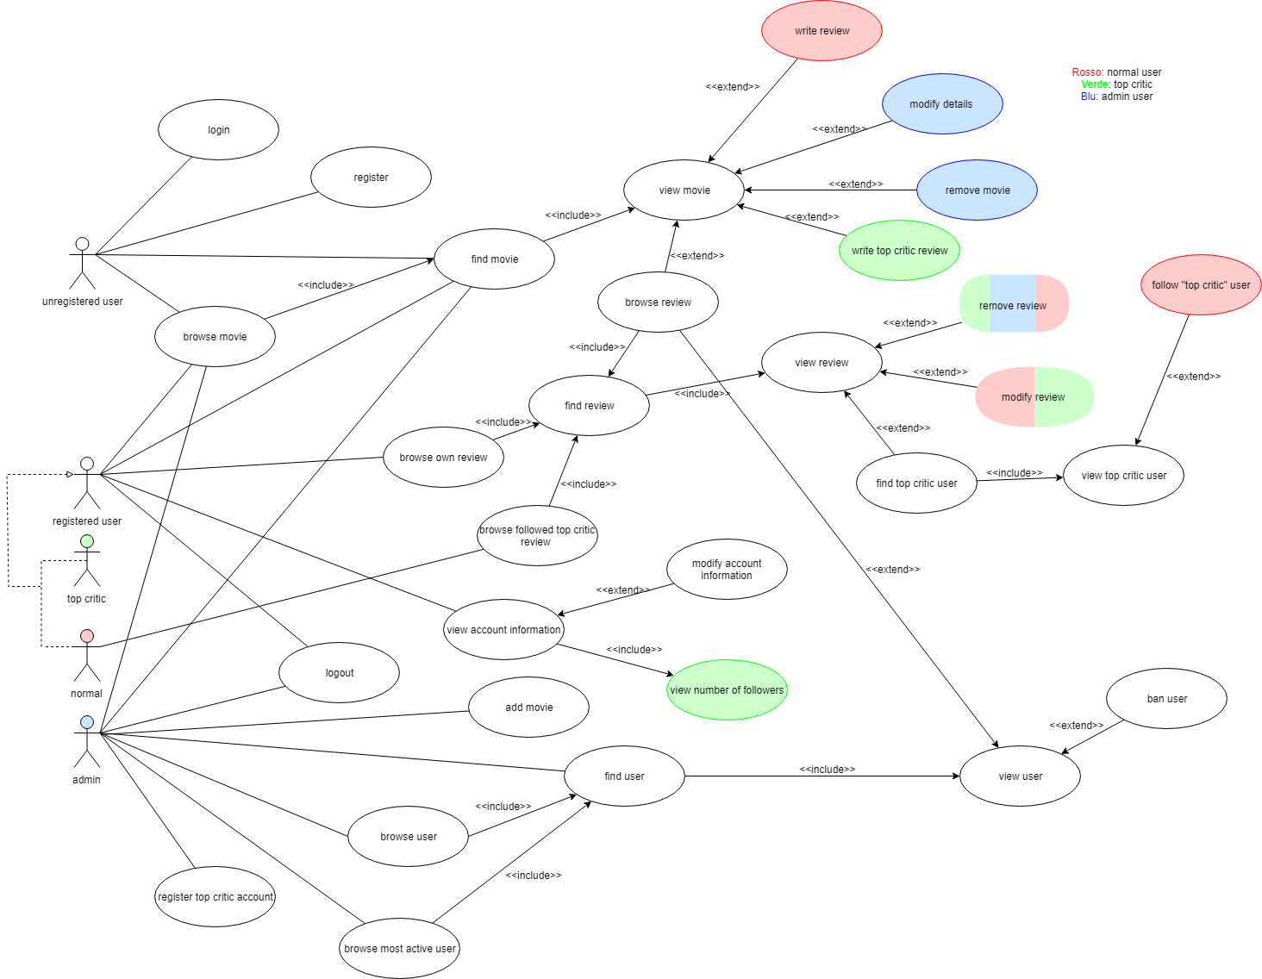
Actors and main supported functionalities
Notes:
This is the general use case diagram.
It is a simplifyied version: the final one that we'll present at the exam may include some additional use case that we didn't include here for readability, but all major use cases of the application are already present.
We can clearly see that we have 4 main actors, 2 of which are derived from a common abstract parent class.
Those are:
- the unregistered user
- that can only browse movies and read reviews
- and hopefully may register or login to the platform so that it becomes a..
- registered user
- that can also leave reviews of a selected movie
- and follow top critic reviewers, so that it can see their recent reviews in its timeline.
- We also have a top critic account that is a special type of registered user
- whose reviews get highlighted.
- It can also be followed by normal users but it can't follow back other users nor top critics.
- Here we added a simple analytic for top critic users about their follower count.
- Finally we have an admin user
- whose job consists in adding, removing and modifying movies and their details.
- It can also ban users or eliminate reviews they find inappropriate.
- They're responsible for creating new top critic accounts for verified reviewers that requested it.
- They also have access to some global analytic for the application: like the list of the most active accounts

Slide 4
Dataset Description
Source:
Rotten Tomatoes (Kaggle) https://www.kaggle.com/datasets/stefanoleone992/rotten-tomatoes-movies-and-critic-reviews-dataset
IMDB (IMDB) https://datasets.imdbws.com/
RandomUser https://randomuser.me/
Description:
From IMDB dataset
basic information about movies like title, cast and crew with roles, year of release, runtime and production houses
From Rotten Tomatoes dataset
reviews and ratings for movies divided between top critics and audience
Volume: ~260MB (+ generated user info)
Variety: IMDB’s dataset is used to retrieve information about films and Rotten Tomatoes’ is used to obtain the reviews about movies
Notes:
Our dataset merges information from 3 different primary sources:
- first one is IMDB for everything related to movies and their cast,
- then we tried to overlap it with reviews found on Rotten Tomatoes,
- finally users informations have been randomly generated starting from usernames found in the reviews.
Volume exceeds the 250MB, excluding the generated user information, and with the different data sources we tried to comply to the variety requirement of the assignment.

Slide 5
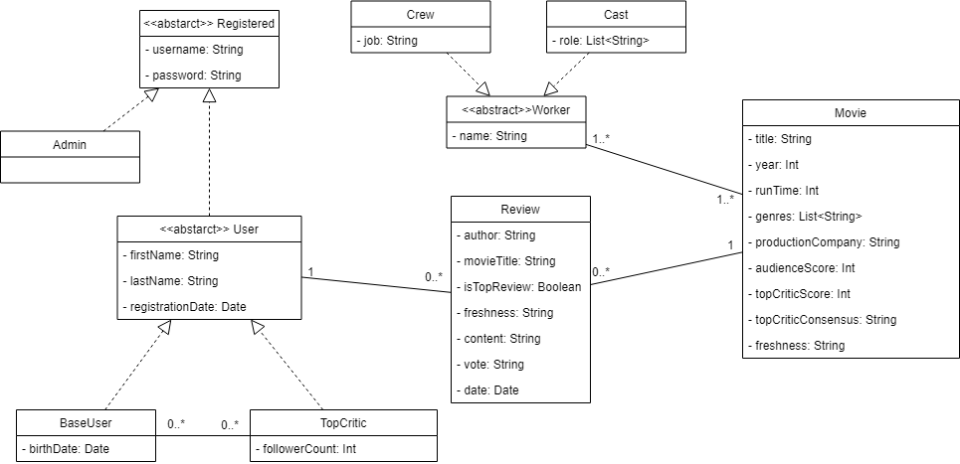
Preliminary UML Class Diagram
Notes:
This's the preliminary UML Class Diagram, where we highlighted the most important fields for each class and their relationships with each other.
We can also see the abstract classes from which are derived the concrete implementations that will be used.

Slide 6
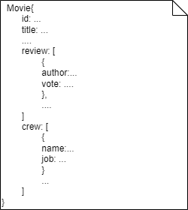
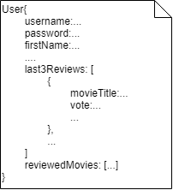
Requirements and Entities handled by Document DB
Entities: Movie, User, Review, Worker
Queries:
Most positive reviewed movies for each genre/year
Best production houses
Most divisive movies between audience and top critic
Most active users in terms of reviews
Notes:
Here we can see the 2 main collections used in the document db.
We implemented document embedding for the cast and reviews for each movie
And for each user we have document linking for their reviewed movies
We also implemented a redundancy for the last 3 reviews of a user, that are directly emebedded whithin its document.
This is to reduce database computational load each time a user wants to read its recent reviews, which is much more likely to happen instead of retrieving all of them.
We also present some interesting queries that can be performed on the docuemnt db:
- for each genre or each year we can retrieve the most positive or negative reviewed movie
- or, as said previously, the movies with the most aligned or disagreements between top critics and audiance
- and also, for the administrator, the list of most active users in terms of reviews

Slide 7
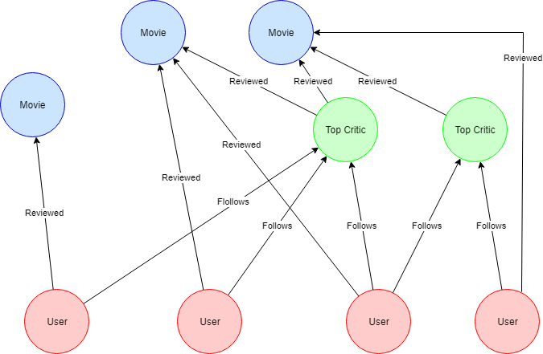
Requirements and Entities handled by Graph DB
Entities:
User
Movie
TopCritic
Queries:
Most followed top critics
Last reviewed movies of followed top critics
Suggest critics to follow based on affinity
Notes:
In the graph DB we have decided to have three entities: User, Top Critic and Movie.
Every registered user is linked to the movies that they have reviewed, the link contains the raiting and a preview of the entire review
In addition each normal user is connected to the top critics that they follow to keep track with their thinking.
We also present some interesting queries that can be performed on the graph db:
- find the most followed top critics
- find the last reviews of all top critics followed by a particular user to build their feed
- suggesting a not already followed top critics based upon the affinity calculated by confronting ratings on movies revied by both

Slide 8
Software Architecture Preliminary Idea
Programming languages and frameworks:
Python for data scraping and cleaning
Java for application logic
(Java Spring and JSP for web gui)
DBMS:
MongoDB
Neo4j
Tools for data analysis and preparation of the dataset:
Google Colab
Pandas library
Microsoft Excel
Notes:
Our idea for the implementation of the software is to use Python for data scraping and cleaning and to use Java to create the application logic.
The DBMS we intent to use for this project are mongoDB and Neo4j
and here are other tools used during the initial stage of development

