Slide 1
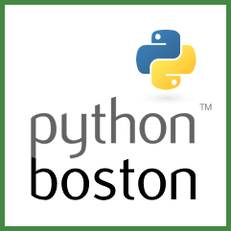
NumPy
For Beginners
Prepared for:
Boston Python User Group https://about.bostonpython.com/
Teach to Learn Data Science Study Group Series.
Glenn Lehman
https://www.linkedin.com/in/glenndlehman/
Notes:
Welcome Everyone

Slide 2

Who is Glenn? A Few Weird Things to Know
Working in programing since 1984
Been to the north pole on a nuclear sub
Familiar with SQL, VB, and Python
Fun project - EZ Pass, Bill Payment Processing
Spent a good amount of time cleaning data and designing data structures
Finally in college to get a degree
4 kids x 4 grandkids

Slide 3
Agenda
What is NumPy (overview and where does it fit in to Data Science)
Installing NumPy (pip and conda)
Difference between Python List and NumPy Array
Creating Arrays (Vector and Matrix)
Reshaping, Resizing, Indexing, and Slicing
Simple Math
Linear Regression Analysis (Start)
Review Additional Resources
Questions

Slide 4
What is NumPy
NumPy is the fundamental package for scientific computing in Python.
Provides a multidimensional array object, various derived objects (such as masked arrays and matrices), and an assortment of routines for fast operations on arrays
A growing plethora of scientific and mathematical Python-based packages are using NumPy arrays.
FAST - Vectorized code
Notes:
including mathematical, logical, shape manipulation, sorting, selecting, I/O, discrete Fourier transforms, basic linear algebra, basic statistical operations, random simulation and much more.
A growing plethora of scientific and mathematical Python-based packages are using NumPy arrays; though these typically support Python-sequence input, they convert such input to NumPy arrays prior to processing, and they often output NumPy arrays. In other words, in order to efficiently use much (perhaps even most) of today’s scientific/mathematical Python-based software, just knowing how to use Python’s built-in sequence types is insufficient - one also needs to know how to use NumPy arrays.
https://medium.com/analytics-vidhya/understanding-vectorization-in-numpy-and-pandas-188b6ebc5398

Slide 5
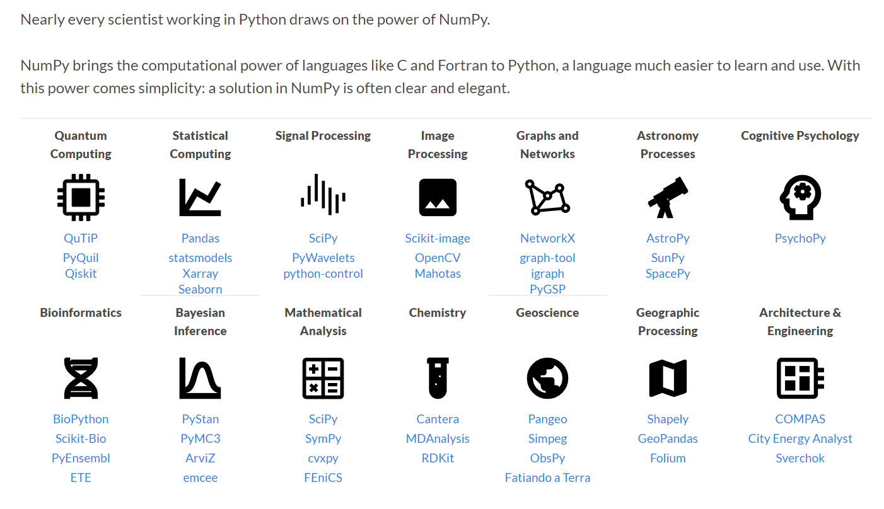
Numpy in the World of Data Science

Slide 6
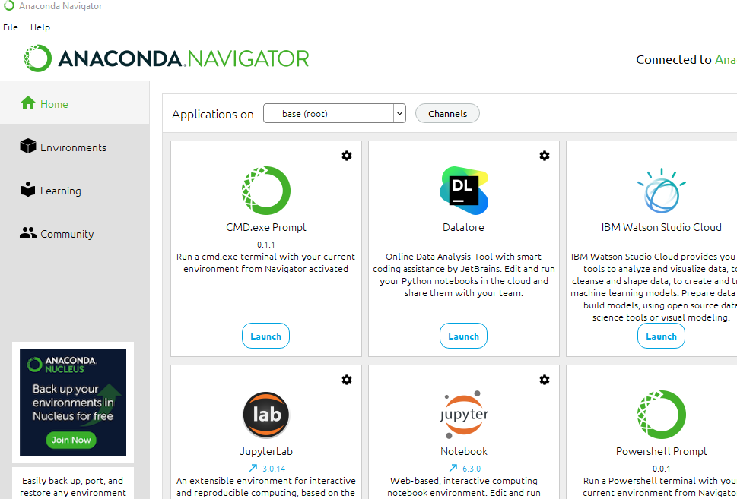
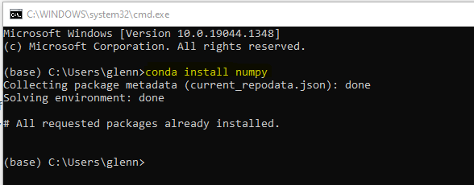
Numpy Install
Launch Anaconda Navigator
Launch CMD.exe Prompt
Create your virtual environment
Enter command:
conda install numpy
Notes:
If you use conda, you can install NumPy from the defaults or conda-forge channels:
# Best practice, use an environment rather than install in the base env
conda create -n my-env
conda activate my-env
# If you want to install from conda-forge
conda config --env --add channels conda-forge
# The actual install command
conda install numpy

Slide 7
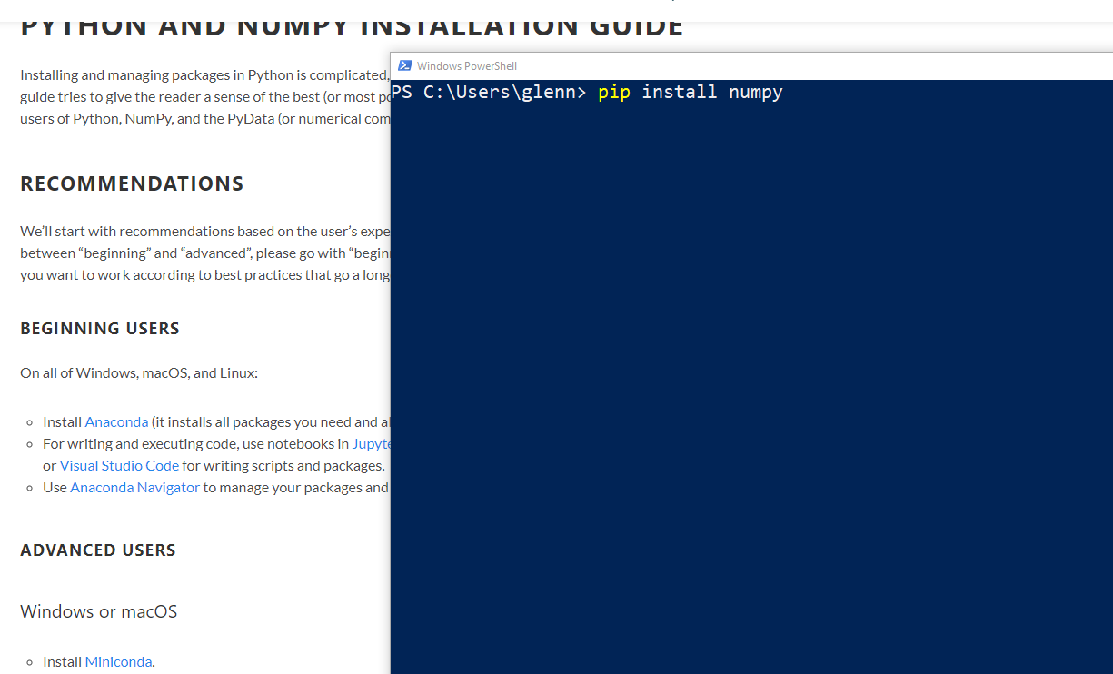
Numpy - Pip Install
From the windows powershell
pip install numpy
Installation for other operating systems and advance options are can be found at:
https://numpy.org/install/

Slide 8
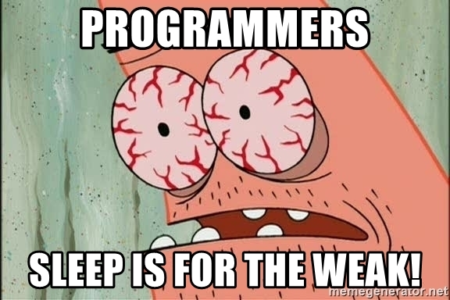
Arrays - Vocabulary Lesson
ndarray | Shorthand for “N-dimensional array.” An N-dimensional array is simply an array with any number of dimensions
1-D | One-dimensional array
2-D | Two-dimensional array (And so on)
Vector | One-dimensional array
Matrix | Two-dimensional array
Tensor | 3-D or Higher
Axis | A specific dimension in the array
Shape | Tuple of non negative integers specify the size of each dimension.
Attribute List:
https://numpy.org/doc/stable/reference/arrays.ndarray.html#arrays-ndarray

Slide 9
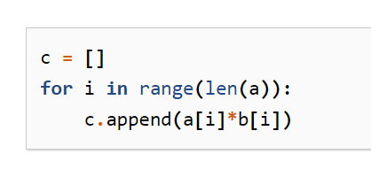
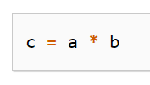
Python List vs Numpy Array
Python List
Grow dynamically
Multiple data types
Numpy Array
Fixed size at creation
Same data type (same size in memory)*
Facilitate advanced mathematical on large numbers of data (Less code execute more efficiently)
Example
Notes:
* one can have arrays of (Python, including NumPy) objects, thereby allowing for arrays of different sized elements
Consider a loop with 1,000,000 items in the List.
Why so Fast
vectorized code is more concise and easier to read
fewer lines of code generally means fewer bugs
the code more closely resembles standard mathematical notation (making it easier, typically, to correctly code mathematical constructs)
vectorization results in more “Pythonic” code. Without vectorization, our code would be littered with inefficient and difficult to read for loops.

Slide 10
Real Code Examples
Why stop here?
Finally!!

Slide 11
References and Resources
NumPy
NumPy: https://numpy.org/
NumPy API Reference: https://numpy.org/doc/stable/reference/index.html
NumPy Cheat Sheet: https://towardsdatascience.com/numpy-cheat-sheet-4e3858d0ff0e
NumPy Illustrated: The Visual Guide to NumPy: https://betterprogramming.pub/numpy-illustrated-the-visual-guide-to-numpy-3b1d4976de1d
Introduction to Numerical Computing with NumPy | SciPy 2019 Tutorial: https://www.youtube.com/watch?v=ZB7BZMhfPgk
Pure Python vs NumPy vs TensorFlow Performance Comparison: https://realpython.com/numpy-tensorflow-performance/
Real Python Tutorial: Your First Steps Into Data Science in Python https://realpython.com/numpy-tutorial/
Numpy Full Course: https://youtu.be/j31ah5Qa4QI
Statistics
StatQuest (Josh Starmer): https://statquest.org/
Stats 101 (Brandon Foltz): https://www.bcfoltz.com/blog/

Slide 12

Questions?

