Slide 1
Allocation of river gauges on CaMa-Flood
GRDC gauge allocation data is include as default. GRDC_alloc.txt in CaMa-Flood package.
<Basic strategy>
If possible, please allocate gauges on high-resolution river map (1min or 3sec),
rather than allocating directly to coarse-resolution (e.g. 6min or 15min) map.
- In order to increase re-usability of the gauge allocation data. (e.g. when map is updated)
- Also, sub-grid characteristics is important both for discharge and water level.
Please share your work when you have a new observation data for CaMa validation.
- We’d better to avoid overlap.
<Existing Tools & Ongoing works>
A package to allocate river gauges (with lat, lon, uparea information) is prepared. [Yamazaki]
Now it can be downloaded from CaMa-Flood webpage.
A procedure to allocate satellite altimetry (with lat, lon info) is being developed by Menaka.
A system to evaluate/benchmark CaMa-Flood simulation is being developed by Xudong.

Slide 2
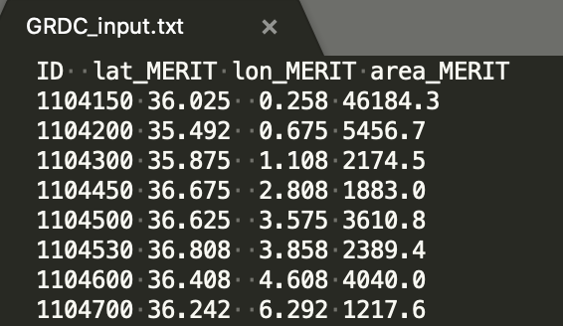
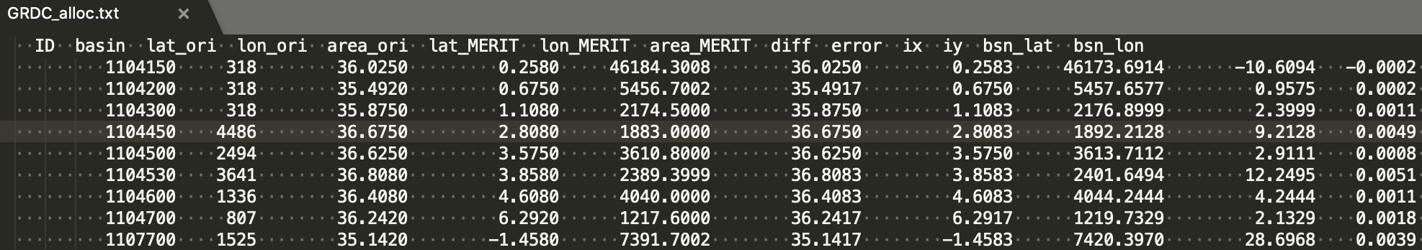
Allocation of river gauges on CaMa-Flood
<River gauge allocation>
If you have gauge data (with lat, lon, uparea info),gauge allocation package can be used.
http://hydro.iis.u-tokyo.ac.jp/~yamadai/cama-flood/distribute/AllocGauge_1min_v405.tar.gz
Step-1: Allocate river gauge (with Lat, Lon, Uparea) onto 1minute river map.
→ Codes for automatic allocation available in the package.
Quality assessment is recommended after automatic allocation.
Step-2: Allocate gauges on CaMa-Flood river map:
→ Step-1 output is used to allocate gauges on CaMa-Flood river map. Sub-grid characteristics is considered.
Step-1 Input Data
Step-1 Output Data

Slide 3
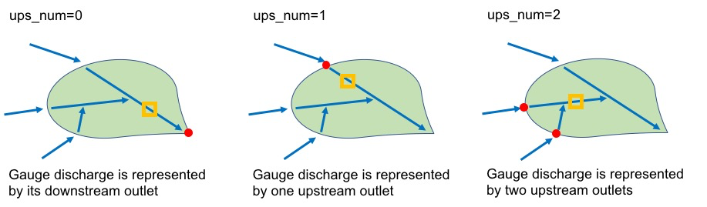
Allocation of river gauges on CaMa-Flood
<Sub-grid Characteristics for discharge evaluation>
Corresponding grid(s) to a river discharge gauge depends on the sub-grid gauge location. It can be
Downstream of gauge
Direct upstream of gauge
Multiple upstream of gauges.
Allocation code (in map/src/src_param/) considers this sub-grid characteristics.

Slide 4
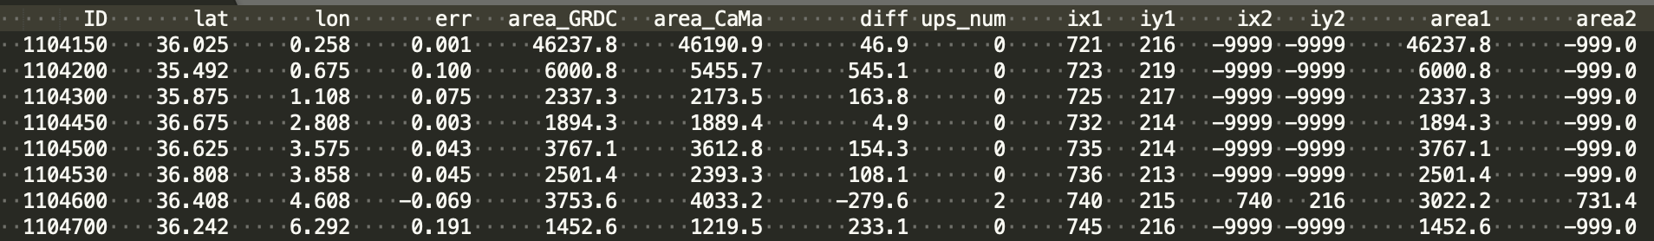
Step-2 Output Data (allocation on MERIT Hydro map)
- Multiple upstream grids can be corresponding.
- Note: (ix,iy) coordinate is for Fortran grid id. For python grid id, you should extract -1.

