Slide 1
Smart Traffic Grid
The Resistars
Lingjun Gao
Zhifeng He
Robert Skelton
Kefan Xiao
Yi Xu
Xuyu Wang

Slide 2
STREETS MONITORED
Busiest intersections in Auburn
Traffic at Toomer’s Corner
Traffic and Gay and Magnolia (Hamilton’s)
auburnalabama.org/mvc/cams/City-Cameras/Toomer's-Corner
auburnalabama.org/mvc/cams/City-Cameras/Gay-and-Magnolia

Slide 3
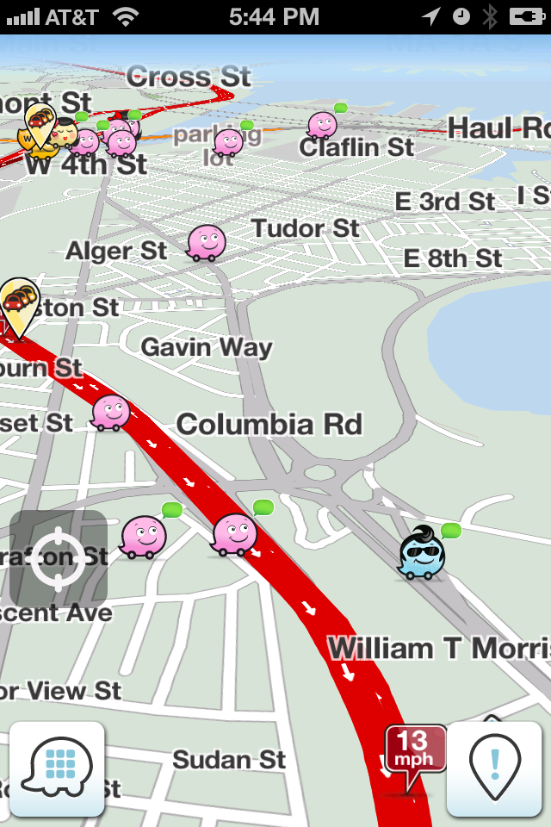
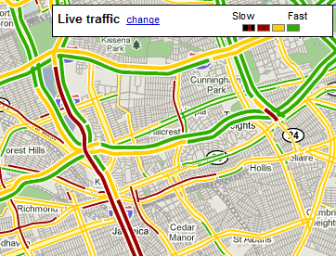
Existing solution issues
Google Maps / Waze
Rely on user’s GPS

Slide 4
Image processing algorithm
Motion Detection
Retrieve statistics on the cars in the intersection
Train thresholds to decide what the traffic situation is

Slide 5
Data from image processing

Slide 6
Overall setup
Bash script to download video feed
Traffic algorithm processes the video
Sends calculated number to database
Database is queried by JSP server
Frontend plots numbers with colors using Google Maps API

Slide 7
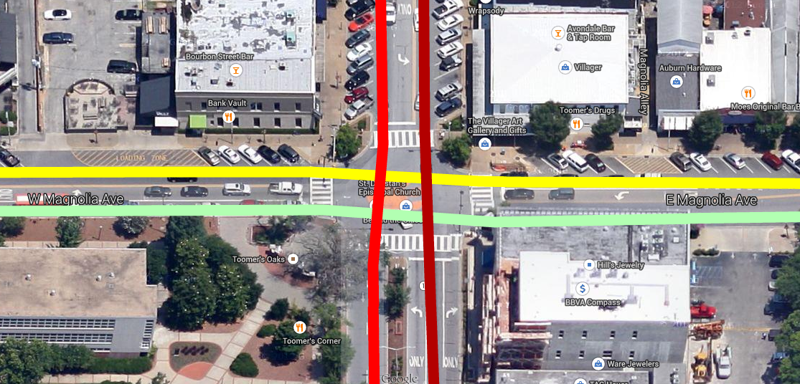

Implementation

Slide 8
limitations
Viewing angle of cameras
Algorithms need to be redesigned for every intersection

