Slide 1


Introduction to C++ Programming

Slide 2
OBJECTIVES
In this lecture you will learn:
To write simple computer programs in C++.
To write simple input and output statements.
To use fundamental types.
Basic computer memory concepts.

Slide 3
Introduction
C++ Programming
  Facilitates disciplined approach to computer program design
  Programs process information and display results
Examples Demonstrate
  How to display messages
  How to obtain information from the user

Slide 4
First Program in C++: Printing a Line of Text
Simple Program
  Prints a line of text
  Illustrates several important features of C++

Slide 5
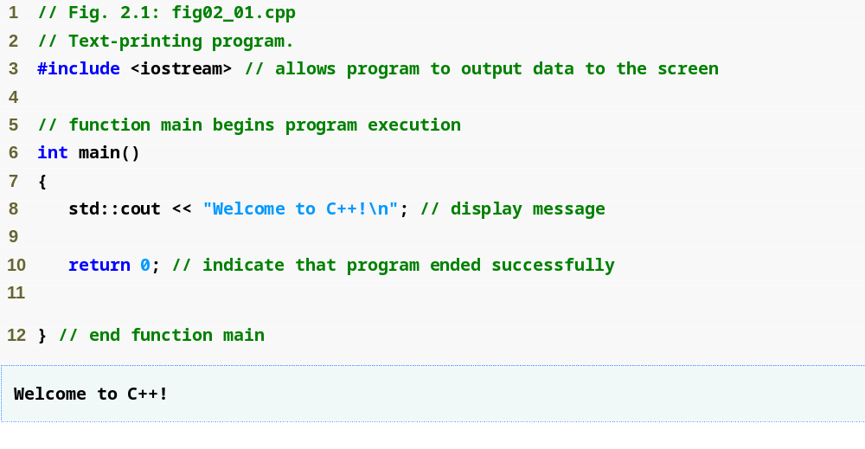
Outline
Single-line comments
Function main returns an integer value
Preprocessor directive to include input/output stream header file <iostream>
Left brace { begins function body
Function main appears exactly once in every C++ program
Statements end with a semicolon ;
fig02_01.cpp
(1 of 1)
fig02_01.cpp
output (1 of 1)
Corresponding right brace } ends function body
Stream insertion operator
Name cout belongs to namespace std
Keyword return is one of several means to exit a function; value 0 indicates that the program terminated successfully

Slide 6
Good Programming Practice
Every program should begin with a comment that describes the purpose of the program, author, date and time.

Slide 7
Common Programming Error
Forgetting to include the <iostream> header file in a program that inputs data from the key­board or outputs data to the screen causes the compiler to issue an error message, because the compiler cannot recognize references to the stream components (e.g. cout).

Slide 8
Common Programming Error
Syntax errors are also called compiler errors, compile-time errors or compilation errors, because the compiler detects them during the compilation phase. You will be unable to execute your program until you correct all the syntax errors in it. As you will see, some compilation errors are not syntax errors.

Slide 9
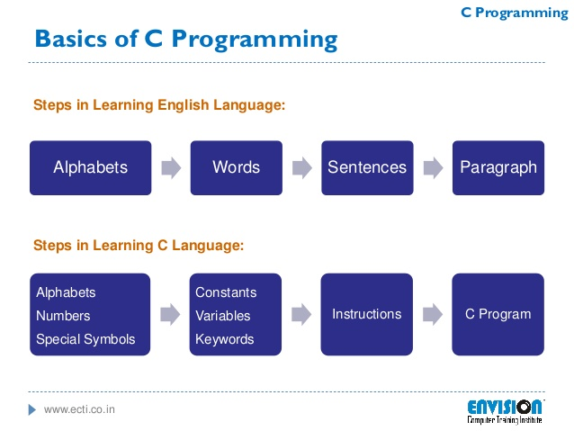

Slide 10
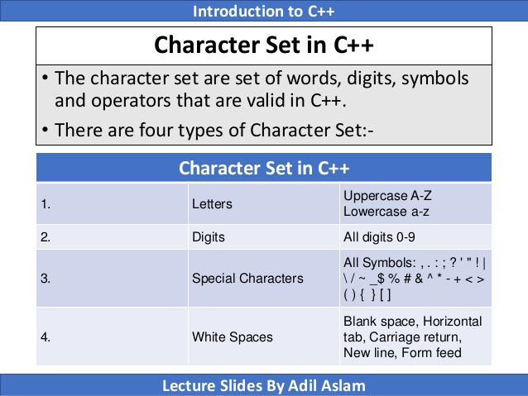

Slide 11
Tokens: The smallest individual units of a program are called tokens.
Constants
Variables
Keywords
Data Types
A C++ program is written using these tokens, white spaces , and the syntax of the language.

Slide 12
Constants , Identifiers and Keywords
The alphabets , numbers and special symbols when properly combined form constants , identifiers and keywords.
Constant: a constant is a quantity that does not change. This can be stored at a location in memory of computer.
Variable(identifiers) : is considered as a name given to the location in memory where this constant is stored. Naturally the contents of the variable can change. There are fundamental requirement of any language. Each language has its own rules for naming these identifiers.

Slide 13
Following are the rules for naming identifiers:
Only alphabetic characters digits and underscores are permitted.
The name cannot start with a digit.
Uppercase and Lowercase letters are distinct
A declared keyword cannot be used as a variable name.
For Example:
3X + Y = 20

Slide 14
Keywords
Keywords implement specific C++ language features.
They are explicitly reserved identifiers and cannot be
used as names for the program variables or other
user defined program elements.

Slide 15
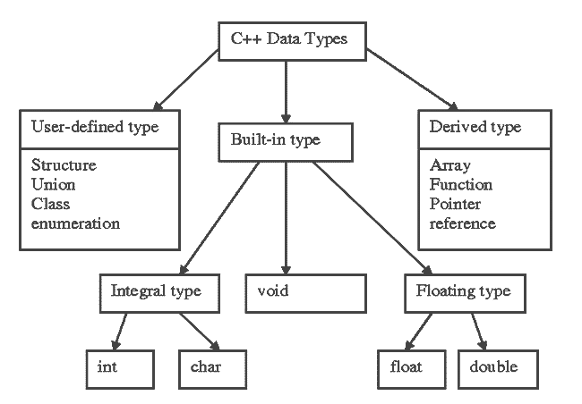

Slide 16

Data Type
Data Type : type of data to be stored in a variable
  Primitive data type (built-in data type): provided as an integral part of the language
    Integer type
    Real type
int val;

Slide 17
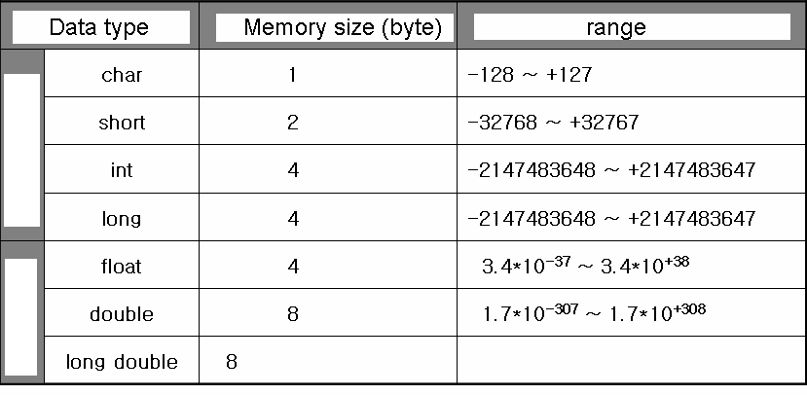
Primitive Data Type
Primitive Type
I
N
T
E
G
E
R
or more
R
E
A
L
or more
big

Slide 18
Primitive Data Type
Why do we need to define the type of data?
  Efficient use of memory space
  Data loss can happen when store big data into small memory space

Slide 19
Primitive Data Type
sizeof operator
  Return memory size of operand in byte
  Need () when the operand is data type
  Otherwise () is optional
#include <iostream>
using namespace std;
int main(void)
{
int val=10;
cout << sizeof val << endl;// print memory size
cout << sizeof(int) << endl;// print int data type
return 0;
}

Slide 20
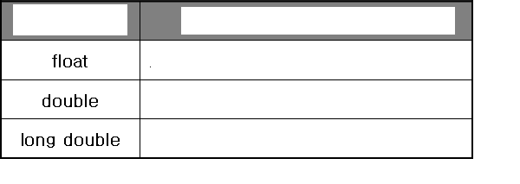
Primitive Data Type
Criteria of selection of data type
  Real type data
    Accuracy
    ‘double’ is common
Data type
Accuracy
6th below decimal point
15th below decimal point
More accurate than double

Slide 21
Primitive Data Type
Example
#include <iostream>
#include <iomanip>
using namespace std;
int main(void)
{
double radius;
double area;
cout << "Input radius of circle" << endl;
cin >> radius;
area = radius * radius * 3.1415;
cout << area;
return 0;
}

Slide 22
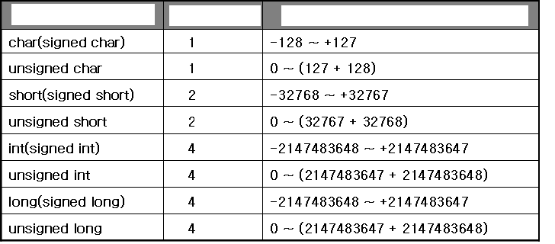
Primitive Data Type
unsigned: the range of data is changed
  Positive integer only
  Can not be used in real data type
Data type
Byte
Range

Slide 23
Primitive Data Type
How to express letter (including characters, notations, …) inside computer?
  ASCII (American Standard Code for Information Interchange) code was born for expressing letters.
  Defined by ANSI (American National Standard Institute)
  The standard of letter expression by computer
  Ex) letter ‘A’ → 65, letter ‘B’ → 66

Slide 24
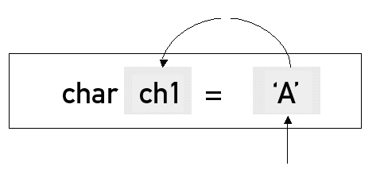
Primitive Data Type
Range of ASCII code
  0 ~ 127, → possible using ‘char’ type
  Declare ‘char’
Expression of letters
  ‘’ (quotation mark)
Change ‘A’ into 65 and store it.
Declare “store letter A into
variable ch1”
Refer ASCII code table

Slide 25
Primitive Data Type
Example
#include <iostream>
using namespace std;
int main(void)
{
char ch1='A';
char ch2=65;
cout << ch1 <<endl << ch2 << endl;
cout << (int)ch1 << endl << (int)ch2 <<endl;
return 0;
}

Slide 26
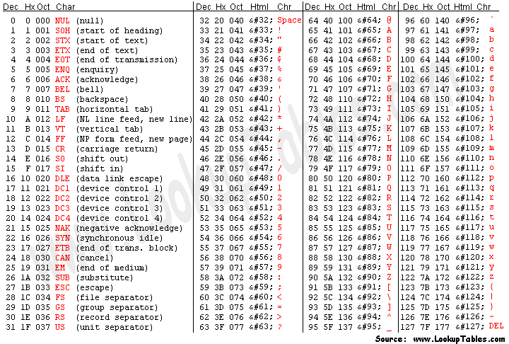
Primitive Data Type
ASCII code

Slide 27
Symbolic Constant
Make ‘variable’ to ‘constant’
#include <iostream>
using namespace std;
int main(void)
{
const int MAX = 100;
const double PI = 3.1415;
return 0;
}

Slide 28
Another C++ Program: Adding Integers
Variables
  Location in memory where value can be stored
  Common data types (fundamental, primitive or built-in)
    int – integer numbers
    char – characters
    double – floating point numbers
  Declare variables with name and data type before use
    int integer1;
    int integer2;
    int sum;

Slide 29
Another C++ Program: Adding Integers (Cont.)
Variables (Cont.)
  Can declare several variables of same type in one declaration
    Comma-separated list
    int integer1, integer2, sum;
  Variable names
    Valid identifier
      Series of characters (letters, digits, underscores)
      Cannot begin with digit
      Case sensitive (upper and lower case letter)
    Keywords

Slide 30
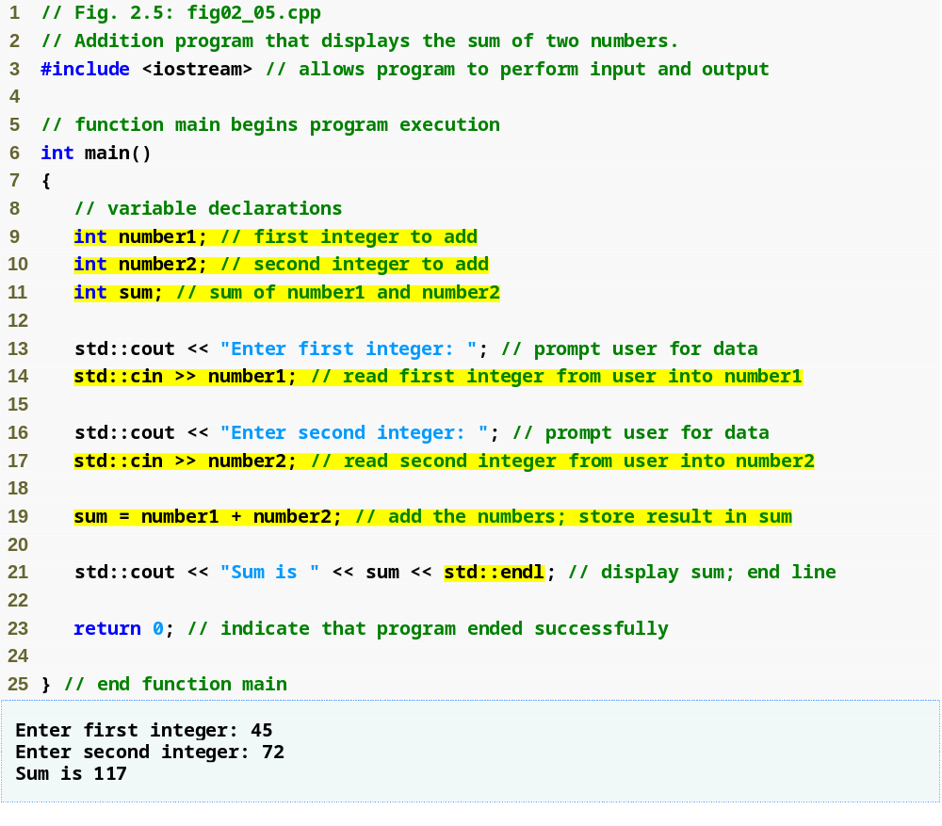
Outline
fig02_05.cpp
(1 of 1)
fig02_05.cpp output (1 of 1)
Declare integer variables
Use stream extraction operator with standard input stream to obtain user input
Stream manipulator std::endl outputs a newline, then “flushes output buffer”
Concatenating, chaining or cascading stream insertion operations

Slide 31
Good Programming Practice
Place a space after each comma (,) to make programs more readable.

Slide 32
Good Programming Practice
Some programmers prefer to declare each variable on a separate line. This format allows for easy insertion of a descriptive comment next to each declaration.

Slide 33
Portability Tip
C++ allows identifiers of any length, but your C++ implementation may impose some restrictions on the length of identifiers. Use identifiers of 31 characters or fewer to ensure portability.

Slide 34
Good Programming Practice
Choosing meaningful identifiers helps make a program self-documenting—a person can understand the program simply by reading it rather than having to refer to manuals or comments.

Slide 35
Good Programming Practice
Always place a blank line between a declaration and adjacent executable statements. This makes the declarations stand out in the program and contributes to program clarity.

Slide 36
Another C++ Program: Adding Integers
Input stream object
  std::cin from <iostream>
    Usually connected to keyboard
    Stream extraction operator >>
      Waits for user to input value, press Enter (Return) key
      Stores value in variable to right of operator
        Converts value to variable data type
    Example
      std::cin >> number1;
        Reads an integer typed at the keyboard
        Stores the integer in variable number1

Slide 37
Another C++ Program: Adding Integers (Cont.)
Assignment operator =
  Assigns value on left to variable on right
  Binary operator (two operands)
  Example:
    sum = variable1 + variable2;
      Add the values of variable1 and variable2
      Store result in sum
Stream manipulator std::endl
  Outputs a newline
  Flushes the output buffer

Slide 38
Another C++ Program: Adding Integers (Cont.)
Concatenating stream insertion operations
  Use multiple stream insertion operators in a single statement
    Stream insertion operation knows how to output each type of data
  Also called chaining or cascading
  Example
    std::cout << "Sum is " << number1 + number2
    << std::endl;
      Outputs "Sum is “
      Then, outputs sum of number1 and number2
      Then, outputs newline and flushes output buffer

Slide 39
Memory Concept
Variable names
  Correspond to actual locations in computer's memory
    Every variable has name, type, size and value
  When new value placed into variable, overwrites old value
    Writing to memory is destructive
  Reading variables from memory nondestructive
  Example
    sum = number1 + number2;
      Value of sum is overwritten
      Values of number1 and number2 remain intact

Slide 40
Fig. 2.6 | Memory location showing the name and value of variable number1.

Slide 41

Fig. 2.7 | Memory locations after storing values for number1 and number2.

Slide 42

Fig. 2.8 | Memory locations after calculating and storing the sum of number1 and number2.

Slide 43
Arithmetic
Arithmetic operators
  *
    Multiplication
  /
    Division
    Integer division truncates remainder
      7 / 5 evaluates to 1
  %
    Modulus operator returns remainder
      7 % 5 evaluates to 2

Slide 44
Common Programming Error
Attempting to use the modulus operator (%) with non integer operands is a compilation error.

Slide 45
Arithmetic (Cont.)
Straight-line form
  Required for arithmetic expressions in C++
  All constants, variables and operators appear in a straight line
Grouping subexpressions
  Parentheses are used in C++ expressions to group subexpressions
    Same manner as in algebraic expressions
  Example
    a * ( b + c )
      Multiple a times the quantity b + c

Slide 46
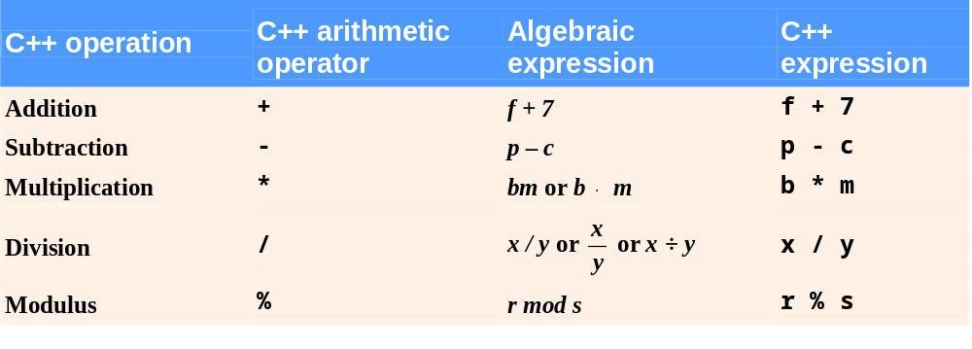
Fig. 2.9 | Arithmetic operators.

Slide 47
2.6 Arithmetic (Cont.)
Rules of operator precedence
  Operators in parentheses evaluated first
    Nested/embedded parentheses
      Operators in innermost pair first
  Multiplication, division, modulus applied next
    Operators applied from left to right
  Addition, subtraction applied last
    Operators applied from left to right

Slide 48
Common Programming Error 2.4
Some programming languages use operators ** or ^ to represent exponentiation. C++ does not support these exponentiation operators; using them for exponentiation results in errors.
Use pow(A, B) = A^B function in C++

Slide 49
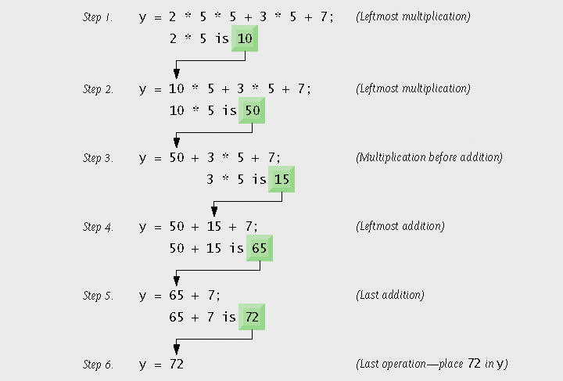
Fig. 2.11 | Order in which a second-degree polynomial is evaluated.

Slide 50
Decision Making: Equality and Relational Operators
Condition
  Expression can be either true or false
  Can be formed using equality or relational operators
if statement
  If condition is true, body of the if statement executes
  If condition is false, body of the if statement does not execute

Slide 51
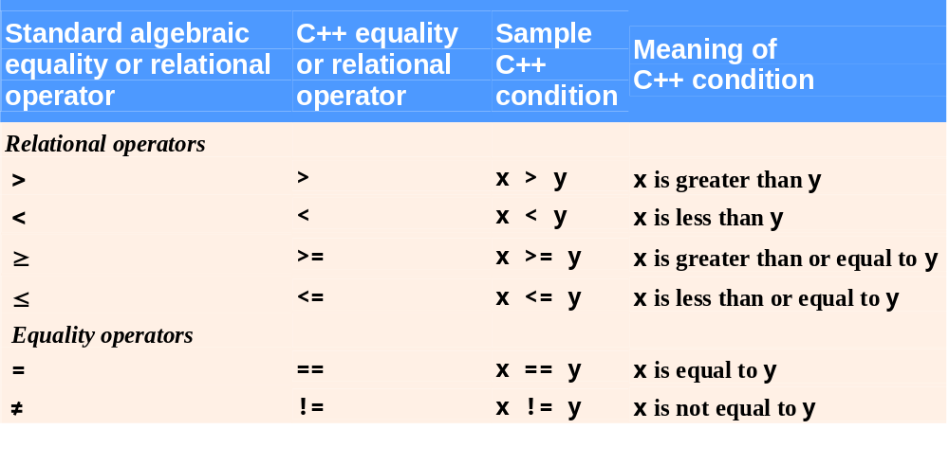
Fig. 2.12 | Equality and relational operators.

Slide 52
Common Programming Error 2.5
A syntax error will occur if any of the operators ==, !=, >= and <= appears with spaces between its pair of symbols.

Slide 53
Common Programming Error
Reversing the order of the pair of symbols in any of the operators !=, >= and <= (by writing them as =!, => and =<, respectively) is normally a syntax error. In some cases, writing != as =! will not be a syntax error, but almost certainly will be a logic error that has an effect at execution time. (cont…)

Slide 54
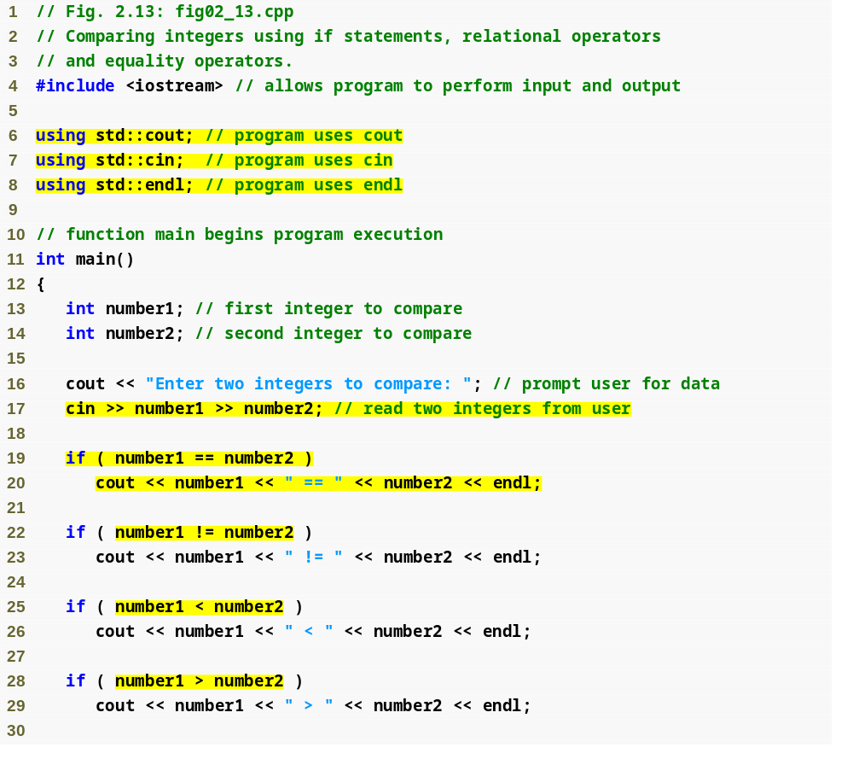
Outline
fig02_13.cpp
(1 of 2)
using declarations eliminate need for std:: prefix
Declare variables
Can write cout and cin without std:: prefix
if statement compares values of number1 and number2 to test for equality
If condition is true (i.e., values are equal), execute this statement
if statement compares values of number1 and number2 to test for inequality
If condition is true (i.e., values are not equal), execute this statement
Compares two numbers using relational operator < and >

Slide 55
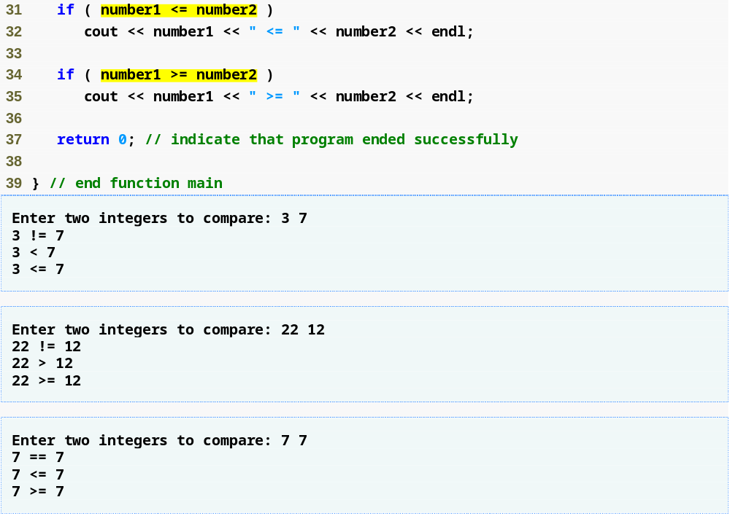
Outline
Compares two numbers using relational operators <= and >=
fig02_13.cpp
(2 of 2)
fig02_13.cpp output (1 of 3)
(2 of 3)
(3 of 3)

Slide 56
Common Programming Error
It is a syntax error to split an identifier by inserting white-space characters (e.g., writing main as ma in).

