Slide 1
Control Structures
Week 4

Slide 2
Objectives
To use the selection structure to choose among the alternative actions
  if selection statement
  Double Selection (if else ) statements
  Nested Selection statements

Slide 3
Control structures
Control structure
  A control statement and the statements whose execution it controls.
  a control statement is any statement that alters the linear flow of control of a program. C++ examples include: if-else, while, for, break, continue and return statement
Sequential execution
  Statements executed in order
Transfer of control
  Next statement to be executed may be other than the next one in sequence.

Slide 4
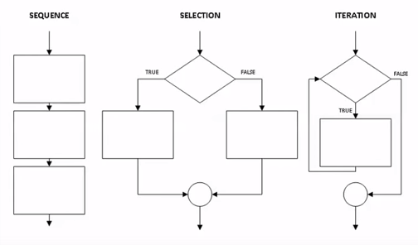
Control structures
Bohm and Jacopini’s control structures
Bohm and Jacopino’s work demonstrate that all programs could be written in terms of only three control structures.
Sequence structures, selection structures and repetition structures.
  Sequence structure
    Built into C++. Programs executed sequentially by default.
  Selection structures
    C++ has three types - if, if/else, and switch
  Repetition structures
    C++ has three types – for, while and do while

Slide 5
Control structures
    if Selection Structure
    Perform an action if condition is true.
    .Skip the action if condition is false.
    If/else Selection Structure
    Perform an action if condition is true.
    Performs a different action if the condition is false.
    switch Selection Structure
    .Perform one of many different actions depending on the value of an integer expression.

Slide 6
Control Structures
  Repetition structures
  Many application require certain operations to be carried out more than once. Such situations require repetition in control flow.
    C++ has three types while, do/while, for
    While selection structure
    . An action to be repeated while some conditions remains true.
    Do/While selection structure
    . Similar to while structure.
    Tests the loop continuation after the loop body is performed.
    while structure the loop continuation condition is tested at the beginning of the loop before the body of loop is performed.

Slide 7
    We are going to discuss if and if/else selection structures and switch first and will explain the repetition structures later. It was just an introduction to these structures.

Slide 8
Decision making structure/ selection structure
Selection structure/decision structure
allows the program to make a decision or comparison and then select one of two paths, depending on the result of the comparison.
Condition
condition is a logical expression that evaluates to true or false. It could be a relational or Boolean expression. In other words
  Specifies the decision you are making
  Must result in either a true or false answer
IF Structure
  One statement or a block of statement enclosed in braces {} i.e. (compound statement), to be processed If condition met otherwise it is skipped.
  Uses equality and relational operators

Slide 9
Equality and Relational operators
  Conditions in if structures can be formed by using the equality and relational operators
  Equality operators
    Same level of precedence
    Associated left to right.
  Relational operators
    Same level of precedence.
    Associated left to right.
Equality operators precedence is lower then precedence of relational operators.

Slide 10
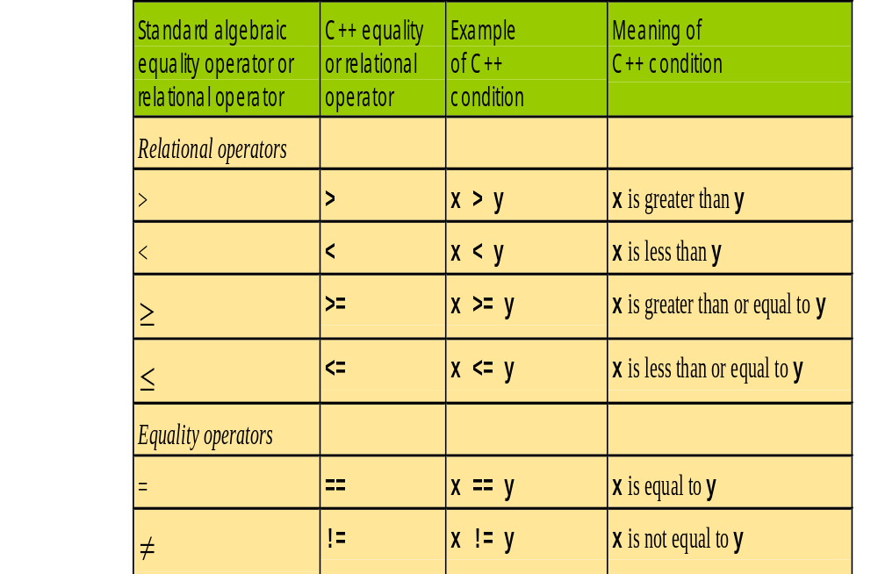
Equality and relational operators

Slide 11
Boolean Expressions
Boolean expressions are expressions that are
either true or false
comparison operators such as '>' (greater than)
are used to compare variables and/or numbers
  (grade >= 60) Including the parentheses, is the
  boolean expression from the grade example
  A few of the comparison operators that use two
  symbols (No spaces allowed between the symbols!)
    > greater than
    != not equal or inequality
    == equal or equivalent
    <= less than or equal to
    etc

Slide 12
If Selection Structure
  The primary C++ selection structure statement used to perform a single-alternative selection.
  Choose among alternative courses of action
  If the condition is true
    statement Print statement executed, program continues to next
  If the condition is false
    Print statement ignored, program continues

Slide 13

Flow chart
  Graphical representation of an algorithm or a portion of algorithm.
  Drawn using certain special-purpose symbols connected by arrows called flow lines.
Special purpose symbols.
Following are some symbols to draw a flow chart and there purpose.
Ovals or rounded rectangles, indicate start or end of the program usually containing the word "Start, begin” or "End“.
Rectangles are action symbols to indicate any type of ACTION, including a calculation or an input output operation.
Diamonds are conditional or decision symbols. It indicates a decision to be made.

Slide 14
Flow chart
Parallelogram are the input/output symbols
Arrows, showing what's called "flow of control“. An arrow coming from one symbol and ending at another symbol represents that control passes to the symbol the arrow points to. Arrows are also called flow lines.

Slide 15
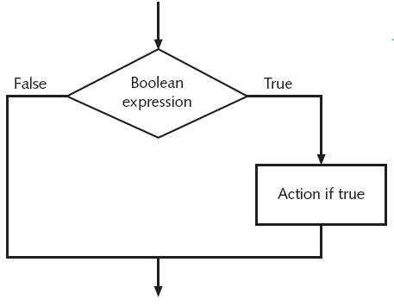
If selection structure flow chart

Slide 16
If selection structure
  example:
Pseudocode
If student’s grade is greater than or equal to 60
      Print “Passed”
C++ code
      if ( grade >= 60 )
      cout << "Passed";

Slide 17
If selection structure
Flow chart for the pseudocode statement.
A decision can be made on any expression.
true
grade >= 60
print “Passed”
false

Slide 18
Example
Example is using the relational and equality operators.
Following example used six if statements to compare two numbers input by the user.
If the condition in any of these if statements is satisfied, the output statement associated with if is executed.
If the condition with the if statement is false the output statement associated with that if statement is skipped.
Observe the different outputs for various inputs at the end of the program.

Slide 19
1 // example
2 // Using if statements, relational
3 // operators, and equality operators
4 #include <iostream.h>
5
6
7
8
9
10 int main()
11 {
12 int num1, num2; // declare variables
13
14 cout << "Enter two integers, and I will tell you\n"
if structure compares values of num1 and num2 to test for equality.
If condition is true (i.e., values are equal), execute this statement.
15 << "the relationships they satisfy: ";
16 cin >> num1 >> num2; // read two integers
17
if structure compares values of num1 and num2 to test for inequality.
If condition is true (i.e., values are not equal), execute this statement.
18 if ( num1 == num2 )
19 cout << num1 << " is equal to " << num2 << endl;
20
If structure compare the values of num1 and num2 to test if num1 is less than num2
21 if ( num1 != num2 )
If condition is true (i.e., num1 is less than num2 ), execute this statement.
22 cout << num1 << " is not equal to " << num2 << endl;
23
if structure compares values of num1 and num2 to test if num1 is greater than num2
24 if ( num1 < num2 )
If condition is true (i.e., num1 is greater than num2 ), execute this statement.
25 cout << num1 << " is less than " << num2 << endl;
26
if structure compares values of num1 and num2 to test if num1 is less than or equal to num2
27 if ( num1 > num2 )
If condition is true (i.e., num1 is less than or equal to num2), execute this statement.
28 cout << num1 << " is greater than " << num2 << endl;
29
30 if ( num1 <= num2 )
31 cout << num1 << " is less than or equal to "
32 << num2 << endl; //continued on next slide
33

Slide 20
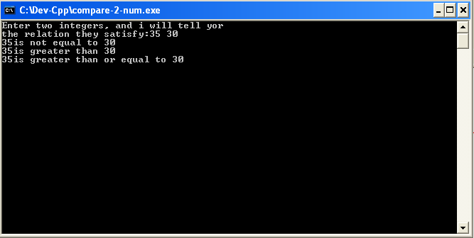

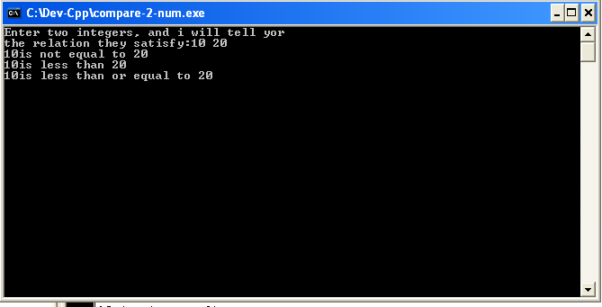
34 if ( num1 >= num2 )
35 cout << num1 << " is greater than or equal to "
36 << num2 << endl;
37
38 return 0; // indicate that program ended successfully
39 }
Input is 35 and 30
Input is 25 and 25
Input is 10 and 20

Slide 21
The if-else statement
The if statement by itself will execute a single statement, or a group of statements , when conditions following if is true.
It does nothing when the conditions is false.
Can we execute one group of statements if the condition is true and another group of statements if the condition is false?
Of course this is what is the purpose of else statement, which is demonstrated in the following example:

Slide 22
Ques: In a company an employee is paid as under:
If his basic salary is less than $1500, then HRA = 10% of basic salary and DA=90% of basic. If his salary is either equal to or above $1500, then HRA = $500 and DA=98% of basic salary. If the employee’s salary is input through keyboard write a program to find his gross salary.

Slide 23
If/else selection structure
  Different actions if conditions true or false
Syntax
A single statement for each alternative
if (Boolean_expression)
yes_statement;
else
no_statement;
A sequence statement for each alternative
if (Boolean_expression)
{ yes_statement1;
yes_statement2;
yes_statement last; }
else
{ no_statement1;
no_statement2;
no_statement last; }

Slide 24
If/else selection structure flow chart
false
Boolean expression
true
Action if false
Action if true

Slide 25
If/else selection structure
Example
Pseudocode
    if student’s grade is greater than or equal to 60
    print “Passed”
    else
    print “Failed”
C++ code
    if ( grade >= 60 )
    cout << "Passed";
    else
    cout << "Failed";

Slide 26
If/else selection structure
Flow chart for the pseudocode
false
true
grade >= 60
print “Failed”
print “Passed”

Slide 27
Compound Statement
Compound statement
  Set of statements within a pair of braces also known as BLOCK
  if ( grade >= 60 )
  cout << "Passed.\n";
  else {
  cout << "Failed.\n";
  cout << "You must take this course again.\n";
  }
  Without braces,
  cout << "You must take this course again.\n";
  always executed

Slide 28
Another simple Example
//program to determine if user is ill
#include <iostream>
using namespace std;
int main()
{
const double NORM = 98.6; // degree Fahranheit;
double temperature;
cout<<"Enter your temperature\t";
cin>>temperature;
if (temperature>NORM) //if temperature is greater than NORM print following statement
cout<<"\n\nYou are sick\n"<<"take rest and drink lots of fluids";
else //if temperature is <= NORM print following statement
cout<<"\n\nYou are perfectly fine";
return 0;
}

Slide 29
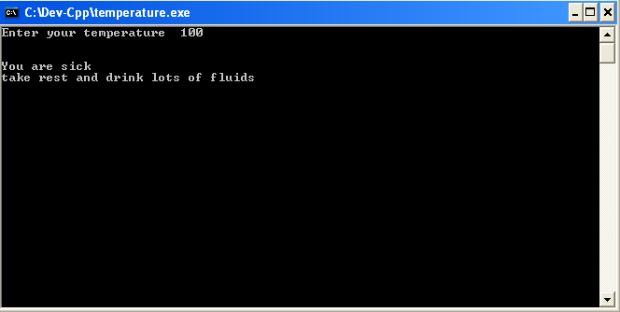

output
Input is 100
100 > NORM
Input is 98
98<NORM

Slide 30
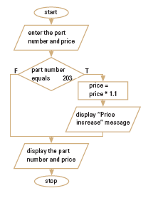
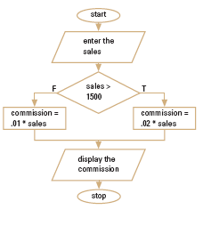
Example of if and if/else selection structure drawn in flow chart form
If selection structure(program 1)
If/else selection structure(program2)

Slide 31
c++ code for the flow chart of if selection structure (program 1).
//program 1
//program to find the part prices for the given part number.
#include<iostream>
using namespace std;
int main()
{
int part_number, ;
float price;
cout<<"enter part number"<<endl;
cin>>part_number;
cout<<"enter price"<<endl;
cin>>price;
if(part_number==203)
price = price*1.1;
cout<<"price is "<<price;
return 0;
}

Slide 32
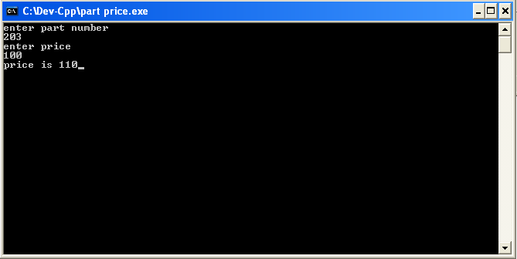
Output of program 1
Part_number is not equal to 203
Part_number is equal to 203

Slide 33
c++ code for the flow chart of if/else selection structure (program 2).
//program to calculate the sales commission
#include <iostream>
using namespace std;
int main()
{
float sales, commission;
cout<<"enter the sales"<<endl;
cin>>sales;
if (sales>1500)
commission = sales*0.2;
else
commission = sales*0.1;
cout<<"commission is"<<commission;
return 0;
}

Slide 34
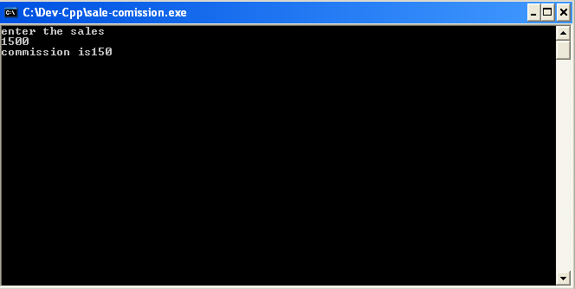
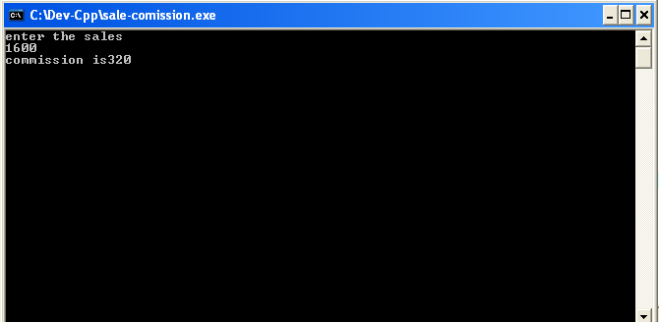
Output of program 2
Sales is 1500
Sales is greater than 1500

Slide 35
Example of if/else
Write a program to calculate the gross pay of an employee.
The employee is paid at his basic hourly rate for the first 40 hours worked during a week. Any hours worked beyond 40 is considered overtime.
overtime is paid at the 1.5 times the hourly rate.
Pseudocode
  If total number of hours >40
    Gross pay = rate*40 + rate*1.5(hours – 40)
  Else
  Gross pay = rate * hours

Slide 36
C++ code
#include <iostream>
using namespace std;
int main()
{
int hour; //declaration
double gross_pay, rate;
cout<<"enter the hourly rate of pay\t"<<endl; //prompt
cin>>rate; //reading data
cout<<"enter the number of hours worked \t"<<endl; //prompt
cin>>hour; //readin data
if(hour>40) //condition if working hours is greater than 40
gross_pay = rate*40 + 1.5*rate*(hour - 40); //gross pay including extra hour
else //if working hour is <=40 then use this formula to get gross pay
gross_pay = rate*hour;
cout<<" Gross pay is \t"<<gross_pay<<endl; //printing the gross pay on screen.
return 0;
}

Slide 37
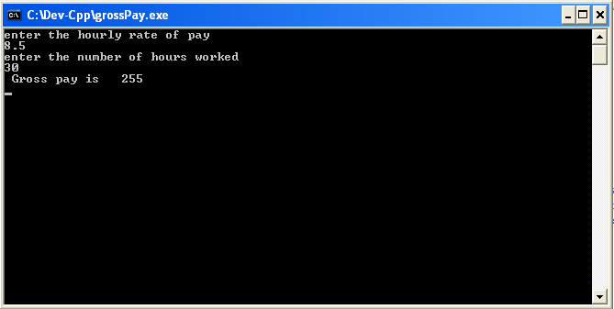

output
Hour<40
Hour>40

Slide 38
Nested if/else structure
if structure that rests entirely within another if structure, within either the if or the else clause
  One inside another, test for multiple cases
  Once condition met, other statements skipped

Slide 39
Simple example to understand the nested if/else
Consider an example of a program segment that accepts a gender code and print gender according to that code.
Pseudocode
if the gender code is F
print female
else
if the gender code is M
print male
else
print invalid code

Slide 40
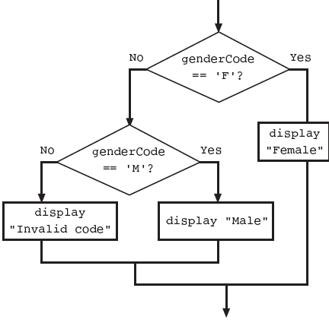
Simple example to understand the nested if/else
Flow chart

Slide 41
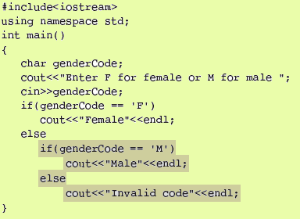
Simple example to understand the nested if/else
C++ code
//F and M are correct codes
//f and m are invalid codes

Slide 42
Nested if/else structure
  following pseudocode is example of nested if/else
  if student’s grade is greater than or equal to 90
  Print “A”
  else
  if student’s grade is greater than or equal to 80
  Print “B”
  else
  if student’s grade is greater than or equal to 70
  Print “C”
  else
  if student’s grade is greater than or equal to 60
  Print “D”
  else
    Print “F”

Slide 43
Nested if/else structure
C++ code
if ( grade >= 90 ) // 90 and above
cout << "A";
else
if ( grade >= 80 ) // 80-89
cout << "B";
else
if ( grade >= 70 ) // 70-79
cout << "C";
else
if ( grade >= 60 ) // 60-69
cout << "D";
else // less than 60
cout << "F";
if grade>=90, first four conditions will be true. But only the cout statement after the first test will be executed. After that cout is executed, the else part of the outer if/else statement is skipped.

Slide 44
Avoiding Common Pitfalls with if Statements
Forgetting that C++ is case sensitive
Assuming that indentation has a logical purpose
Adding an unwanted semicolon
Forgetting curly braces
Using = instead of == (explained with example on next slide)
Making unnecessary comparisons

Slide 45
Confusing Equality (==) and Assignment (=) Operators
L-values
  Expressions that can appear on left side of equation
  Can be changed (I.e., variables)
    x = 4;
R-values
  Only appear on right side of equation
  Constants, such as numbers (i.e. cannot write 4 = x;)
L-values can be used as R-values, but not vice versa

Slide 46
The switch Multiple-Selection Structure
Switch is typically a selection structure and an alternative to the long string of ifs
Tests variables for multiple values
Consists of a series of case labels and an optional default case
General format
switch ( variable ) {
case value1: // taken if variable == value1
statements
break; // necessary to exit switch
case value2:
case value3: // taken if variable == value2 or == value3
statements
break;
default: // taken if variable matches no other cases
statements
break;
}

Slide 47
The switch Multiple-Selection Structure
Expression (variable in braces after switch) must be of type integer or character. It is the controlling expression of switch statement
The keyword case must be followed by a constant
break statement is required unless you want all subsequent statements to be executed.

Slide 48
Reviewing character data type
As we know a computers can process character data too
char
  Short for character
  Can be any single character from the keyboard
To declare a variable of type char:
char letter;
Character constants are enclosed in single quotes
char letter = 'a';
Strings of characters, even if only one character
is enclosed in double quotes
  "a" is a string of characters containing one character
  'a' is a value of type character

Slide 49
Type Casting (char ←→ int ←→float)
It is possible to store char values in integer variables (an important feature of c++)
Characters are represented as 1-byte integer in computers so we can treat a character as either char or int depending on its use
int value = ‘A'; //65 is ASCII for A
value will contain an integer representing 'A‘ i.e. value = 65.
Similarly ,It is possible to store int values in char variables
char letter = 97; //97 is numerical representation of lower case a (ASCII)

Slide 50
Result of the above statement is letter = a
Use single quotes to get numerical representation of a character
    cout << "The character (" << 'a' << ") has the value "
    << ( int ) ( 'a' ) << endl;
    Prints
    The character (a) has the value 97
  ASCII (American Standard Code For Information Interchange)

Slide 51
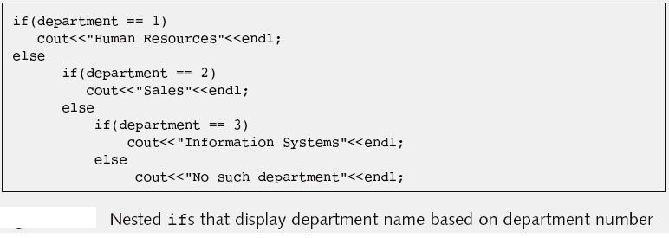
Comparing if/else with switch with the help of an example
When you want to create different outcomes depending on specific values, you can use a series of ifs.

Slide 52
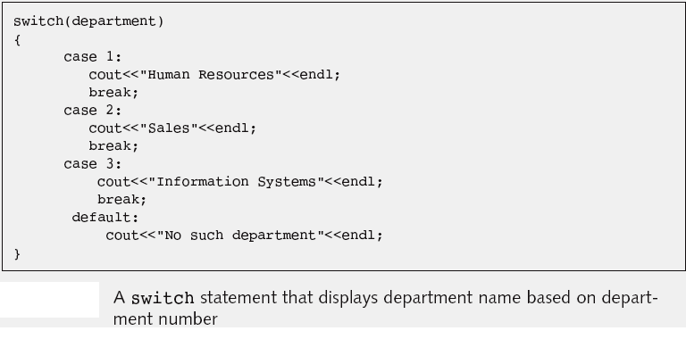
Comparing if/else with switch with the help of an example
However, as an alternative to the long string of ifs, you can use the switch statement
Department is the control variable and is integer
Compare the department to cases and prints the department it matches.
Removing break changes behavior of statement.
It causes switch statement to end.

