Slide 1
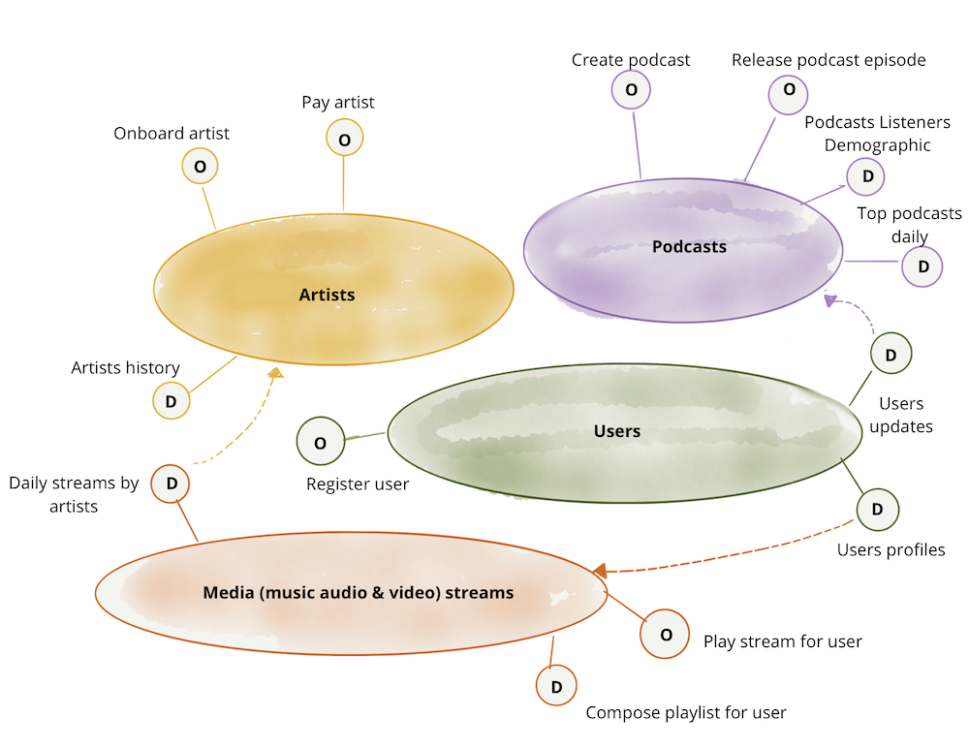
Bounded Domains is Data Mesh++
https://martinfowler.com/articles/data-mesh-principles.html

Slide 2

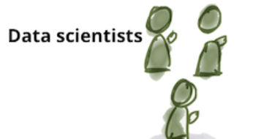
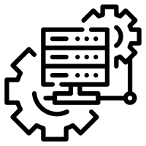

Domain Boundary
O
D
D
APIs
Apps…
Data…

Slide 3
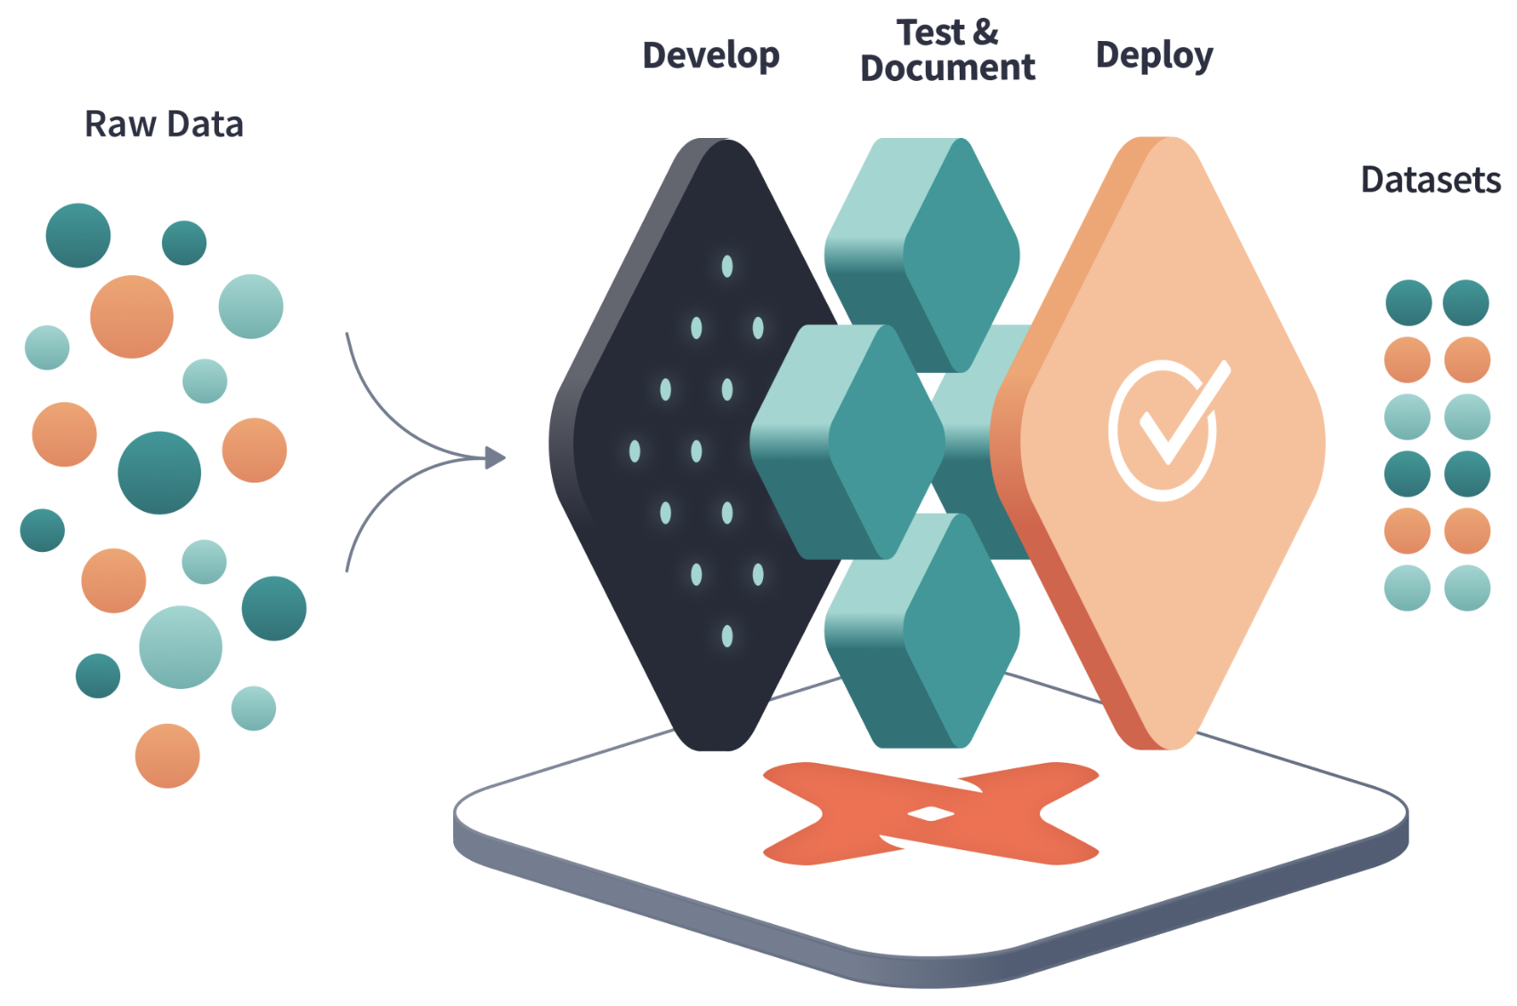
Domain Boundary
O
D
D
APIs
Apps…
Data…

Slide 4
Finding the right domains and enabling Self-Service
Language of the Domain Defines Boundary. DSLs enable SELF-SERVICE.
O
D
D
APIs that process DSLs
Transform Layer
Metrics Layer
Apps…
DSL(s)
Data…
DBT (a DSL)
DBT-Metrics, Metriql,…
(a DSL)

Slide 5
Slides with talking points

Slide 6
Think beyond a Data Mesh to EA as Bounded Domains
The secret to the boundaries is the ubiquitous language. The boundaries are at the points where the language of the domain’s data models and processing changes.
Everyone wants Self-Service
Few have credibly attained it and there is little agreement on how attain it: low-code/no-code, drag-and-drop, AI/ML, Citizen Data Scientists/Analysts, …
It’s only possible if users can create executable solutions using the language of the domain: A Domain Specific Language (DSL)
Data Mesh

Slide 7
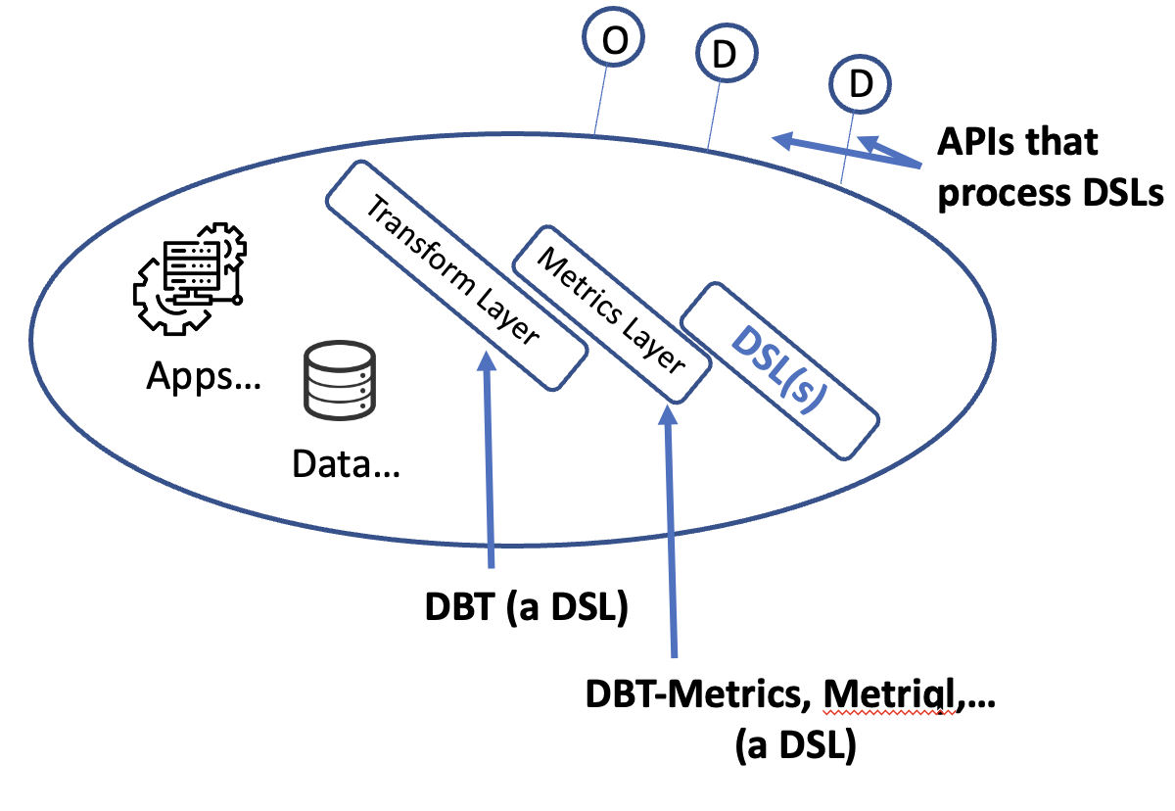
Beyond and Within Data Mesh
Everyone wants APIs/MicroServices¹:
APIs expose our modeled data or processing without a way to sequence or operate on it. This is too low level to empower and control it’s use.
Create the API to accept DSL programs that enable and control rich data semantics without low level programming.
Examples of DSLs within a Bounded Domain:
Everyone wants DBT. It’s an actual path to self-service. It’s a low-level DSL. We’ve wrapped it with a real DSL in several projects to supercharge self-service.
Everyone should want configurable Metrics, a.k.a. a semantic layer. There are multiple open source and commercial projects that provide a language for centrally defining metrics. It’s another low-level DSL that should be wrapped.
We’re now using tech that enables us to rapidly build comprehensive DSLs rapidly, e.g., to completely define a clinical protocol that can be translated into all the runtime and data management applications needed.
¹ We don’t need microservices…

