Slide 1

Introduction to React
Bitbucket: react-starter-kit
https://codesandbox.io

Slide 2
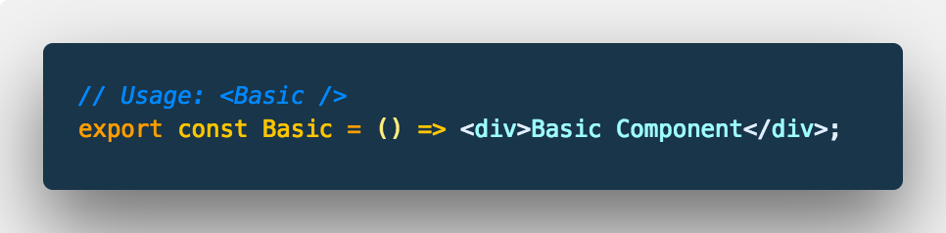
Stateless component
Purely presentational

Slide 3
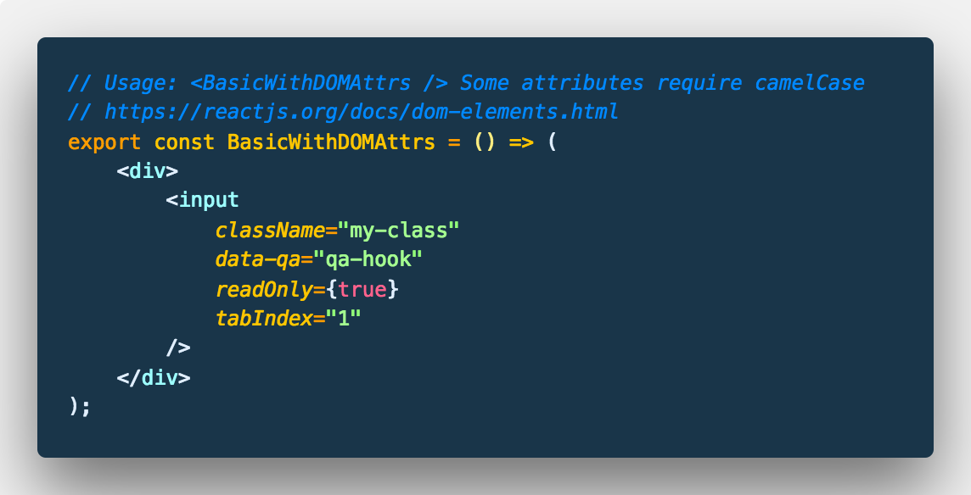
JSX? Ermagherd!
DOM Attributes and events are camelCase, dataset properties remain the same.
JSX expects anything between { } to be interpreted as JavaScript (not a string).

Slide 4
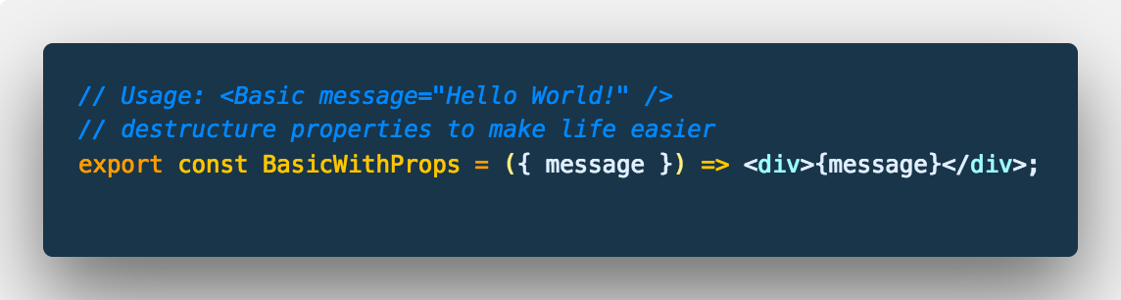
Stateless component
Displays with a dynamic message passed as a property
Property here is destructured, { message } in render tells JSX to process variable

Slide 5
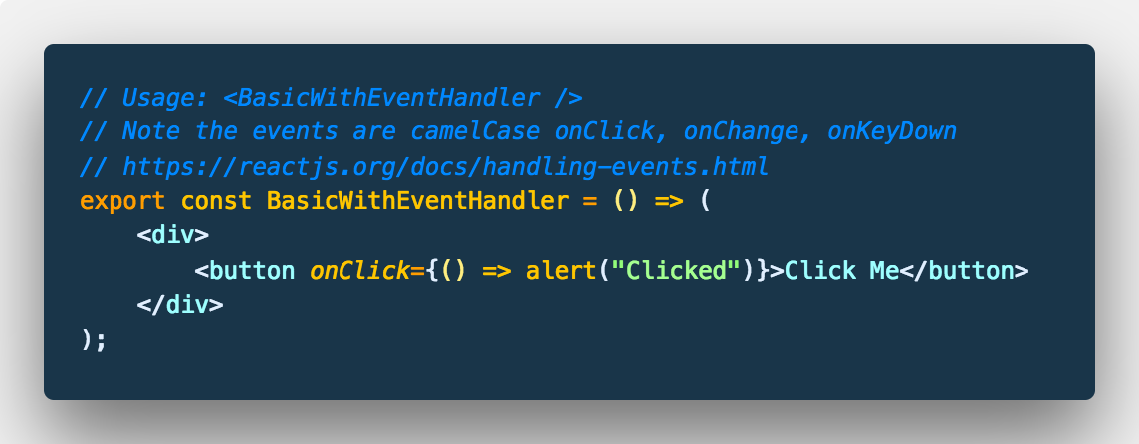
Stateless component
Basic event handler - note the camelCase

Slide 6
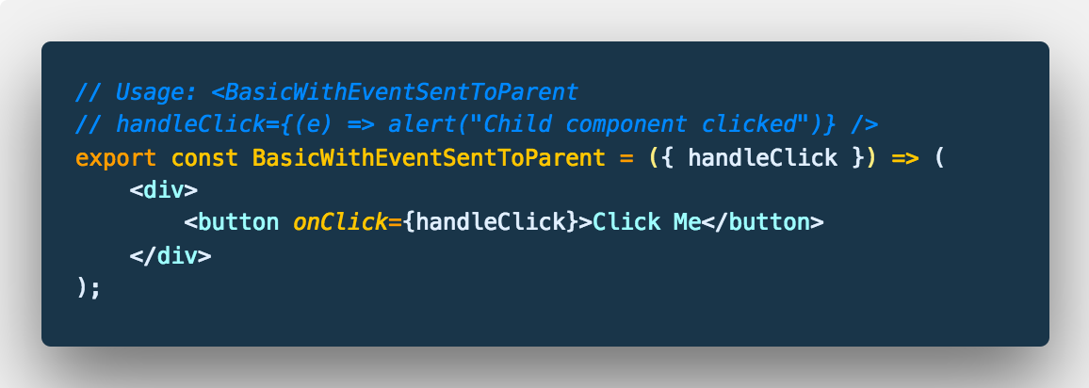
Stateless component
Handle event using method passed in as a property

Slide 7
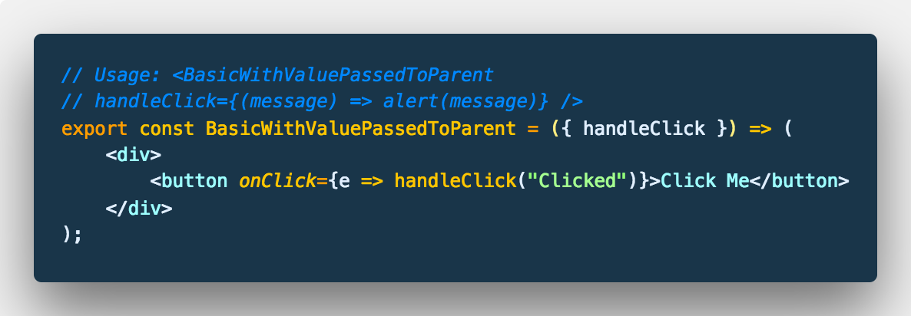
Stateless component
Handle event inline, do some processing, pass data back to parent.

Slide 8
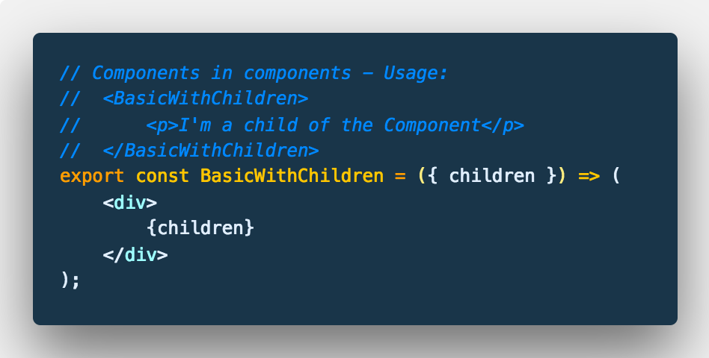
Stateless component
Wrap other components in a custom component

Slide 9
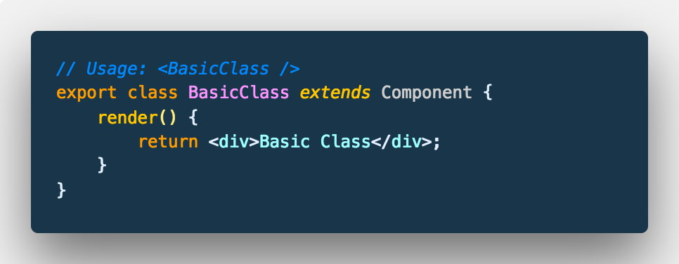
Class components
Basic example of class syntax

Slide 10
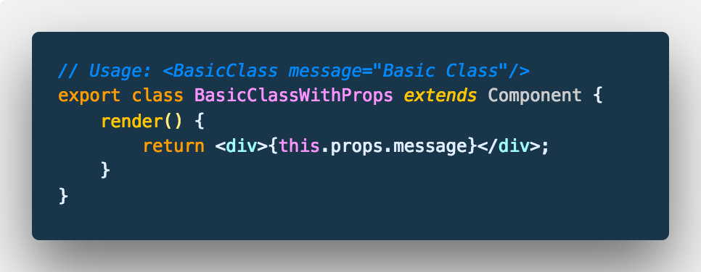
Class components
Properties on class components are attached to this.props

Slide 11
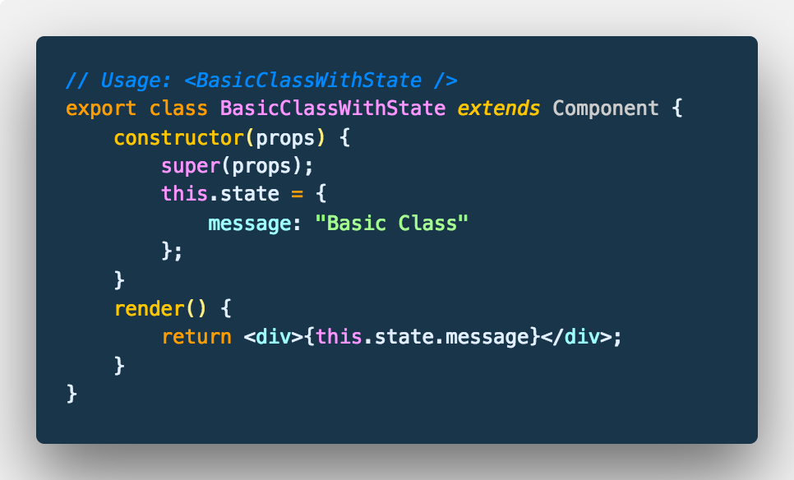
Stateful component
Class components have inherited behaviours, one of which is state.
State can be initialised in the constructor or as a class property (stage 3)

Slide 12
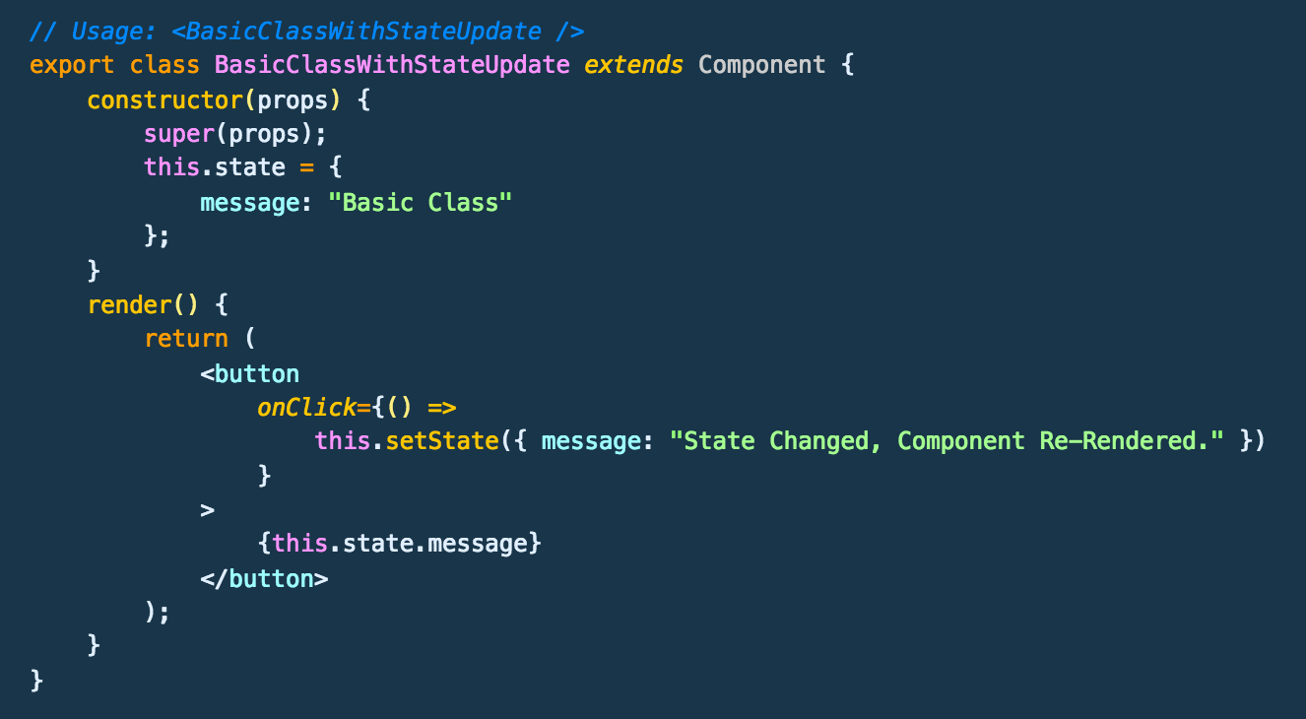
Stateful component
Clicking the button updates the state, updating the state triggers a re-render of the component. Updates to state must be performed using setState.

Slide 13
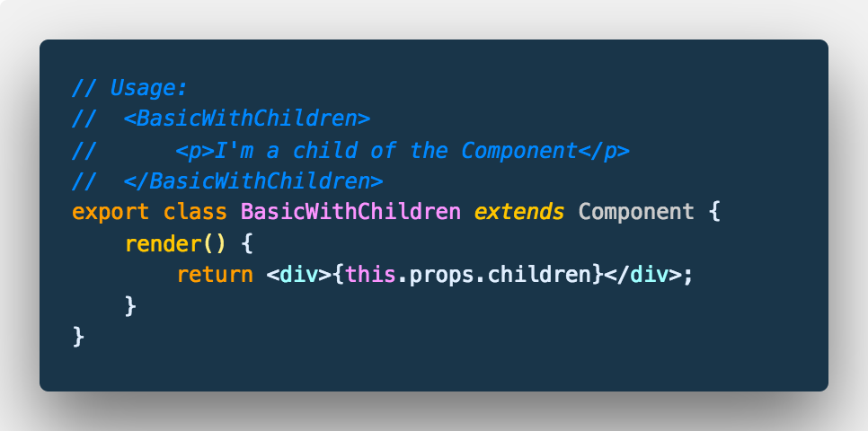
Stateful component
Just like with stateless components, the class / stateful component can render it’s children using this.props.children

Slide 14
Lifecycle methods
Class components inherit other behaviours as well as state handling
ComponentDidMount
ComponentDidUpdate
ComponentWillUnmount
Quite a few others, check out lifecycle.js for links and some inline explanations.

Slide 15
Styling components

Slide 16
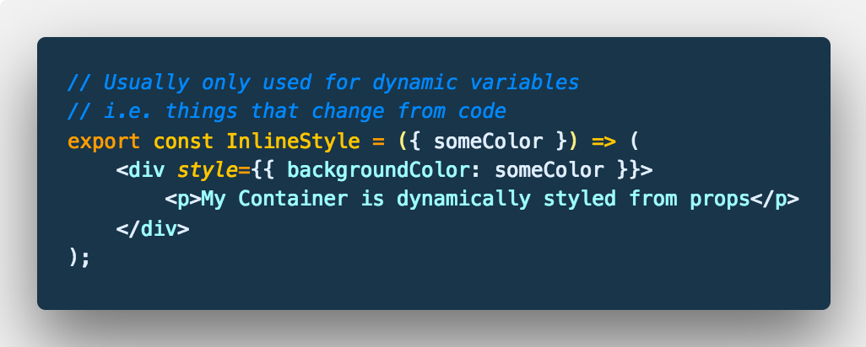
Styling
Inline styles in JSX are considered as bad as inline styles in HTML
Generally only use them if the value contained therein is dynamic.

Slide 17
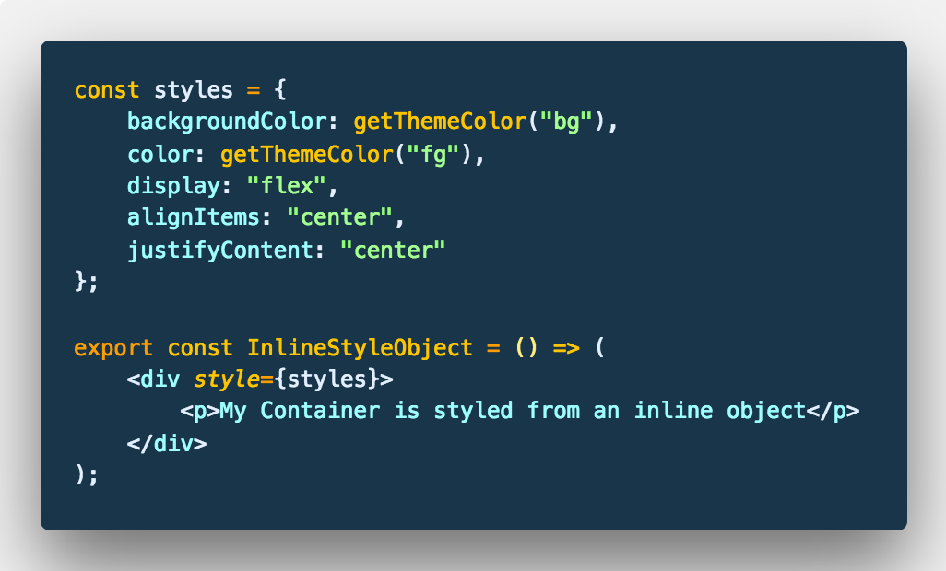
Style objects
Style objects are the prevalent pattern in React Native and the co-location of template and styles is viewed as beneficial by some.

Slide 18
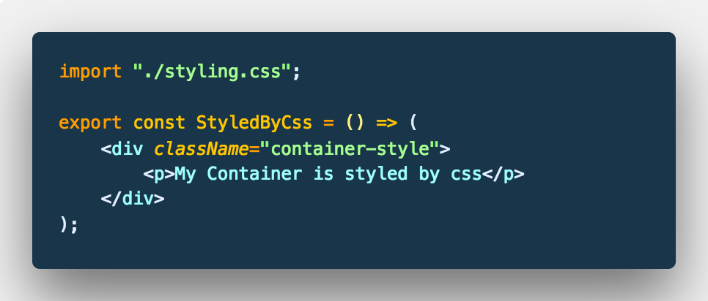
Class Styles
Styling by CSS / SCSS / Whichever preprocessor works just like HTML with the caveat that the property is called className

Slide 19
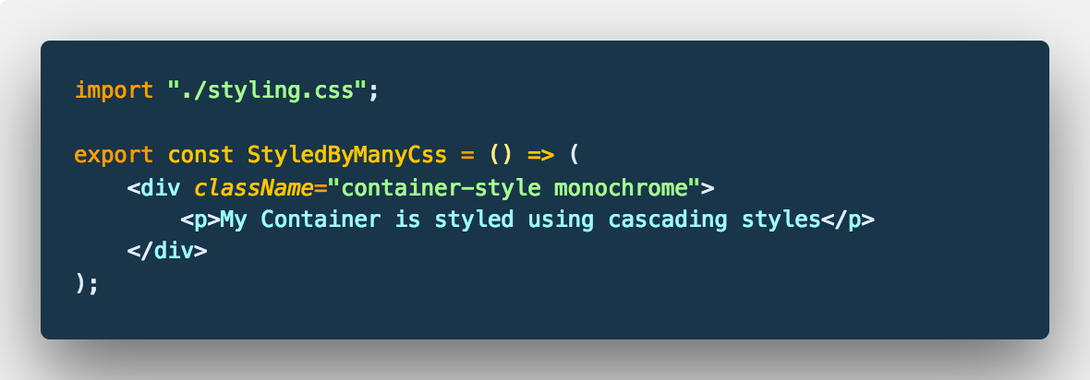
Class styles
They also cascade as you’d expect.

Slide 20
Exercise One
Stateless components
Stateful components
Styling components
Mapping over data
Handling data entry
Manipulating state
Code walkthrough and questions, you can do the tasks when / if you like
or just use for reference in your own learning.

Slide 21

Introduction to GraphQL
react-starter-kit/server
npm i && npm start
browse to localhost:4000

Slide 22
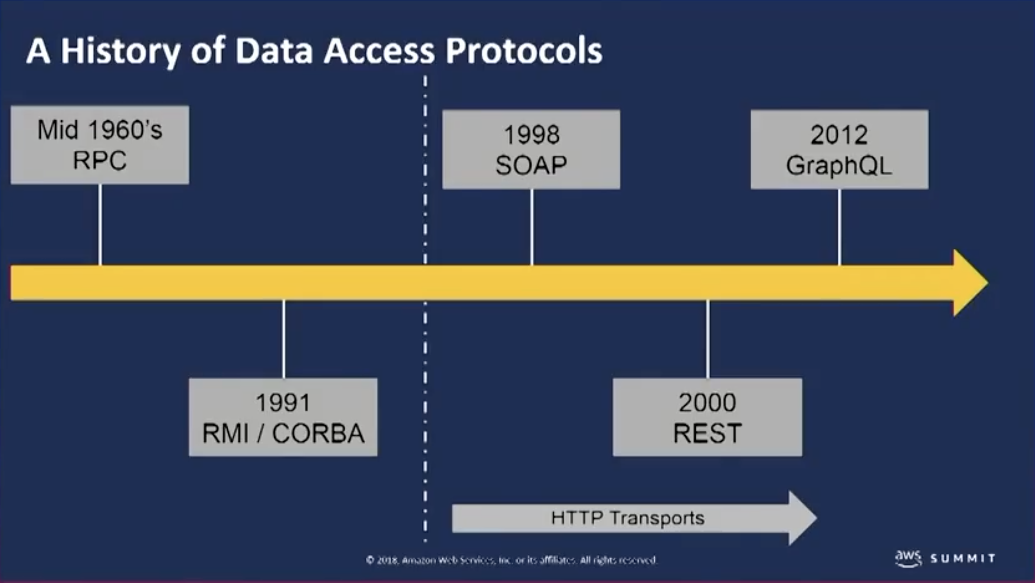
So what is it?
As this image from AWS Summit 2017 shows, it’s a REST replacement.
It’s made by Facebook.

Slide 23
Great! But… What does it give us?
You get back exactly what you ask for in a single request
It’s typed, you build a schema and relationships just like a traditional database. You make queries based on the Types you create.
Because it is typed its self documenting and the tooling support is outstanding.
You build resolvers around those types i.e. how do you get the data.
The data can be anywhere and in any shape, JSON, web service, internal system as long as you describe the data shape you want and the resolver knows how to get it, then you’re away.

Slide 24
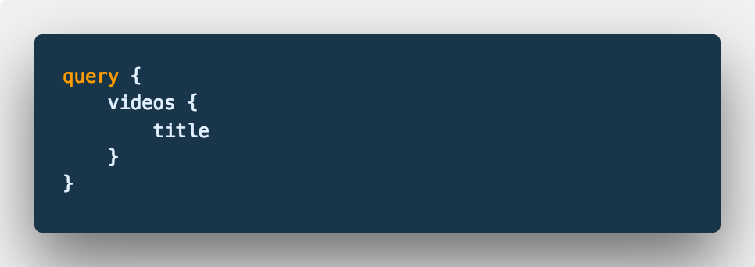
A basic query
This gets passed to the server as a POST request and parsed, the relevant resolvers are called and the data is returned in the same shape you requested, give it a try.
react-starter-kit/server
http://localhost:4000

Slide 25
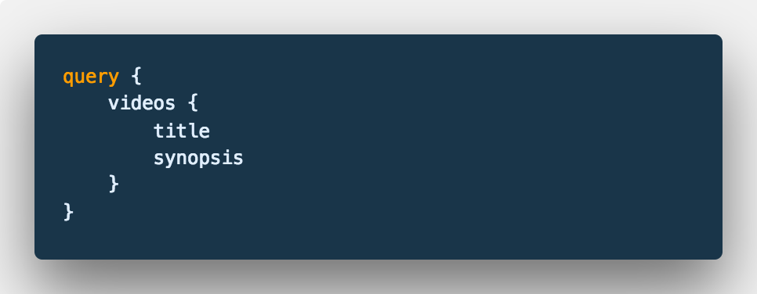
Add an additional field
Check out the data shape returned.
Each of your components only need to request the data they require to render.

Slide 26
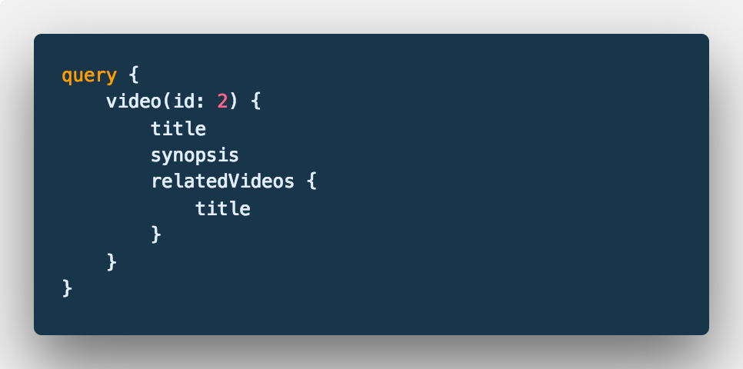
Query parameters
You can specify parameters for your queries like this, there are a couple available on the video query, byId and byTitle.

Slide 27
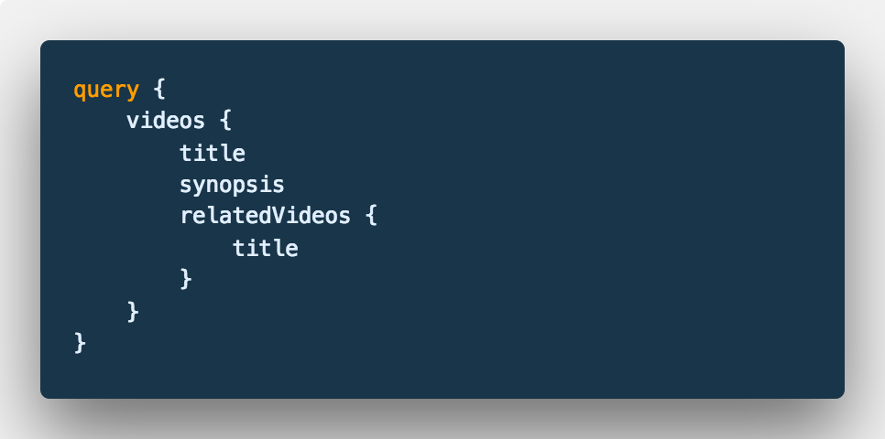
Custom data type
The related videos are just an array of numbers. A resolver defined in the ‘VideoType’ understands that it needs to take the id of the current video being processed and grab the requested meta in the query for that video too before returning.

Slide 28
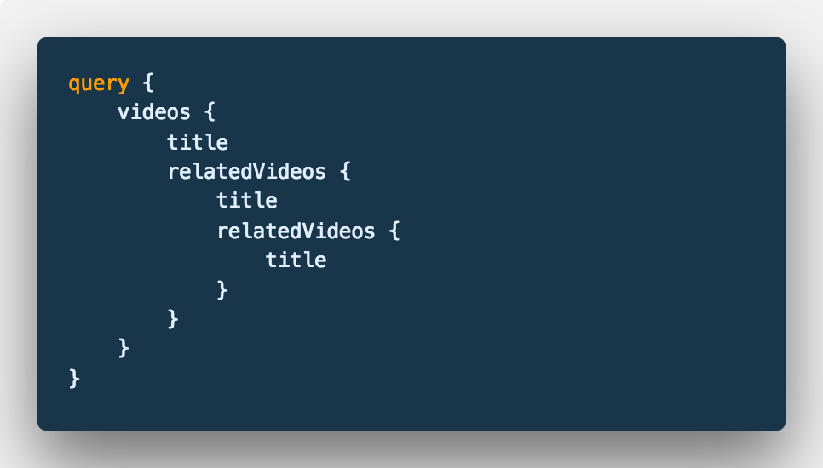
Turtles all the way down
Because we have a Custom type with a resolver, every VideoType has a VideoType as part of it’s response, which means you can construct nested data queries really easily.

Slide 29
Exercise Two
Stateless components
Stateful components
Styling components
Mapping over data
Conditional rendering
Async data / endpoints
Manipulating state
Fragments
GraphQL queries
Code walkthrough and questions, you can do the tasks when / if you like
or just use for reference in your own learning.

Slide 30

Just one more thing

Slide 31
Hooks proposal
(October 25 2018)
Introduced in React 16.7 alpha
Community overwhelmingly positive
There are some arguments against, but these aren’t gaining traction to date.
They get rid of a lot of boilerplate.
They get rid of the fake classes

Slide 32
Exercise Three
Hooks
Why Hooks?
Controlled input class vs Hook
Custom input hook
Async component with Class vs async component with Hook
Exercise: Basic hooks solution to the Hired Fired exercise
Code walkthrough and questions, use the examples to build your own hooks
There are tasks in the Hired Fired hook example to experiment with.

