Slide 1
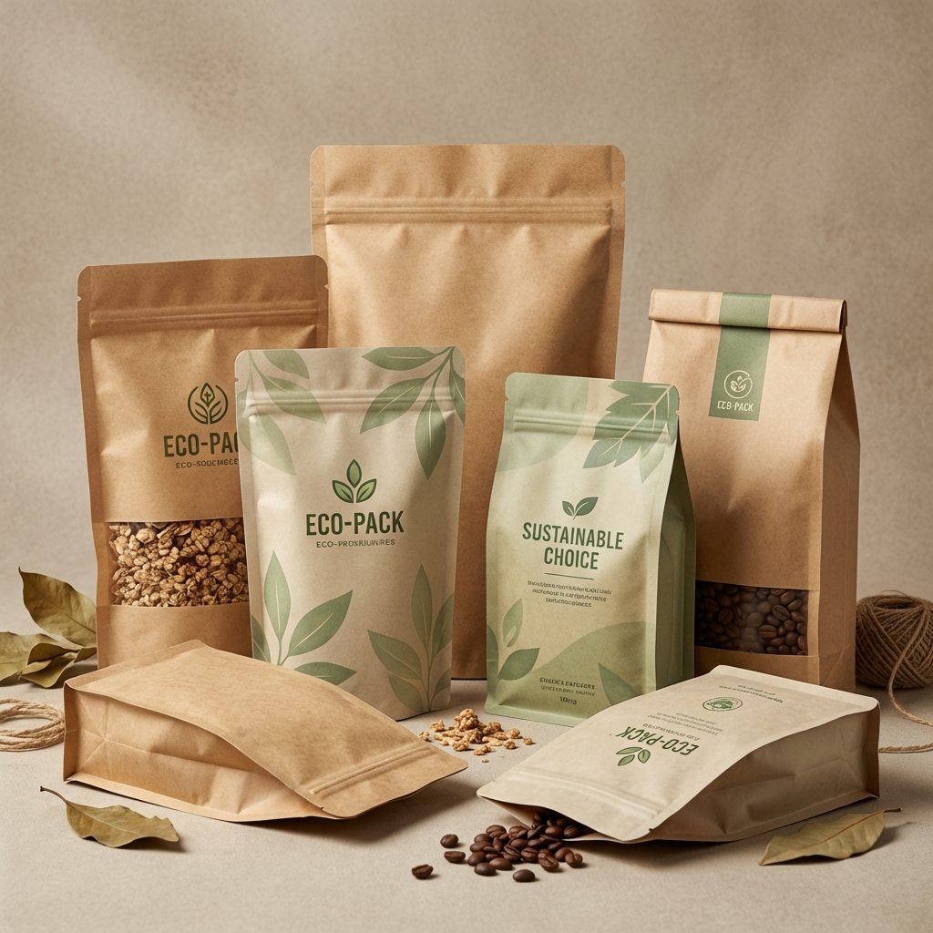
Achieve Pack
Certified Eco-Friendly Packaging Solutions
for Global Brands

Slide 2
Our Mission
Making sustainable packaging the easy choice for every business.
Founded in 2011, serving 500+ brands worldwide.
We believe environmental responsibility shouldn't be a premium feature—it should be the standard.
Bridging the gap between eco-friendly materials and high-performance needs.

Slide 3
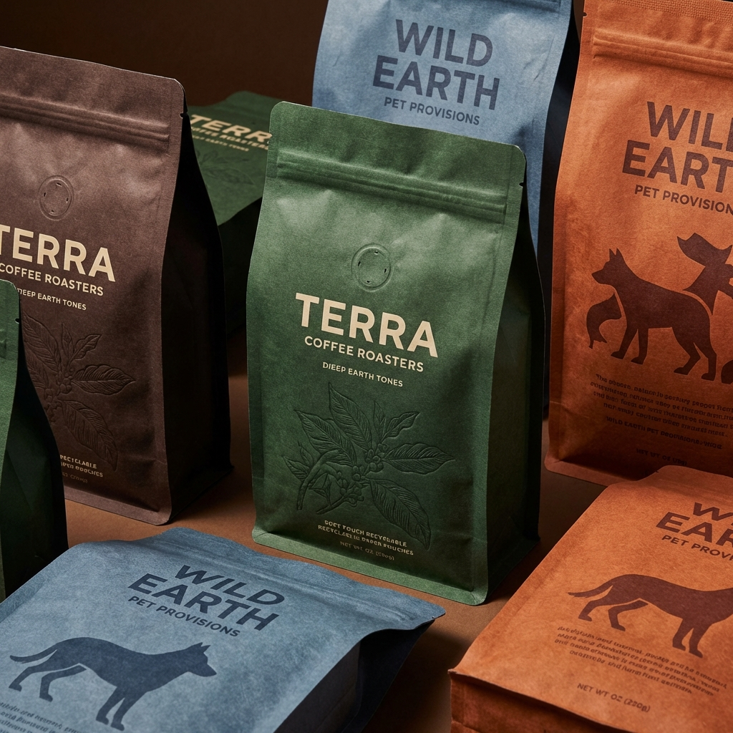
Why Brands Choose Us
Low MOQs: Start with just 100 pieces.
Fast Turnaround: Samples in 2-3 weeks.
Real Certifications: EN13432, GRS-Certified.
Cost Effective: Save 15-22% on shipping.
No Greenwashing: Full transparency.

Slide 4
Sustainable Material Options
Compostable (Kraft + PLA / NatureFlex):
- Breaks down in 90-180 days.
- Ideal for coffee, tea, and dry goods.
Recyclable Mono-PE & Mono-PP:
- Single material structure = Actually recyclable.
- High barrier options available (EVOH).
PCR (Post-Consumer Recycled):
- Made from plastics that already existed.
- GRS Certified content (30-100%).

Slide 5
Packaging Formats
Stand-Up Pouches: Great shelf presence.
Flat Bottom Bags: Premium 'box' look.
Spout Pouches: Liquid-ready.
Vacuum Pouches: Extended shelf life.
Rollstock: For automated lines.

Slide 6
Industries & Applications
Coffee & Tea: High barrier valves, kraft aesthetics.
Pet Food: Odor-blocking, durable, large formats.
Supplements: Moisture control for powders.
Beauty & Cosmetics: Premium finishes.
Food & Snacks: FDA-compliant, grease-resistant.
Frozen Food: Cold-resistant materials.

Slide 7
Success Stories
Bean & Bole Coffee: Compostable bags + freshman protection.
VitalGreen Superfoods: Recyclable Mono-PE for 8 SKUs.
Pawsome Naturals: Child-Resistant PCR packaging.
Artisan Cocoa (Dubai): Heat-resistant packaging.

Slide 8
Quality & Certifications
Certified Compostable: EN 13432, ASTM D6400.
Start-of-Life: FSC Certified Paper, Bio-based PE.
End-of-Life: TUV Austria OK Compost, GRS.
Food Safety: FDA 21 CFR, EU 10/2011 Compliance.
Testing: Seal strength, OTR/MVTR (Barrier checking).

Slide 9
Ready to Switch?
Start your sustainable packaging journey today.
Web: achievepack.com
Email: ryan@achievepack.com

