Slide 1

Age Range Model Update
2020-08-11

Slide 2
Agenda
Feature table finalization (by feature importance)
Hyperparameter tuning
Over-sampling techniques
*Feature selection with selectors in PySpark

Slide 3
Finalize feature table
Feature selection by feature importance
Section features: high feature importance
Subsection_1 features: relatively low feature importance
Subsection_2 features: low feature importance
Percentage of time spent shows higher feature importance for most sections and for all subsections
For section features, keep either percentage of time spent or total time spent
Subsection_1 timespent features → Subsection_1 timespent%
Remove subsection_2 timespent features

Slide 4
Finalized feature table
Total time spent in sections:
'sum_business’, 'sum_globeandmail’,
Total time spent in subsection_2:
'sum_insidethemarket’,
Section time spent percentage:
'section_canada_timespentp’, 'section_business_timespentp’, 'section_investing_timespentp’, 'section_world_timespentp’, 'section_opinion_timespentp’, 'section_politics_timespentp’, 'section_life_timespentp’, 'section_arts_timespentp’, 'section_sports_timespentp’, 'section_globerealestate_timespentp’,
Subseciton_1 time spent percentage:
'subsec1_markets_timespentp’, 'subsec1_personalfinance_timespentp’, 'subsec1_uspolitics_timespentp’, 'subsec1_investmentideas_timespentp’, 'subsec1_internationalbusiness_timespentp’, 'subsec1_cpc_timespentp', 'subsec1_commentary_timespentp’, 'subsec1_britishcolumbia_timespentp’, 'subsec1_toronto_timespentp’, 'subsec1_alberta_timespentp’,

Slide 5
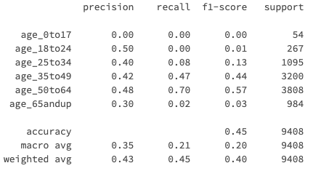
Parameter tuning
Train_test_split:
test_size/random_state/stratify
XGBoost
learning_rate
max_depth
n_estimators
…
*No guarantee of future performance
Notes:
Improvement for group under 34
Group under 24 unstable

Slide 6
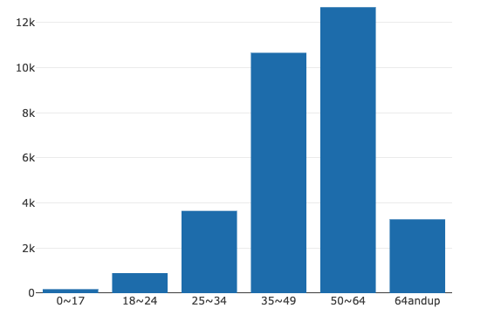
Oversampling techniques
Random Oversampler
Oversample minority class for training data
*SMOTE

Slide 7
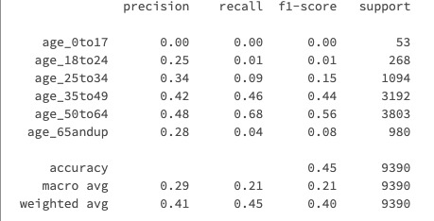
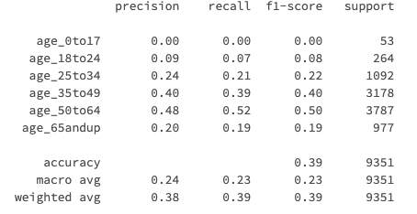
Random oversampling
→

Slide 8
*Feature selection with feature selector
Chi square selector with PySpark
Chi square test of independence
Challenges:
Perfect for categorical feature table
Multi-label problem
Dynamic feature selection
Performance
In progress

