Slide 1

Age Range Distribution by Section
2020-07-15

Slide 2
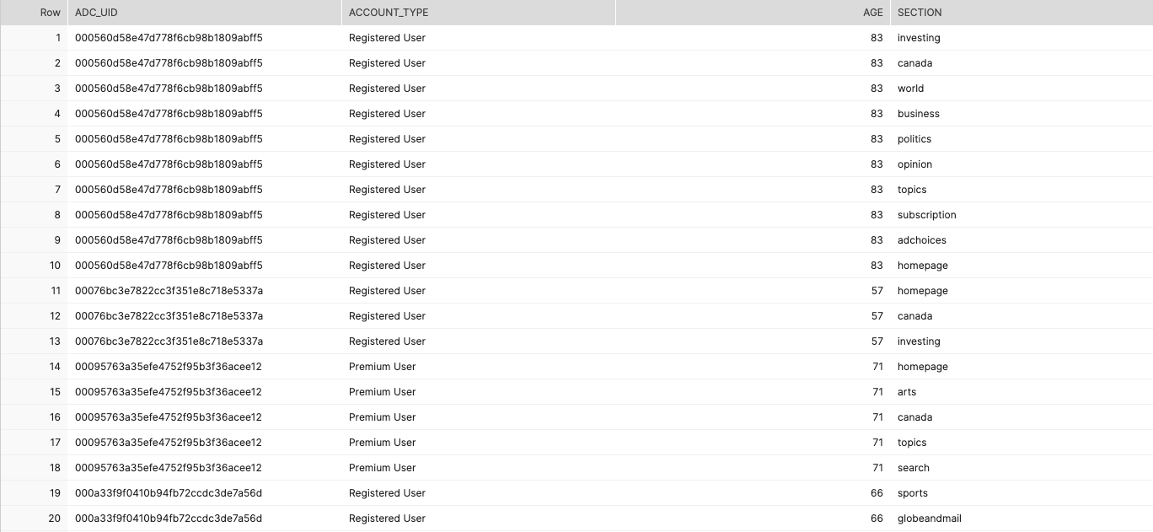
Preparation
Notes:
SELECT DISTINCT adc_uid, account_type, age, section
FROM adc.public.adcv2_pageview_users
WHERE account_type in ('Premium User', 'Registered User’) AND age is not null AND section is not null

Slide 3
Registered VS Premium
Condition | Count | Registered User | Premium User | Total | Intersection
Overall | User Count | 359,357 (67%) | 175,724 (23%) | 535,081 (actual: 510,777) | 24,304
 | Pageview Count | 10,155,980 (14%) | 63,644,643 (86%) | 73,800,623
“Age” not null | User Count | 9,186 (39%) | 14,593 (61%) | 23,779 (actual: 21,492) | 2,287
 | Pageview Count | 622,776 (9%) | 6,499,665 (91%) | 7,122,441

Slide 4
Age Range
Age range: [16, 119]
Outlier: >=100
Age column cut into bins:
(1, 17], (17, 24], (24, 34], (34, 49], (49, 64], (64, 99]
Equivalent to age range:
Under 17, 18~24, 25~34, 35~49, 50~64, 64 and up

Slide 5
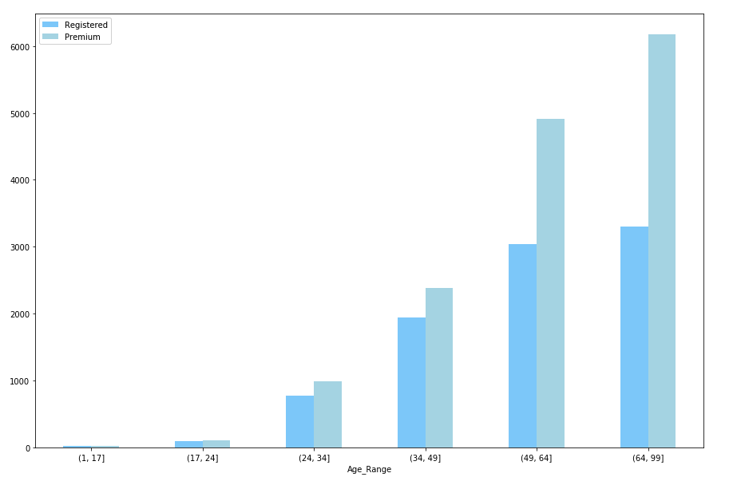
Distribution: Registered VS Premium
User Count

Slide 6
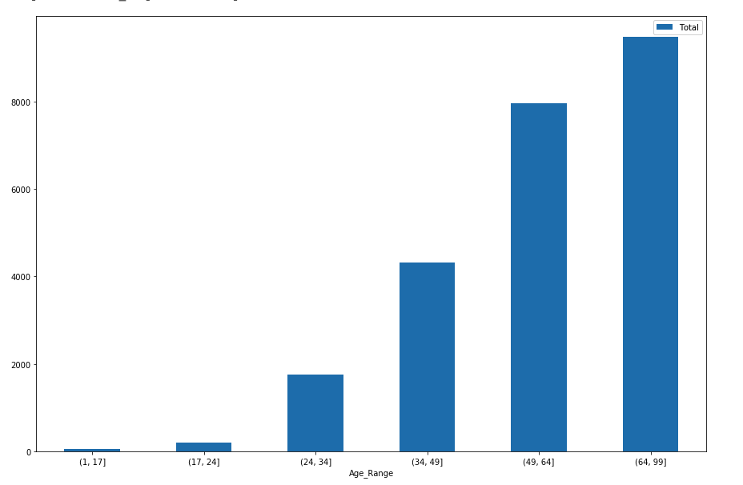
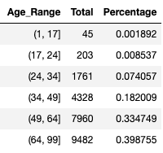
Age Structure (Registered + Premium)
39.9%
33.5%
18.2%
7.4%
0.2%
0.9%

Slide 7
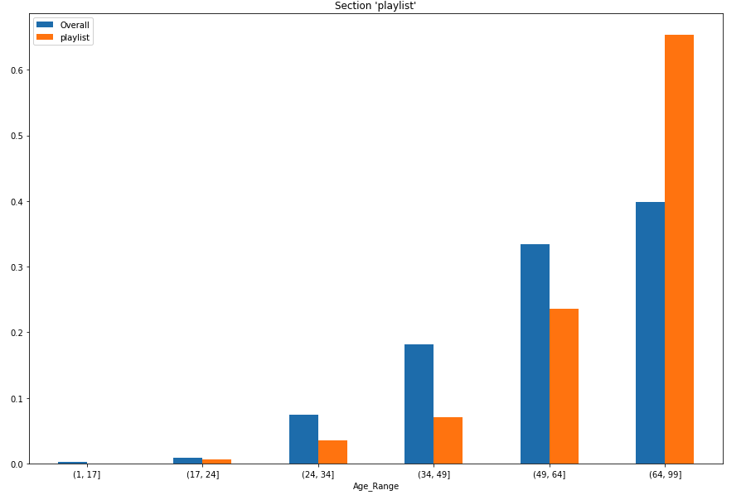
Metric: Mean absolute difference*100
Notes:
→

Slide 8
Top 10 Sections
Drop sections with reader count less than 50
Top 10:
Playlist: 8.476867343934924
Adchoices: 6.9737400631448345
Robcannabispro: 6.480439070429274
Insidetheglobe: 5.567808983748743
Globecorporatesales: 5.511914137171717
Technology: 5.465606908056127
Puzzles: 5.4344100509402065
Newsletters: 4.743463007526532
About: 4.395687601731784
Cannabis: 4.2592493444437185

Slide 9
Playlist
Notes:
→

Slide 10
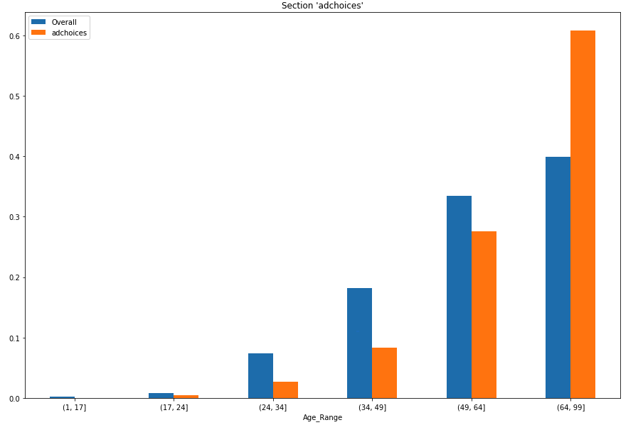
Adchoices
Notes:
→

Slide 11
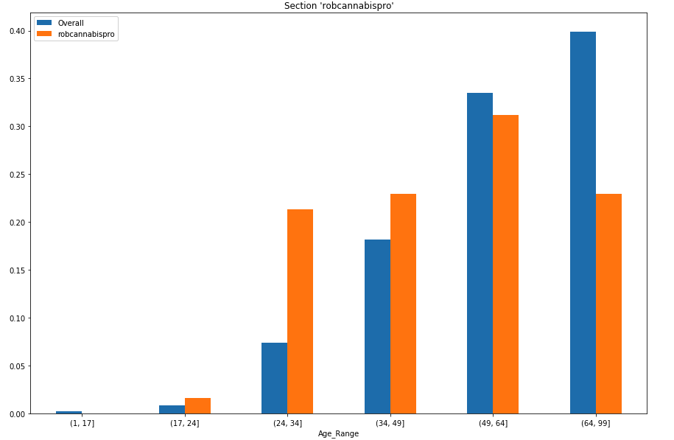
Robcannabispro
Notes:
←

Slide 12
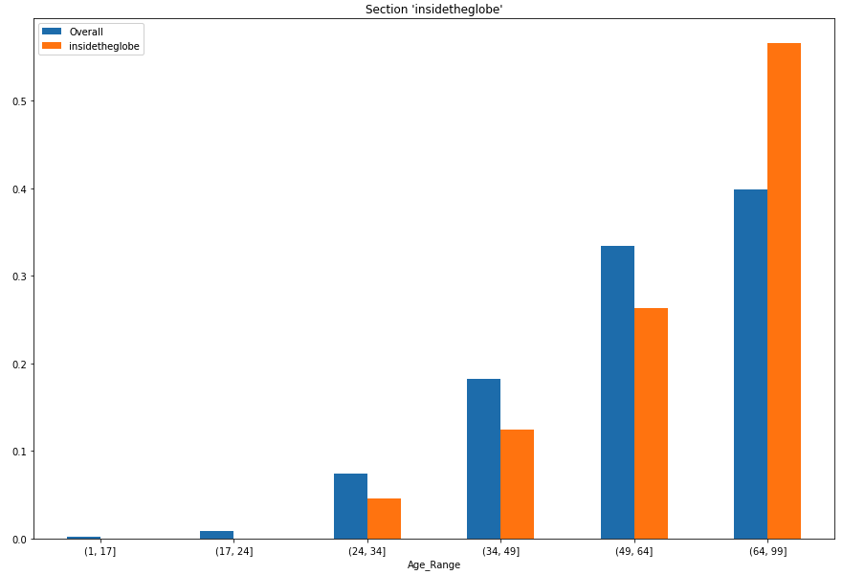
Insidetheglobe
Notes:
→

Slide 13
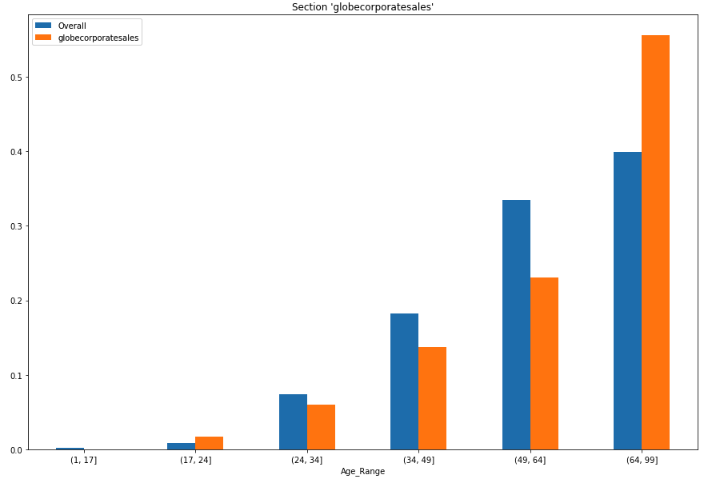
Globecorporatesales
Notes:
→

Slide 14
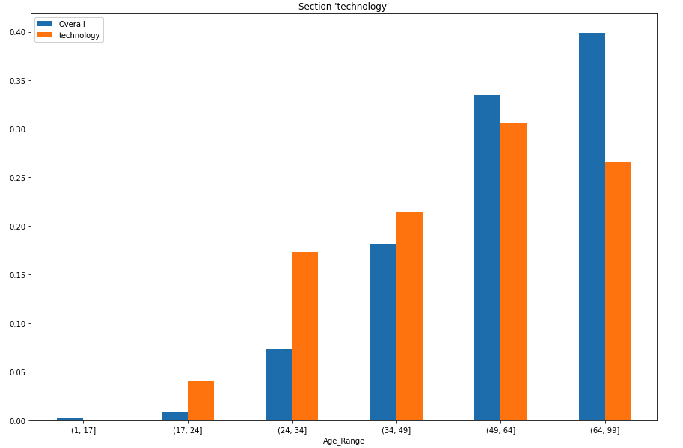
Technology
Notes:
←

Slide 15
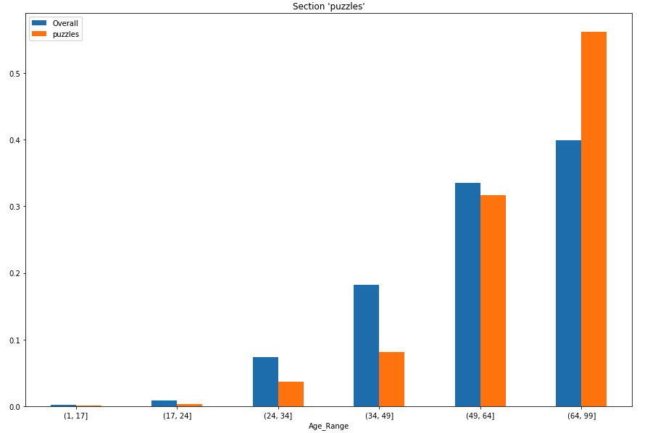
Puzzles
Notes:
→

Slide 16
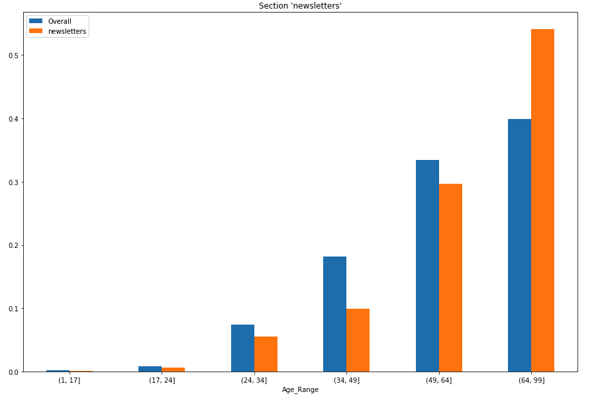
Newsletters
Notes:
→

Slide 17
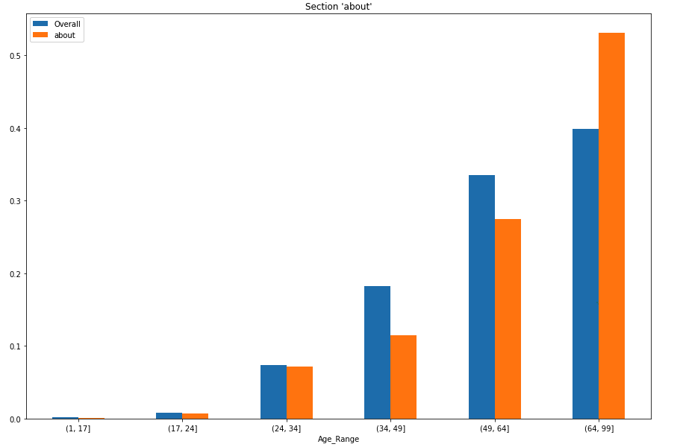
About
Notes:
→

Slide 18
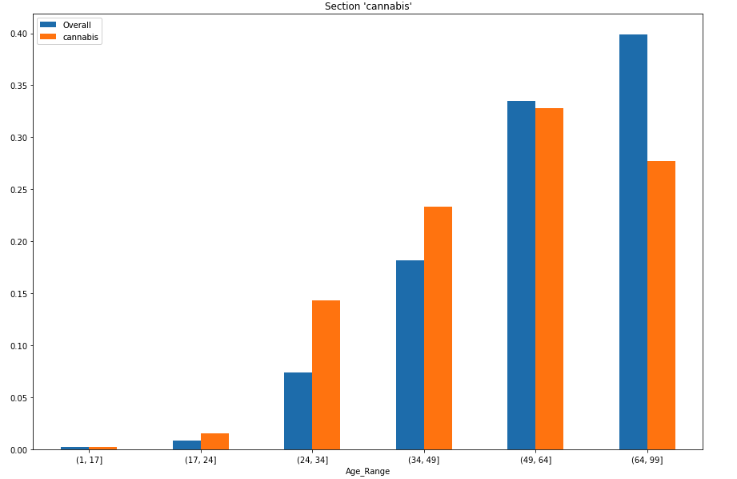
Cannabis
Notes:
←

Slide 19
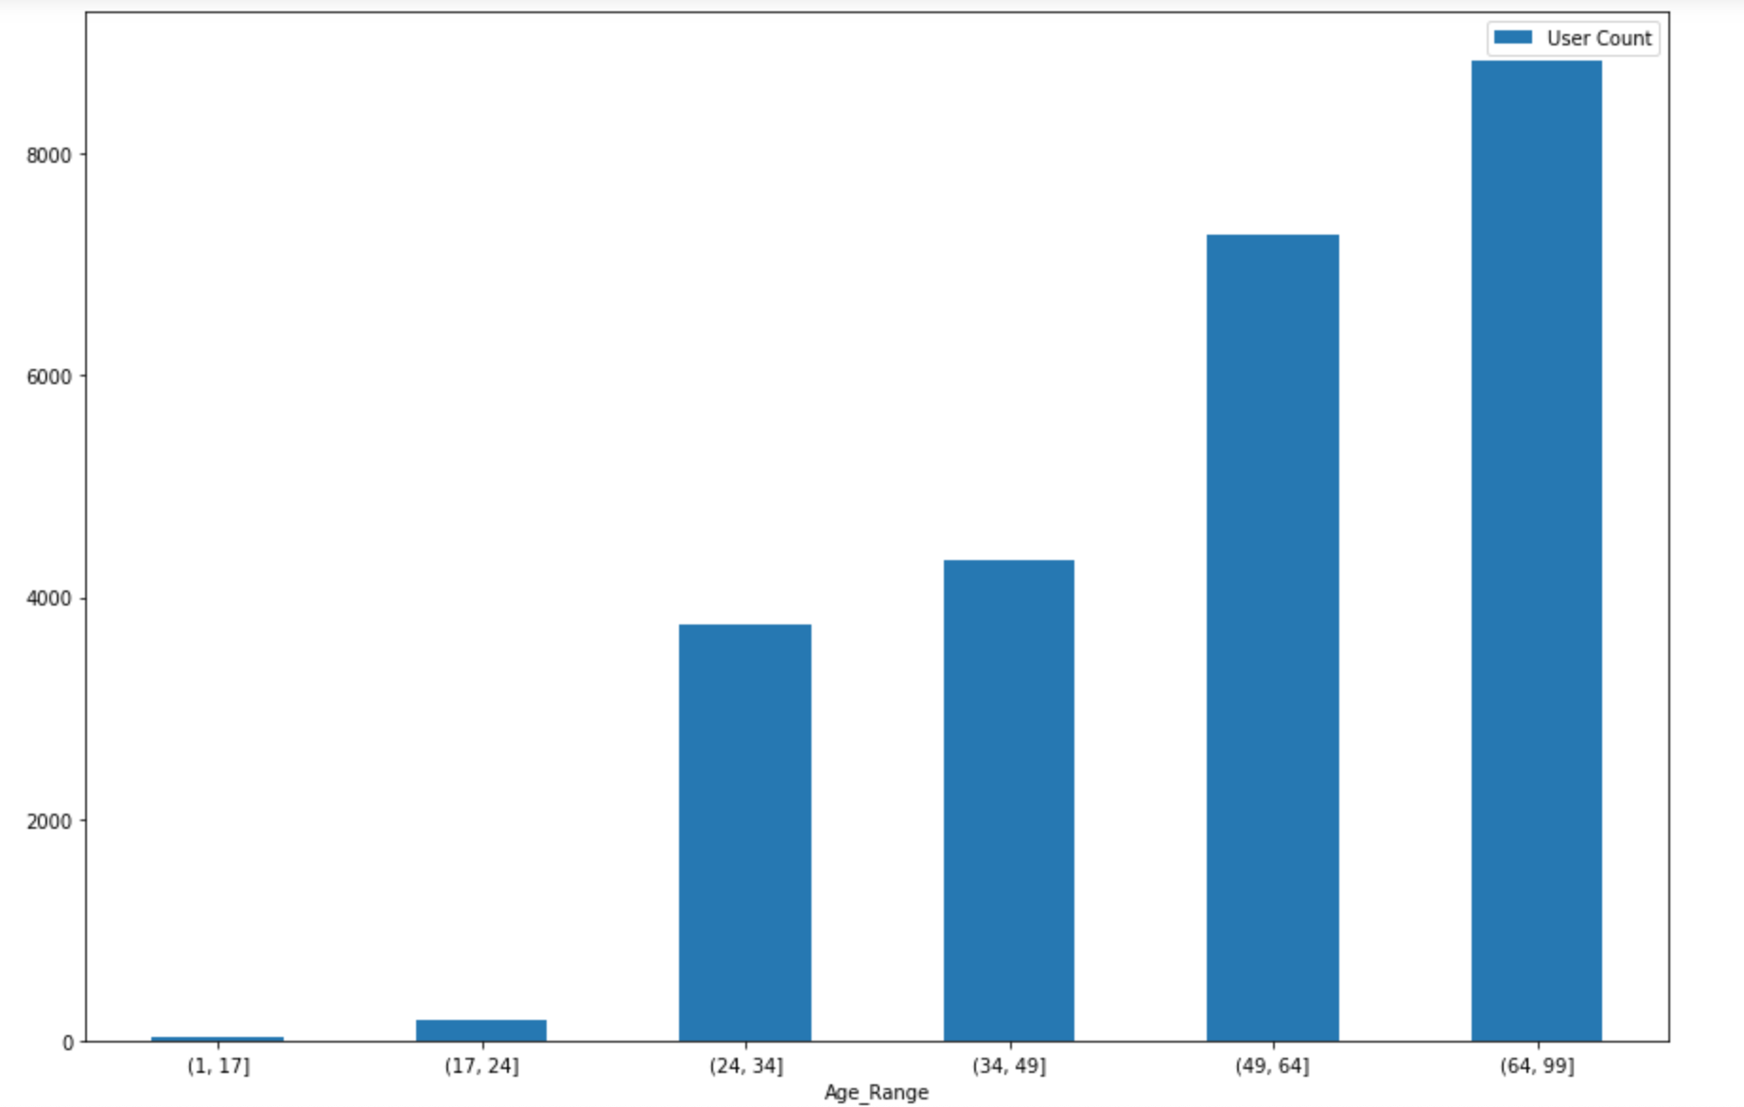
Distribution by “Subsection_1”
User Count
Notes:
SELECT DISTINCT adc_uid, account_type, age, subsection_1
FROM adc.public.adcv2_pageview_users
WHERE account_type in ('Premium User', 'Registered User’) AND age is not null AND subsection_1 is not null

Slide 20
Top 10 Subsections
crypticcrossword 11.47051376698525
help 9.917520983625973
sudokuclassic 8.801935819678874
universalcrossword 7.840852478386038
subscriptionprintlookup 7.489046484021768
blog 7.208202266727788
ErrorPage 6.253677192368926
globe2go 6.228306613864134
globalreporting 6.114302352573365
callins 6.079837045505748

Slide 21
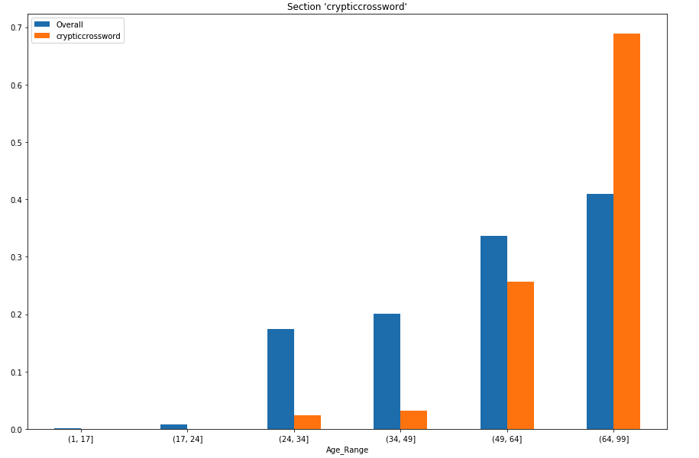
crypticcrossword

Slide 22
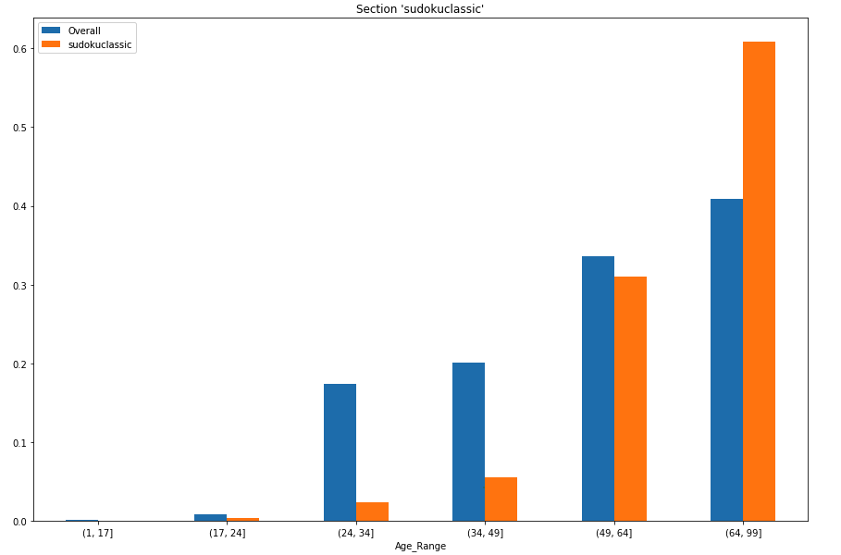
sudokuclassic

