Slide 1

Age Group Label Deduplication
2020.6.26

Slide 2
Data Preparation Process Confirmation
The new users’ feature tables are automatically aggregated and created based on 90-day’s “adc_pageview_users” data.
The feature table is saved in S3, then model picks up the features to make age range predictions based on the users’ features.
As the model is trained based on the data over 90 days, the prediction is getting more and more accurate when the users are predicted time by time.
The reason that we get different predictions for the same user is that the values in feature table are dynamic.
Feature Table
S3
Pre-trained Age Group Prediction Model
A list of new user ADC_UID
Result: ADC_UID, predicted age_group

Slide 3
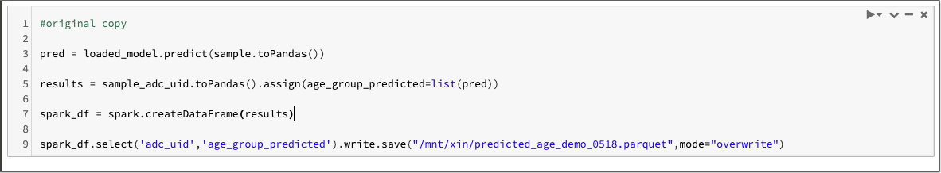
Original Output

Slide 4
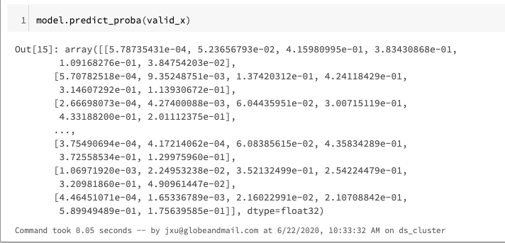
Prediction with Probability
[age_0to17, age_18to24, age_25to34, age_35to49, age_50to64, age_65andup]
Notes:
For each user, instead of giving a result as age_range, pred_proba gives probability of a user falling in each age range

Slide 5
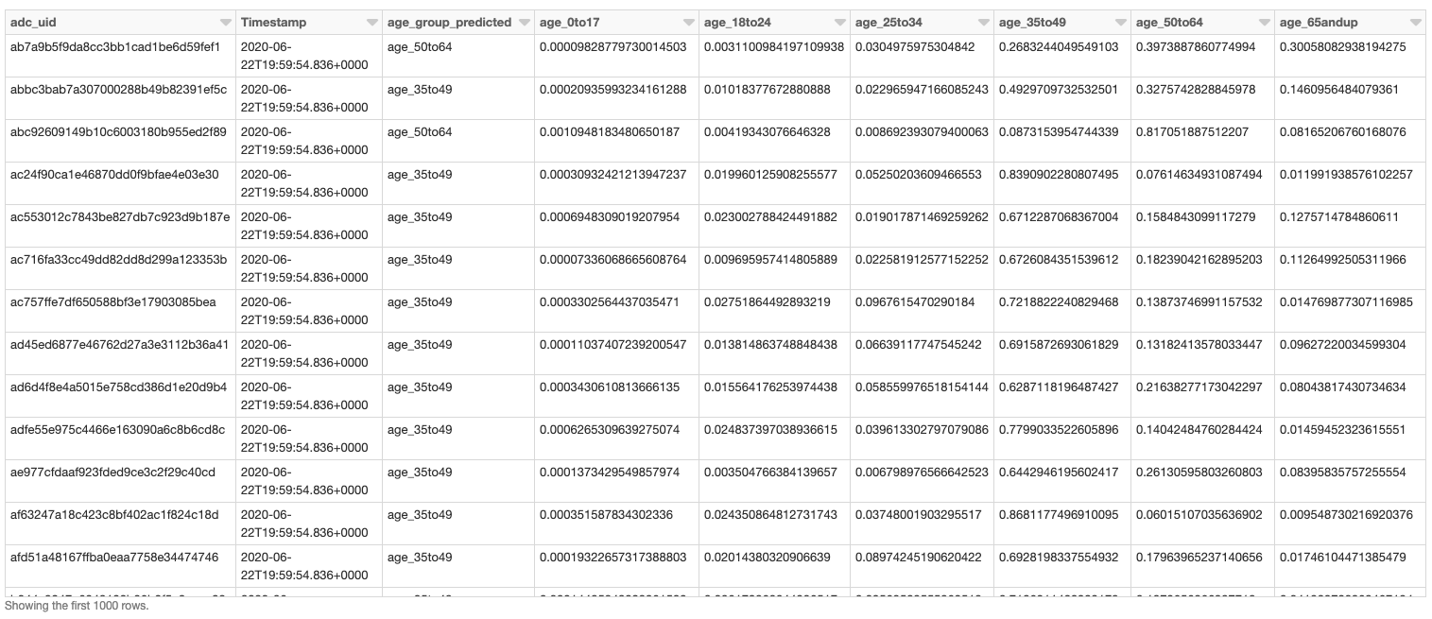
Output with Timestamp

Slide 6
Options
1. Add memory unit into the model to ensure that age range of each user will only be predicted once
Filter to exclude the users that has been predicted before
2. Add probabilities of age range prediction along with date when the result is returned
deduplicate results by selecting the one with latest date

Slide 7
Final Decision (June 26th)
Save four columns only in final output:
ADC_UID,
timestamp,
predicted age group,
probability of predicted age group (max proba)
Save a csv of most recent predictions for all registered and premium users as reference
Update prediction file

Slide 8
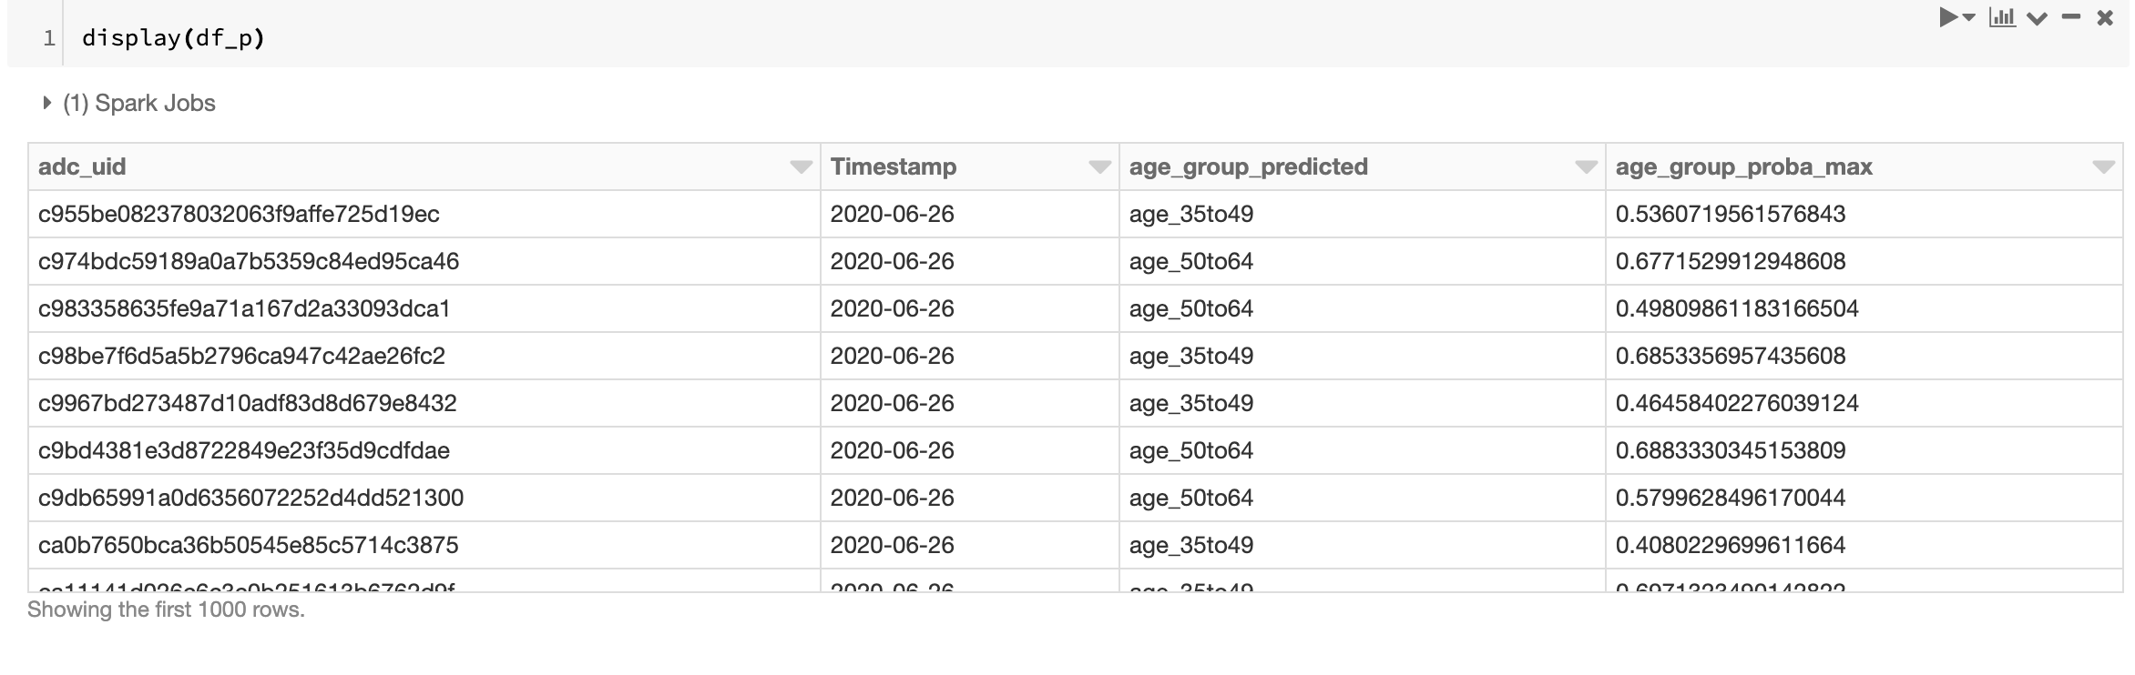
Final output

Slide 9
June 29th Update
A dataframe with four columns (ADC_UID, timestamp, predicted age group, predicted age group with max probability) was saved as a csv file under “dbfs:/mnt/xin/predicted_age_with_proba_0629.csv”.
This file contains predictions of 513,780 users (registered and premium only, until June 29th, 9 AM).
Model was saved as a new file with the name “age_model_0624.sav”. (same as the old one)
Prediction file was saved as “predicted_age_with_proba_0624.parquet” under “/mnt/xin/predicted_age_with_proba_0624.parquet”.
Updated notebook can be found as “Age Prediction 0626 copy” in DataBricks folder (jxu).

