Slide 1
Gender Prediction by Email Update
June 30th 2020

Slide 2
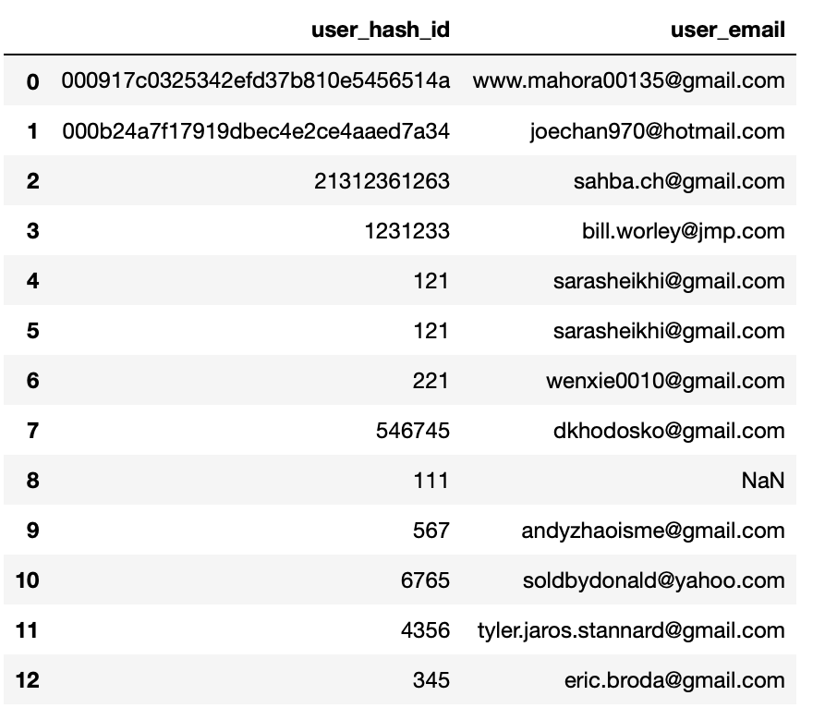
Updates
1. Added one column (user_hash_id) in new_users to compare if there are any duplicated user_hash_id

Slide 3
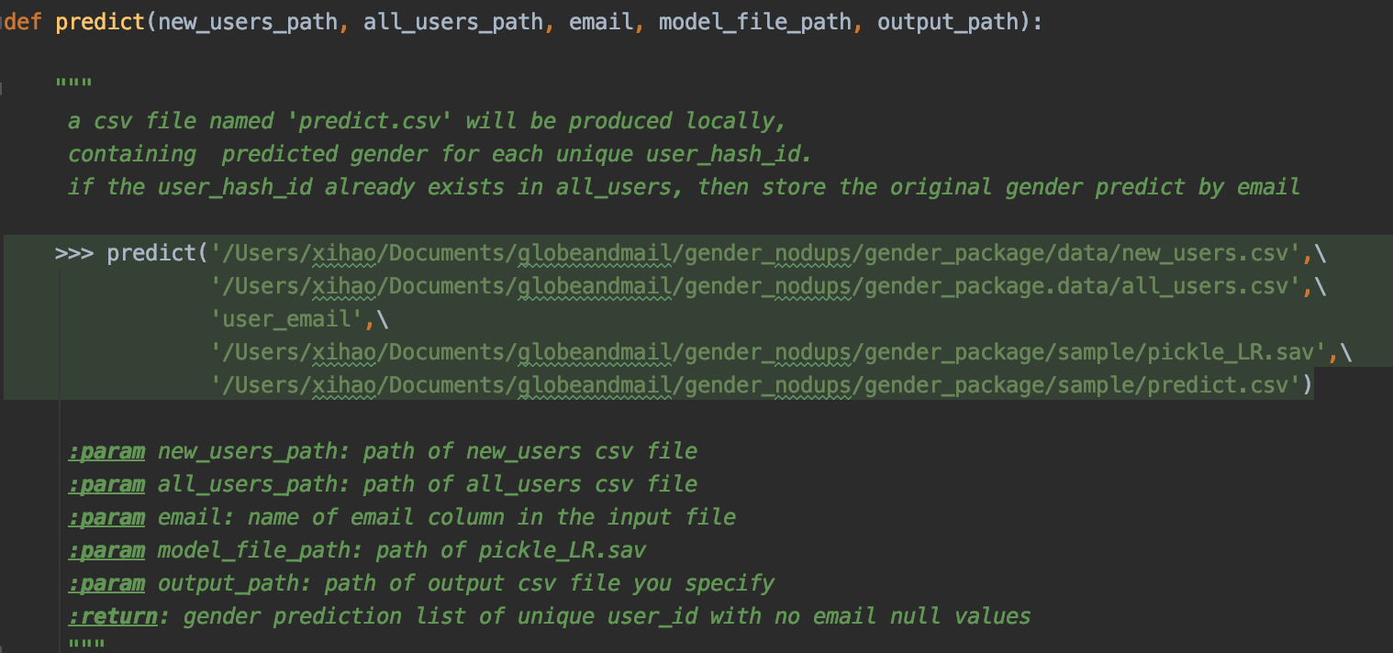
Updates
2. Added one parameter (all_users_path) to detect if there are any new_users already exist in all_users

Slide 4
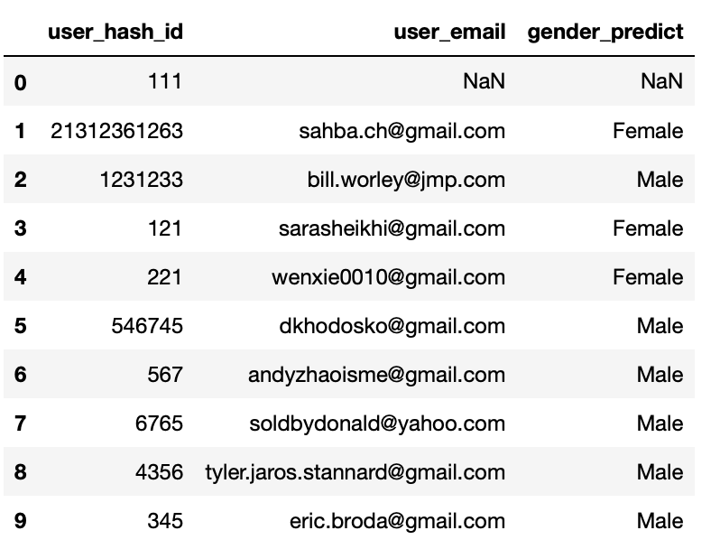
Updates
3. Our function will drop any duplicated user_hash_id in new_users and all_users, and predict users’ gender with emails
input: new_users.csv:
output: predict.csv
exist in all_users
duplicated user_hash_id
unique user_hash_id

Slide 5
Actions
1. Add user_hash_id column in new_users file
2. When calling this function, add one more parameter (all_users_path)
3. After new users’ gender are predicted, new users’ prediction need to append to the all_users file
4. Python package stored in /mnt/xzhao/gender_nodups.zip

Slide 6
Updated Conclusion July 7th 2020
1. Found duplicated new users in 90-day users data under /mnt/tgam_adc/data/ur_gender/date=2020-04-26/
2. Gender prediction by email has 3% variance, model does not produce duplicates
2. Globe and Mail team to update ETL and check if the new user exist in the 90-day users data, keep the gender as is

