Slide 1

Lookalike Model Validation (Feature Importance)
Xin Zhao, Zheng Xu
July 30th 2020

Slide 2
Overview
Use classification model to determine feature importance of each segment
Select the top 10 important features for each segment and calculate the average values for each feature of strangers and similar users.
The sample size is the same as the base segment size
Plot radar graphs to compare features for similar users and strangers

Slide 3
Sample Segment 1: Segment of Globe Ad Clickers - ADC, all users that clicked on ads in the last 90 days (794,628 users)
Score | # of Lookalikes | % of Lookalikes
90-99 | 7,763 | 0.015%
80-90 | 55,313 | 0.105%
70-80 | 114,356 | 0.217%
60-70 | 325,467 | 0.618%
50-60 | 4,708,308 | 8.933%
40-50 | 42,184,563 | 80.039%
30-40 | 247,334 | 0.469%
20-30 | 117,305 | 0.223%
10-20 | 101,158 | 0.192%
0-10 | 4,843,244 | 9.189%
Total | 52,704,811 | 100.000%

Slide 4
Sample Segment 1: Segment of Globe Ad Clickers - ADC, all users that clicked on ads in the last 90 days (794,628 users)
SQL expression from Snowflake:
select adc_uid
from adc.public.adcv2_pageview_users
where 1 = 1 and date >= current_date - 90
group by adc_uid
having ((sum(click_count) >= 1))

Slide 5
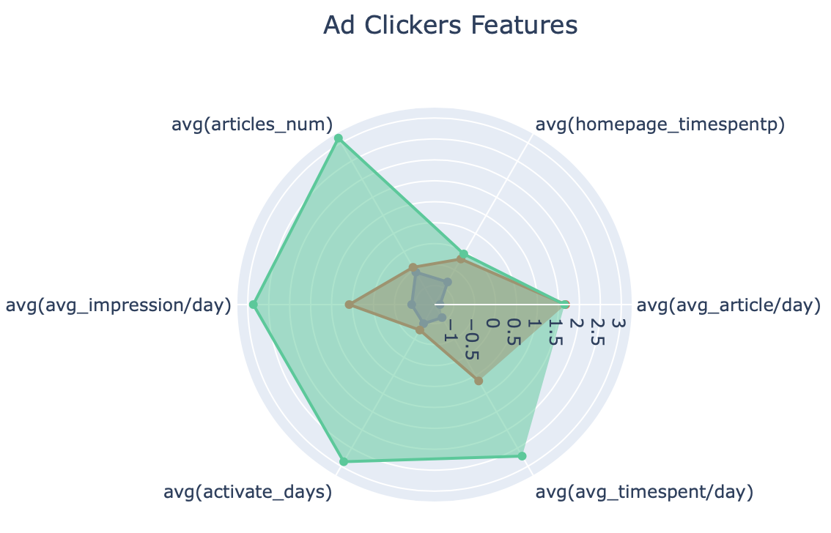
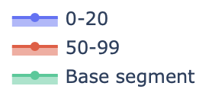
Sample Segment 1: Segment of Globe Ad Clickers - ADC, all users that clicked on ads in the last 90 days (794,628 users)
Features | Importance
homepage_timespentp | 0.199
section_total_timespent | 0.148
homepage_total_timespent | 0.064
avg_impression/day | 0.055
articles_num | 0.046
avg_article/day | 0.042
sum_time_spent | 0.037
avg_timespent/day | 0.027
activate_days | 0.025
sum_Computer | 0.019

Slide 6
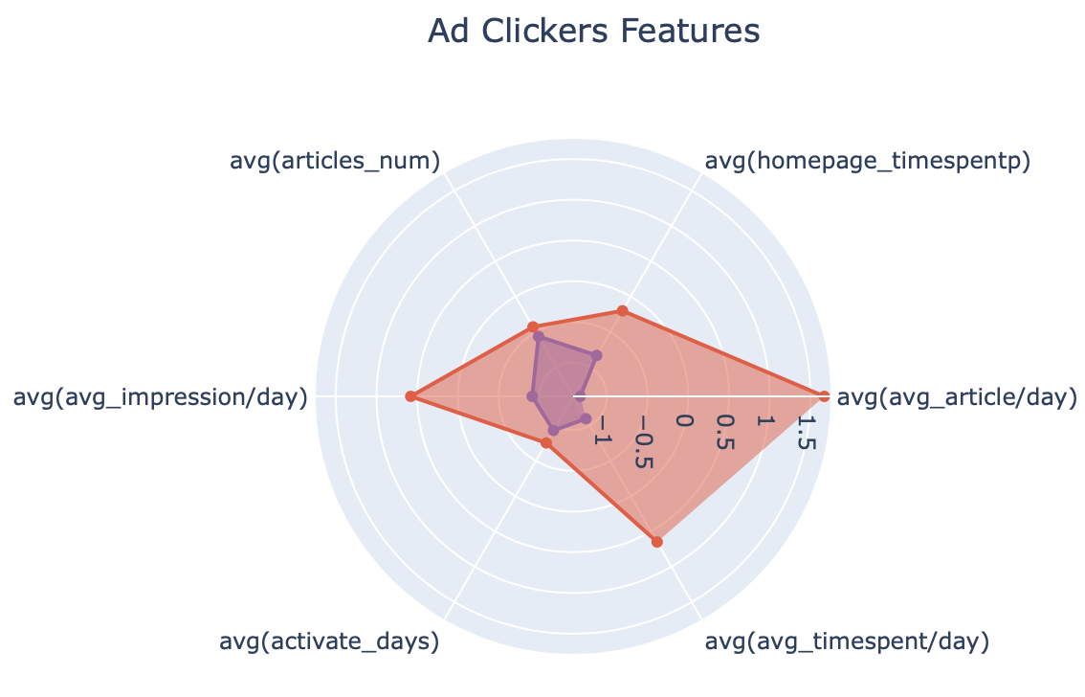
Sample Segment 1: Segment of Globe Ad Clickers - ADC, all users that clicked on ads in the last 90 days (794,628 users)
Features | Importance
homepage_timespentp | 0.199
section_total_timespent | 0.148
homepage_total_timespent | 0.064
avg_impression/day | 0.055
articles_num | 0.046
avg_article/day | 0.042
sum_time_spent | 0.037
avg_timespent/day | 0.027
activate_days | 0.025
sum_Computer | 0.019

Slide 7
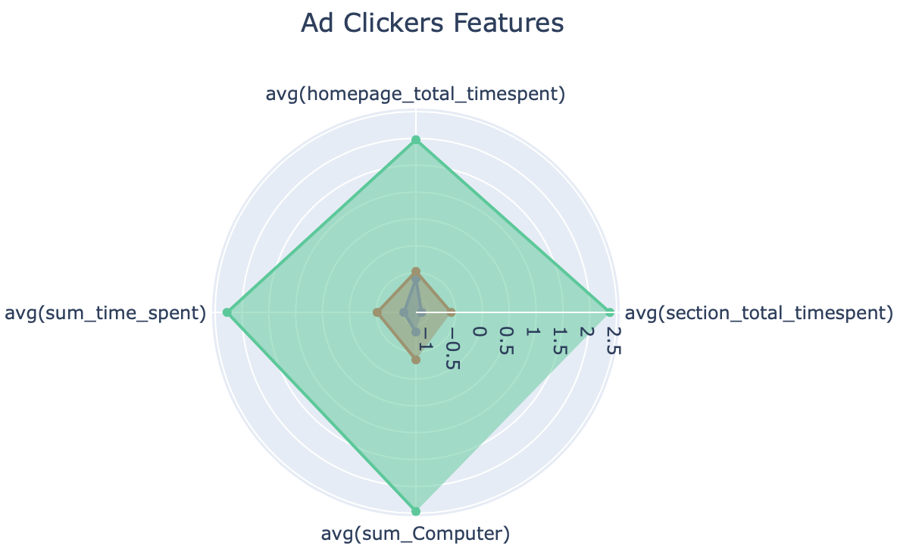
Sample Segment 1: Segment of Globe Ad Clickers - ADC, all users that clicked on ads in the last 90 days (794,628 users)
Features | Importance
homepage_timespentp | 0.199
section_total_timespent | 0.148
homepage_total_timespent | 0.064
avg_impression/day | 0.055
articles_num | 0.046
avg_article/day | 0.042
sum_time_spent | 0.037
avg_timespent/day | 0.027
activate_days | 0.025
sum_Computer | 0.019

Slide 8
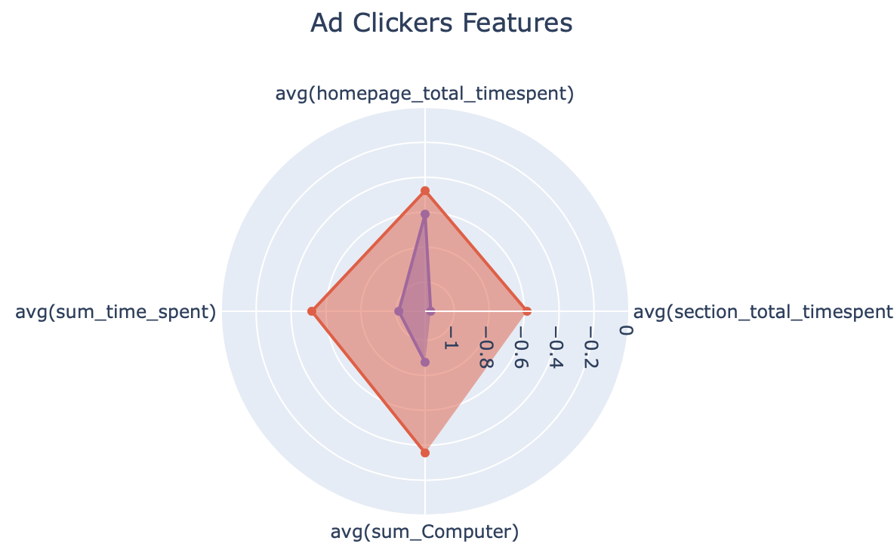
Sample Segment 1: Segment of Globe Ad Clickers - ADC, all users that clicked on ads in the last 90 days (794,628 users)
Features | Importance
homepage_timespentp | 0.199
section_total_timespent | 0.148
homepage_total_timespent | 0.064
avg_impression/day | 0.055
articles_num | 0.046
avg_article/day | 0.042
sum_time_spent | 0.037
avg_timespent/day | 0.027
activate_days | 0.025
sum_Computer | 0.019

Slide 9
Sample Segment 2: Segment of Globe readers with interest in Politics. Frequency 3/30 ( 89,363 users)
Score | # of Lookalikes | % of Lookalikes
90-99 | 1,933 | 0.004%
80-90 | 5,024 | 0.009%
70-80 | 13,149 | 0.025%
60-70 | 285,309 | 0.534%
50-60 | 410,903 | 0.769%
40-50 | 447,832 | 0.838%
30-40 | 1,462,802 | 2.739%
20-30 | 3,674,581 | 6.880%
10-20 | 42,562,558 | 79.690%
0-10 | 4,545,985 | 8.511%
Total | 53,410,076 | 100.000%

Slide 10
Sample Segment 2: Segment of Globe readers with interest in Politics. Frequency 3/30 ( 89,363 users)
SQL expression from Snowflake:
select adc_uid
from adc.public.adcv2_pageview_users
where (((p_contenttype_politics in ('Interested','Mildly Interested','Very Interested')) OR (ARRAY_CONTAINS('Politics Briefing'::VARIANT, newsletter)) OR (section in ('politics')))) and date >= current_date - 30
group by adc_uid
having ((count(distinct pageview_id) >= 3))

Slide 11
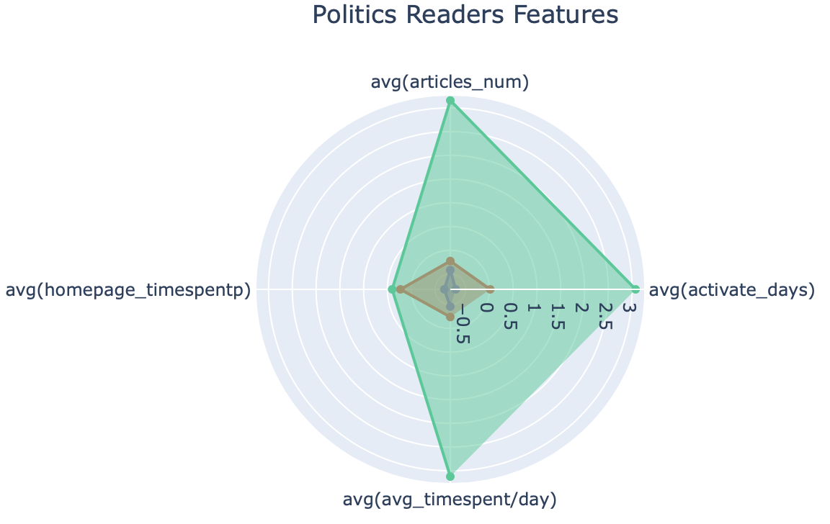
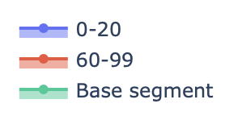
Sample Segment 2: Segment of Globe readers with interest in Politics. Frequency 3/30 ( 89,363 users)
Features | Importance
activate_days | 0.165
articles_num | 0.117
section_total_timespent | 0.076
homepage_total_timespentp | 0.067
sum_politics | 0.037
homepage_total_timespent | 0.034
sum_world | 0.032
sum_Mobile | 0.032
sum_Wed | 0.03
avg_timespent/day | 0.03

Slide 12
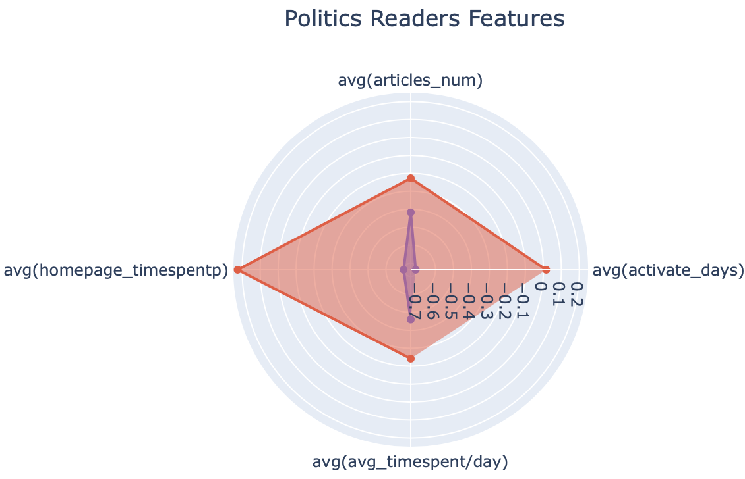
Sample Segment 2: Segment of Globe readers with interest in Politics. Frequency 3/30 ( 89,363 users)
Features | Importance
activate_days | 0.165
articles_num | 0.117
section_total_timespent | 0.076
homepage_total_timespentp | 0.067
sum_politics | 0.037
homepage_total_timespent | 0.034
sum_world | 0.032
sum_Mobile | 0.032
sum_Wed | 0.03
avg_timespent/day | 0.03

Slide 13
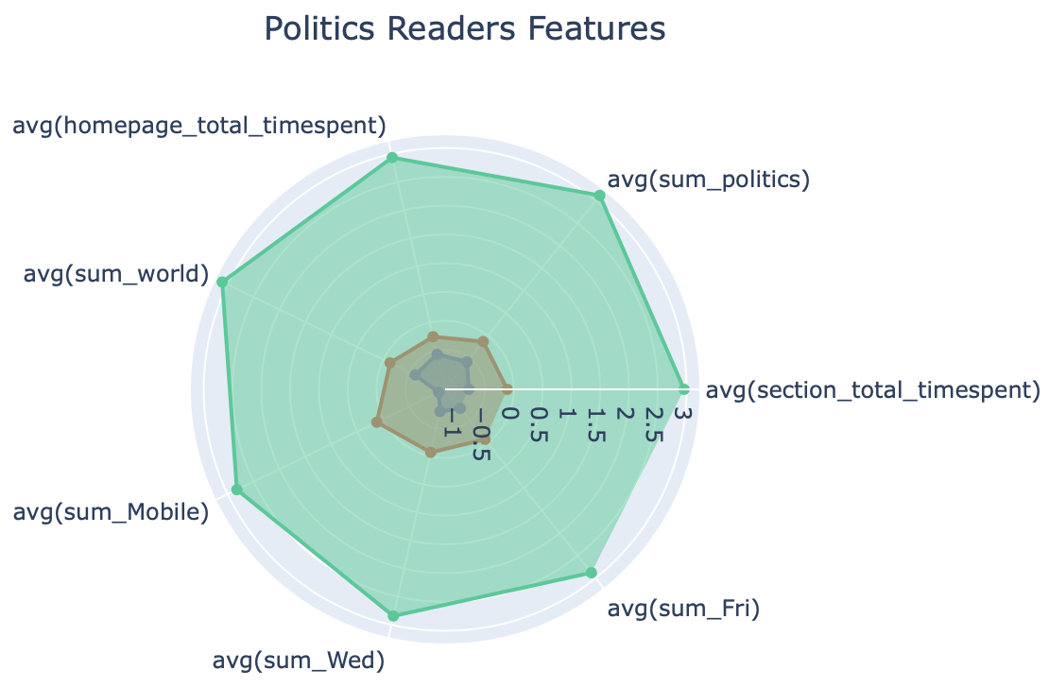
Sample Segment 2: Segment of Globe readers with interest in Politics. Frequency 3/30 ( 89,363 users)
Features | Importance
activate_days | 0.165
articles_num | 0.117
section_total_timespent | 0.076
homepage_total_timespentp | 0.067
sum_politics | 0.037
homepage_total_timespent | 0.034
sum_world | 0.032
sum_Mobile | 0.032
sum_Wed | 0.03
avg_timespent/day | 0.03

Slide 14
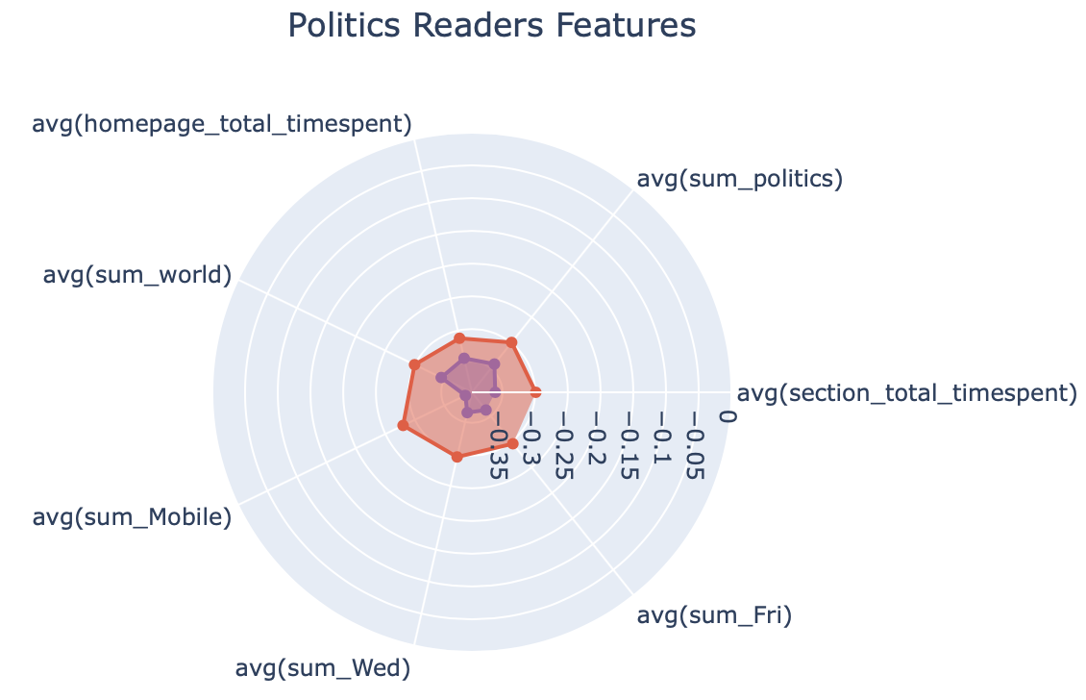
Sample Segment 2: Segment of Globe readers with interest in Politics. Frequency 3/30 ( 89,363 users)
Features | Importance
activate_days | 0.165
articles_num | 0.117
section_total_timespent | 0.076
homepage_total_timespentp | 0.067
sum_politics | 0.037
homepage_total_timespent | 0.034
sum_world | 0.032
sum_Mobile | 0.032
sum_Wed | 0.03
avg_timespent/day | 0.03

Slide 15
Sample Segment 3: Segments of users who do site search for stock tickers of top 5 banks TD, Scotiabank, Royal Bank of Canada, BMO or CIBC (33,569 users)
Score | # of Lookalikes | % of Lookalikes
90-99 | 8,346 | 0.016%
80-90 | 22,221 | 0.042%
70-80 | 331,620 | 0.620%
60-70 | 867,818 | 1.623%
50-60 | 1,190,699 | 2.227%
40-50 | 3,399,016 | 6.357%
30-40 | 42,066,334 | 78.679%
20-30 | 687,630 | 1.286%
10-20 | 95,548 | 0.179%
0-10 | 4,796,638 | 8.971%
Total | 53,465,870 | 100.000%

Slide 16
Sample Segment 3: Segments of users who do site search for stock tickers of top 5 banks TD, Scotiabank, Royal Bank of Canada, BMO or CIBC (33,569 users)
SQL expression from Snowflake:
select distinct adc_uid
from adc.public.adcv2_pageview_users
where (ARRAY_CONTAINS('td'::VARIANT, search_keyword) or ARRAY_CONTAINS('bns'::VARIANT, search_keyword) or ARRAY_CONTAINS('ry'::VARIANT, search_keyword) or ARRAY_CONTAINS('bmo'::VARIANT, search_keyword) or ARRAY_CONTAINS('cm'::VARIANT, search_keyword)) and date >= current_date - 90

Slide 17
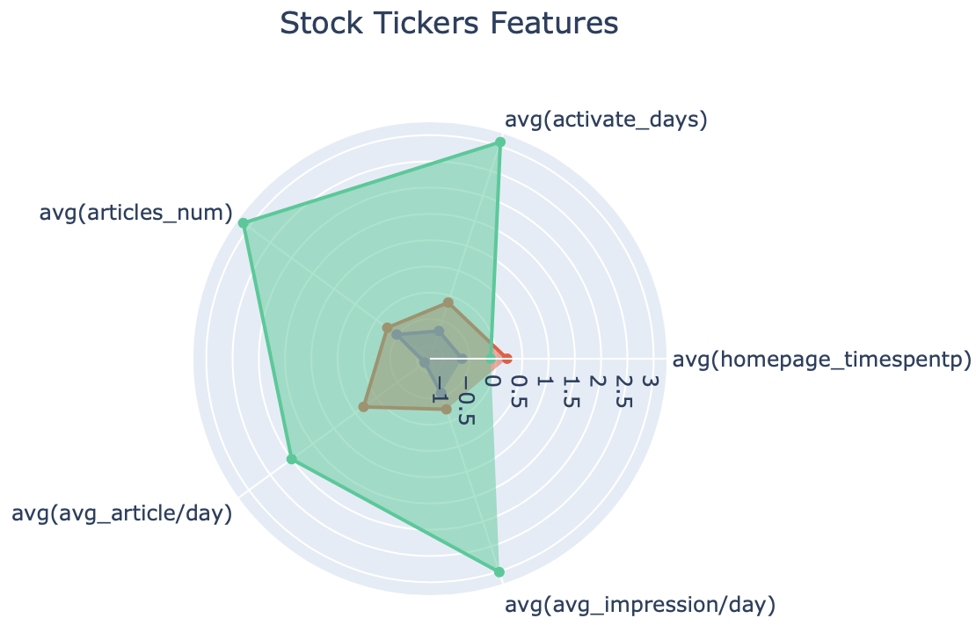
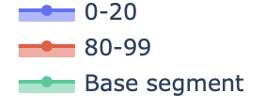
Sample Segment 3: Segments of users who do site search for stock tickers of top 5 banks TD, Scotiabank, Royal Bank of Canada, BMO or CIBC (33,569 users)
Features | Importance
homepage_timespentp | 0.121341
activate_days | 0.081270
sum_stocks | 0.065493
section_total_timespent | 0.065409
homepage_total_timespent | 0.063523
articles_num | 0.043504
avg_timespent/day | 0.037105
sum_time_spent | 0.031486
avg_article/day | 0.030519
avg_impression/day | 0.028161

Slide 18
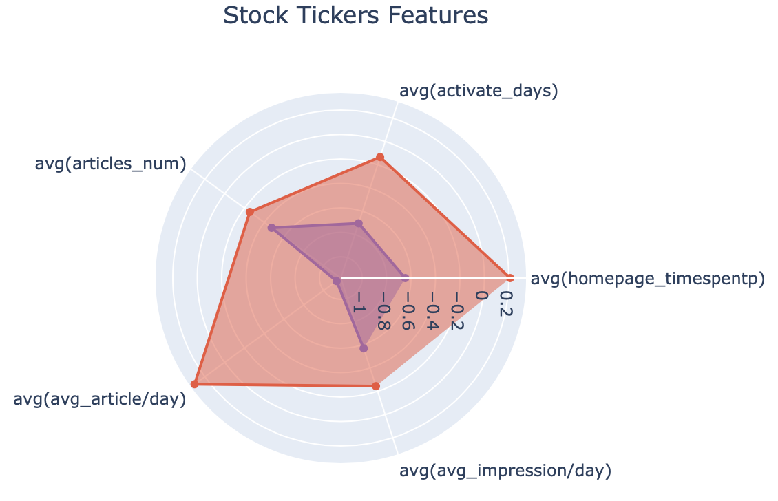
Sample Segment 3: Segments of users who do site search for stock tickers of top 5 banks TD, Scotiabank, Royal Bank of Canada, BMO or CIBC (33,569 users)
Features | Importance
homepage_timespentp | 0.121341
activate_days | 0.081270
sum_stocks | 0.065493
section_total_timespent | 0.065409
homepage_total_timespent | 0.063523
articles_num | 0.043504
avg_timespent/day | 0.037105
sum_time_spent | 0.031486
avg_article/day | 0.030519
avg_impression/day | 0.028161

Slide 19
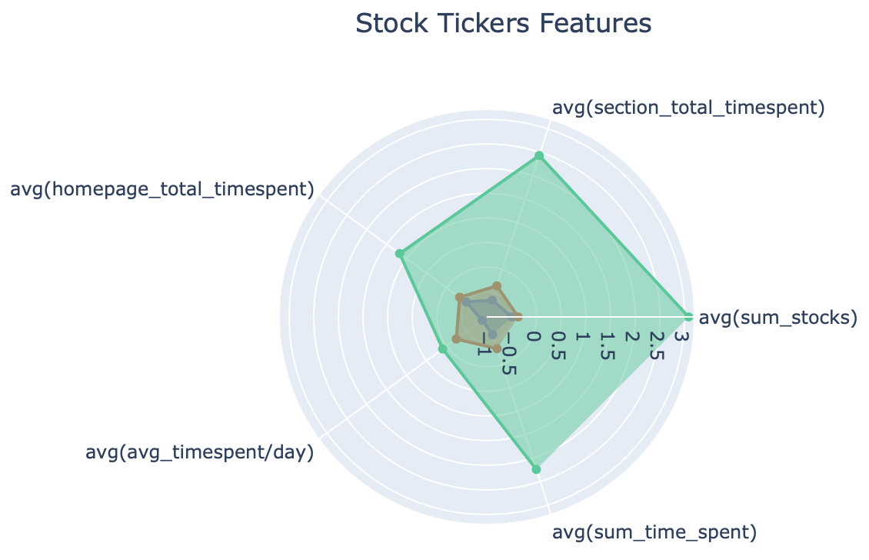
Sample Segment 3: Segments of users who do site search for stock tickers of top 5 banks TD, Scotiabank, Royal Bank of Canada, BMO or CIBC (33,569 users)
Features | Importance
homepage_timespentp | 0.121341
activate_days | 0.081270
sum_stocks | 0.065493
section_total_timespent | 0.065409
homepage_total_timespent | 0.063523
articles_num | 0.043504
avg_timespent/day | 0.037105
sum_time_spent | 0.031486
avg_article/day | 0.030519
avg_impression/day | 0.028161

Slide 20
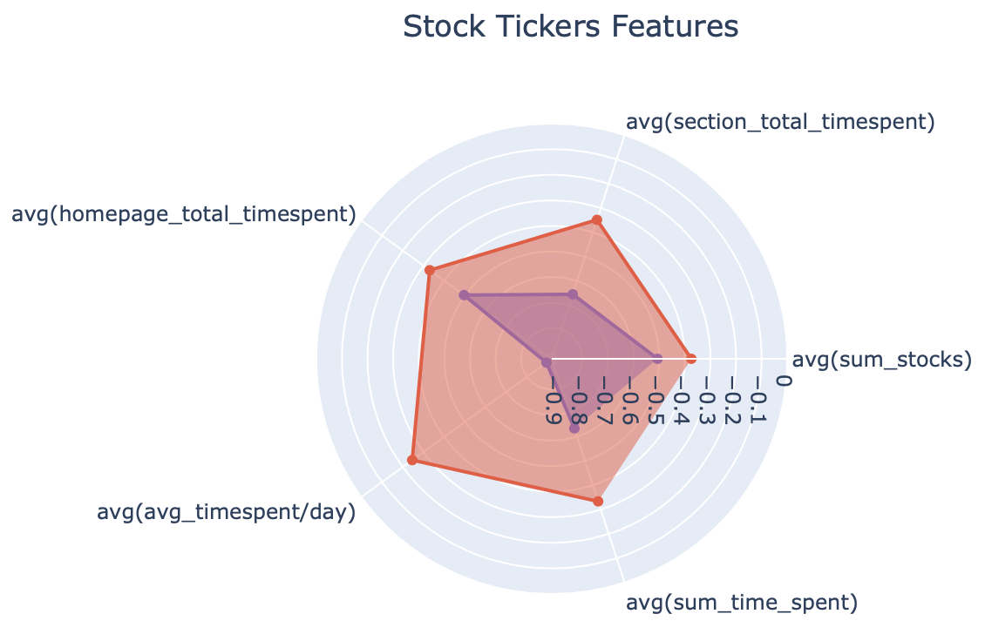
Sample Segment 3: Segments of users who do site search for stock tickers of top 5 banks TD, Scotiabank, Royal Bank of Canada, BMO or CIBC (33,569 users)
Features | Importance
homepage_timespentp | 0.121341
activate_days | 0.081270
sum_stocks | 0.065493
section_total_timespent | 0.065409
homepage_total_timespent | 0.063523
articles_num | 0.043504
avg_timespent/day | 0.037105
sum_time_spent | 0.031486
avg_article/day | 0.030519
avg_impression/day | 0.028161

