Slide 1
Lookalike Model Update Meeting
Beamdata
Apr.17th

Slide 2
Feature Table
Feature Engineering
Features are scaled
Important to be selective with NN / clustering
Because model does not weight the features
Must manually avoid correlation through feature engineering / selection
Curse of dimensionality

Slide 3
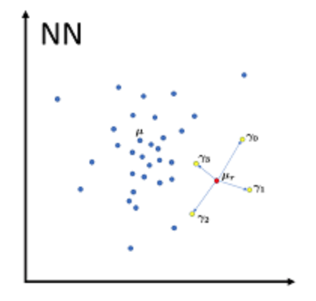
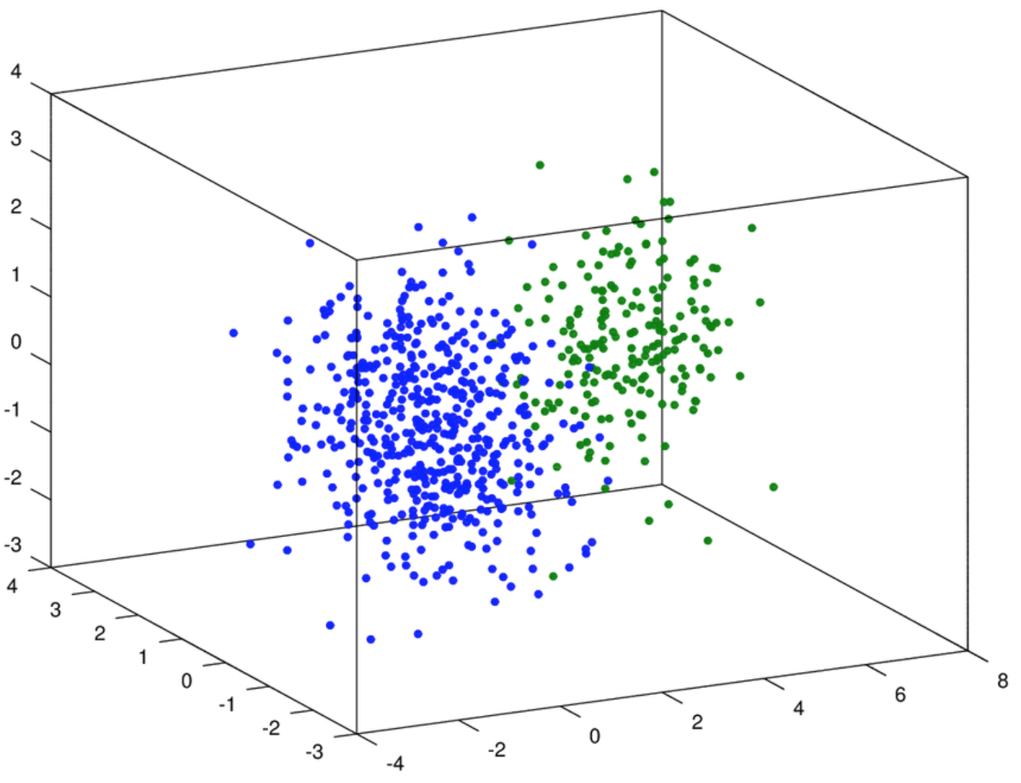
Modelling
Focus on Neighbor model
Spark version Nearestis Locality Sensitive Hashing (LSH)
Same concept, but lumps users into buckets of users for computational efficiency
Incorporates K Means Clustering
Splits each segment into optimal # of sub clusters (2-6)
Having multiple cluster centers improves accuracy of neighbors by casting a wider net

Slide 4
Similarity Score
Measures distance between each user and each cluster center
Orders neighbors based on distance - For all centers for each segment
We will normalize this distance to use as a similarity scale (0-100)
Can either select certain number of users OR users above a certain similarity score
Returns a ranked list of neighbors’ ADC_UIDs for each segment

Slide 5
Current works
Currently the model works on a sample of simplified test data (size)
Must run model on full-sized dataset
Test for bugs
How long does the model take to run?
Optimistic from our testing (batch run), but hard to predict
Engineer similarity score from Euclidean distance

Slide 6
Future Plan
Explore similar neighbors algorithm:
Min Hash (using Jaccard distance)
Test more classification models
Encouraging early results
More complex and difficult to understand
Not industry standard
Connect models to live database
Model Implementation

