Slide 1
GCS WorkHub
Work, Workload & Performance Management Platform
A proposal for a centralized operating layer for Globecon Convergence Solutions
EMPLOYEES
DEPARTMENTS
PROJECTS
EXECUTIVES
GCS WorkHub • Concept proposal
1

Slide 2
GCS
The opportunity
Move from fragmented activity tracking to one operational source of truth.
Today’s common challenge
What GCS WorkHub changes
The result
• Tasks live across email, chats, spreadsheets and people’s memory.
• Deadlines can be visible to the assignee but invisible to management.
• Workload is difficult to compare across people and departments.
• Management often receives status after a problem has already occurred.
• Every important responsibility and task has an owner, timeline and status.
• Departments become visible operating units rather than isolated teams.
• Blockers, dependencies and approvals become trackable events.
• Management gets early warning instead of late explanations.
• Clear accountability without relying on manual follow-up.
• Better workload distribution and prioritization.
• Faster escalation of overdue or blocked work.
• A foundation for automation, analytics and future AI.
GCS WorkHub • Internal concept proposal
2

Slide 3
GCS
The vision
A single operating layer connecting people, work, projects, departments and management.
People
Responsibilities
Projects
GCS WORKHUB
ONE SOURCE OF TRUTH
Departments
Management
Workload
GCS WorkHub • Internal concept proposal
3

Slide 4
GCS
How work flows through GCS WorkHub
The system follows the real lifecycle of work — from responsibility to delivery.
01 Create
02 Plan
03 Execute
04 Review
05 Close
Responsibility / task is created
Owner, priority, effort & deadline
Work progresses; blockers are captured
Approval or evidence where required
Completed work feeds reports & KPIs
Design principle
• The system should make the next action obvious: who owns the work, what is expected, when it is due, what is blocking it, and what happens next.
GCS WorkHub • Internal concept proposal
4

Slide 5
GCS
Employee workspace
Give every person one place to see, plan and report their work.
My Workspace
Each task can capture
• Owner • project • client • priority
• Start & due dates • estimated effort
• Status • blockers • dependencies
• Comments • evidence • attachments
8
2
1
17
Active
Due today
Overdue
Completed
Update company website
High
12 Aug
In Progress
Responsibilities are different from tasks
Prepare client report
Medium
14 Aug
Not Started
• Responsibilities define what a person owns.
• Tasks are the concrete pieces of work.
• Recurring responsibilities can generate tasks automatically.
• This creates a clearer picture of role + activity.
Configure server
Critical
13 Aug
In Progress
Monthly analytics report
Medium
15 Aug
Waiting
GCS WorkHub • Internal concept proposal
5

Slide 6
GCS
Department management
Department Heads should see the health of the whole team — not just individual tasks.
Department
Active
Due this week
Overdue
Completion
Department Head view
Technology
24
9
2
91%
• Team workload • task health • deadlines
• Projects • approvals • blockers
Operations
18
7
1
94%
Marketing
15
6
3
82%
Drill-down
• Department → employee → project → task
• See why work is late, not just that it is late.
• Reassign work or escalate directly.
Finance
8
3
0
100%
GCS WorkHub • Internal concept proposal
6

Slide 7
GCS
The MD dashboard
The MD should be able to understand the company in minutes — then drill down when action is required.
87
9
6
14
4
Active tasks
Overdue
Blocked
Active projects
Overloaded staff
⚠ Attention required
Department completion rate
• 3 overdue high-priority tasks
• 2 departments below target
• 1 project behind schedule
• 4 employees above capacity
• 2 client deliverables awaiting approval
Technology
91%
Operations
94%
Marketing
82%
Finance
100%
Business Development
76%
GCS WorkHub • Internal concept proposal
7

Slide 8
GCS
Workload & capacity management
The goal is not to count tasks — it is to understand whether the work is realistically achievable.
AVAILABLE CAPACITY
PLANNED EFFORT
GAP / SURPLUS
MANAGEMENT ACTION
Example: employee capacity
Weekly workload
• Available this week: 32 hours
• Assigned estimated effort: 46 hours
• Capacity gap: 14 hours
• System flags the person as overloaded
• Manager can reassign, reprioritize or adjust deadlines
32h capacity | 46h planned
OVERLOADED
GCS WorkHub • Internal concept proposal
8

Slide 9
GCS
Projects, dependencies & deliverables
Tasks should roll up into projects so management can see progress, risk and downstream impact.
Requirements
Design
Development
Testing
Deployment
Done
Done
In progress
Waiting
Not started
Dependencies
Deliverables & evidence
• Task B can depend on Task A.
• If A slips, WorkHub surfaces downstream impact.
• Dependencies can be internal, client, vendor or technical.
• Blockers are tracked separately from employee performance.
• Attach reports, documents, screenshots or links.
• Some tasks can require approval before closure.
• Completion becomes verifiable, not just a status click.
• Project completion can roll up from deliverables.
GCS WorkHub • Internal concept proposal
9

Slide 10
GCS
Automation with n8n
The tracker remains the source of truth; n8n becomes the automation engine for reminders, escalations and reports.
GCS Tracker Task data
Schedule / Trigger Check deadlines
Decision Approaching?
Notification Email / message
Log Record delivery
7 days before
3 / 1 day before
Overdue
7+ days
• Friendly reminder to owner.
• No escalation.
• Reminder with priority and due date.
• Owner can update status or request help.
• Notify owner.
• Escalate according to rules.
• Department Head / MD visibility.
n8n supports customizable automated reminder workflows.
GCS WorkHub • n8n can automate scheduled reminders, notifications and workflow-driven email.
10

Slide 11
GCS
Management communication & escalation
The MD and Department Heads should be able to act directly from the work record.
Request update • Task #GCS-1042
Every management action is logged
• Sender • recipient • timestamp
• Related task / project
• Message type and delivery status
Hello John, Please provide an update on the current status of this task and confirm the expected completion date.
Why this matters
• Communication stays attached to the work.
• Follow-ups become searchable and auditable.
• Custom emails remain possible alongside automation.
SEND MESSAGE
ESCALATE
REQUEST UPDATE
GCS WorkHub • Internal concept proposal
11

Slide 12
GCS
KPIs & performance intelligence
Turn activity data into meaningful management signals — without reducing performance to task counts.
92%
84%
96%
88%
Deadline adherence
Project health
SLA compliance
Capacity utilized
Performance should consider
What we should avoid
• Completion rate and deadline adherence
• Task priority and complexity
• Quality / rework / approvals
• Client or project impact
• Blockers and dependencies
• Department and individual KPIs
• Ranking people purely by number of tasks.
• Treating every overdue item as employee failure.
• Using activity volume as a proxy for value.
• Ignoring external blockers or dependencies.
GCS WorkHub • Internal concept proposal
12

Slide 13
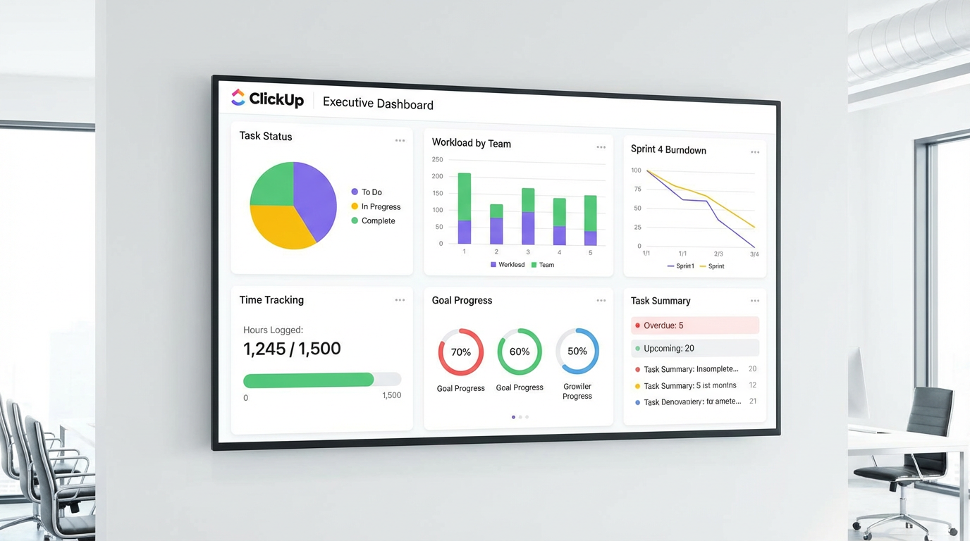
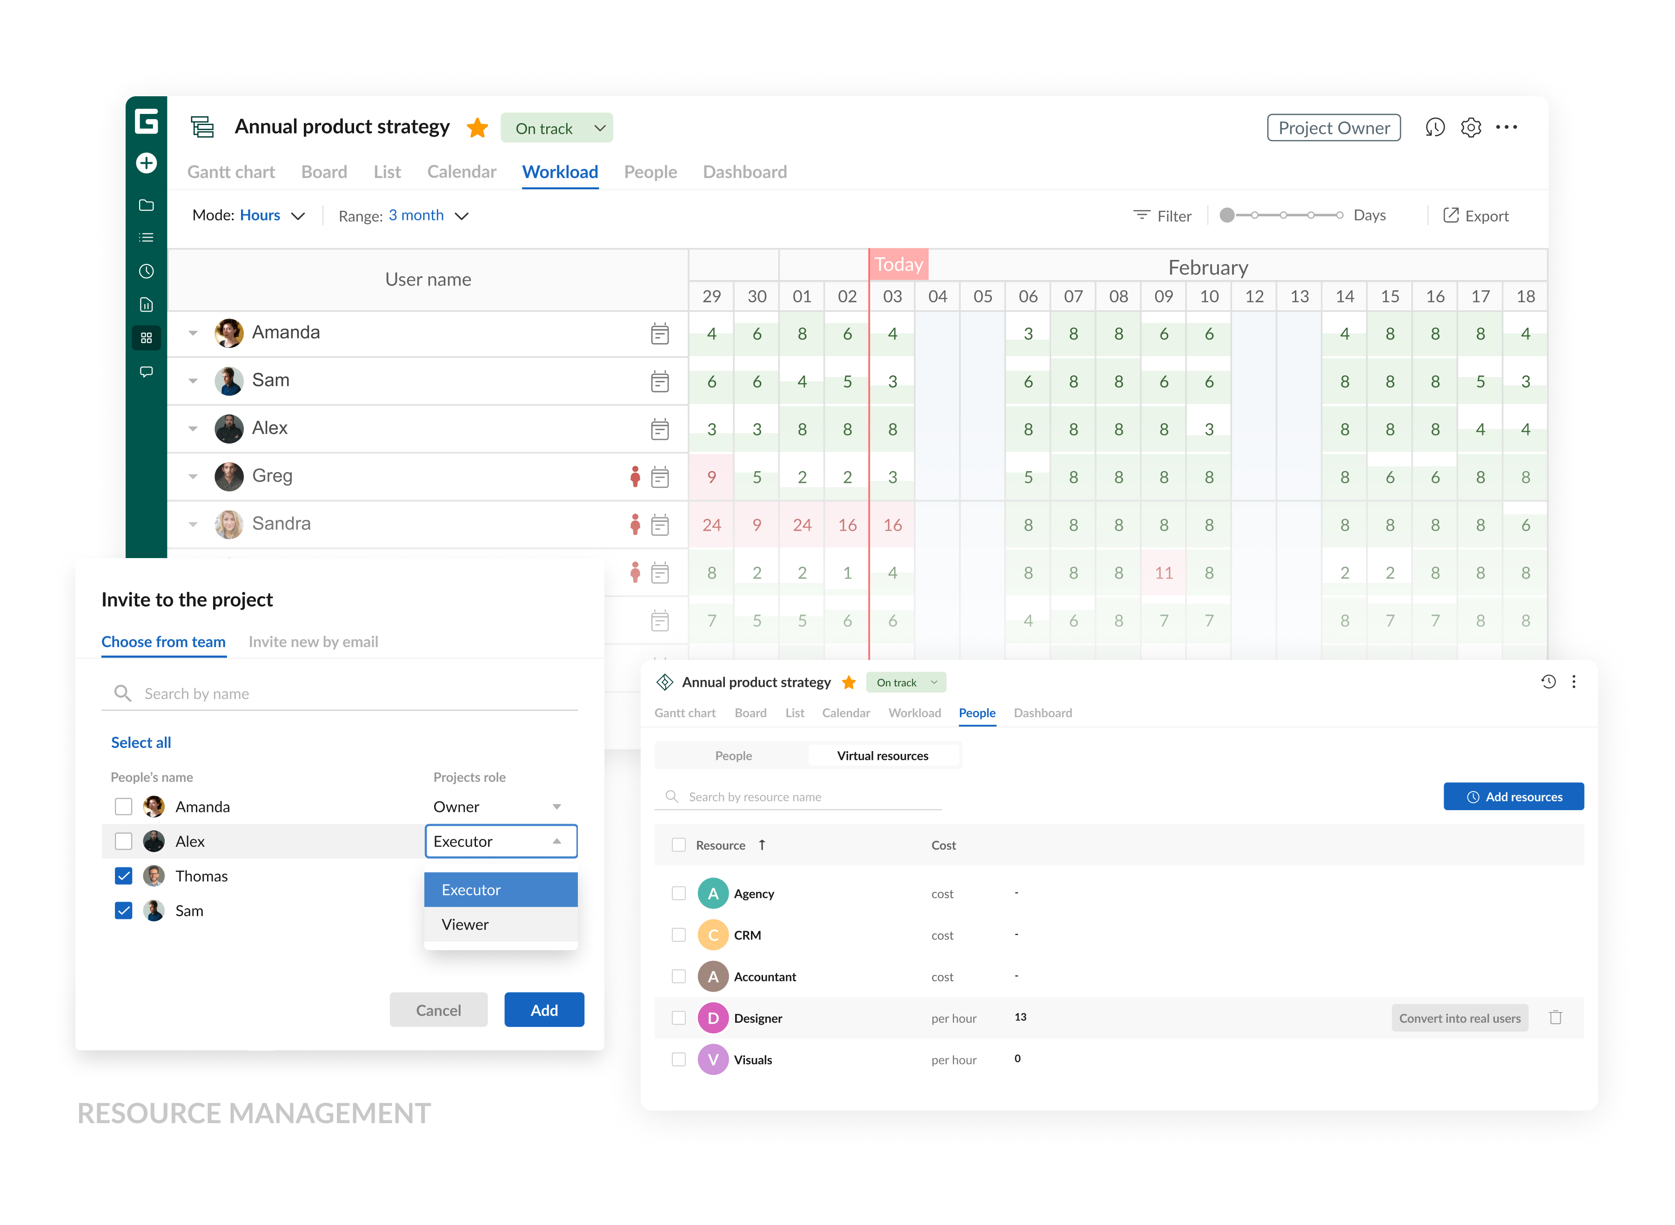
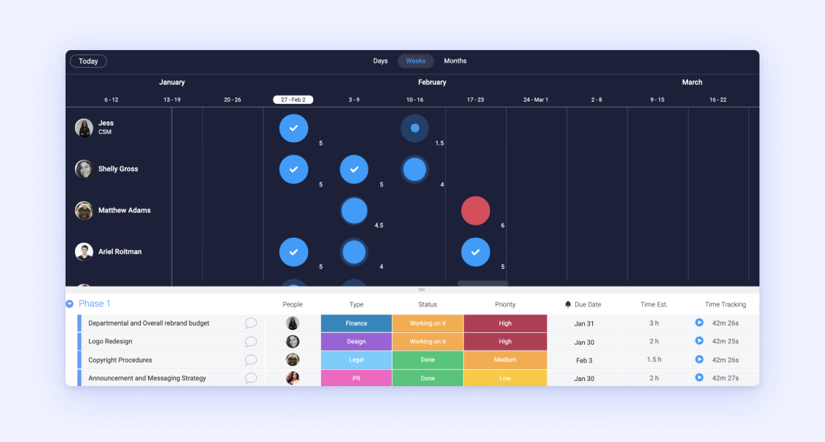
GCS
Reference point: modern work-management interfaces
These examples illustrate the type of visibility GCS WorkHub can bring together — while remaining tailored to GCS.
EXECUTIVE DASHBOARD
WORKLOAD VIEW
CAPACITY / RESOURCE PLANNING
Illustrative interface references: ClickUp, GanttPRO and monday.com resource-management views.
GCS WorkHub • Internal concept proposal
13

Slide 14
GCS
Proposed technical architecture
Keep the core system modular so automation, analytics and future integrations can evolve independently.
USERS
Employees • Department Heads • MD • Admin
GCS WORKHUB
Web app • tasks • projects • responsibilities • approvals • dashboards
GCS DATABASE
Users • departments • tasks • projects • clients • KPIs • audit logs
AUTOMATION
n8n • email alerts • escalations • scheduled reports • integrations
ANALYTICS
Power BI • management reporting • trends • workload • performance
GCS WorkHub • Internal concept proposal
14

Slide 15
GCS
Beyond the first version
The platform can become a broader GCS operations layer over time.
Client work
SLA tracking
• Separate internal vs client work; connect projects to clients.
• Measure response and resolution times against commitments.
Calendar
Leave / availability
• Bring meetings, deadlines, milestones and availability together.
• Adjust workload capacity when people are unavailable.
Approvals
AI assistant
• Formal review flows for reports, deliverables, finance and deployments.
• Ask management questions in natural language and generate summaries.
Resource planning
Project profitability
• Understand who has capacity and where resources are constrained.
• Combine effort and costs with project/client revenue where appropriate.
GCS WorkHub • Internal concept proposal
15

Slide 16
GCS
Recommended implementation roadmap
Start small, prove adoption, then add intelligence.
PHASE 1 CORE WORKHUB
PHASE 2 AUTOMATION
PHASE 3 INTELLIGENCE
PHASE 4 OPERATIONS
PHASE 5 AI
Users • departments • tasks • responsibilities • projects • dashboards
n8n reminders • escalation • management requests • weekly reports
Workload • capacity • KPIs • SLA • Power BI
Calendar • approvals • client work • resource / cost tracking
Natural-language insights • summaries • risk signals • recommendations
Recommended principle
• Do not build every feature at once. Build the operational backbone first, then use real usage data to decide what should come next.
GCS WorkHub • Internal concept proposal
16

Slide 17
What success looks like
Every important piece of work has an owner, a deadline, a status, a reason when blocked, and a clear path to completion.
VISIBILITY
Know what is happening.
ACCOUNTABILITY
Know who owns it.
AUTOMATION
Follow up automatically.
INTELLIGENCE
Know where to act.
Proposed next step: approve the blueprint → define requirements → build the Phase 1 prototype.
GCS WorkHub • Internal concept proposal
17

Slide 18
GCS
Appendix: proposed core data model
A foundation designed to support the first release and future expansion.
Users identity • role • department • manager
Departments name • head • KPIs
Responsibilities owner • recurring pattern • scope
Tasks owner • project • priority • dates • status
Projects client • milestones • health • budget
Dependencies predecessor • successor • blocker
Approvals reviewer • decision • timestamp
Notifications channel • recipient • delivery status
KPIs / SLAs target • actual • period • owner
Audit Logs who • what changed • when • before/after
Key architecture rule
• Keep responsibilities, tasks, projects, notifications and audit history as distinct records so the system can scale cleanly.
GCS WorkHub • Internal concept proposal
18

