Slide 1
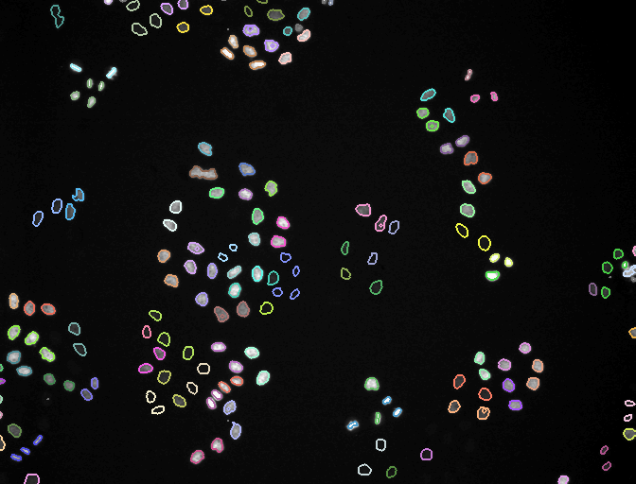
Can an AI agent run, and rerun, a bioimage analysis?
GLOBIAS 2026 · GROUP 5 · SESSION 06 BENCHMARKING
One 2014 ilastik workflow, five Claude sessions
THE BLIND RUNS' WHOLE BRIEF
“I want to answer group 5 task question, use ilastik and the mitocheck dataset”
+ the assignment PDF (the group question: “Can consensus become ground truth?”). No repository, no notes.
Frame 40 of the MitoCheck movie: each lineage in its own colour
Notes:
Hello everyone. This talk is about one bioimage analysis and five AI agent sessions. The analysis is ilastik's MitoCheck example: a movie of dividing cell nuclei, with two ilastik projects that were trained by hand in 2014, one for finding nuclei and one for tracking them. In October 2026 we let Claude, a large language model, run that workflow in agent sessions: first the original run, then two reproductions that had its notes, then two blind runs that did not. The picture is frame 40 of the tracking result, each lineage in its own colour. Everything I show comes from our group's repositories. This one line and the PDF were everything Runs 3 and 4 received.

Slide 2



What an agent session is
It gets a computer
5
In a chat, Claude only writes text. Here it can also run commands, install software, and read and write files.
It loops: command → result → next command
agent sessions
It reads error messages and tries again, on its own, until the task is done or it gets stuck.
October 2026 · five sessions · same data
The person watches and can step in
They answer questions and can step in at any time.
Notes:
Most of you have used a chat assistant. In a chat, Claude only writes text. In an agent session it also gets a computer: it can run commands, install software, read and write files, read error messages and try again. It does this in a loop, on its own: run a command, look at the result, choose the next command, until the task is done or it gets stuck. The person watches, answers questions and can step in at any time. Everything in this talk happened in such sessions, in October 2026: five sessions, all working on the same data.

Slide 3
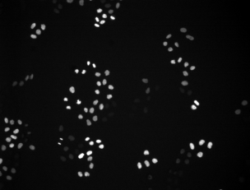
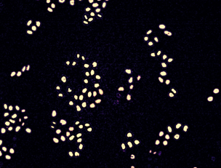
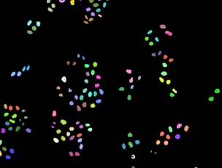
The data and the workflow
53-frame movie
of dividing cell nuclei: ilastik's MitoCheck example
→
→
2014 project 1
pixel classification, trained by hand: finds nuclei
raw frame
probability map
tracking labels
the movie, frame 26
pixel classification
tracking
2014 project 2
Lineage: a nucleus and all its descendants. Each lineage gets its own colour; grey objects were detected but not tracked. Run headless: from the command line, with no window.
tracking, trained by hand: follows them
Notes:
The data is ilastik's MitoCheck example: a 53-frame movie of dividing cell nuclei, plus the two ilastik projects trained by hand in 2014. The workflow has two steps. First, pixel classification: the 2014 project gives every pixel of every frame a score, how nucleus-like is this pixel, which makes a probability map, the middle image. Then tracking: the second project finds each nucleus in that map, follows it from frame to frame and notices divisions. A nucleus and all its descendants form one lineage. The goal was the final tracking labels, with ilastik run headless, meaning from the command line with no window.

Slide 4
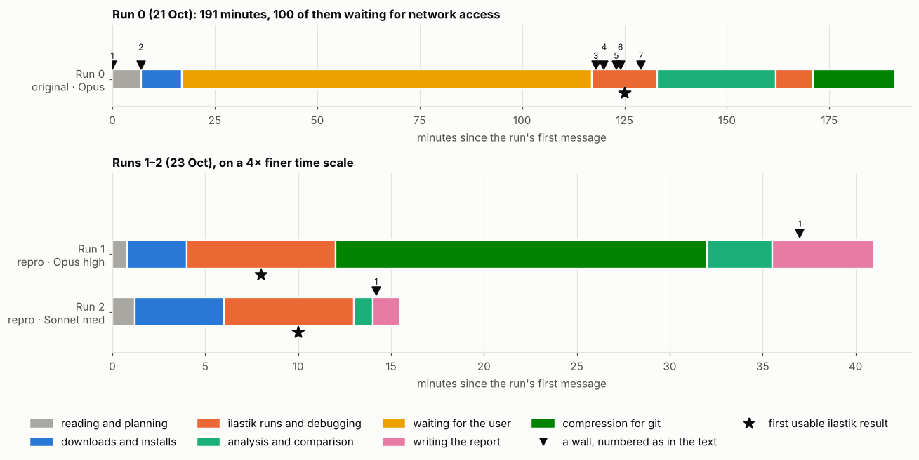
Runs 0–2: the same workflow, three times
191 min
Run 0: 100 of them waiting for network access; 7 walls
0 of 7
walls met by Runs 1–2, in 41 and ≈15 min, with no help
a wall
Colours are activities. Runs 1–2 are drawn on a 4× finer time scale.
★
first usable ilastik result
Notes:
Run 0 was the original, on 21 October, with Opus. The agent started with an almost empty code repository and no access to ilastik's website. This figure shows how each session spent its time, in minutes from its first message. Colours are activities, the black triangles are walls, and the star marks the first usable ilastik result. Run 0 took 191 minutes, 100 of them waiting for network access, and met seven walls. Below it, on a finer scale, the two reproductions ran the same workflow in 41 and about 15 minutes, with no help and none of those seven walls.

Slide 5
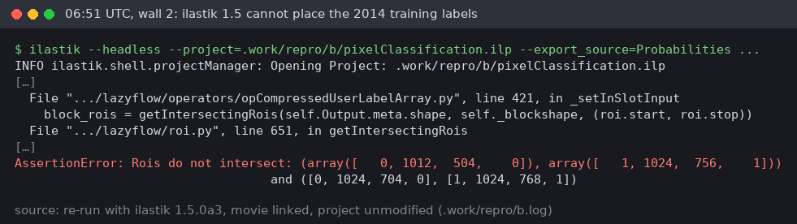

Run 0: the seven walls and their fixes
WALL
FIX
Network to ilastik's website blocked
→
The person allowed the site
ilastik 1.4.1 no longer installs with the usual package manager
→
Newer pre-release, 1.5.0a3
The labels wall: 1.5.0a3 cannot place the 2014 training labels
1.5.0a3 reads the 2014 labels with rows and columns swapped
→
Small fix script
Plus two unchecked claims
Tracking settings kept where current versions no longer look
→
Small fix script
That the versions numbered lineages differently; that 1.3.2post1 "crashes on this project". A second look caught both, and the text was corrected.
1.3.1 (the person's suggestion) is not in the public archive
→
Tried 1.3.2post1
1.3.2post1 crashed: the computer's system libraries, not the project
→
Settled on 1.3.3post3
Notes:
Getting to the result took seven walls; here are the main ones. The network block: the person had to allow the site. ilastik 1.4.1 no longer installs with the usual package manager, so the agent used a newer pre-release, 1.5.0a3. That version could not place the 2014 project's own training labels, because it reads them with rows and columns swapped; the error is on the right. And the tracking project kept its settings where current versions no longer look. For each wall it read the error and, where needed, ilastik's own code, then switched version, linked a file into place or wrote a small fix script. Version 1.3.1 is not in the public archive; 1.3.2post1 crashed; it settled on 1.3.3post3.

Slide 6
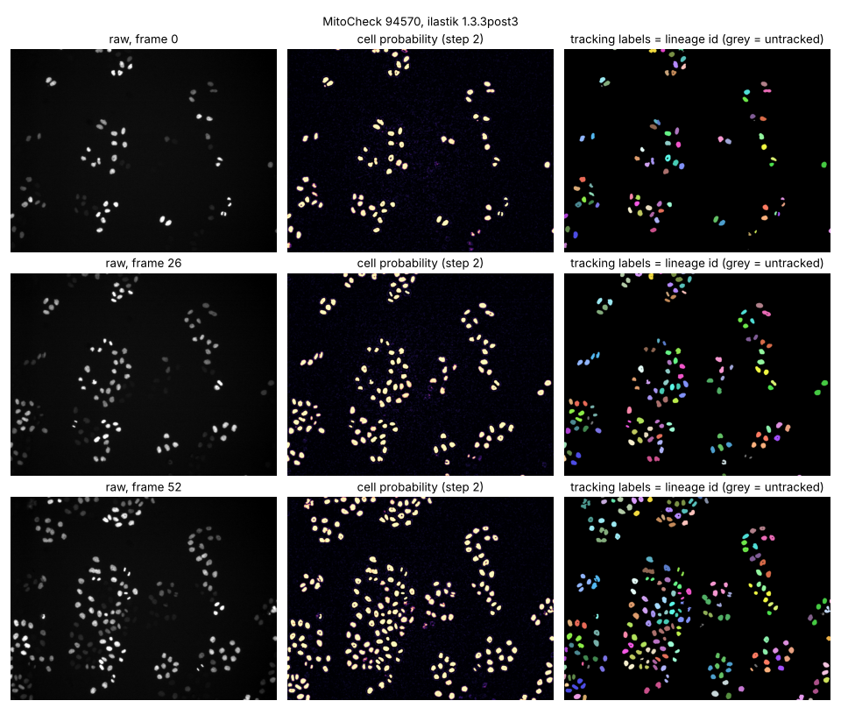
Run 0: the result
7,485
357
detections over the 53 frames
tracks
117
120
lineages
divisions
Both versions give the same counts. Their label images differ in 161 of 3.6 million pixels.
Notes:
And this is the result, on three frames of the movie: the raw frame on the left, the probability map in the middle, the tracking labels on the right, each lineage in its own colour; grey objects were detected but not tracked. Both ilastik versions, 1.5.0a3 and 1.3.3post3, gave the same counts: 7,485 detections over the 53 frames, 357 tracks in 117 lineages, and 120 divisions. Their label images differ in only 161 of 3.6 million pixels. Remember the two unchecked claims from the last slide: one of them was that the versions numbered lineages differently. A second look caught it.

Slide 7
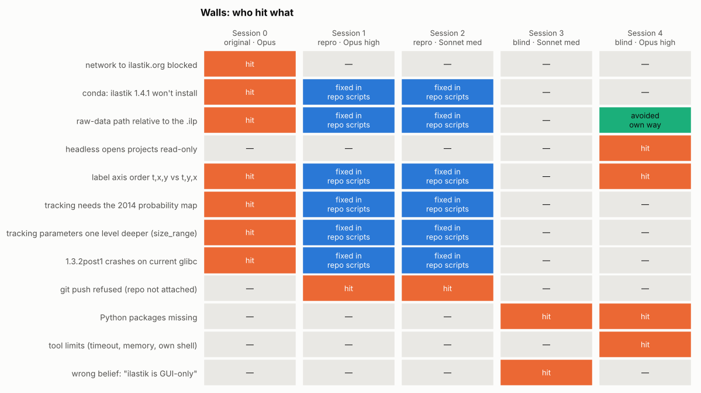
Runs 1 and 2 (23 Oct): reproduce it with the notes
Two fresh sessions were pointed at Run 0's repository and told to regenerate the results, not copy them.
0
times the person was needed
0 of 7
Run 0's walls met
≈15 min
Sonnet, medium effort
41 min
Opus, high effort: mostly compressing files
Orange: hit · Blue: fixed by Run 0's scripts · Green: avoided · Grey: not met
Notes:
Two days later, on 23 October, two fresh sessions, one Opus at high effort and one Sonnet at medium, were pointed at Run 0's repository and told to regenerate the results, not copy them. Neither needed the person at all. Both read the documentation, re-downloaded the data, ran the committed scripts and compared their output with Run 0's. This grid shows who hit which wall: orange means hit, blue means Run 0's scripts had already fixed it. They met none of Run 0's seven walls. Sonnet finished in about 15 minutes, Opus in 41, mostly because Opus also compressed the large files so they could be stored in the repository.

Slide 8
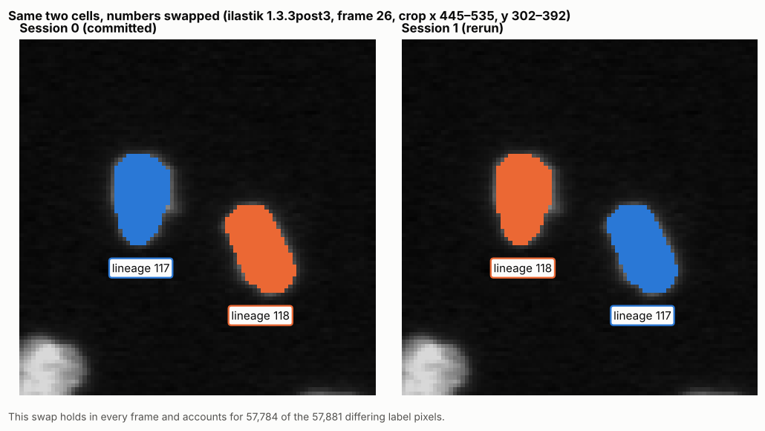
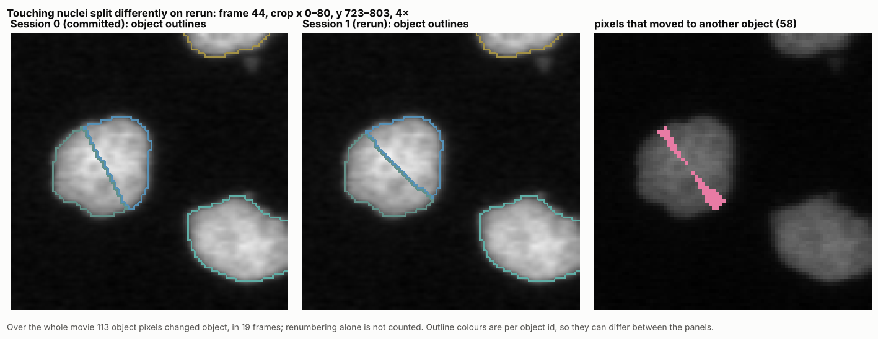
Reproducible, but one step not exactly repeatable
Two lineages swap numbers (Run 0 vs Opus rerun)
The border between two touching nuclei moves
identical
113 px
50 px
1.5.0a3, both reruns: tracking labels pixel for pixel
1.3.3post3, Opus rerun: two lineages renumbered; 80 of the pixels at the touching pair
1.3.3post3, Sonnet rerun: pixels that differed
Notes:
Did they get the same answer? In both reruns the 1.5.0a3 tracking labels were identical to Run 0's, pixel for pixel, and Opus showed the probability maps identical too. The 1.3.3post3 tracking was not. In the Opus rerun two lineages swapped numbers, shown on the left, and 113 pixels changed object, 80 of them on the border between two touching nuclei, shown on the right. The Sonnet rerun differed in 50 pixels. So the pipeline is reproducible, but one step in the old version is not exactly repeatable from run to run.

Slide 9




Runs 3 and 4: the same question, without the notes
RUNS 3 AND 4
They could not see the repository
WHAT THEY GOT
The assignment PDF, with the group's question:
"Can consensus become ground truth?"
and one line: use ilastik and the MitoCheck dataset.
Neither ran the example's tracking; each built a consensus experiment
Their strategies parted in the first minute
Notes:
Now the harder test. Two more sessions got only the assignment PDF, with our group's question, 'Can consensus become ground truth?', and one line: use ilastik and the MitoCheck dataset. They could not see the repository. Neither ran the example's tracking. Each built a consensus experiment with several annotators, which is what the question asks for, and then compared voting rules. Their strategies parted in the first minute, so I will follow each one in turn: first Run 3, with Sonnet, then Run 4, with Opus.

Slide 10
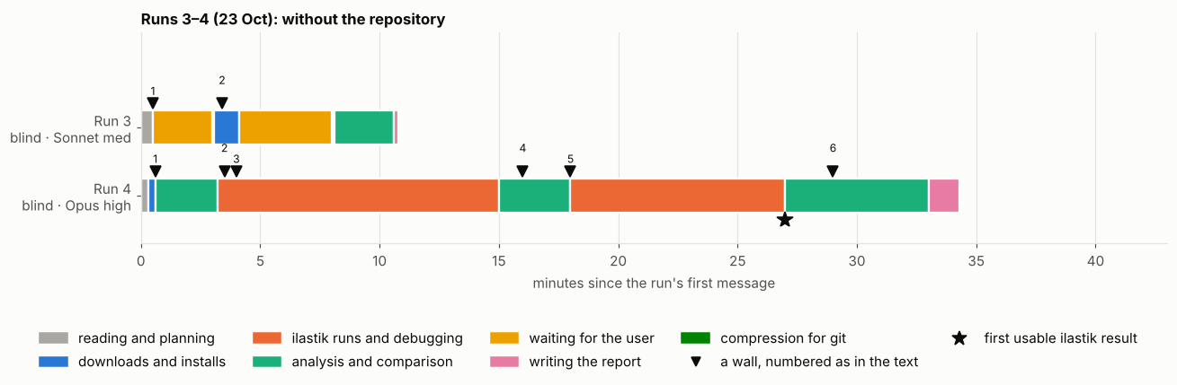
Runs 3–4: the question, the data, nothing else
Run 3 (Sonnet) — 11 min, 6 of them waiting for the person; no ilastik
Run 4 (Opus) — 34 min, no questions; ilastik 1.4.2, headless
★ = first retrained classifier. Neither ran the example's tracking.
Notes:
Here are the two blind runs on the same kind of time chart. Run 3, with Sonnet, took 11 minutes, and six of them were spent waiting for the person to answer its two questions. It never ran ilastik, so it never reaches a star. Run 4, with Opus, took 34 minutes and asked nothing. Within the first minute it was downloading ilastik 1.4.2, and it worked headless from then on. Its star marks its first retrained classifier, not the example's tracking. Neither blind run ran the example's tracking at all.

Slide 11
How ilastik was used, run by run
RUN | RAN ILASTIK? | PIXEL CLASSIFICATION | TRACKING
Runs 0, 1, 2 | yes: 1.3.3post3 and 1.5.0a3 | the 2014 project, as is | the 2014 project, as is
Run 4 (Opus) | yes: 1.4.2 | the 2014 project retrained 8× with new strokes (--retrain) | no
Run 3 (Sonnet) | no | re-implemented outside ilastik (scikit-learn) | no
“Use ilastik” fixed the tool, not the workflow: the runs with the repository ran the example; Run 4 used ilastik as a trainable classifier; Run 3 kept only ilastik's files.
Notes:
Only Runs 0, 1 and 2 did tracking: each ran the 2014 tracking project on a freshly computed probability map. Run 0 first had to patch the project's settings and link the 2014 probability file into place; the reproductions inherited those fixes. Run 4 never opened the tracking project. It used ilastik 1.4.2 as a trainable classifier, retraining the 2014 pixel project eight times with new strokes. Run 3 never ran ilastik at all: it read the project file for the strokes, and used the 2014 export as its "expert" tie-breaker, having concluded that ilastik "is GUI-based". So the one line "use ilastik" fixed the tool, not the workflow.

Slide 12
The commands
ilastik --headless --project=pixelClassification.ilp --export_source=Probabilities
→ Runs 0–2: open the 2014 project and write a probability map; nothing retrained
ilastik --headless --project=conservationTracking.ilp --raw_data=… --prediction_maps=…
--export_source=Tracking-Result
→ Runs 0–2: run the 2014 tracker on that map; nothing retrained
ilastik --headless --readonly=False --retrain --project=A1_tight.ilp
--export_source=Probabilities
→ Run 4: a copy of the 2014 project with the strokes replaced and the old classifier deleted; ilastik trains a fresh classifier and exports probabilities (8 times, ~1–1.5 min each)
From the session scripts. All three run ilastik headless: from the command line, with no window.
Notes:
These are the actual command lines, from the session scripts; all three run ilastik headless. The first two are what Runs 0 to 2 ran: open the 2014 pixel classification project and write a probability map, then run the 2014 tracking project on that map. Nothing was retrained. The third is Run 4's. Each annotator got a copy of the 2014 project with its strokes replaced and the old classifier deleted; the retrain flag makes ilastik train a fresh classifier and export probabilities. Run 4 did this eight times, about one to one and a half minutes each.

Slide 13
Run 3 (Sonnet): 11 minutes, asked twice
1
Read the PDF and found the group's question.
0.87–0.88
2
No ilastik installed, so it concluded ilastik needs a window and cannot run here. It never checked.
Fleiss' kappa (1 = perfect agreement)
1.9% → 4.8%
3
Guessed the data was on IDR (saying so), asked; the person pointed to ilastik's website.
disputed pixels, frame 0 to frame 52
4
Found no multiple annotators, asked; told to use the existing labels.
Consensus "is necessary for measuring reliability, but not sufficient to define ground truth"
Run 3's conclusion
5
Rebuilt the classifier in scikit-learn; five annotators, each trained on a random 16 of the 27 label blocks.
6
Compared five rules on seven frames.
Notes:
Run 3 was Sonnet at medium effort: 11 minutes, and it asked twice. It read the PDF, then looked at the computer: no ilastik installed. From that it concluded that ilastik needs a graphical window and cannot run here. It never looked for a command-line version, and this one belief shaped everything after. It asked where the data was, and whether the group had several annotators; the answer was no, use the existing labels. So it rebuilt the classifier in scikit-learn, and made five annotators from different random 16 of the 27 label blocks: one person's labels, resampled. Agreement was high, kappa 0.87 to 0.88, and disputed pixels rose from 1.9% to 4.8%.

Slide 14
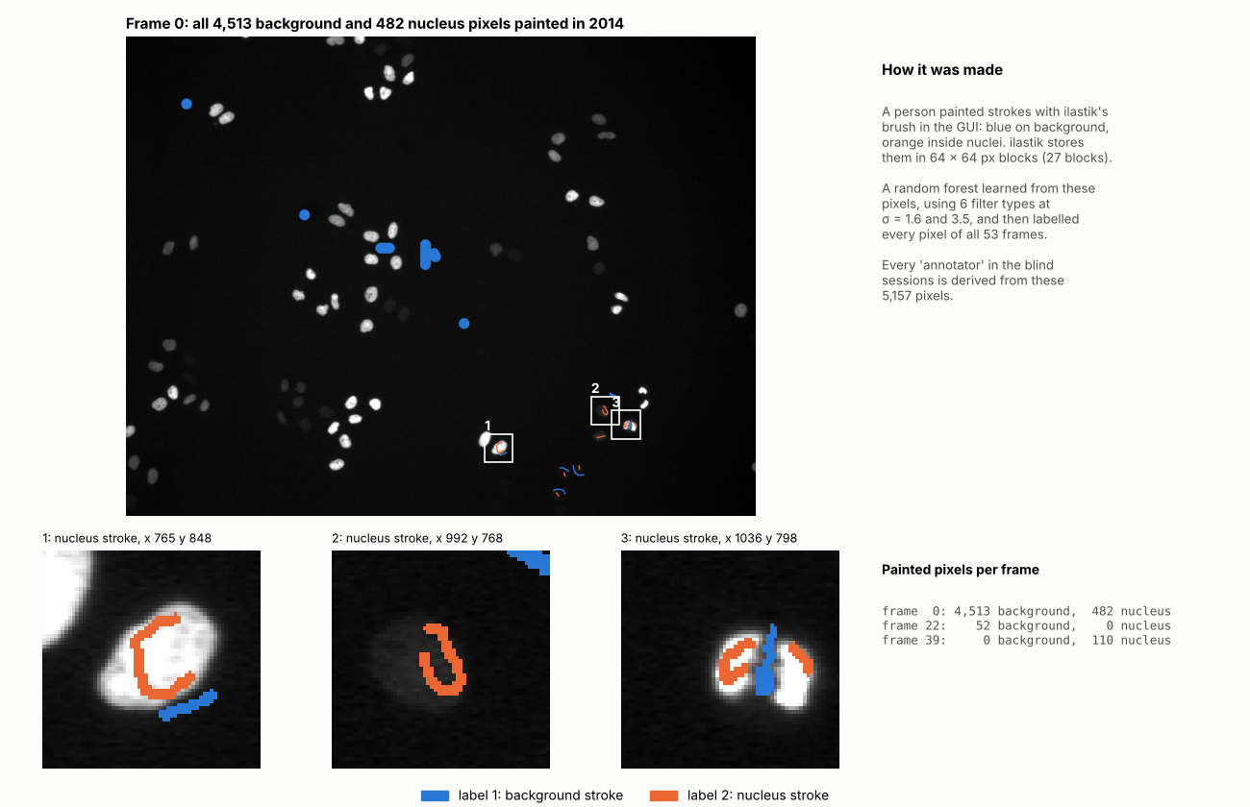
Run 4 (Opus): 34 minutes, no questions
1
Went straight to the download page; within a minute it was fetching the data and ilastik 1.4.2. Headless from then on.
2
Opened the 2014 project: label 1 background, label 2 nucleus; 5,157 painted pixels.
3
Kept the real labels as A0; a program invented five more (A1–A5), each retrained headless.
4
Four walls, all fixed alone, among them rows and columns swapped: Run 0's trap.
The 2014 brush strokes: 5,157 pixels, almost all on frame 0 (blue background, orange nucleus)
5
Compared seven rules over the whole movie, STAPLE among them.
Invented: A1 tight edges · A2 two-pixel halo · A3 dim nuclei are background · A4 very few strokes · A5 late frames only
6
Added a biased pool; checked if rejected nuclei persist in neighbouring frames.
Notes:
Run 4 was Opus at high effort: 34 minutes, no questions. It read the PDF and went straight to ilastik's download page; within the first minute it was downloading the data and ilastik 1.4.2 for Linux, and it worked headless from then on. It opened the 2014 project and saw that the strokes are sparse: 5,157 pixels, almost all on frame 0, as in the picture. It kept these real labels as annotator A0 and wrote a program that invents five more, each with a named style. It hit four walls and fixed them all alone, including the same rows-and-columns trap Run 0 fell into. Then it compared seven rules, and added a biased pool.

Slide 15
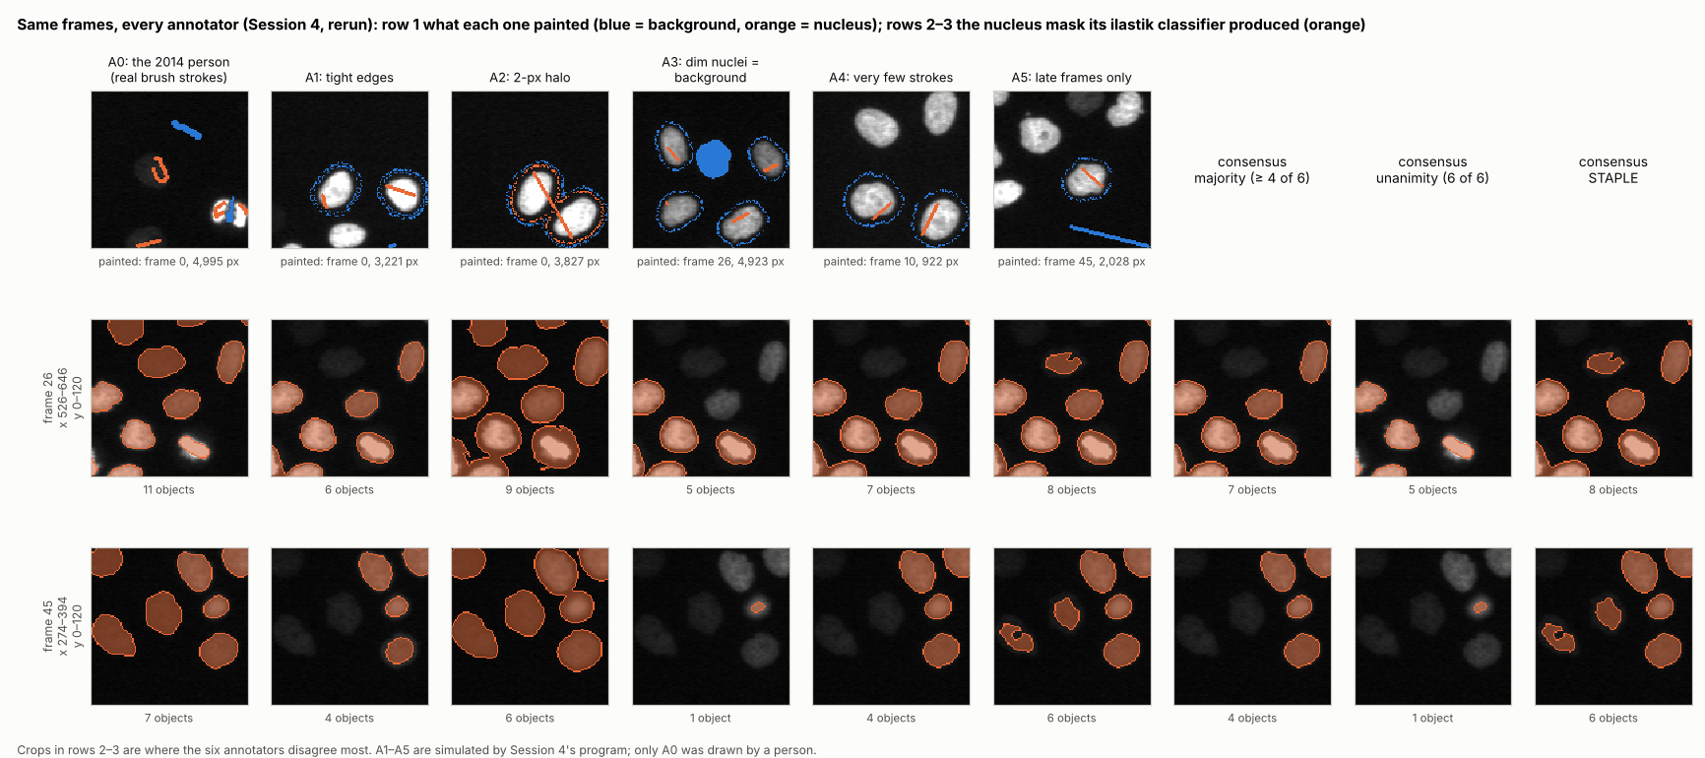
Six annotators, same frames
Row 1: what each annotator painted. Rows 2–3: frames 26 and 45, each nucleus mask and three consensus rules. A1, A3 and A4 miss most of the dim nuclei that A0 finds; majority vote drops them.
Notes:
Here are Run 4's annotators on the same frames, drawn from a rerun of its own scripts. The top row shows what each annotator painted: blue is background, orange is nucleus. The two rows below are the same crops of frames 26 and 45 for every annotator, with the nucleus mask its retrained classifier produced, and then three consensus rules: majority, unanimity and STAPLE. Look at the dim nuclei on the left of each crop. A0, the real 2014 labels, finds them. A1, A3 and A4 miss most of them, and majority vote drops them.

Slide 16
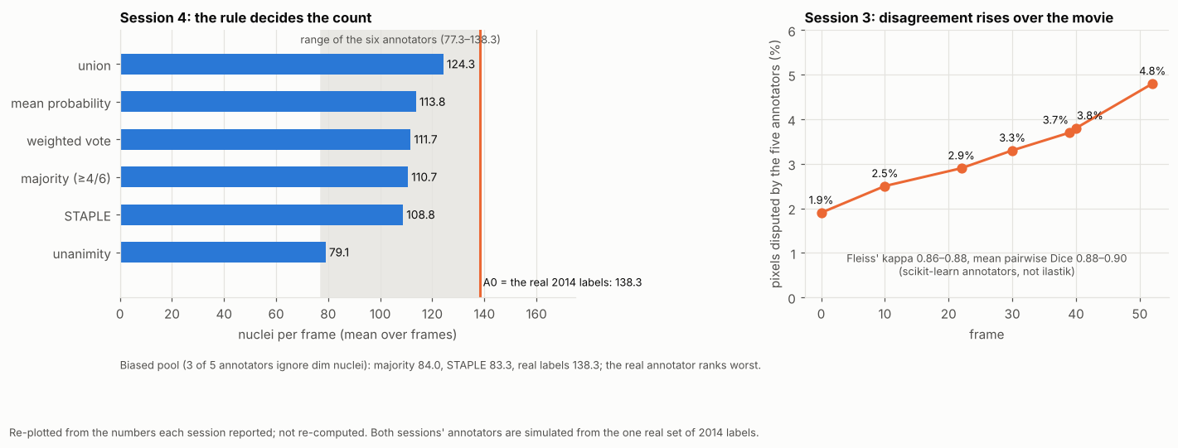
The rule decides the count
NUCLEI PER FRAME
A0, real labels
138
simulated
77–123
union
124
majority
111
STAPLE
109
unanimity
79
STAPLE: estimates how reliable each annotator is from their agreement alone, then trusts the reliable ones more.
84 · 83 vs 138
3,065 of 7,036
94%
biased pool: majority, STAPLE vs A0
A0 objects rejected by the majority
persist in both neighbouring frames
Notes:
This is the key result. A0, the classifier trained on the real 2014 strokes, finds 138 nuclei per frame; the simulated annotators 77 to 123. Which rule you choose then sets the count: union 124, majority 111, STAPLE 109, unanimity 79. STAPLE estimates how reliable each annotator is from their agreement alone, then trusts the reliable ones more. In the biased pool, majority landed at 84 and STAPLE at 83, against A0's 138, and A0 was ranked the least reliable. The majority rejected 3,065 of A0's 7,036 objects, and 94% of those sit at the same place in both neighbouring frames: most likely dim nuclei. On the right of the figure, Run 3's disputed share rises over the movie.

Slide 17

What a second look found
Run 3
Run 4
Rerun of Run 4
Annotators were one person's labels resampled, so their agreement is optimistic
Its chronicle lists a step the transcript does not show
Annotators painted on objects found by a brightness cut-off, so the classifiers partly learn it back
Treated the 2014 labels as correct without showing it
Never asked whether real annotations existed
Within about 1%, except two:
108 vs 99
A4, nuclei per frame
111 vs 102
majority, nuclei per frame
Likely reason: A4 was trained on 922 pixels, and with a 4-of-6 threshold that one annotator moves the majority.
Notes:
Both blind runs had weak points they did not see. Run 3's annotators were one person's labels resampled, so their agreement is optimistic, and its chronicle lists a step that the transcript does not show. Run 4's annotators were painted on objects found by a brightness cut-off, so the classifiers partly learn that cut-off back; it treated the 2014 labels as correct without showing it; and it never asked whether real annotations existed. Re-running Run 4's scripts reproduced its numbers within about 1%, except annotator A4 and the majority. A4 was trained on only 922 pixels, and with a 4-of-6 threshold that one annotator moves the whole majority.

Slide 18
Two strategies, side by side
Run 3 · Sonnet, medium effort
Run 4 · Opus, high effort
Where it looked first
Inward, at the computer: found an absence and never revisited it
Outward, at the download page: found a tool
Asking
Asked twice; lost six of its eleven minutes waiting
Asked nothing: saved time, but left the real question unasked
Effort
About $0.65 and 11 minutes
About $2.62 and 34 minutes; a stronger design
Same answer, different depth
Voting rules shift the result
Voting can reject the annotator most likely right
Both concluded that consensus is not sufficient. Neither used independent human annotators, which is what the question is really about.
Notes:
Side by side. Run 4 looked outward, at the download page, and found a tool. Run 3 looked inward, at the computer, found an absence, and never revisited it. Run 3 asked twice and lost six of its eleven minutes waiting; Run 4 asked nothing, which saved time but left the real question, whether the group had annotators, unasked. Run 4 cost about $2.62 and 34 minutes to Run 3's $0.65 and 11, and its design is stronger: real labels kept, annotators with named biases, a bias experiment, a persistence check. Both concluded that consensus is not sufficient. Neither used independent human annotators, which is what the question is really about.

Slide 19
What the five runs show
1
Documentation turns a problem into a recipe. With Run 0's notes, the reproductions met none of its seven walls; neither needed help.
2
The first judgement decides the rest. Run 4 looked at the download page; Run 3 looked at the computer and built on "ilastik cannot run here".
3
Agents choose the experiment when the task is open. Neither blind run ran the example's tracking; both designed a consensus experiment.
4
Every session overstated something. A second look, by a person or by another session, caught each one.
5
Numbers can mislead. 99.99% of pixels match the 2014 map, but an empty image scores 95%; nuclei overlap is 99.8%, and that is not ground truth either.
https://globias-2026-group5.github.io/
Runs 0–2 kept every command, error and output; Runs 3 and 4 committed nothing.
Analyses run by Claude (Anthropic) agent sessions; data courtesy of the MitoCheck project; example and projects from ilastik.
Notes:
To close, five things the runs show. Documentation turns a problem into a recipe: with Run 0's notes, the reproductions met none of its walls. The first judgement decides the rest. Agents choose the experiment when the task is open. Every session overstated something, and a second look caught each one. And numbers can mislead: both versions match the 2014 map on 99.99% of pixels, but nuclei cover 5% of the image, so an empty image scores 95%. The fairer number is 99.8% overlap of the nuclei, and even that is a comparison with ilastik's own earlier output, not ground truth. Runs 0 to 2 kept every command, error and output; the details are on our website. Thank you.

