Slide 1
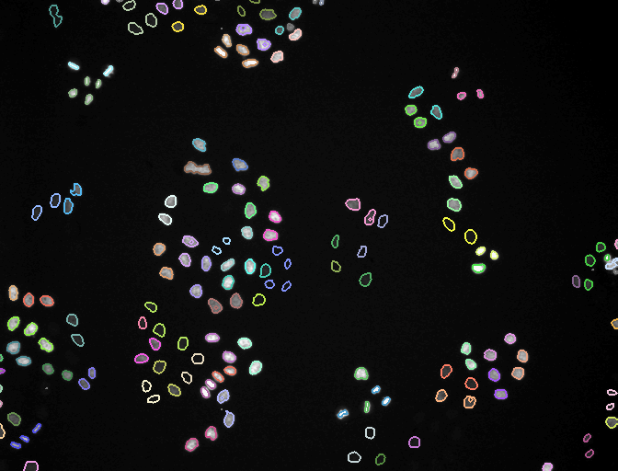
Can an AI agent run, and rerun, a bioimage analysis?
GLOBIAS 2026 · GROUP 5 · SESSION 06 BENCHMARKING
One 2014 ilastik workflow, five Claude sessions
THE BLIND RUNS' WHOLE BRIEF
“I want to answer group 5 task question, use ilastik and the mitocheck dataset”
Frame 40 of the MitoCheck movie, each lineage outlined in its own colour
+ the assignment PDF (the group question: “Can consensus become ground truth?”). No repository, no notes.
Notes:
We gave Claude, a large language model, a real bioimage analysis job: rerun ilastik's MitoCheck example, a 53-frame movie of dividing nuclei with two ilastik projects trained by hand in 2014. Five agent sessions in October 2026 worked on it. The picture is frame 40 of the tracking result, every lineage in its own colour. This one line and the PDF were everything Runs 3 and 4 received.

Slide 2





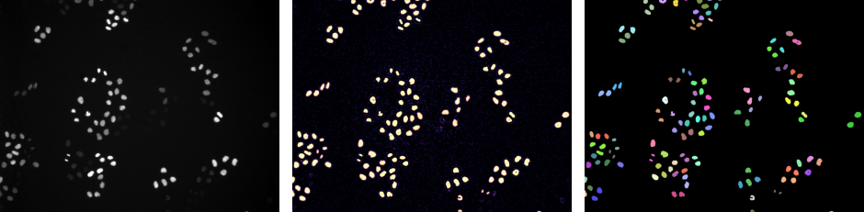

What happened here
AN AGENT SESSION
THE WORKFLOW: ILASTIK'S MITOCHECK EXAMPLE
Claude gets a computer. It runs commands, installs software, reads and writes files.
Raw movie
Pixel classification
Tracking
It works in a loop. Command → error → try again, on its own, until done or stuck.
53 frames of dividing nuclei
a probability map per frame
lineages: nucleus + descendants
A person watches. They answer questions and can step in at any time.
Frame 26, ilastik 1.3.3post3 output from Run 0. Right: each lineage in its own colour; grey objects were detected but not tracked.
Notes:
In a chat Claude only writes text; in an agent session it also gets a computer and works in a loop until the task is done or it gets stuck, while a person watches and can step in. The workflow has two ilastik steps: pixel classification turns each frame into a probability map, then tracking follows each nucleus and notices divisions. A nucleus and all its descendants form one lineage. The goal was the final tracking labels, with ilastik run headless, from the command line with no window.

Slide 3
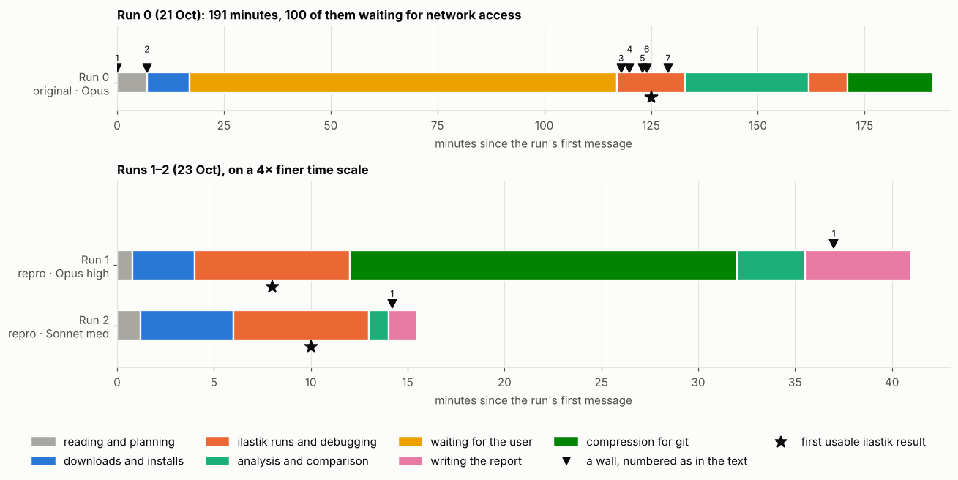
Runs 0–2: the same workflow, three times
191 min
in total
100 min
waiting for network access
7
walls
1.4.1 won't install → 1.5.0a3 pre-release → 1.3.3post3
Two walls needed a small fix script
Two unchecked claims, caught on a second look
Run 0 — 191 min, 100 waiting for network, 7 walls
Runs 1–2 — 41 and ≈15 min, no help, 0 of 7 walls
★ = first usable ilastik result, ▼ = wall
Notes:
Run 0 started with an almost empty repository and no access to ilastik's website; 100 of its 191 minutes were spent waiting for network access. For each wall the agent read the error, and where needed ilastik's own code, then switched version, linked a file into place or wrote a small fix script, and tried again. The 2014 labels were read with rows and columns swapped in 1.5.0a3, and 1.3.2post1 crashed on the computer's system libraries, so it settled on 1.3.3post3. It also made two claims it had not checked; a second look caught both. Runs 1 and 2, pointed at Run 0's repository, needed no help: Sonnet took about 15 minutes, Opus 41, mostly because Opus also compressed the large files. Runs 1 and 2 are drawn on a four times finer time scale.

Slide 4
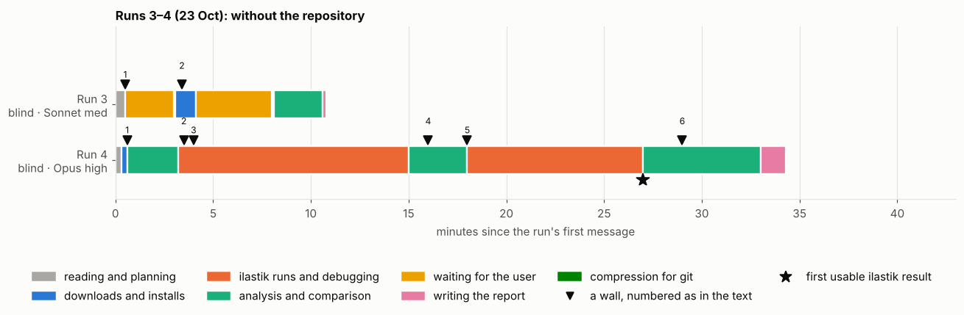
Runs 3–4: the question, the data, nothing else
Run 3 (Sonnet) — 11 min, 6 of them waiting for the person, no ilastik
Run 4 (Opus) — 34 min, no questions, ilastik 1.4.2 headless, ★ = first retrained classifier
Neither ran the example's tracking
Notes:
Runs 3 and 4 got only the assignment PDF and one line, and could not see the repository. Run 3 asked the person twice and lost six of its eleven minutes waiting; it never ran ilastik and never reaches a star. Run 4 asked nothing, worked with ilastik 1.4.2 headless and finished in 34 minutes; its star marks its first retrained classifier, not the example's tracking. Neither ran the example's tracking.

Slide 5
How ilastik was used, run by run
Run | Ran ilastik? | Pixel classification | Tracking
Runs 0, 1, 2 | yes: 1.3.3post3 and 1.5.0a3 | the 2014 project, as is | the 2014 project, as is
Run 4 (Opus) | yes: 1.4.2 | the 2014 project retrained 8× with new strokes (--retrain) | no
Run 3 (Sonnet) | no | re-implemented outside ilastik (scikit-learn) | no
“Use ilastik” fixed the tool, not the workflow: the runs with the repository ran the example; Run 4 used ilastik as a trainable classifier; Run 3 kept only ilastik's files.
Notes:
Only Runs 0, 1 and 2 did tracking, by running the 2014 tracking project on a freshly computed probability map; Run 0 first had to patch the project's settings and link the 2014 probability file into place. Run 4 never opened the tracking project. Run 3 read the project file only for its strokes and used the 2014 export as its "expert" tie-breaker, having concluded that ilastik "is GUI-based".

Slide 6
The commands
ilastik --headless --project=pixelClassification.ilp --export_source=Probabilities
→ Runs 0–2: open the 2014 project and write a probability map; nothing retrained
ilastik --headless --project=conservationTracking.ilp --raw_data=… --prediction_maps=…
--export_source=Tracking-Result
→ Runs 0–2: run the 2014 tracker on that map; nothing retrained
ilastik --headless --readonly=False --retrain --project=A1_tight.ilp
--export_source=Probabilities
→ Run 4: a copy of the 2014 project with the strokes replaced and the old classifier deleted; ilastik trains a fresh classifier and exports probabilities (8 times, ~1–1.5 min each)
Notes:
Runs 0 to 2 ran the first two commands on the 2014 projects as they are: a probability map for all 53 frames, then the 2014 tracker on that map; nothing was retrained. Run 4 ran the third command eight times, about one to one and a half minutes each, on copies of the 2014 project with new strokes and the old classifier deleted. This is what a person does in the ilastik window by painting and pressing "Live update".

Slide 7
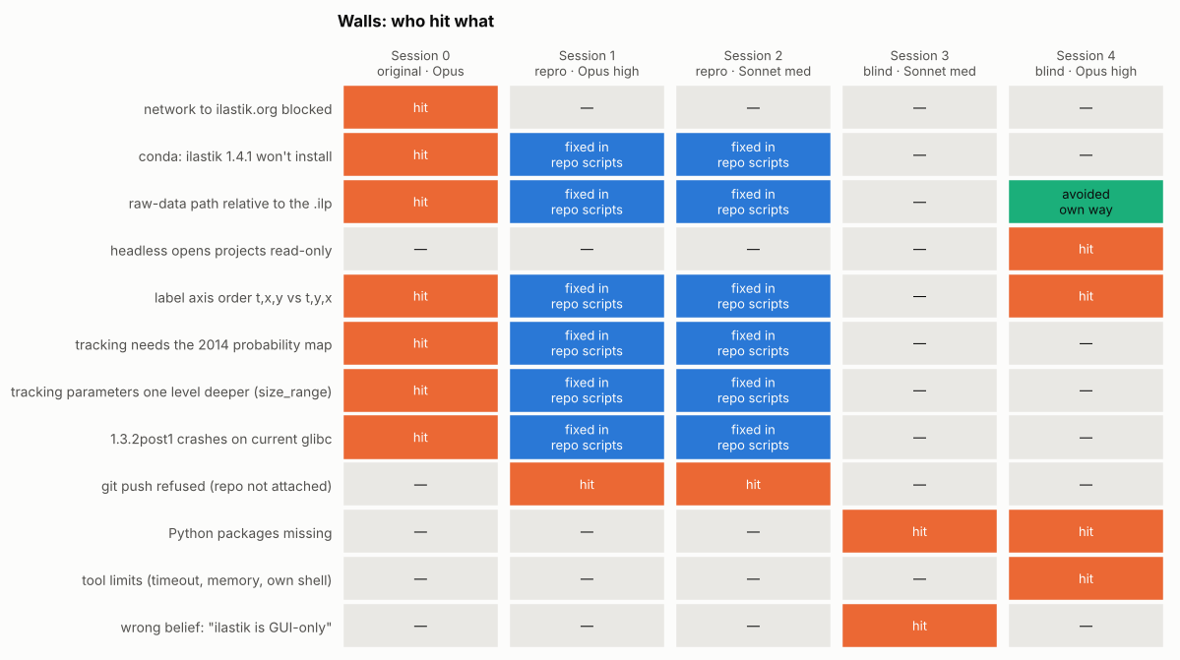
Runs 1 and 2: with the notes, no help needed
0
help needed
≈15 / 41
min, Sonnet / Opus
0 of 7
walls met
1.5.0a3: tracking identical to Run 0's, pixel for pixel
1.3.3post3: not exactly repeatable. Opus rerun: two lineages swapped numbers, 113 pixels changed object; Sonnet rerun: 50 pixels differed
Orange: hit. Blue: already fixed by Run 0's scripts. Green: avoided another way. Grey: not met.
Notes:
Two fresh sessions, one Opus and one Sonnet, were pointed at Run 0's repository and told to regenerate the results, not copy them. Neither needed the person: Sonnet took about 15 minutes, Opus 41, mostly because Opus also compressed the large files. The 1.5.0a3 tracking came back identical pixel for pixel, but the 1.3.3post3 tracking changed slightly from run to run, mostly on borders between touching nuclei. So the pipeline is reproducible, but one step in the old version is not exactly repeatable.

Slide 8

Runs 3 and 4:
without the notes, a different experiment
Run 3 · Sonnet
Run 4 · Opus
11 min · asked twice
34 min · no questions
LOOKED FIRST
The computer → “ilastik needs a window”
The download page → ilastik 1.4.2, run headless
ANNOTATORS
One person's labels, resampled into five classifiers
Real 2014 labels as A0, plus five invented styles
RULES COMPARED
5 rules on 7 frames
7 rules over the whole movie
CONCLUSION
Both: consensus is not sufficient to define ground truth
Notes:
Two more sessions got only the assignment PDF with the group's question, 'Can consensus become ground truth?', and could not see the repository. Their strategies parted in the first minute: Run 3 looked at the computer, found no ilastik and concluded it needs a window; Run 4 went to the download page and worked with ilastik 1.4.2 headless. Neither ran the example's tracking; both built a consensus experiment with several annotators. Both concluded that consensus is not sufficient to define ground truth.

Slide 9
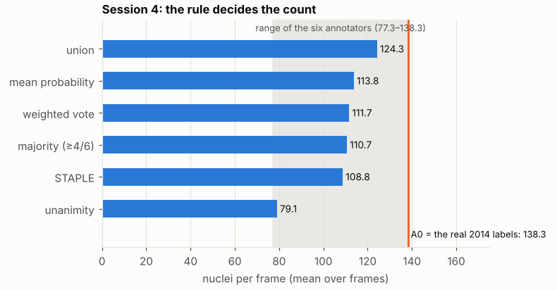
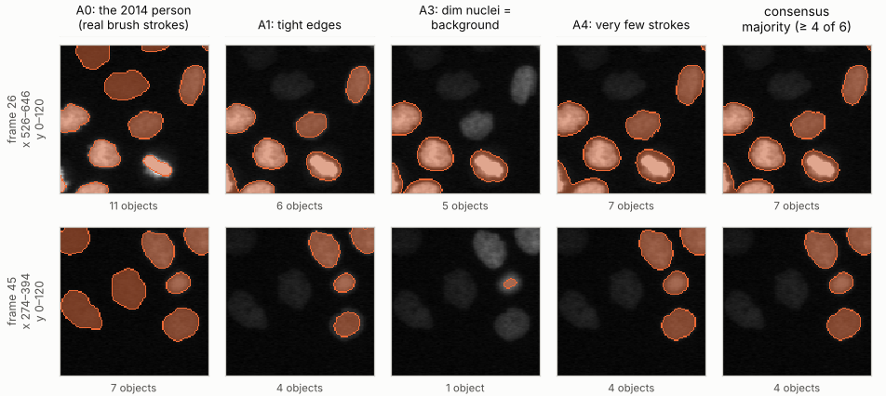
The rule decides the count
In the biased pool, majority vote landed at 84 nuclei per frame against A0's 138, and the agreement scores ranked A0 the least reliable.
Run 4, main pool: nuclei per frame under each rule (blue), the six annotators' range (grey), A0 (orange).
Run 4, frames 26 and 45: A1, A3 and A4 miss most of the dim nuclei that A0 finds; majority vote drops them.
Notes:
A0 is the classifier trained on the real 2014 strokes; it finds 138 nuclei per frame, the simulated annotators 77 to 123, and the rule you choose sets the count, from 124 for union to 79 for unanimity. In a biased pool, A0 plus A1 and three annotators that treat dim nuclei as background, majority vote and STAPLE dropped to about 84 and 83, and A0 was ranked least reliable. 94% of the objects the majority rejected sit at the same place in both neighbouring frames, so they are most likely dim nuclei. Agreement measures agreement, not correctness.

Slide 10





What the five runs show
Documentation turns a problem into a recipe.
With Run 0's notes, the two reproductions met none of its seven walls. Neither needed help.
The first judgement decides the rest.
Run 3 looked at the computer, concluded ilastik could not run, and built everything on that.
Agents choose the experiment when the task is open.
Both blind runs answered with a consensus experiment of their own design.
Every session overstated something.
A second look, by a person or by another session, caught each one.
Numbers can mislead.
99.99% of pixels match the 2014 map, but an empty image scores 95%; nuclei overlap 99.8%.
globias-2026-group5.github.io
Analyses run by Claude (Anthropic) agent sessions; data courtesy of the MitoCheck project; example and projects from ilastik.
Notes:
Five take-aways. With documentation, a hard problem became a recipe; without it, the first judgement shaped everything and the agents chose their own experiment. Every session overstated something, and a second look caught it each time. And be careful with numbers: a 99.99% pixel match sounds perfect, but nuclei cover only 5% of the image, and even 99.8% overlap is a comparison with ilastik's own earlier output, not with ground truth.

