Slide 1
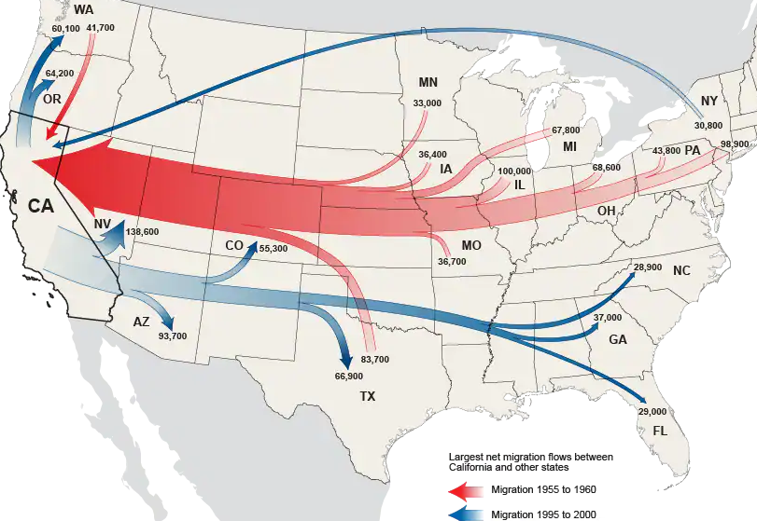
Figure 2: The Great Escape - Californian Net Migration in in the Late 1950's and Late 1990's
Source: U.S. Census Bureau
Notes:
Figure 2: The Great Escape: Net Migration in California in the Late 1950's and Late 1990's

