Slide 1
GridShib
Tom Barton, U Chicago

Slide 2
Grid Computing
Distributed computing and/or data resources
Heterogeneous computing & storage environments
Interfaces & services defining an abstract service platform – a Services Oriented Architecture that virtualizes large scale computation
One pernicious problem: lack of a common means of authenticating all of the users comprising each Virtual Organization sharing a grid platform

Slide 3
GridShib Motivations
Scaling. Current grid project credentialing methods don’t scale to large, widely dispersed user populations
Attributes. For access management and for audit & reporting needs
Support. Leverage production identity management operations provided by campus central IT units
NSF Middleware Initiative (NMI) project
  Von Welch (NCSA), Frank Siebenlist (ANL), Kate Keahy (U Chicago), Tom Barton (U Chicago)

Slide 4
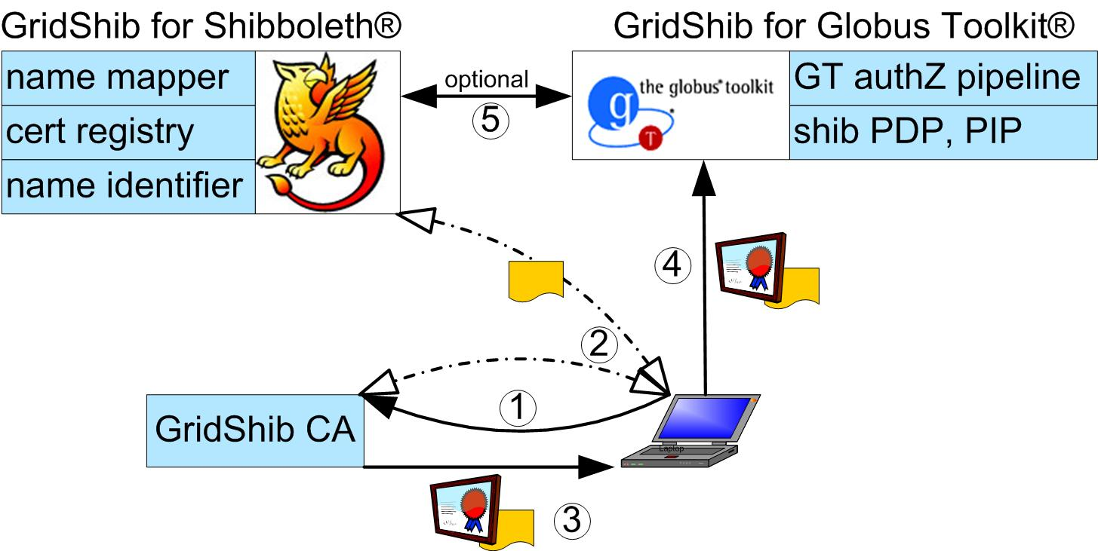
GridShib Approach

Slide 5
Issues
Adoption. Established Grids are vested in older technology.
Virtual Organization attribute management. How attributes should be managed is a difficult question with different answers depending on circumstances.
Trust. Policy management and organizational placement to enable certificates minted by a GridShib Certificate Authority to be trusted by relying parties.
Bleeding-edge architecture. It’s the first attempt to address problems with no prior solution, raising issues of how best to map GridShib elements to specific use cases.

Slide 6
Status & Related Activities
Developing push capability
  SAML (the lingua franca of shibboleth) embedded in proxy certificates
Focus moving to TeraGrid
  nanoHub Science Gateway
  MyVocs-as-ProxyIdP → TG test bed
Shib-grid BoF
  1-2 dozen projects globally to use identity federation (mostly shib) to enable grid userships to scale way up

