Slide 1
GT 4 WS Core Tutorial
Sam Meder
11/08/26

Slide 2
Disclaimer
Everything GT4 related is subject to change
Don’t expect to be able to do more than prototype with current code

Slide 3
GT 4 WS Core Architecture
Grid Service vs. Web Service + Resource
Operation Providers
Service Properties vs. JNDI Directory
Service State Management vs. Resource State Management
Client side support
Service Data vs. Resource Properties
Notifications
Security

Slide 4
GT3 Grid Service
Implements the OGSI grid service port type
  Persistent/Transient lifecycle
  Provides operations for
    Service lifetime management
    Inspecting and changing Service Data

Slide 5
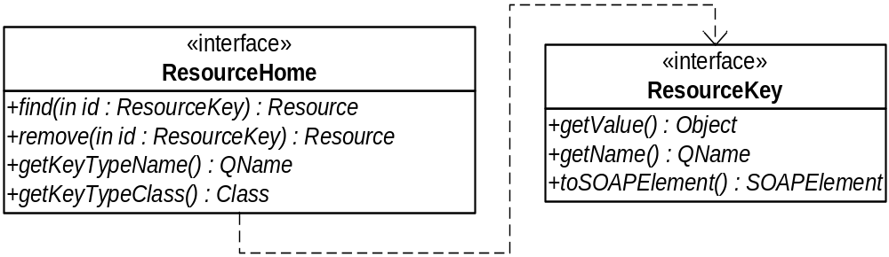
GT4 Web Service + Resource
The service bit is just a plain web service
Resources are managed/discovered via a Resource Home:
In addition to the above most resource homes are expected to have a implementation specific create() method

Slide 6
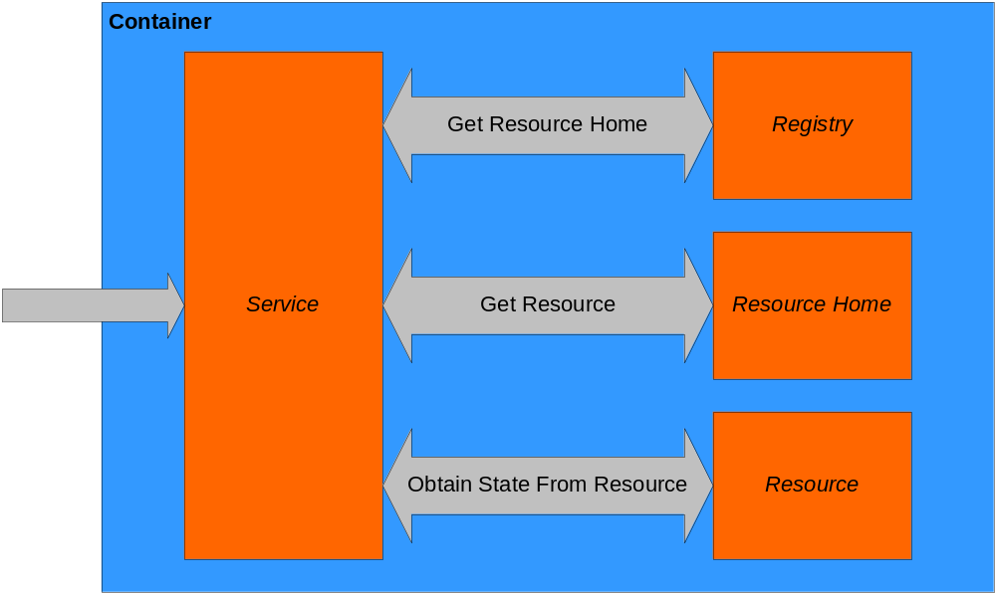
Resource Discovery
Notes:
First two bits are done under the covers

Slide 7
Resource Discovery in Practice
The simple case:
  Counter counter = (Counter) ResourceContext.getResource();
The complicated case:
  ResourceContext ctx = null;
  CounterHome home = null;
  Object key = null;
  try
  {
  ctx = ResourceContext.getResourceContext();
  home = (CounterHome)ctx.getResourceHome();
  key = home.create();
  }
  catch (Exception e)
  {
  throw new RemoteException("", e);
  }

Slide 8
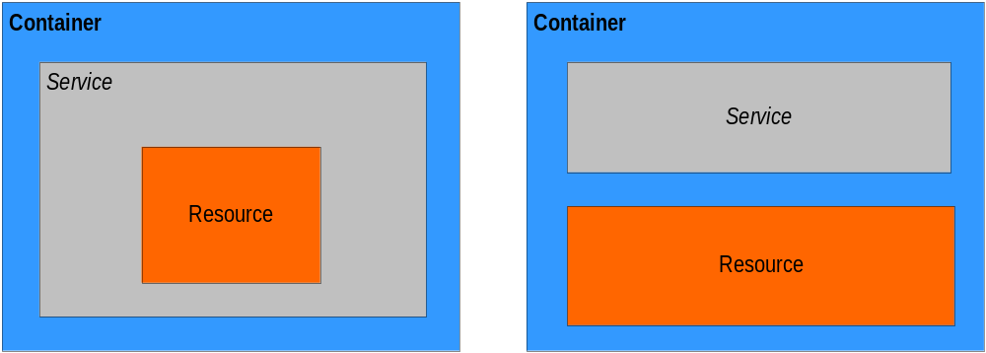
GT4 Web Service + Resource
Service and resource in the same object
  One resource per service
Service and resource as separate entity
  Any number of resources per service

Slide 9
Available Resource Homes
SimpleResourceHome
  Basic hash table based implementation
SoftResourceHome
  Uses soft references for storing resources
ServiceResourceHome
  Service/Resource singleton home
PersistentResourceHome
  For use with resources that can be persisted
We may introduce a more generic home to replace some of these implementations

Slide 10
Operation Provider Model
Used in both GT3 and GT4
Provides a web service composition framework
  Enables reusable components
    Currently implemented for GT4:
      Destroy
      Set Termination Time
      Get Current Message
      Notification Consumer
      Pause/Resume Subscription
      Subscribe
      Get/Set Resource Property
      Get Multiple Resource Properties
      Query Resource Properties

Slide 11
GT3 Service Properties
Allows services to store/checkpoint configuration properties
  Flat Table (key, value)
  Values can be persisted to deployment descriptor
  Works for simple things

Slide 12
GT4 Directory
Uses JNDI code from Apache Tomcat
  Hierarchical
  Object Factories
    Resource Homes
    DataSource
    Etc.
  Entries can be linked
  For more information see http://jakarta.apache.org/tomcat/tomcat-5.0-doc/jndi-resources-howto.html

Slide 13
JNDI Examples
Environment entry:
  <environment
  name="subscriptionManagerServiceName”
  type="java.lang.String" value="SubscriptionManagerService"/>
Resource Link entry:
  <resourceLink
  name="home" target="java:comp/env/notificationConsumerHome"/>

Slide 14
JNDI Examples Continued
Resource entry:
  <resource
  name="subscriptionHome"
  type="org.globus.wsrf.impl.notification.SimpleSubscriptionHome">
  <resourceParams>
  <parameter>
  <name>
  factory
  </name>
  <value>
  org.apache.naming.factory.BeanFactory
  </value>
  </parameter>
  </resourceParams>
  </resource>

Slide 15
GT3 Service State Management
Persistent vs. Transient Service
  Persistent service - created through container configuration entry
  Transient service – created at runtime
Persistent vs. Transient Lifecycle
  Persistent – Service can checkpoint and recover properties
  Transient – Service Properties are volatile

Slide 16
GT4 Resource State Management
Resource State Management
  Will provide implementations for common patterns:
    Soft references
      Good when state is easily recreated
    Persistent Resources
Design your service with scalability in mind
  Don’t keep long lived references to your resources

Slide 17
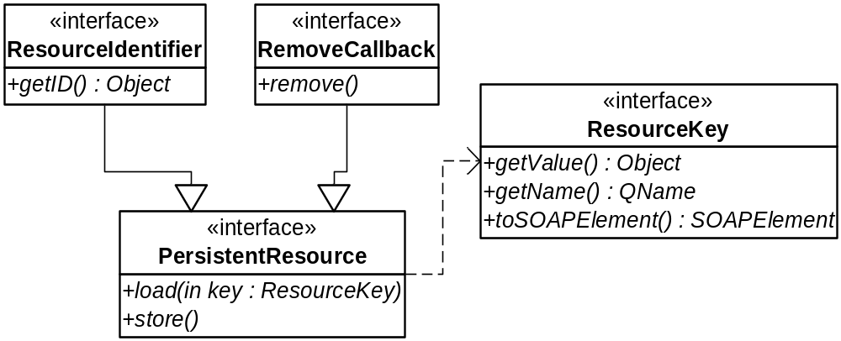
Persistent Resources in GT4
Must implement PersistentResource interface
Up to implementation to call store() when appropriate

Slide 18
Client Side Model
No more Grid Service Handle to Grid Service Reference resolution
  Similar step likely in GT4
    Needed for below
    Discovery of remote security policy and certificates
Can’t really pass WS-A Endpoint References on command line
  Factory returns human readable string as well as EPR
  Discover EPR via Service Group lookup

Slide 19
Security
Model remains unchanged
  Clients will have to set security properties on stub
  Service/Resource security policy via deployment descriptor
    Security settings will be per resource
New Features in 4.0
  Better GSI Secure Message support
    Encryption
    Replay Attack Prevention
  Flexible Authorization Support
    Based on Work in OGSA AuthZ WG
  (Rebase on Apache WSS4J code)
Notes:
Might do some Security related WS-Policy work

Slide 20
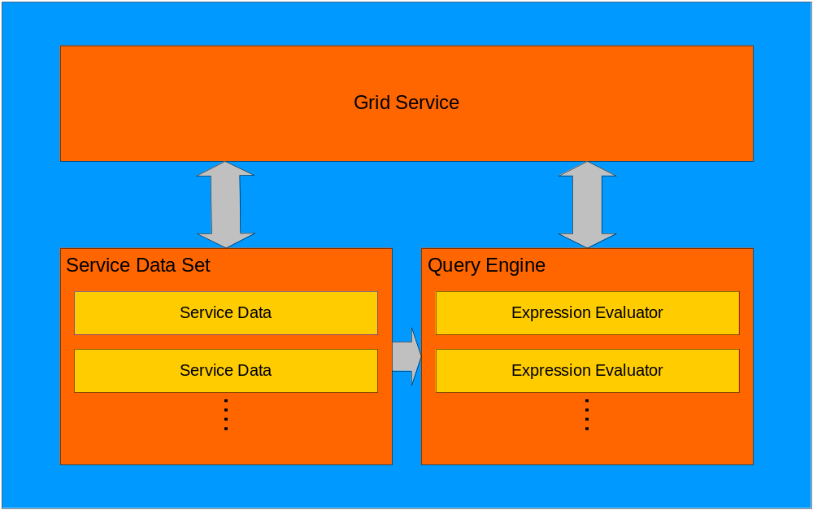
GT3 Service Data

Slide 21
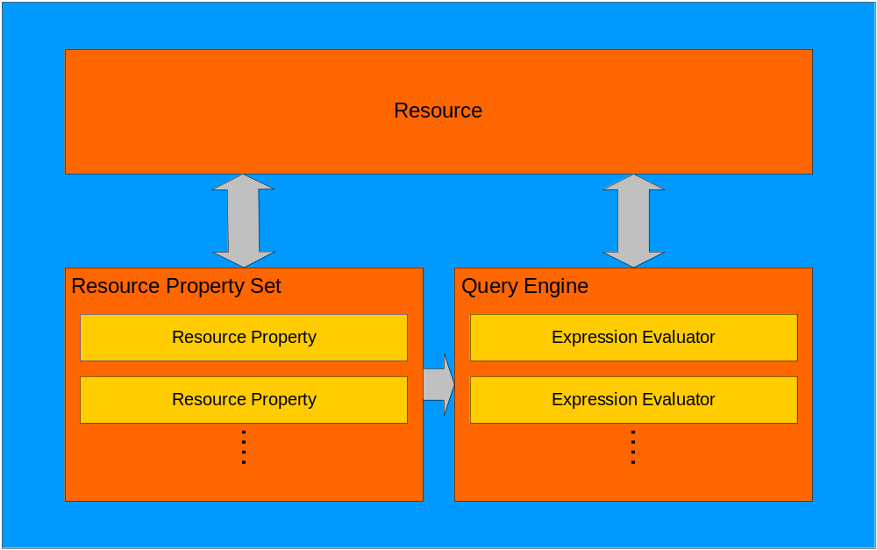
GT4 Resource Properties

Slide 22
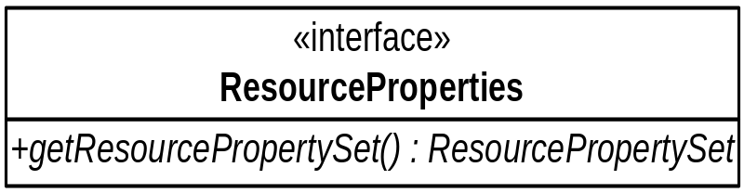
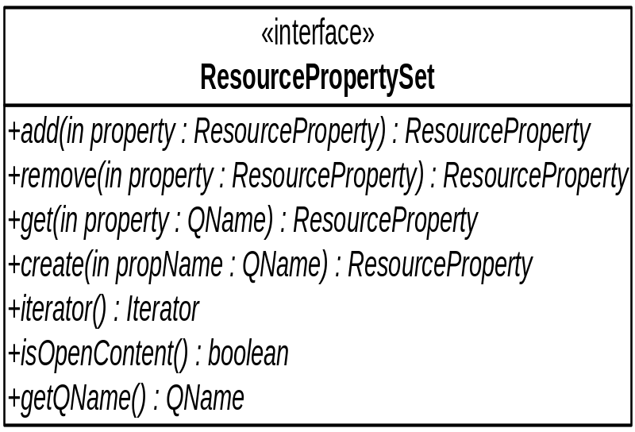
GT4 Resource Properties
Resources implement the Resource Properties interface:
The Resource Property Set manages properties:

Slide 23
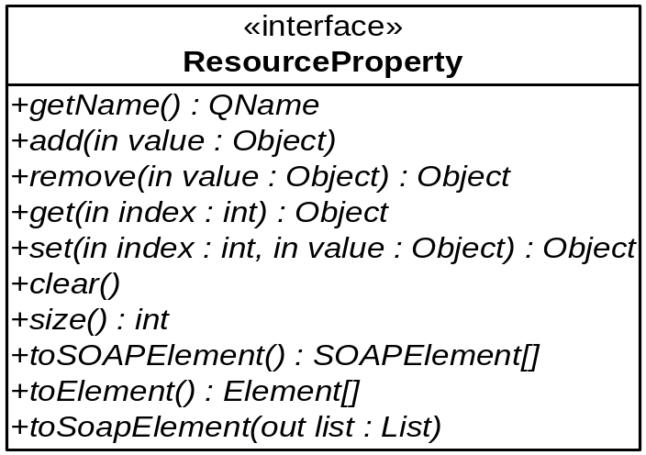
GT4 Resource Properties
Every Resource Property implements:

Slide 24
Resource Property Implementations
SimpleResourceProperty
  Basic resource property implementation
  Stores the resource property values
ReflectionResourceProperty
  Relies on reflection to get/set values

Slide 25
GT Query Framework
Supports multiple query dialects
  New dialects can be added at runtime
  Evaluation engine is chosen using dialect in query

Slide 26
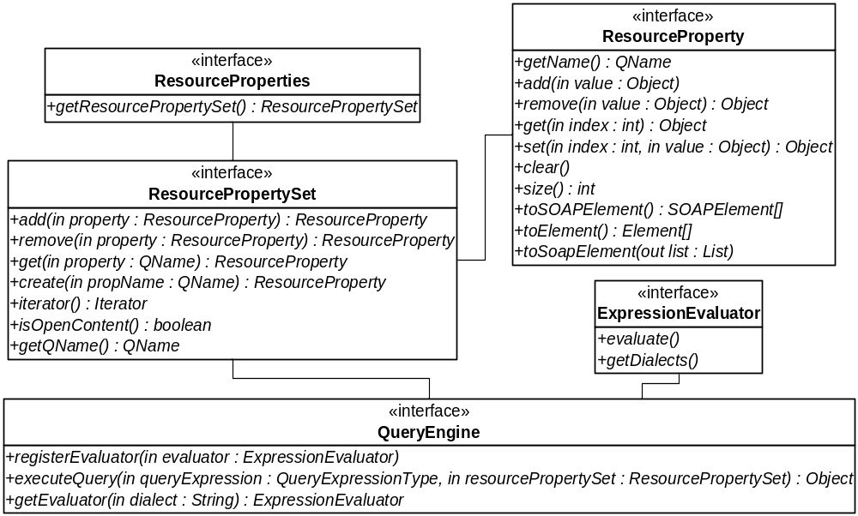
Resource Properties Summary

Slide 27
GT3 Notification
Notifications are coupled to Service Data changes
  Flat namespace
Notification interfaces are added via operation providers
Often required one notification sink per subscription
  Disambiguation of source

Slide 28
GT4 Notification
Main change: Notifications are no longer coupled to service data
  Parallel code structure
  Hierarchy of topics
  Topic can represent anything you want
Default notification consumer (sink) service per hosting environment
  Individual sinks are represented by resources
Default subscription manager service per hosting environment
  Subscriptions are resources
Still uses operation providers model

Slide 29
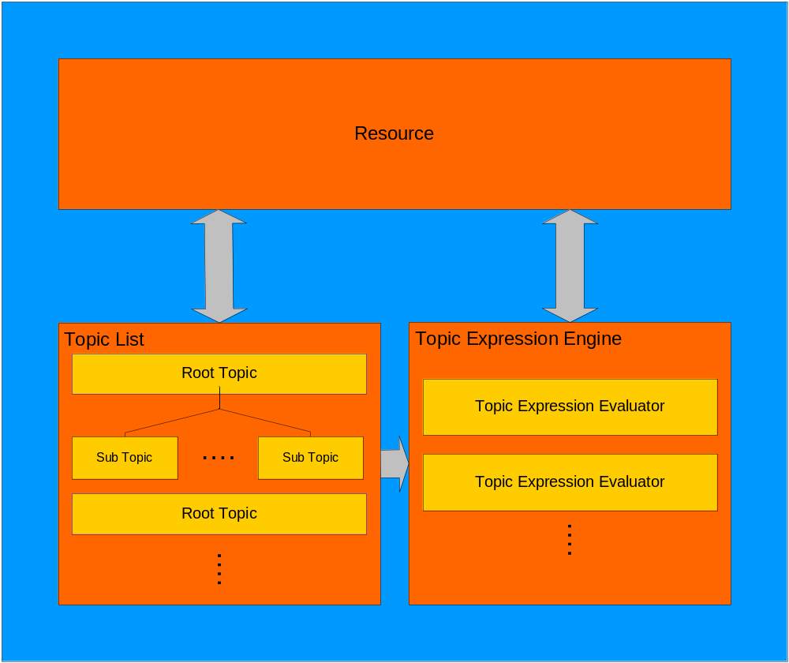
GT4 Notification Overview

Slide 30
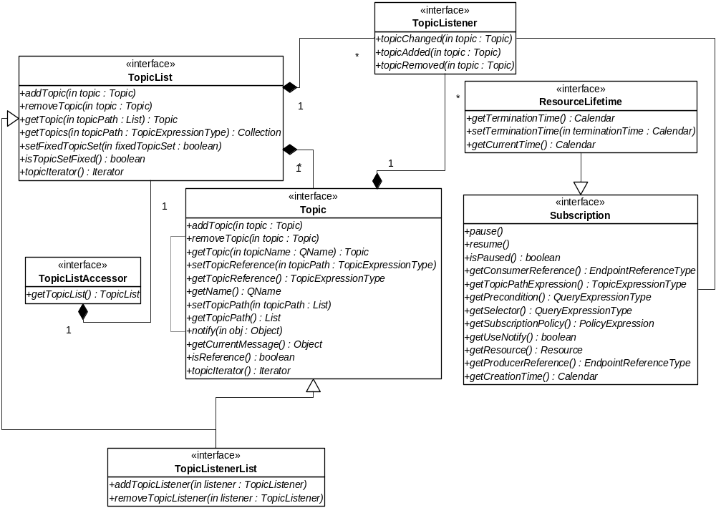
GT4 Notification Interfaces

Slide 31
GT4 Notification Interfaces
Topic List Accessor
  Allows for different TopicList implementations
  Usually implemented by a Resource
Topic List
  List of root topics
Topic
  Represents a topic
  May have child topics

Slide 32
GT4 Notification Interfaces
Topic Listener
  Interface for propagating Topic changes
  Used to connect subscriptions to topics\
  Used for creating the topics RP
Subscription
  Interface to subscription state

Slide 33
Current Topic Implementations
SimpleTopic
  Your basic no-frills implementation
ResourcePropertyTopic
  Creates a topic from a object that implements the Resource Property Interface

Slide 34
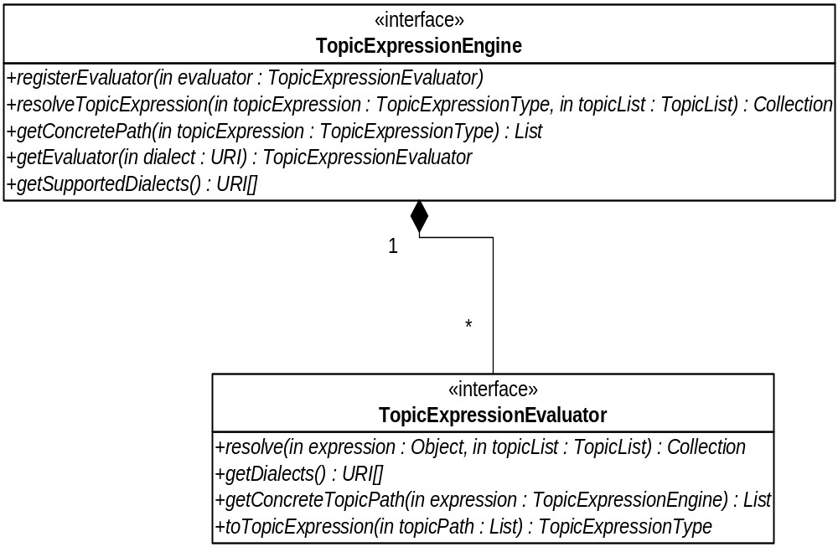
Topic Expression Framework
Similar to Query Engine
You will also need to register dialect with axis

Slide 35
GT4 Threads and Timers
Based on J2EE APIs proposed by IBM & BEA
  Royalty free
  More information at http://www-106.ibm.com/developerworks/java/library/j-commonj-sdowmt/
WorkManager & Timer interfaces
  Using thread/timer pools
  Container provides default WorkManager and Timer objects via JNDI lookup
Replaces SweeperPool in GT3

Slide 36
Timer Example
Get the TimeManager and schedule:
  Context initialContext = new InitialContext();
  TimerManager timerManager = (TimerManager)
  initialContext.lookup(WSRFConstants.DEFAULT_TIMER);
  timerManager.schedule(new TerminationTimerListener(), period,
  period);
Each timer task needs to implement TimerListener:
  protected class TerminationTimerListener implements TimerListener
  {
  public void timerExpired(Timer timer)
  {
  …
  }
  }

Slide 37
WorkManager Example
Get the WorkManager and schedule:
  Context initialContext = new InitialContext();
  WorkManager workManager = (WorkManager)
  initialContext.lookup(WSRFConstants.DEFAULT_WORK_MANAGER);
  WorkItem item1 = workManager.schedule(work1);
Each work task needs to implement Work:
  private class TestWork implements Work
  {
  public void release()
  {
  …
  }
  public void run()
  {
  …
  }
  }

Slide 38
Base Faults
You should define your service faults
Helper API (FaultHelper)
  Methods for populating and inspecting Base Faults
Currently have a handler that fills in some of the fields (timestamp etc)

Slide 39
GT3 vs. GT4 Summary
What has fundamentally changed:
  No long lived address anymore (GSH)
  doc/literal (GT4) instead of wrapped/literal
  Decoupled notification framework
Not that much

Slide 40
Counter Service II: The Revenge
What is required to implement a new service?
  WSDL
  Service
  Resource
  Resource Home
  Client
  Configuration
Notes:
Ant build file

Slide 41
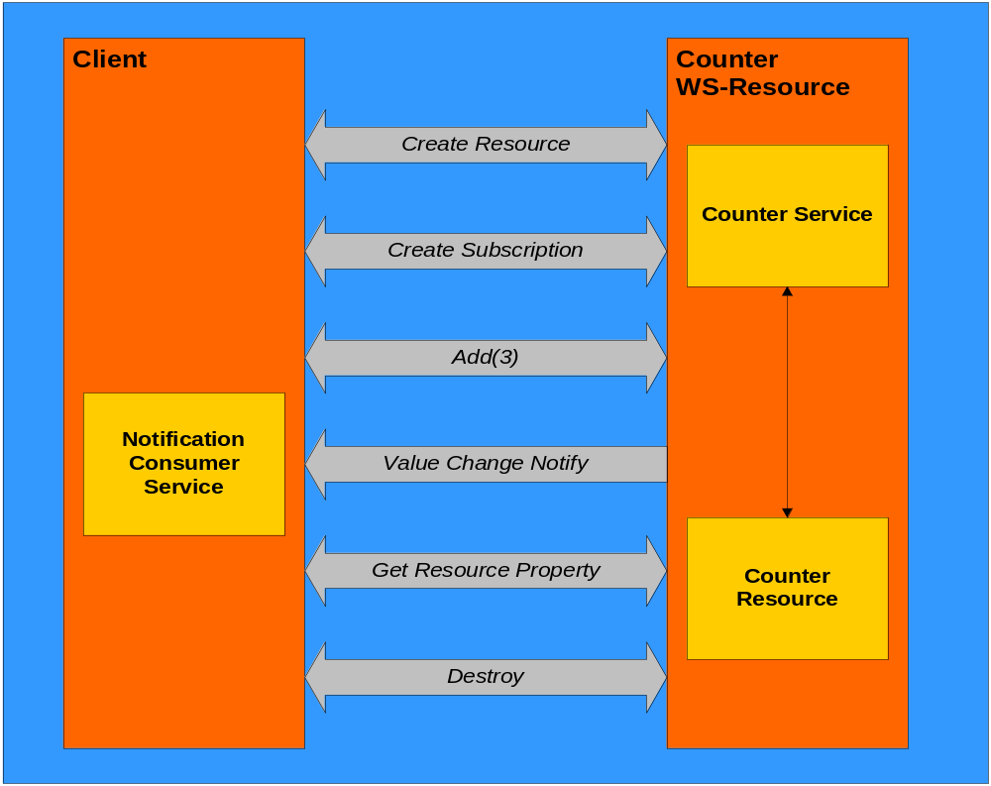
Counter Service Interaction

Slide 42
The Code: WSDL
<types>
<xsd:schema targetNamespace="http://counter.com"
xmlns:tns="http://counter.com"
xmlns:xsd="http://www.w3.org/2001/XMLSchema">
…
<xsd:element name="Value" type="xsd:int"/>
<xsd:element name="CounterRP">
<xsd:complexType>
<xsd:sequence>
<xsd:element ref="tns:Value"
minOccurs="1" maxOccurs="1"/>
</xsd:sequence>
</xsd:complexType>
</xsd:element>
</xsd:schema>
</types>

Slide 43
The Code - WSDL
<portType name="CounterPortType"
gtwsdl:implements="wsnt:NotificationProducer wsrl:ImmediateResourceTermination"
wsrp:ResourceProperties ="tns:CounterRP">
<operation name="createCounter">
<input message="tns:CreateCounterRequest"/>
<output message="tns:CreateCounterResponse"/>
</operation>
<operation name="add">
<input message="tns:AddInputMessage"/>
<output message="tns:AddOutputMessage"/>
</operation>
</portType>

Slide 44
The Code: Service
public _createCounterResponse createCounter(_createCounterRequest request)
throws RemoteException
{
ResourceContext ctx = null;
CounterHome home = null;
ResourceKey key = null;
try
{
ctx = ResourceContext.getResourceContext();
home = (CounterHome) ctx.getResourceHome();
key = home.create();
}
catch(RemoteException e)
{
throw e;
}
catch(Exception e)
{
throw new RemoteException("", e);
}

Slide 45
The Code: Service
EndpointReferenceType epr = null;
try
{
epr = AddressingUtils.createEndpointReference(ctx, key);
}
catch(Exception e)
{
throw new RemoteException("", e);
}
_createCounterResponse response = new _createCounterResponse();
response.setEndpointReference(epr);
return response;
}

Slide 46
The Code: Service
public int add(int arg0) throws RemoteException
{
Object resource = null;
try
{
resource = ResourceContext.getResourceContext().getResource();
}
catch(RemoteException e)
{
throw e;
}
catch(Exception e)
{
throw new RemoteException("", e);
}
Counter counter = (Counter) resource;
int result = counter.getValue();
result += arg0;
counter.setValue(result);
return result;
}

Slide 47
The Code: Resource
public class PersistentCounter
extends Counter
implements RemoveCallback, PersistentResource, ResourceLifetime {
public void setValue(int value) {
super.setValue(value);
try {
store();
} catch (Exception e) {
throw new RuntimeException(e.getMessage());
}
}
public void setTerminationTime(Calendar time) {
super.setTerminationTime(time);
try {
store();
} catch (Exception e) {
throw new RuntimeException(e.getMessage());
}
}

Slide 48
The Code: Resource
/**
* User-defined function.
*
* @return the resource key
*/
public Object create() throws Exception {
Object key = super.create();
store();
return key;
}

Slide 49
/**
* Called when activating a Counter resource by PersistentResourceHome
*/
public void load(ResourceKey key) throws ResourceException {
File file = getKeyAsFile(key.getValue());
if (!file.exists()) {
throw new NoSuchResourceException();
}
FileInputStream fis = null;
int value = 0;
try {
fis = new FileInputStream(file);
ObjectInputStream ois = new ObjectInputStream(fis);
value = ois.readInt();
this.terminationTime = (Calendar)ois.readObject();
} catch (Exception e) {
throw new ResourceException("Failed to load resource", e);
} finally {
if (fis != null) {
try { fis.close(); } catch (Exception ee) {}
}
}
initialize(key.getValue());
this.value.set(0, new Integer(value));
}

Slide 50
The Code: Resource
public void store() throws ResourceException {
FileOutputStream fos = null;
try {
fos = new FileOutputStream(getKeyAsFile(this.key));
ObjectOutputStream oos = new ObjectOutputStream(fos);
oos.writeInt(((Integer) this.value.get(0)).intValue());
oos.writeObject(this.terminationTime);
} catch (Exception e) {
throw new ResourceException("Failed to store resource", e);
} finally {
if (fos != null) {
try { fos.close(); } catch (Exception ee) {}
}
}
}

Slide 51
The Code: Resource
private static File getKeyAsFile(Object key)
throws InvalidResourceKeyException {
if (key instanceof Integer) {
return new File(key.toString());
} else {
throw new InvalidResourceKeyException();
}
}
public void remove() throws ResourceException {
File f = getKeyAsFile(this.key);
f.delete();
}

Slide 52
The Code: Resource Home
public class CounterHome extends PersistentResourceHome {
static Log logger =
LogFactory.getLog(CounterHome.class.getName());
public ResourceKey create() throws Exception {
Counter counter = (Counter)createNewInstance();
counter.create();
ResourceKey key = new SimpleResourceKey(keyTypeName,
counter.getID());
this.resources.put(key, counter);
return key;
}
}

Slide 53
The Code: Configuration
<?xml version="1.0" encoding="UTF-8"?>
<jndiConfig xmlns="http://wsrf.globus.org/jndi/config">
<service name="CounterService">
<resource
name="home"
type="org.globus.wsrf.samples.counter.CounterHome">
<resourceParams>
<parameter>
<name>factory</name>
<value>org.globus.wsrf.tools.jndi.BeanFactory</value>
</parameter>
<parameter>
<name>resourceClass</name>
<value>org.globus.wsrf.samples.counter.PersistentCounter</value>
</parameter>
<parameter>
<name>resourceKeyName</name>
<value>{http://counter.com}CounterKey</value>
</parameter>
<parameter>
<name>resourceKeyType</name>
<value>java.lang.Integer</value>
</parameter>
</resourceParams>
</resource>
</service>
</jndiConfig>

Slide 54
The Code: Configuration
<?xml version="1.0" encoding="UTF-8"?>
<deployment name="defaultServerConfig"
xmlns="http://xml.apache.org/axis/wsdd/"
xmlns:java="http://xml.apache.org/axis/wsdd/providers/java"
xmlns:xsd="http://www.w3.org/2001/XMLSchema">
<service name="CounterService" provider="Handler"
use="literal" style="document">
<parameter name="allowedMethodsClass"
value="com.counter.CounterPortType"/>
<parameter name="handlerClass"
value="org.globus.axis.providers.RPCProvider"/>
<parameter name="className"
value="org.globus.wsrf.samples.counter.CounterService"/>
<wsdlFile>share/schema/core/samples/counter/counter_service.wsdl</wsdlFile>
<parameter name="scope" value="Application"/>
<parameter name="providers" value="
DestroyProvider SetTerminationTimeProvider GetRPProvider
SubscribeProvider GetCurrentMessageProvider"/>
</service>
</deployment>

Slide 55
The Code: Client
public class CounterClient implements NotifyCallback
{
public static void main(String [] args)
{
CounterServiceAddressingLocator locator =
new CounterServiceAddressingLocator();
try
{
EndpointReferenceType endpoint = new EndpointReferenceType();
endpoint.setAddress(
new Address(
"http://localhost:8080/wsrf/services/CounterService"));
CounterPortType port = locator.getCounterPortTypePort(endpoint);
// Create counter resource
_createCounterResponse createResponse =
port.createCounter(new _createCounter());
endpoint = createResponse.getEndpointReference();
port = locator.getCounterPortTypePort(endpoint);
_Subscribe request = new _Subscribe();
request.setUseNotify(Boolean.TRUE);

Slide 56
The Code: Client
// Create client side notification consumer
ClientNotificationConsumer.startListening();
List topicPath = new ArrayList();
topicPath.add(Counter.VALUE);
EndpointReferenceType consumerEPR =
NotificationConsumerUtils.createNotificationConsumer(
topicPath,
new CounterClient());
request.setConsumerReference(consumerEPR);
TopicExpressionType topicExpression = new TopicExpressionType();
topicExpression.setDialect(WSRFConstants.SIMPLE_TOPIC_DIALECT);
topicExpression.setValue(Counter.VALUE);
request.setTopicExpression(topicExpression);
// Subscribe to value
port.subscribe(request);

Slide 57
The Code: Client
// Add 3
port.add(3);
// Sleep so we actually get the notification
Thread.sleep(5000);
// Get the value RP
_GetResourcePropertyResponse getRPResponse =
port.getResourceProperty(Counter.VALUE);
System.out.println("Counter has value: " +
getRPResponse.get_any()[0].getValue());
// Destroy the counter resource
port.destroy(new _Destroy());
ClientNotificationConsumer.stopListening();
}
catch(Exception e)
{
e.printStackTrace();
}

Slide 58
The Code: Client
// Notification callback
public void deliver(
List topicPath, EndpointReferenceType producer,
Object message)
{
ResourcePropertyValueChangeNotificationType changeMessage =
((ResourcePropertyValueChangeNotificationElementType) message).
getResourcePropertyValueChangeNotification();
if(changeMessage != null)
{
System.out.println("Got notification with value: " +
changeMessage.getNewValue().get_any()[0].getValue());
}
}

Slide 59
What is still missing?
GT3 Compatibility Layer
More Helper APIs
Performance Work
Lots of examples
Lots of Polish
Service Group
Notes:
Examples are need because it is easy to loose track of how the stuff was intended to be used
Performance: mention db interaction
Interop workshop: half a dozen implementations

Slide 60
Take A Look
Anonymous CVS:
  cvs \
  -d:pserver:anonymous@cvs.globus.org:/home/globdev/CVS/globus-packages \
  login
  When asked for a password, please enter your email.
  cvs \
  -d:pserver:anonymous@cvs.globus.org:/home/globdev/CVS/globus-packages \
  checkout \
  wsrf
  unset GLOBUS_LOCATION ; cd wsrf ; ant all
  Installation will end up in wsrf/install
  Take a look at test services in wsrf/java/core/test/interop
Releases
  Public core alpha in mid-May

