Slide 1
Distributed Monitoring and Information Services for the Grid
Jennifer M. Schopf
UK National eScience Centre
Argonne National Lab
April 27, 2005

Slide 2
My Definitions
Grid:
  Shared resources
  Coordinated problem solving
  Multiple sites (multiple institutions)
Monitoring:
  Discovery
    Registry service
    Contains descriptions of data that is available
  Expression of data
    Access to sensors, archives, etc.

Slide 3
What do *I* mean by
Grid monitoring?
Grid level monitoring concerns data
  Shared between administrative domains
  For use by multiple people
  Think scalability
Different levels of monitoring needed:
  Application specific
  Node level
  Cluster/site Level
  Grid level

Slide 4
Grid Monitoring Does Not Include…
All the data about every node of every site
Years of utilization logs to use for planning next hardware purchase
Low-level application progress details for a single user
Application debugging data (except perhaps notification of a failure of a heartbeat)
Point-to-point sharing of all data over all sites

Slide 5
Overview of This Talk
Evaluation of information infrastructures
  Globus Toolkit MDS2, R-GMA, Hawkeye
  Insights into performance issues
What monitoring and discovery could be
Next-generation information architecture
  Web Service Resource Framework (WS-RF) mechanisms
  Integrated monitoring & discovery architecture for GT4
  Performance Numbers

Slide 6
Performance and the Grid
It’s not enough to use the Grid, it has to perform – otherwise, why bother?
First prototypes rarely consider performance (tradeoff with dev’t time)
  MDS1–centralized LDAP
  MDS2–decentralized LDAP
  MDS3–decentralized OGSA Grid service
    Prototype of a WS-based monitoring approach
  MDS4–decentralized WS-RF Web service
Often performance is simply not known

Slide 7
So We Did Some
Performance Analysis
Common model for our systems
3 Monitoring systems
  Globus Toolkit MDS2
  EDG’s R-GMA
  Condor’s Hawkeye
Tried to compare apples to apples
Got some numbers as a starting point

Slide 8
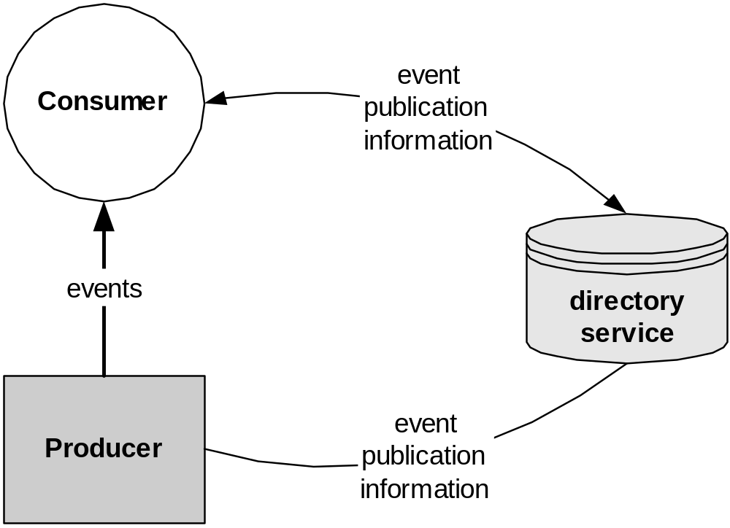
GGF Grid Monitoring Architecture
Defines only the basic concepts
No API’s, protocols, schema defined
Every monitoring system I’ve seen fits this model

Slide 9
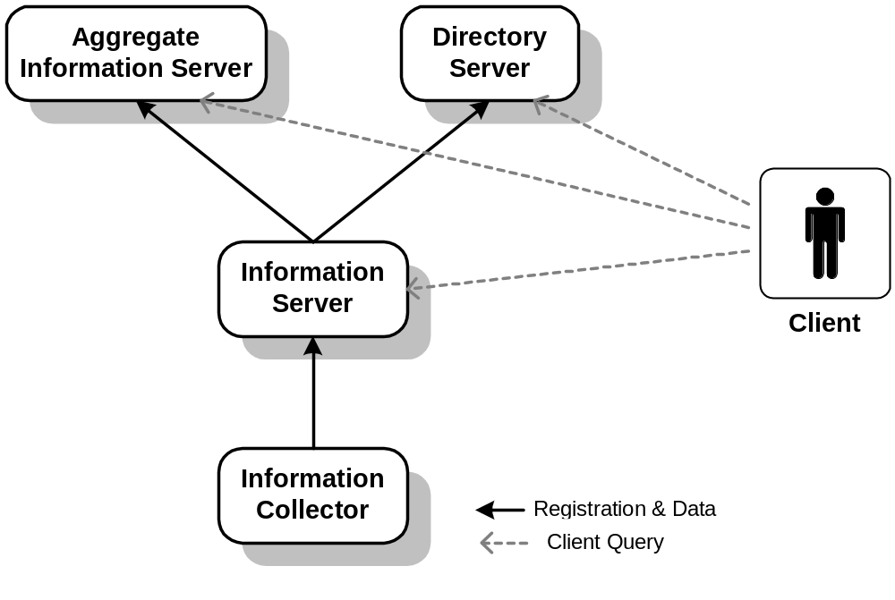
Our Generic Model
Defines functionality for our experiments
No API’s, protocols, schema defined
Can be mapped to GMA

Slide 10
Globus Monitoring and
Discovery Service (MDS2)
Part of Globus Toolkit, compatible with other elements
Used most often for resource selection
  aid user/agent to identify host(s) on which to run an application
Standard mechanism for publishing and discovery
Decentralized, hierarchical structure
Soft-state protocols
Caching (lazy)
Grid Security Infrastructure credentials

Slide 11
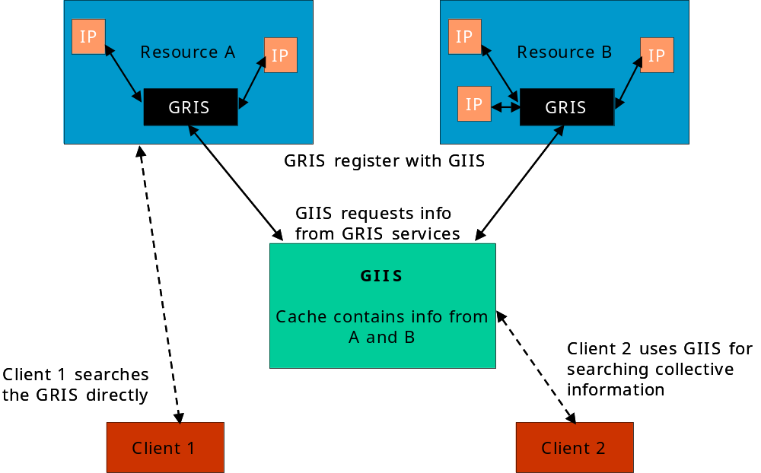
MDS2 Architecture

Slide 12
Relational Grid Monitoring Architecture (R-GMA)
Monitoring used in the EU Datagrid Project
  Steve Fisher, RAL, and James Magowan, IBM-UK
Implementation of the Grid Monitoring Architecture (GMA) defined within the Global Grid Forum (GGF)
Based on the relational data model
Used Java Servlet technologies
Focus on notification of events
User can subscribe to a flow of data with specific properties directly from a data source

Slide 13
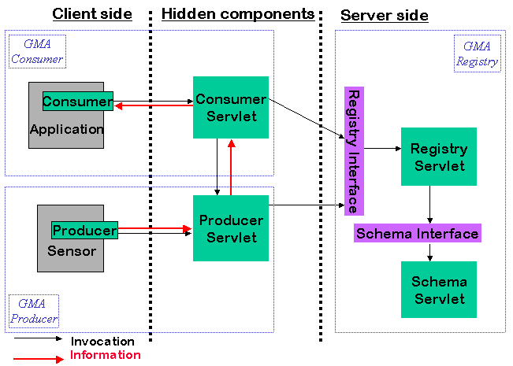
R-GMA Architecture

Slide 14
Hawkeye
Developed by Condor Group
Focus – automatic problem detection
Underlying infrastructure builds on the Condor and ClassAd technologies
  Condor ClassAd Language to identify resources in a pool
  ClassAd Matchmaking to execute jobs based on attribute values of resources to identify problems in a pool
Passive Caching – updates to Agents done periodically by default

Slide 15
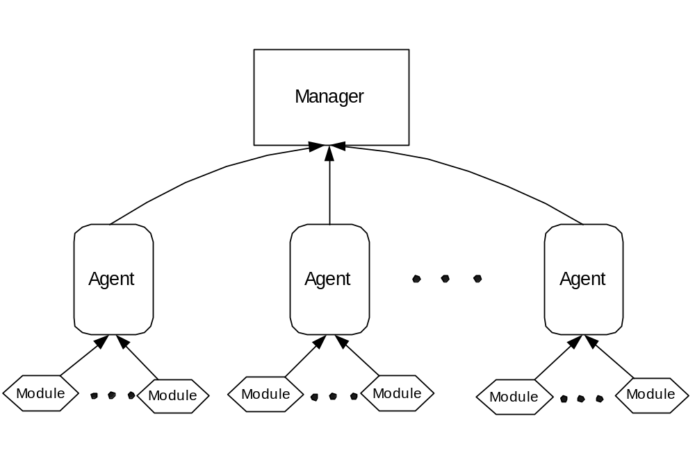
Hawkeye Architecture

Slide 16
Comparing Information Systems
 | MDS2 | R-GMA | Hawkeye
Info Collector | Information Provider | Producer | Module
Info Server | GRIS | Producer Servlet | Agent
Aggregate Info Server | GIIS | Combo Producer-Consumer | Manager
Directory Server | GIIS | Registry | Manager
Notes:
We ran a number of experiments. They were all run using the lucky cluster at argonne, and with “users” simulated at the UC nodes (evenly distributed among 20 nodes for up to 600 simulated users or queries) except in the case of R-GMA where due to architectural constraints we could only run up to about 60 users (consumers) per consumer servlet, and to have multiple consumer servlets we had to have them located at the lucky nodes (details in the paper)
All the figures are 10 minute averages, with the queries happening with a one second wait between each query (think synchronous send with a 1 second wait)
Metrics:
Throughput
Response time
Load – percentage of CPU cycles spent in user mode and system mode, recorded by ganglia
Load1 – average number of processes in the ready queue waiting to run, 1 minute average, from ganglia
Load may be high while load1 is low when a machine is running a small number of compute intensive applications. Load may be low, while load1 is high, if the same machine is trying to run a large number of applications that are blocking on I/O.

Slide 17
Experiments
How many users can query an information server at a time?
How many users can query a directory server?
How does an information server scale with the amount of data in it?
How does an aggregator scale with the number of information servers registered to it?

Slide 18
Our Experiments
2
4
1
3

Slide 19
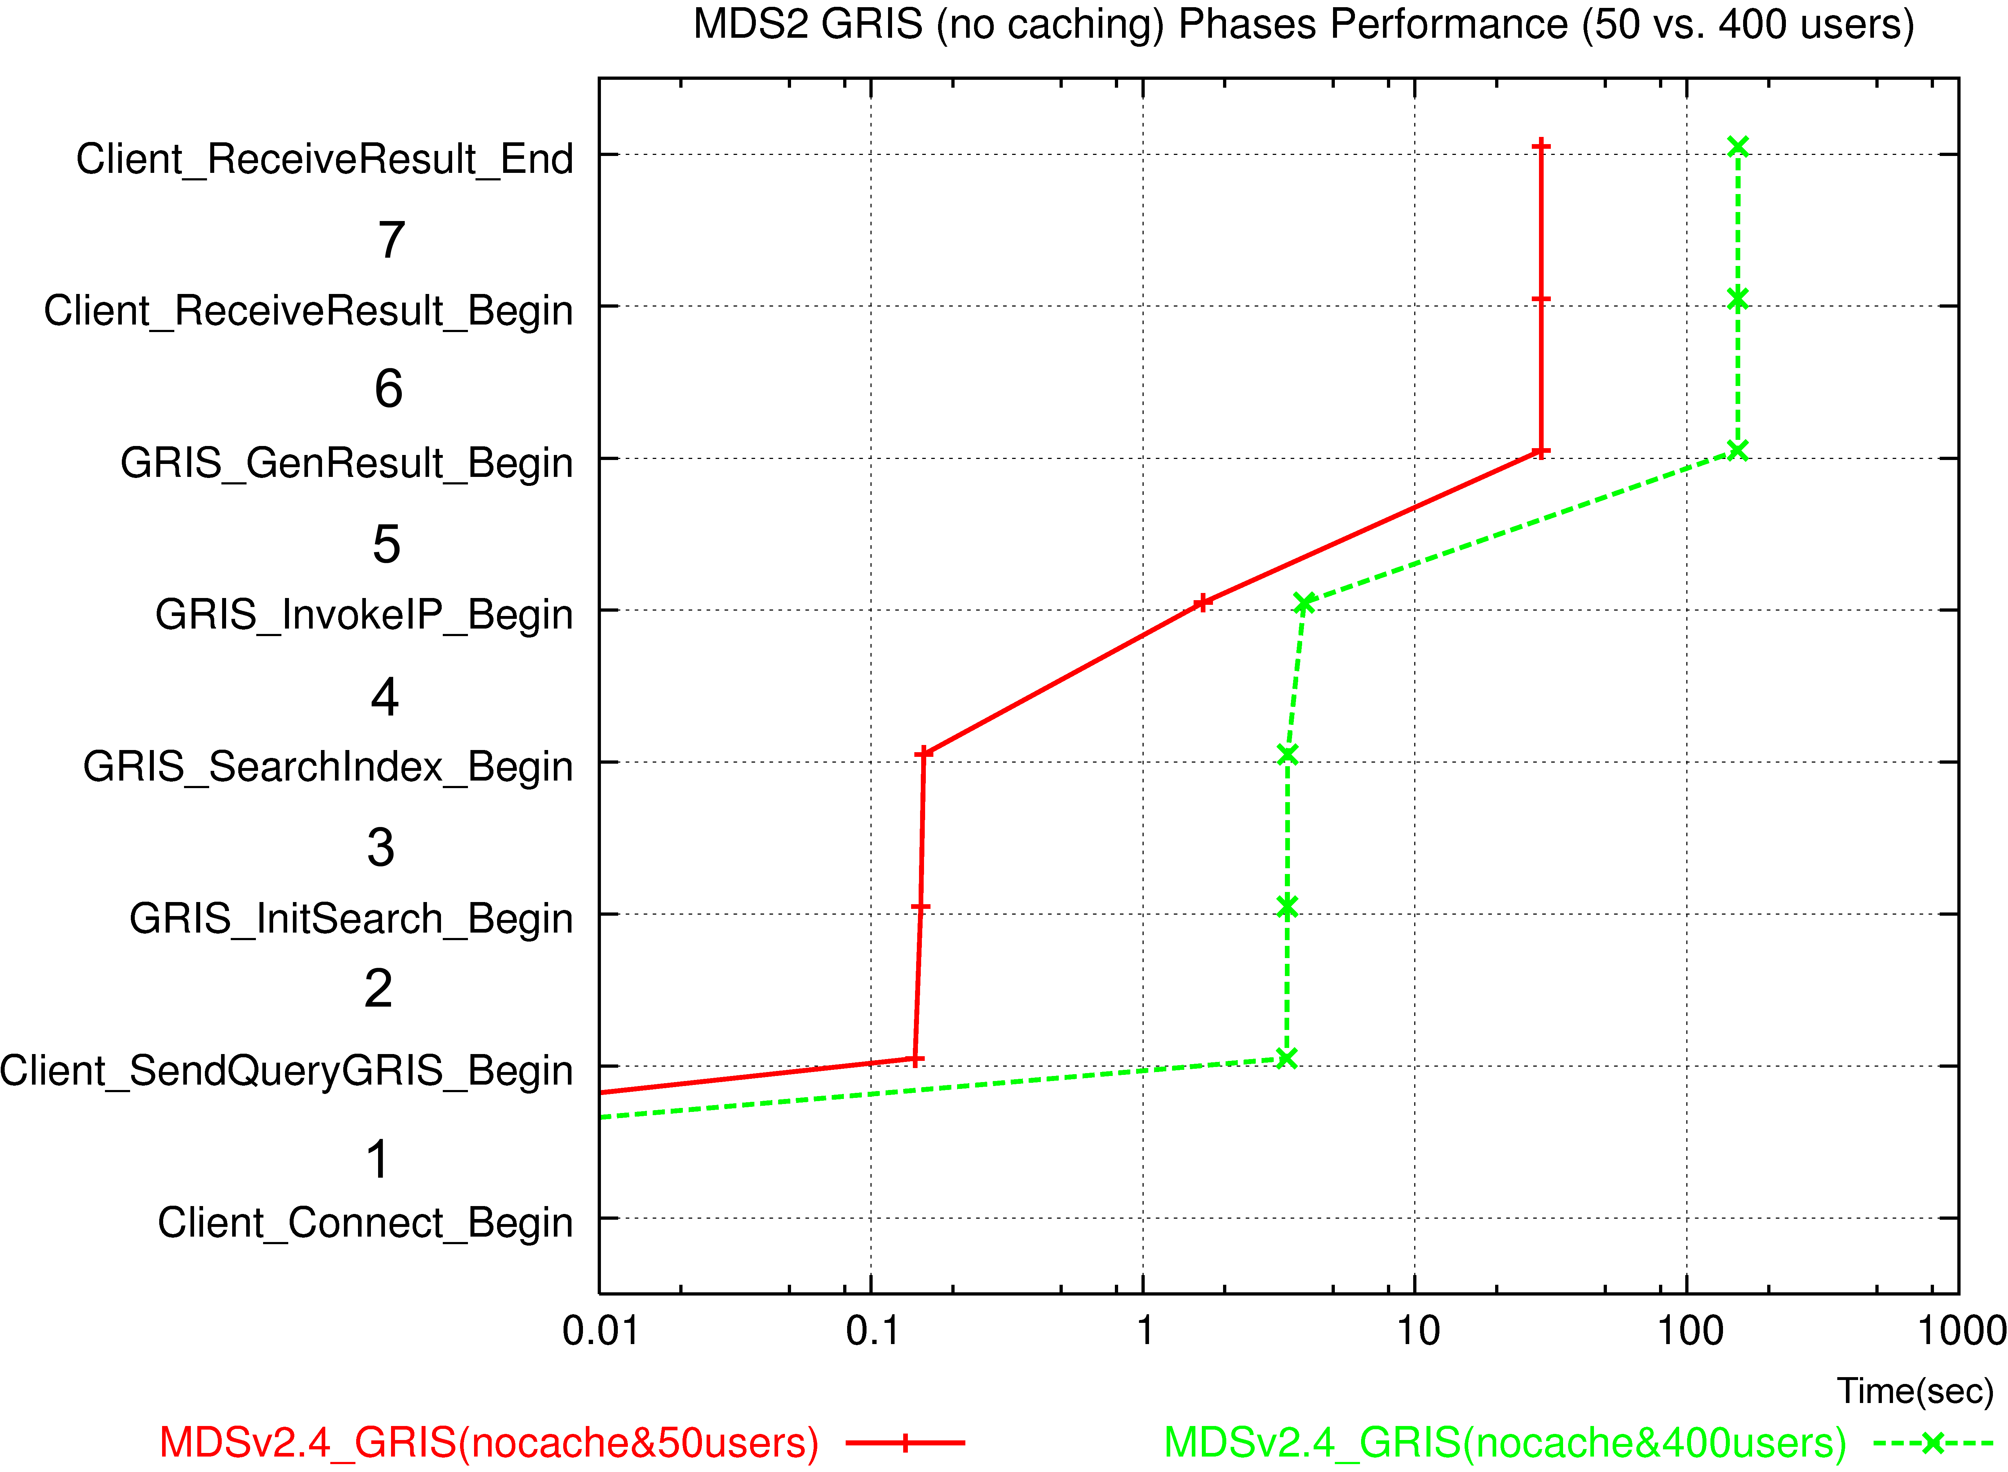
Comparing Information Systems
We also looked at the queries in depth - NetLogger
3 phases
  Connect, Process, Response
Response
Process
Connect

Slide 20
Some Architecture Considerations
Similar functional components
  Grid-wide for MDS2, R-GMA; Pool for Hawkeye
  Global schema
Different use cases will lead to different strengths
  GIIS for decentralized registry; no standard protocol to distribute multiple R-GMA registries
  R-GMA meant for streaming data – currently used for NW data; Hawkeye and MDS2 for single queries
Push vs Pull
  MDS2 is PULL only
  R-GMA allows push and pull
  Hawkeye allows triggers – push model

Slide 21
Testbed
Lucky cluster at Argonne
  7 nodes, each has two 1133 MHz Intel PIII CPUs (with a 512 KB cache) and 512 MB main memory
Users simulated at the UC nodes
  20 P3 Linux nodes, mostly 1.1 GHz
  R-GMA has an issue with the shared file system, so we also simulated users on Lucky nodes
All figures are 10 minute averages
Queries happening with a one second wait between each query (think synchronous send with a 1 second wait)

Slide 22
Metrics
Throughput
  Number of requests processed per second
Response time
  Average amount of time (in sec) to handle a request
Load
  percentage of CPU cycles spent in user mode and system mode, recorded by Ganglia
  High when running small number compute intensive aps
Load1
  average number of processes in the ready queue waiting to run, 1 minute average, from Ganglia
  High when large number of aps blocking on I/O

Slide 23
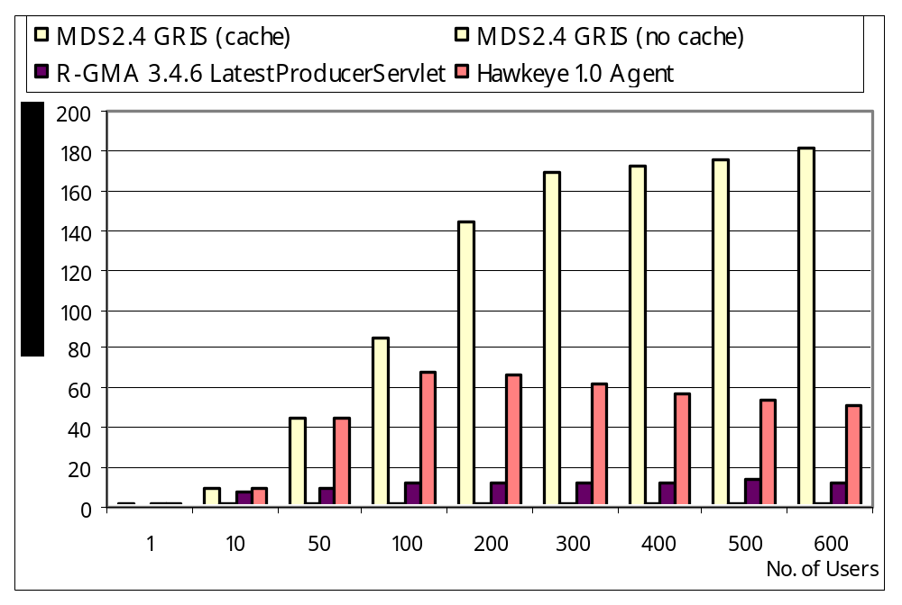
Information Server Throughput vs. Number of Users
(Larger
number
is better)
Notes:
The information server is the most heavily accessed component in a monitoring and information service. We evaluated the performance of the information servers for three systems—the MDS GRIS, the R-GMA ProducerServlet, and the Hawkeye Agent—when a large number of users accessed it concurrently.
10 info collectors each
MDS GRIS throughput has a near linear relationship with the number of concurrent users if the data is in cache. Its throughput, however, does not exceed 2 queries per second when the data is not in cache, suggesting that data caching is very important to support a large number of users. We observe throughput thresholds for the information servers that did not cache data. We believe this is because the network on the server side can no longer handle the traffic from the queries, which limits the number of concurrent queries presented to the information server, and so the throughput does not rise above a set level.
With respect to response time behavior, the GRIS results show stable performance (approximately 4 seconds per query) for 50 concurrent users or more if the GRIS has data in cache. Otherwise the performance is much worse. For the R-GMA ProducerServlet, the response time grows almost linearly with the number of users, indicating that for larger number of users the system should be configured to have multiple ProducerServlets for the same information to allow better scaling. The Hawkeye Agent had under a 10 second response time per query until 500 users are tested, quite likely because the Hawkeye Agent does not hold the indexed resident database as the Hawkeye Manager and it has to retrieve new information for each query.

Slide 24
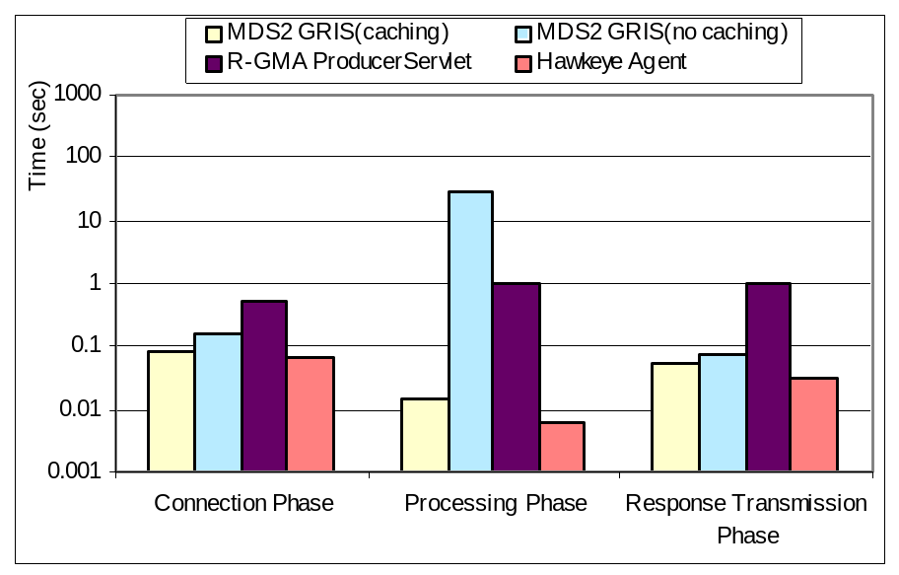
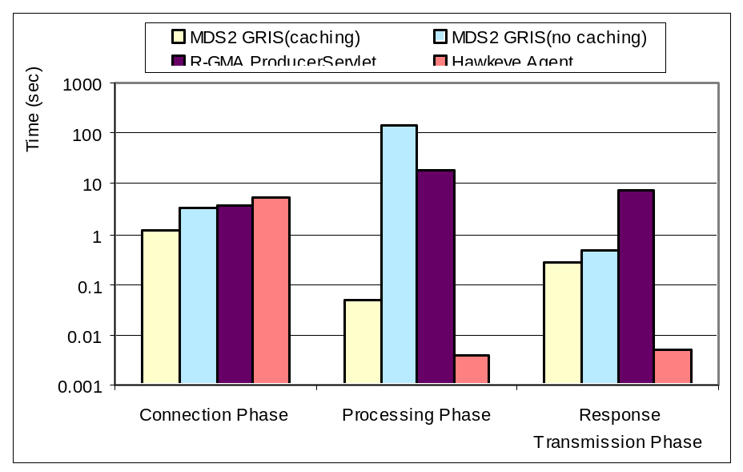
Query Times
50 users
400 users
(Smaller number is better)

Slide 25
Experiment 1 Summary
Caching can significantly improve performance of the information server
  Particularly desirable if one wishes the server to scale well with an increasing number of users
When setting up an information server, care should be taken to make sure the server is on a well-connected machine
  Network behavior plays a larger role than expected
  If this is not an option, thought should be given to duplicating the server if more than 200 users are expected to query it

Slide 26
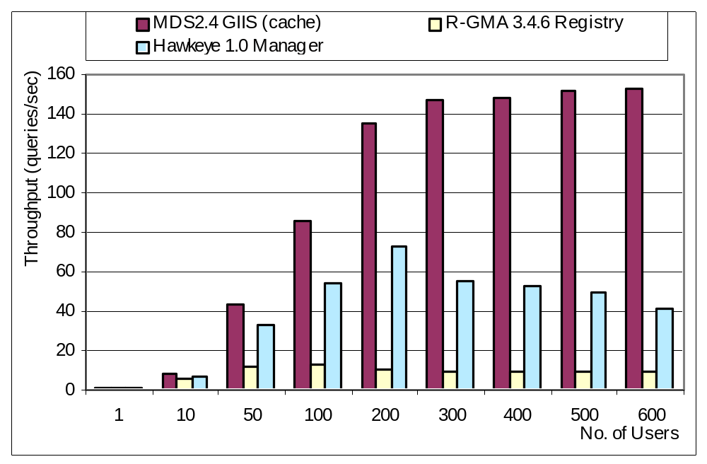
Directory Server Throughput
(Larger
number
is better)
Notes:
The second functionality we tested was the scalability of the directory server with the number of users. In particular, we examined the performance of the MDS GIIS, the R-GMA Registry and the Hawkeye Manager.
10 info providers, up to 600 users

Slide 27
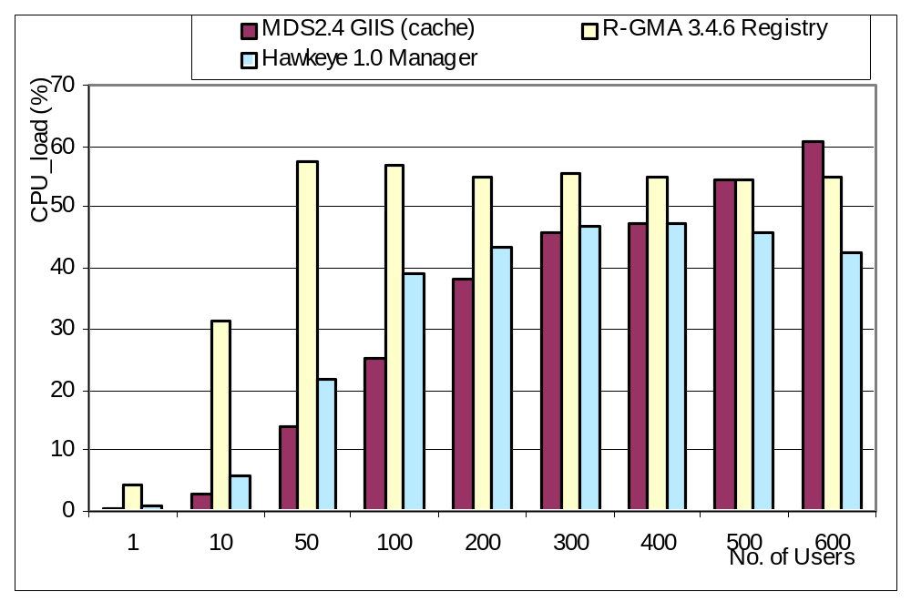
Directory Server CPU Load
(Smaller
number
is better)

Slide 28
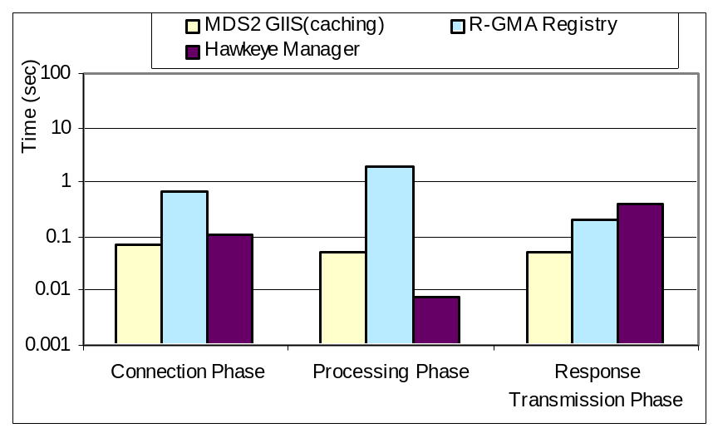
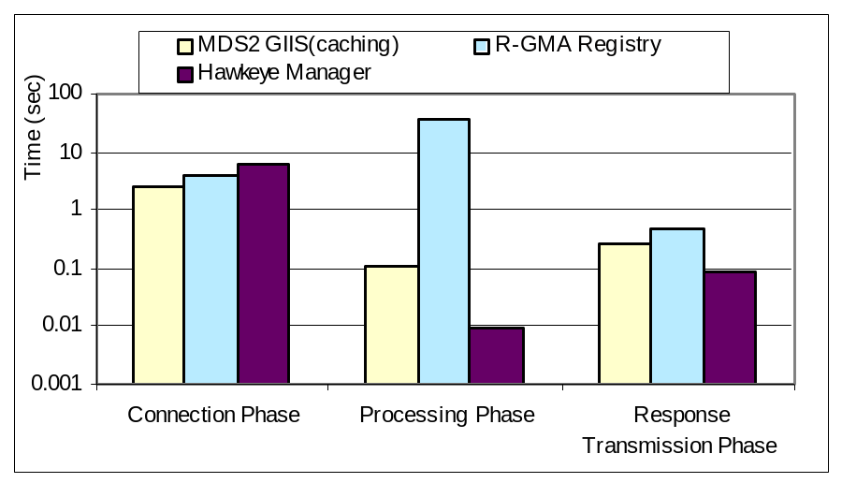
Query Times
50 users
400 users
(Smaller number is better)

Slide 29
Experiment 2 Summary
Because of the network contention issues, the placement of a directory server on a highly connected machine will play a large role in the scalability as the number of users grows
Significant loads are seen even with only a few users, it will be important that this service be run on a dedicated machine, or that it be duplicated as the number of users grows.

Slide 30
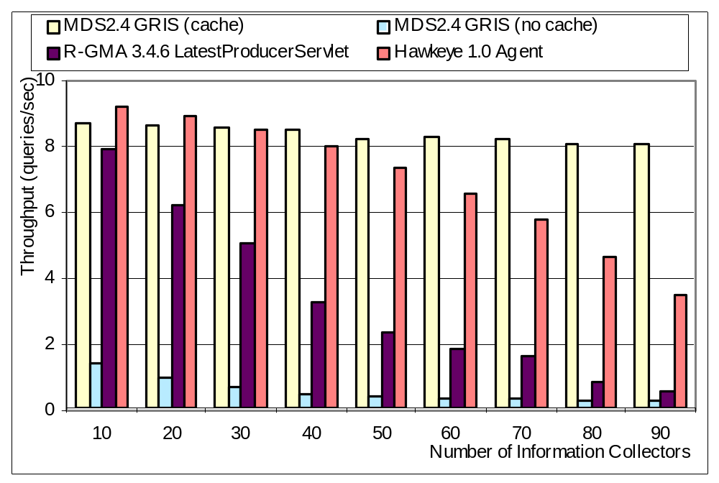
Information Server Scalability with Information Collectors
(Larger
number
is better)

Slide 31
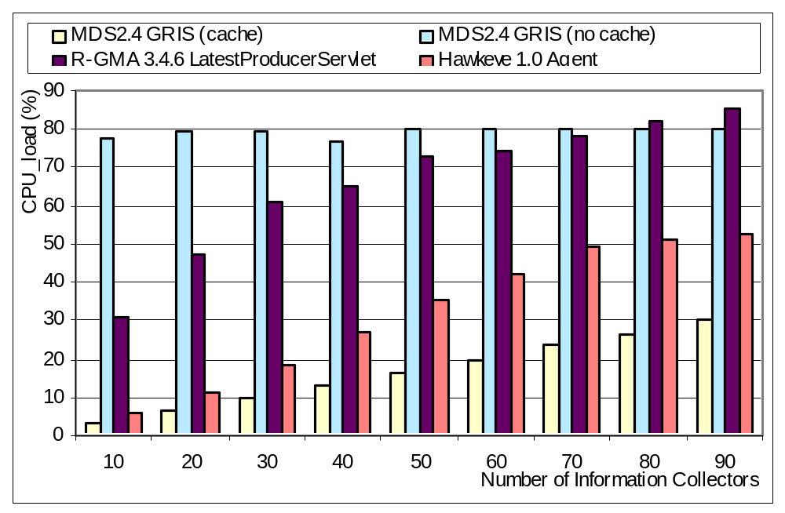
Experiment 3 Load Measurements
(Smaller
number
is better)

Slide 32
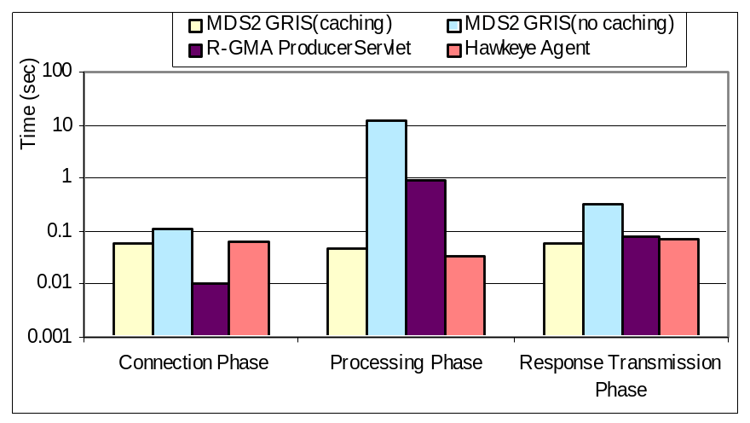
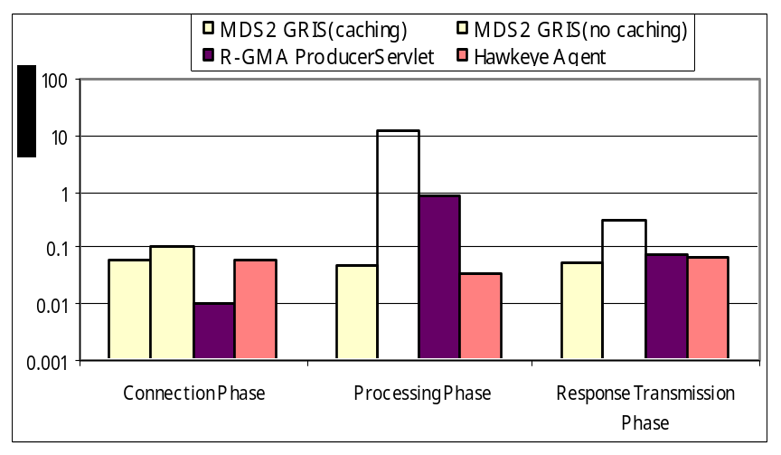
Experiment 3 Query Times
30 Info Collectors
80 Info Collectors
(Smaller number is better)

Slide 33
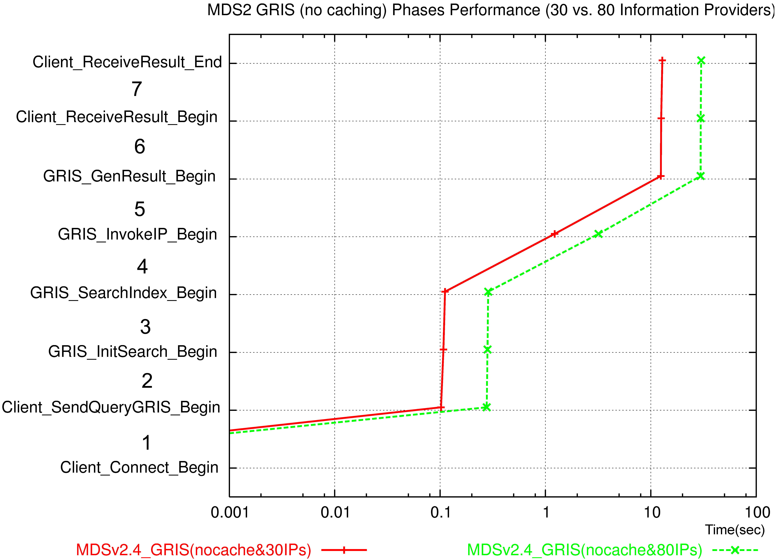
Sample Query
Note: log scale

Slide 34
Experiment 3 Summary
The more the data is cached, the less often it has to be fetched, thereby increasing throughput
Search time isn’t significant at these sizes

Slide 35
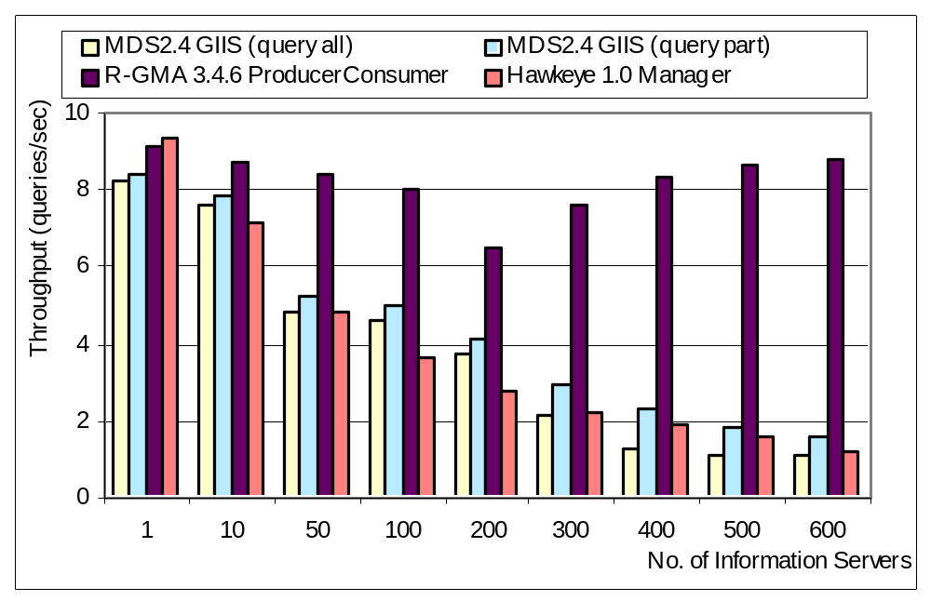
Aggregate Information Server Scalability
(Larger
number
is better)

Slide 36
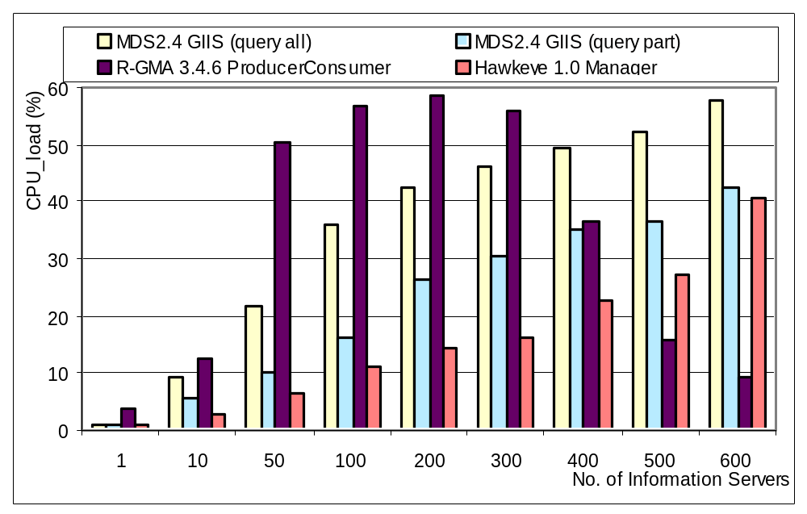
Load

Slide 37
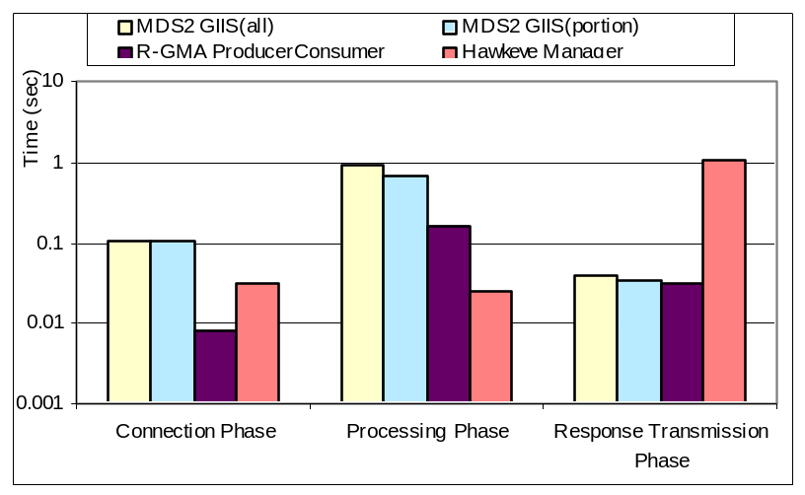
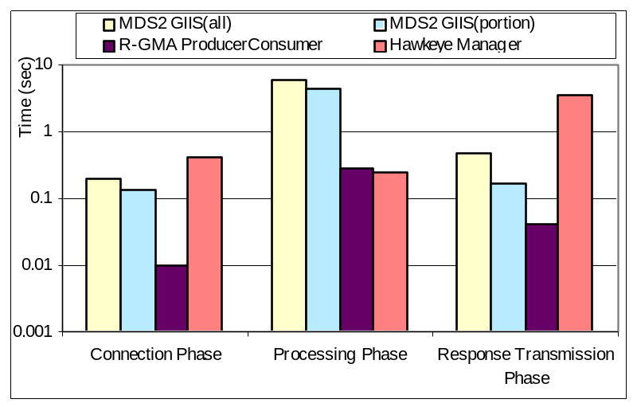
Query Response Times
50 Info Servers
400 Info Servers
(Smaller number is better)

Slide 38
Experiment 4 Summary
None of the Aggregate Information Servers scaled well with the number of Information Servers registered to them
When building hierarchies of aggregation, they will need to be rather narrow and deep having very few Information Servers registered to any one Aggregate Information Server.

Slide 39
Overall Results
Performance can be a matter of deployment
  Effect of background load
  Effect of network bandwidth
Performance can be affected by underlying infrastructure
  LDAP/Java strengths and weaknesses
Performance can be improved using standard techniques
  Caching; multi-threading; etc.

Slide 40
So what could monitoring be?
Basic functionality
  Push and pull (subscription and notification)
  Aggregation and Caching
More information available
  All services should be monitor-able automatically
More higher-level services
  Triggers like Hawkeye
  Viz of archive data like Ganglia
Plug and Play
  Well defined protocols, interfaces and schemas
Performance considerations
  Easy searching
  Keep load off of clients

Slide 41
Topics
Evaluation of information infrastructures
  Globus Toolkit MDS2, RGMA, Hawkeye
  Throughput, response time, load
  Insights into performance issues
What monitoring and discovery could be
Next-generation information architecture
  Web Service Resource Framework (WS-RF) mechanisms
  Integrated monitoring & discovery architecture for GT4
  Performance

Slide 42
Web Service Resource Framework (WS-RF)
Defines standard interfaces and behaviors for distributed system integration, especially (for us):
  Standard XML-based service information model
  Standard interfaces for push and pull mode access to service data
    Notification and subscription

Slide 43
MDS4 Uses Web Service Standards
WS-ResourceProperties
  Defines a mechanism by which Web Services can describe and publish resource properties, or sets of information about a resource
  Resource property types defined in service’s WSDL
  Resource properties can be retrieved using WS-ResourceProperties query operations
WS-BaseNotification
  Defines a subscription/notification interface for accessing resource property information
WS-ServiceGroup
  Defines a mechanism for grouping related resources and/or services together as service groups

Slide 44
MDS4
Monitoring and Discovery System
Higher level services
  Index Service
  Trigger Service
  Common aggregator framework
Information providers
  Monitoring is a part of every WSRF service
  Non-WS services can also be used
Clients
  WebMDS
All of the tool are schema-agnostic, but interoperability needs a well-understood common language

Slide 45
MDS4 Index Service
Index Service is both registry and cache
Subscribes to information providers
  Data, datatype, data provider information
Caches last value of all data
In memory default approach

Slide 46
Index Service Facts 1
No single global Index provides information about every resource on the Grid
  Hierarchies or special purpose index’s are common
  Each virtual organization will have different policies on who can access its resources
  No person in the world is part of every VO!
The presence of a resource in an Index makes no guarantee about the availability of the resource for users of that Index
  Ultimate decision about whether the resources is left to direct negotiation between user and resource
  MDS does not need to keep track of policy information (something that is hard to do concisely)
  Rscs do not need to reveal their policies publicly

Slide 47
Index Service Facts 2
MDS has a soft consistency model
  Published information is recent, but not guaranteed to be the absolute latest
  Load caused by information updates is reduced at the expense of having slightly older information
  Free disk space on a system 5 minutes ago rather than 2 seconds ago.
Each registration into an Index Service is subject to soft-state lifetime management
  Reg’s have expiry times and must be periodically renewed
  Index is self-cleaning, since outdated entries disappearing automatically

Slide 48
MDS4 Trigger Service
Subscribe to a set of resource properties
Evaluate that data against a set of pre-configured conditions (triggers)
When a condition matches, email is sent to pre-defined address
Similar functionality in Hawkeye
GT3 tech-preview version in use by ESG

Slide 49
Aggregator Framework
General framework for building services that collect and aggregate data
  Index and Trigger service both use this
1) Collect information via aggregator sources
  Java class that implements an interface to collect XML-formatted data
  Query source uses WS-ResourceProperty mechanisms to poll a WSRF service
  Subscription source collects data from a service via WS-Notification subscription/notification
  Execution source executes an administrator-supplied program to collect information

Slide 50
Aggregator Framework (cont)
2) Common configuration mechanism
  Maintain information about which aggregator sources to use and their associated parameters
  Specify what data to get, and from where
3) Aggregator services are self-cleaning
  Each registration has a lifetime
  If a registration expires without being refreshed, it and its associated data are removed from the server.

Slide 51
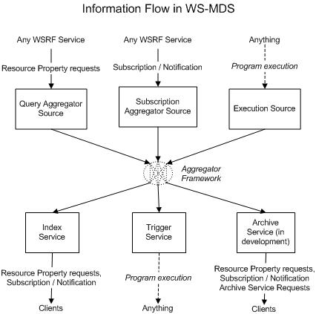
Aggregator Framework

Slide 52
Information Providers
Data sources for any aggregator service (eg. Index, Trigger)
WSRF-compliant service
  WS-ResourceProperty for Query source
  WS-Notification mechanism for Subscription source
Other services/data sources
  Executable program that obtains data via some domain-specific mechanism for Execution source.

Slide 53
Information Providers: Cluster Data
Interfaces to both Hawkeye and Ganglia
  Not WS so these are Execution Sources
  Basic host data (name, ID), processor information, memory size, OS name and version, file system data, processor load data
  Some condor/cluster specific data
GRAM – GT4 Job Submission Interface
  Queue information, number of CPUs available and free, job count information, some memory statistics and host info for head node of cluster

Slide 54
Information Providers:
GT4 Services
Reliable File Transfer Service (RFT)
  Service status data, number of active transfers, transfer status, information about the resource running the service
Community Authorization Service (CAS)
  Identifies the VO served by the service instance
Replica Location Service (RLS)
  Note: not a WS
  Location of replicas on physical storage systems (based on user registrations) for later queries
Every WS built using GT4 core
  ServiceMetaDataInfo element includes start time, version, and service type name

Slide 55
WebMDS
Web-based interface to WSRF resource property information
User-friendly front-end to the Index Service
Uses standard resource property requests to query resource property data
XSLT transforms to format and display them
Customized pages are simply done by using HTML form options and creating your own XSLT transforms

Slide 56
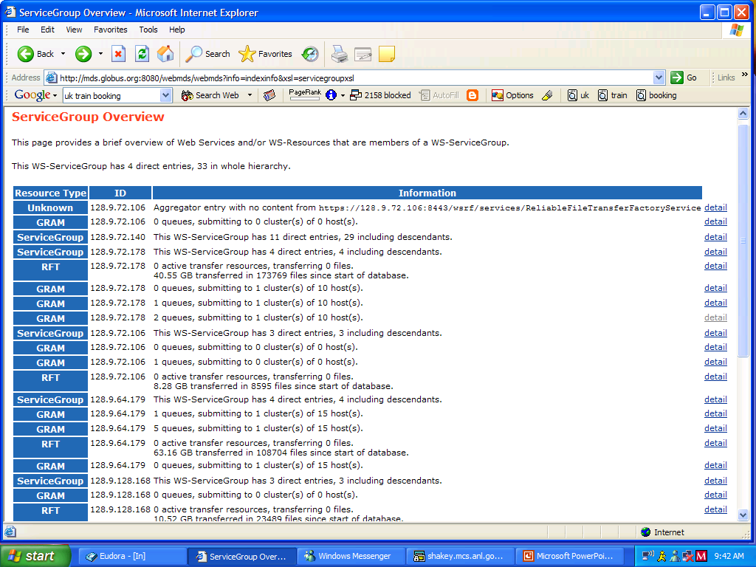
WebMDS Service

Slide 57
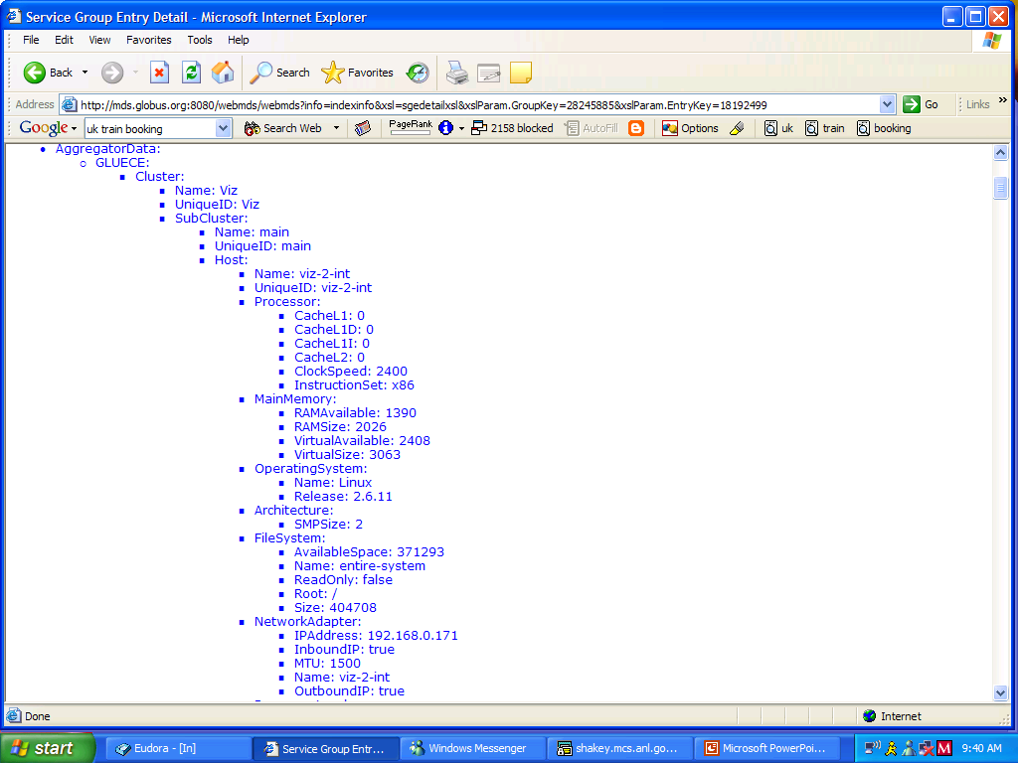

Slide 58
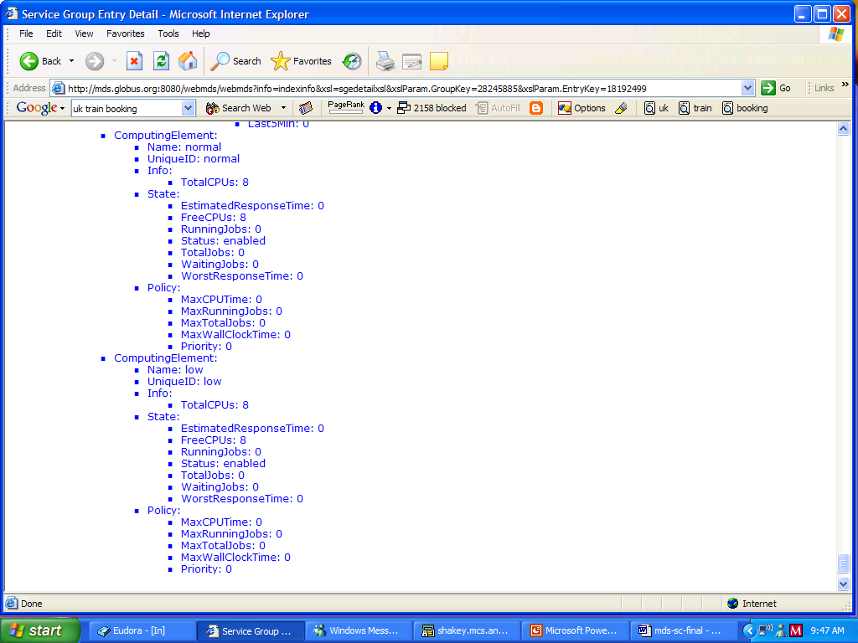

Slide 59
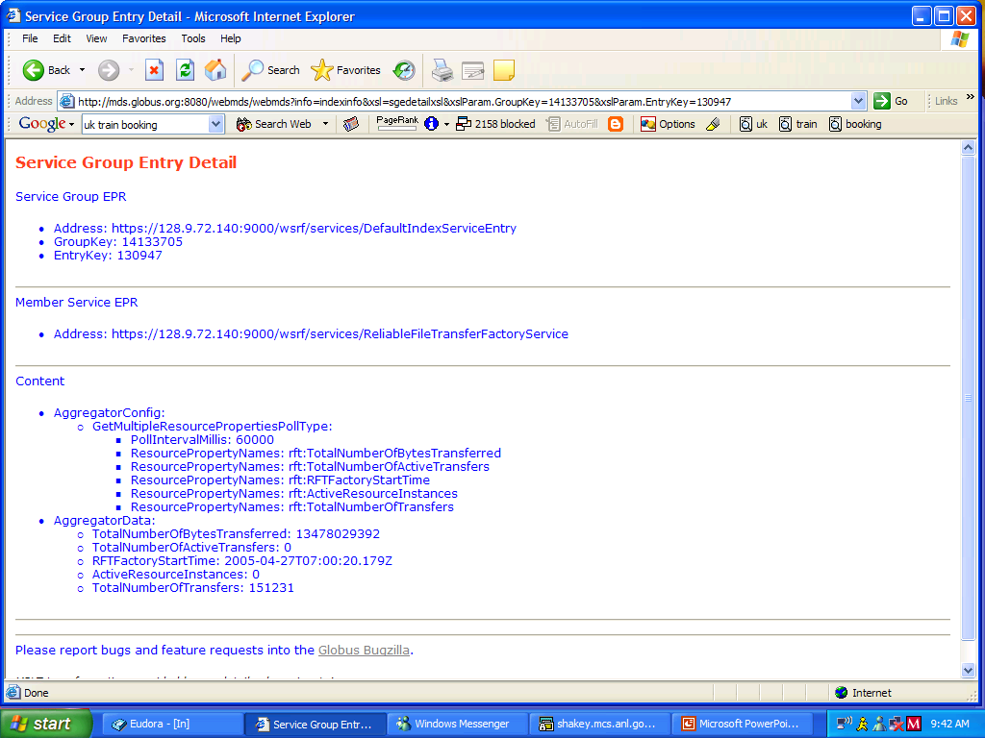

Slide 60
Any questions before I walk through a sample deployment?

Slide 61
Site 1
Rsc 1.a
1. Resources at Sites
Site 1
Index
Rsc 1.b
Site 3
GRAM
(PBS)
Rsc 2.a
Rsc 3.a
I
Site 3
Index
Ganglia/PBS
Rsc 1.c
Site 2
Index
I
GRAM
(LSF)
Rsc 2.b
Rsc 3.b
Ganglia
I
GRAM
Rsc 1.d
I
I
RFT
Hawkeye
RLS
Notes:
WebMDS: configurable via XSLT style sheets

Slide 62
Site 1
Rsc 1.a
2. Site Index Setup
Site 1
Index
Rsc 1.b
Site 3
GRAM
(PBS)
Rsc 2.a
Rsc 3.a
I
Site 3
Index
Ganglia/PBS
Rsc 1.c
Site 2
Index
I
GRAM
(LSF)
Rsc 2.b
Rsc 3.b
Ganglia
I
GRAM
Rsc 1.d
I
I
RFT
Hawkeye
RLS
Notes:
WebMDS: configurable via XSLT style sheets

Slide 63
Site 1
Rsc 1.a
3. Application Index Setup
Site 1
Index
Rsc 1.b
Site 3
GRAM
(PBS)
Rsc 2.a
Rsc 3.a
I
Site 3
Index
Ganglia/PBS
Rsc 1.c
Site 2
Index
App B
Index
I
GRAM
(LSF)
Rsc 2.b
Rsc 3.b
Ganglia
I
GRAM
Rsc 1.d
I
I
RFT
Hawkeye
RLS
Notes:
WebMDS: configurable via XSLT style sheets

Slide 64
Site 1
Rsc 1.a
4. VO Index Setup
Site 1
Index
Rsc 1.b
Site 3
GRAM
(PBS)
Rsc 2.a
Rsc 3.a
I
VO
Index
Site 3
Index
Ganglia/PBS
West Coast
Index
Rsc 1.c
Site 2
Index
App B
Index
I
GRAM
(LSF)
Rsc 2.b
Rsc 3.b
Ganglia
I
GRAM
Rsc 1.d
I
I
RFT
Hawkeye
RLS
Notes:
WebMDS: configurable via XSLT style sheets

Slide 65
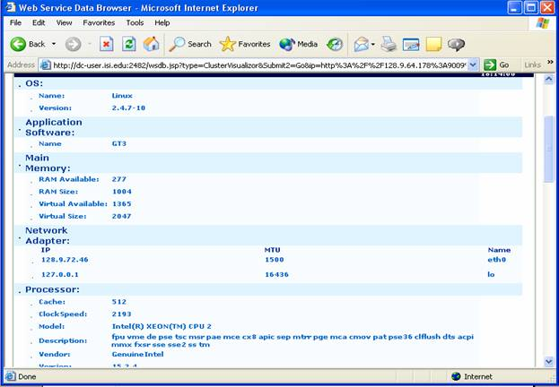
Trigger Service
WebMDS
Site 1
A
Rsc 1.a
Site 1
Index
Rsc 1.b
Site 3
GRAM
(PBS)
D
Rsc 2.a
Rsc 3.a
I
VO
Index
C
Site 3
Index
Ganglia/PBS
West Coast
Index
Rsc 1.c
Site 2
Index
App B
Index
B
I
GRAM
(LSF)
Rsc 2.b
Rsc 3.b
Ganglia
I
GRAM
Rsc 1.d
I
I
RFT
Hawkeye
RLS
Notes:
WebMDS: configurable via XSLT style sheets

Slide 66
With this deployment, the project can…
Discover needed data from services in order to make job submission or replica selection decisions by querying the VO-wide Index
Evaluate the status of Grid services by looking at the VO-wide WebMDS setup
Be notified when disks are full or other error conditions happen by being on the list of administrators
Individual projects can examine the state of the resources and services of interest to them

Slide 67
Some Performance Numbers
Basic Index Server Performance
  How long does one response take?
  How many responses per minute are possible?
  How long does the service stay up while being used before failing?
The set up
  5 client nodes (ned0–ned4), dedicated
    dual CPU 1133MHz Pentium III machines with 1.5GB of RAM
  1 server node (dc-user2), shared
    dual Intel (hyperthreaded) Xeon, 2.20GHz with 1GB of RAM
  Interconnected by Gigabit Ethernet, same physical switch

Slide 68
Index Server Performance (3.9.4)
Index
Size
1 client
2 Clients
25 Clients
100 Clients
Sing. clt q/sec
Resp. Time (msec)
Sing. clt q/sec
Resp. Time (msec)
Sing. clt q/sec
Resp. Time (msec)
Sing. clt q/sec
Resp. Time (msec)
10
24
40
22
44
4.5
245
0.85
1243
30
15
64
10
93
n/a
n/a
n/a
n/a
100
5
190
4
265
0.78
1334
0.19
5824

Slide 69
Index Server Performance
As the MDS4 Index grows, query rate and response time both slow, although sublinearly
Response time slows due to increasing data transfer size
  Full Index is being returned
  Response is re-built for every query
Real question – how much over simple WS-N performance?

Slide 70
MDS4 compared to other systems
Monitoring System
1 client
10 Clients
50 Clients
100 Clients
Sing. cli. q/sec
Resp.Time (msec)
Sing. cli. q/sec
Resp.Time (msec)
Sing. cli. q/sec
Resp.Time (msec)
Sing. cli. q/sec
Resp.Time (msec)
MDS2 w/cache
0.88
129
0.45
147
0.92
153
0.93
182
MDS2 w/o cache
0.45
1219
0.15
5534
0.77
29,175
0.91
40,410
R-GMA
0.92
61
0.03
277
0.24
3230
0.89
9734
Hawkeye
0.93
79
0.02
106
0.12
113
0.68
463
MDS-4
24
40
16.8
n/a
3.29
n/a
0.85
1243

Slide 71
Index Server Stability
Zero-entry index on same server
Ran queries against it for 1,225,221 seconds (just over 2 weeks)
  (server machine was accidentally rebooted)
Processed 93,890,248 requests
  Avg 76 per second
  Average query round-trip time of 13ms
No noticeable performance or usability degradation over the entire duration of the test

Slide 72
Summary
MDS4 is a WS-based Grid monitoring system that uses current standards for interfaces and mechanisms
Available as part of the GT4 release
  Final April 29!
Initial performance results aren’t awful – we need to do more work to determine bottlenecks

Slide 73
Where do we go next?
Extend MDS4 information providers
  More data from GT4 WS
    GRAM, RFT, CAS
  More data from GT4 non-WS components
    RLS, GridFTP
  Interface to other data sources
    Inca, GRASP
  Interface to archivers
    PinGER, NetLogger
Additional scalability testing and development
Additional clients

Slide 74
Other Possible Higher
Level Services
Archiving service
  The next thing we’re doing
  Looking at Xindice as a possibility
Site Validation Service
Prediction service (ala NWS)
What else do you think we need?

Slide 75
More Deployment Experience
Open Science Gird (OSG) currently deploys 8-12 different monitoring tools
Can MDS4 act as a common framework?

Slide 76
Summary
Current monitoring systems
  Insights into performance issues
What we really want for monitoring and discovery is a combination of all the current systems
Next-generation information architecture
  WS-RF
  MDS4 plans
Additional work needed!

Slide 77
Thanks
MDS4 Team: Mike D’Arcy (ISI), Laura Pearlman (ISI), Neill Miller (UC), Jennifer Schopf (ANL)
Students: Xuehai Zhang (UC), Jeffrey Freschel (UW)
Testbed/Experiment support and comments
  John Mcgee, ISI; James Magowan, IBM-UK; Alain Roy and Nick LeRoy at University of Wisconsin, Madison;Scott Gose and Charles Bacon, ANL; Steve Fisher, RAL; Brian Tierney and Dan Gunter, LBNL.
This work was supported in part by the Mathematical, Information, and Computational Sciences Division subprogram of the Office of Advanced Scientific Computing Research, U.S. Department of Energy, under contract W-31-109-Eng-38, and NSF NMI Award SCI-0438372. This work also supported by DOESG SciDAC Grant, iVDGL from NSF, and others.

Slide 78
For More Information
Jennifer Schopf
  jms@mcs.anl.gov
  http://www.mcs.anl.gov/~jms
Globus Toolkit MDS4
  http://www.globus.org/mds
Scalability comparison of MDS2, Hawkeye, R-GMA
  www.mcs.anl.gov/~jms/Pubs/xuehaijeff-hpdc2003.pdf
  Journal paper in the works – email if you want a draft
Monitoring and Discovery in a Web Services Framework: Functionality and Performance of the Globus Toolkit's MDS4
  Submitted to SC ’05, online later this week

