Slide 1
OGSA Security
Roadmap Discussion
GGF5 – 7/24/02

Slide 2
Outline
Introduction
Architecture Goal
Roadmap Goal
Proposed Specs
Challenges
Next Steps
…
Discussion

Slide 3
OGSA Security Architecture Goal
Address the Grid Security Requirements
Leverage existing/emerging Frameworks/Architecture/Standards
High Level

Slide 4
OGSA Security Roadmap Goal
Address the Grid Security Architecture Requirements
Make Implementations Possible
Address Interoperability
Address Pluggability/Replaceability
Address missing/late/insufficient Standards

Slide 5
Leverage existing/emerging Security Standards
WS-Security/Policy/Trust/Federation/
Authorization/SecureConversation/Privacy
XKMS, XML-Signature/Encryption, SAML, XACML, XrML
But…
  Need to OGSA’fy
  Need to define Profile/Mechanisms
  Need to define Naming conventions
  Need to address late/missing specs

Slide 6
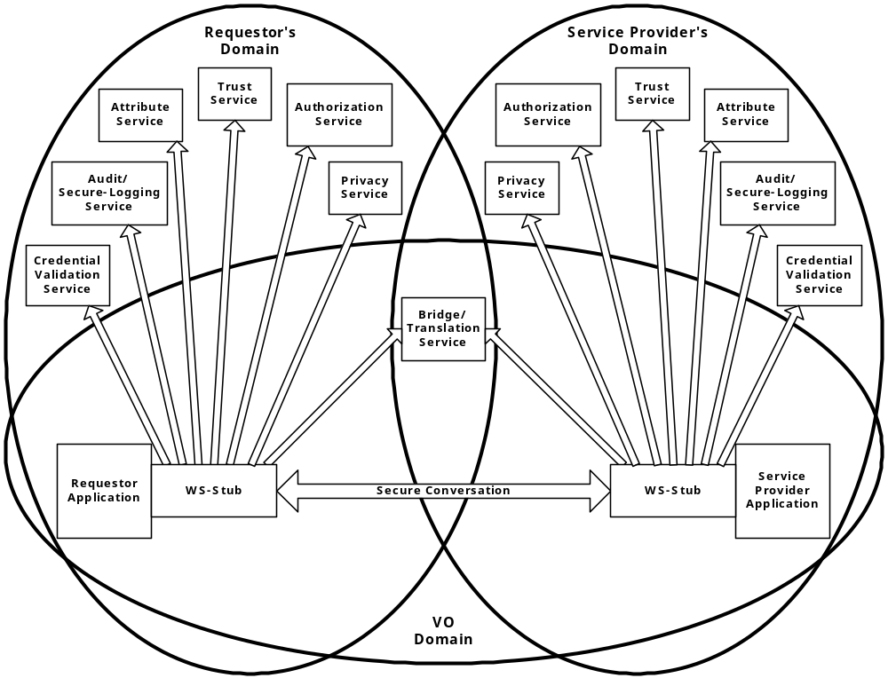
Security Services

Slide 7
Proposed Specs. (1)
Category | Specifications
Naming | OGSA Identity OGSA Target/Action Naming OGSA Attribute and Group Naming Transient Service Identity Acquisition
Translation between Security Realms | Identity Mapping Service Generic Name Mapping Policy Mapping Service Credential Mapping Service
Authentication Mechanism Agnostic | OGSA Certificate Validation Service OGSA-Kerberos Services
Pluggable Session Security | GSSAPI-SecureConversation
Pluggable Authorization Service | OGSA-Authorization Service

Slide 8
Proposed Specs. (2)
Category | Specifications
Authorization Policy Management | Coarse-grained Authorization Policy Management Fine-grained Authorization Policy Management
Trust Policy Management | OGSA Trust Service
Privacy Policy Management | Privacy Policy Framework
VO Policy Management | VO Policy Service
Delegation | Identity Assertion Profile Capability Assertion Profile

Slide 9
Proposed Specs. (3)
Category | Specifications
Firewall Friendly | OGSA Firewall Interoperability
Security Policy Expression and Exchange | Grid Service Reference and Service Data Security Policy Decoration
Secure Service Operation | Secure Service’s Policy and Processing Service Data Access Control
Audit and Secure Logging | OGSA Audit Service OGSA Audit Policy Management

Slide 10
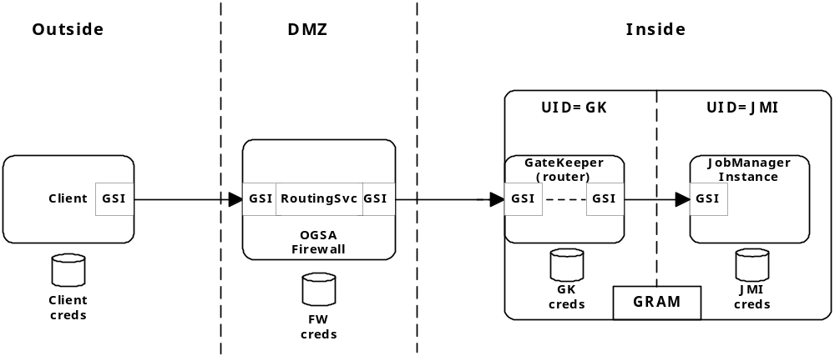
Firewall “Friendly”

Slide 11
Challenges
Empty WS Security Architecture boxes
Dependencies on other Standards Orgs
Grid Community & Industry Participation
Time
High expectations…

Slide 12
Proposed Charter
Produce and maintain Architecture and Roadmap docs
  Identify OGSA Security requirements
Identify and initiate other Security WG associated with needed specs.
Coordinate and participate in external Standardization efforts
  Specifically related to the emerging
  WS Security Architecture

Slide 13
Next Steps
OGSA Security WG Charter
  OGSA Security Architecture & Roadmap docs.
Refining the Architecture & Roadmap
  Dependencies & timelines
  Add missing specs & delete obsolete ones
Solicit/ask/force/bribe people/orgs/companies to commit to work on the specs
Formation of other OGSA-security WGs
  Address different specs.
Ensure “Grid–focus” in other Standards Orgs

