Slide 1

MyProxy and the Globus Toolkit
Agenda:
  10:00-10:30 MyProxy Introduction and Update
  (Jim Basney, NCSA)
  10:30-10:45 MyProxy and NVO
  (Mike Freemon, NCSA)
  10:45-11:00 MyProxy and FusionGrid
  (Mary Thompson, LBL)
  11:00-11:15 MyProxy and EGEE
  (Ludek Matyska, CESNET)
  11:15-11:30 Panel Discussion
  See http://myproxy.ncsa.uiuc.edu/talks.html for slides.
http://myproxy.ncsa.uiuc.edu/

Slide 2
MyProxy
Introduction and Update
Jim Basney
Senior Research Scientist
NCSA
jbasney@ncsa.uiuc.edu

Slide 3
What is MyProxy?
An Online Certificate Authority
  Issues short-lived X.509 End Entity Certificates
  Avoid need for long-lived user keys
An Online Credential Repository
  Issues short-lived X.509 Proxy Certificates
  Long-lived private keys never leave the server
Supporting multiple authentication methods
  Passphrase, Certificate, PAM, SASL, Kerberos, Pubcookie, VOMS
Open Source Software
  Included in Globus Toolkit, UGE, NMI, VDT, and CoG Kits
  C, Java, Python, and Perl clients available
  Contributions from EDG, UVA, LBL, and others

Slide 4
MyProxy Logon
Authenticate to retrieve PKI credentials
  End Entity or Proxy Certificate
  Trusted CA Certificates
  Certificate Revocation Lists (CRLs)
MyProxy maintains the user’s PKI context
  Users don’t need to manage long-lived credentials
  Enables server-side monitoring and policy enforcement (ex. passphrase quality checks)
  CA certificates & CRLs updated automatically at login
MyProxy integrates with existing authentication systems
  Providing a gateway to grid authentication

Slide 5
MyProxy Authentication
Key Passphrase
X.509 Certificate
  Control credential storage, retrieval, and renewal
  Supports trusted authentication and renewal services
Pluggable Authentication Modules (PAM)
  Kerberos password
  One Time Password (OTP)
  Lightweight Directory Access Protocol (LDAP) password
Simple Authentication and Security Layer (SASL)
  Kerberos ticket (SASL GSSAPI)
Pubcookie
  Web Single Sign-On
Virtual Organization Membership Service (VOMS)
  Attribute-based access control

Slide 6
MyProxy Deployment Options
Users already have PKI credentials
  MyProxy repository can help users manage the credentials by:
    Securing private keys in a professionally managed server
    Obtaining credentials when/where needed
    Using credentials with MyProxy-enabled applications
Users have site logons but no PKI credentials
  MyProxy CA can provide the bridge
Users need to register to obtain PKI credentials
  User registration portals provide a MyProxy interface
    Grid Account Management Architecture (GAMA)
    http://grid-devel.sdsc.edu/gama
    Portal-Based User Registration Service (PURSE)
    http://www.grids-center.org/solutions/purse

Slide 7
MyProxy CA Configuration
Authentication options:
  PAM, SASL/Kerberos, SSL/TLS
Username to certificate subject mapping
  Via “gridmap” file, LDAP query, or call-out
Certificate extension config file and call-out
Maximum certificate lifetime policy
Works well with Globus Simple CA

Slide 8
MyProxy Repository Policies
Who can store credentials?
  Restrict to specific users or CAs
  Restrict to administrator only
Who can retrieve credentials?
  Allow anyone with correct password
  Allow only trusted services / portals
Maximum lifetime of retrieved credentials
server-wide
and
per-credential

Slide 9
MyProxy-enabled Applications
CoG Kit APIs (www.cogkit.org)
Grid portal toolkits
  GridSphere (www.gridsphere.org)
  GridPort (gridport.net)
  OGCE (www.collab-ogce.org)
Authentication modules
  JAAS (myproxy.ncsa.uiuc.edu/jaas)
  Apache (myproxy.ncsa.uiuc.edu/apache)
  Pubcookie (myproxy.ncsa.uiuc.edu/pubcookie)

Slide 10
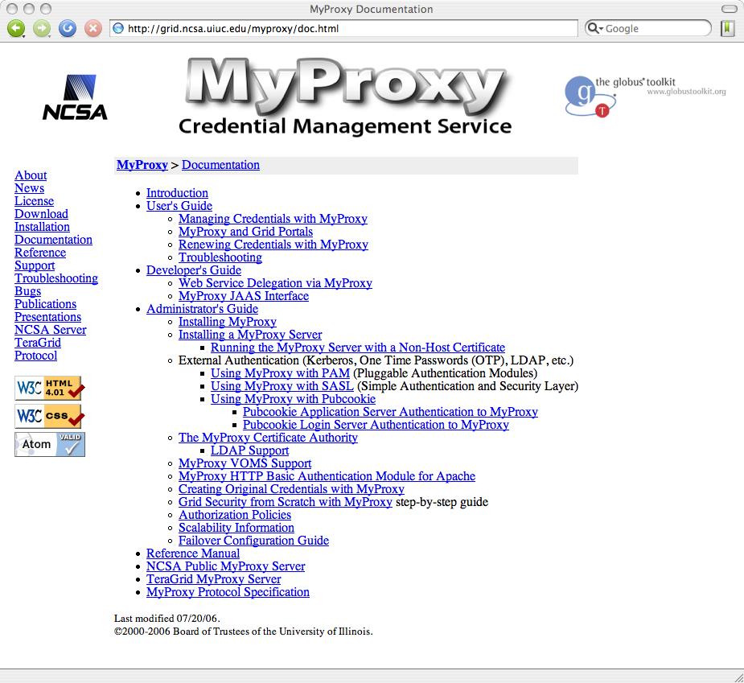
MyProxy Documentation

Slide 11
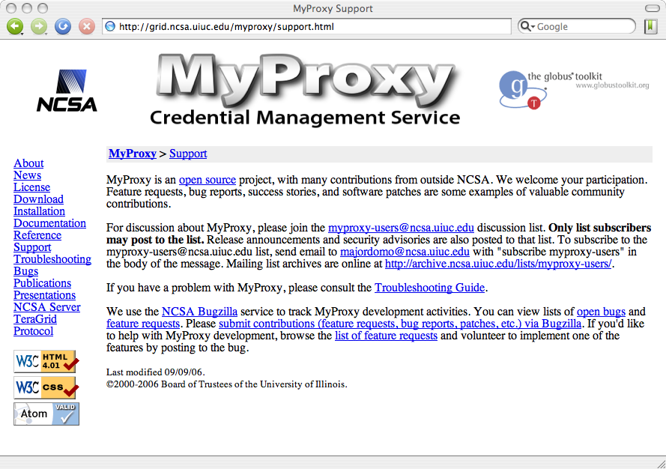
MyProxy Support

Slide 12
MyProxy Protocols
Presenting the following scenarios:
  Obtain credentials via MyProxy CA
  Store credentials in MyProxy repository
  User Registration Portals
  Web Portal Authentication and Delegation
  Web Single Sign-On (SSO)
  Credential Renewal
  Password-based Delegation

Slide 13
MyProxy CA with PAM
DN lookup
Grid
Service
LDAP
Server
X.509
password
MyProxy
Server
gridmap
P
A
M
Client
TLS handshake
RADIUS
Server
certificate request
certificate
keypair
password
password
CA key
TGT
Kerberos
KDC

Slide 14
MyProxy CA with Kerberos
DN lookup
Grid
Service
LDAP
Server
X.509
MyProxy
Server
S
A
S
L
S
A
S
L
gridmap
TLS handshake
Client
SASL/GSSAPI/Kerberos
certificate request
certificate
keypair
CA key
ticket
Kerberos
KDC

Slide 15
MyProxy Put
Client
MyProxy
Server
TLS handshake
certificate
username
proxy certificate chain
certificate request
password
policy
private key
keypair
cert chain
private key

Slide 16
MyProxy Get
Client
MyProxy
Server
TLS handshake
username
proxy certificate chain
certificate request
cert chain
password
private key
cert chain
X.509
private key
Grid
Service

Slide 17
User Registration Portal
Certificate
Authority
Registration
Portal
Browser
TLS handshake
certificate
username
password
User
DB
certificate
Client
MyProxy
Server
private key
TLS handshake
username
username
proxy certificate chain
certificate request
cert chain
password
private key
certificate
X.509
private key
Grid
Service

Slide 18
Password-based Portal Auth
MyProxy
X.509
cert request
username
password
TLS handshake
Portal
cert
Browser
username
password
cert
cert
key
key
X.509
Grid
Service

Slide 19
Trusted Portal
MyProxy
X.509
cert request
username
Portal
cert
TLS handshake
Browser
username
password
User
DB
cert
cert
key
key
X.509
Grid
Service

Slide 20
MyProxy and Web SSO
PURSE
password
password
cert
Pubcookie
Login Server
password
password
cookie
Browser
cookie
MyProxy
cookie
Portal A
cookie
cert
X.509
Grid
Service
cookie
X.509
cookie
Portal B
cert

Slide 21
Password-based Renewal
Condor-G
proxy
GRAM Gatekeeper
job
proxy
job
proxy
proxy
proxy
proxy
proxy
proxy
password
Client
Job
proxy
password
proxy
proxy
password
MyProxy
proxy

Slide 22
Certificate-based Renewal
Workload Management
Service
Renewal
Service
Condor-G
proxy
GRAM Gatekeeper
proxy
proxy
job
proxy
job
proxy
proxy
cert
key
proxy
Client
proxy
Job
proxy
policy
proxy
X.509
proxy
MyProxy
proxy

Slide 23
Password-based Delegation
Delegator
Delegatee
certificate
certificate
username
password_{random}
certificate
private key
certificate
private key
certificate
certificate
username
MyProxy
username
certificate
certificate
certificate request
certificate request
password_{random}
password_{random}
TLS handshake
certificate
certificate
TLS handshake
certificate
private key

Slide 24
SSO for Browser and Application
Browser
Authenticate
Portal
password_{random}
cert
JWS
cert
password_{random}
password_{random}
Application
MyProxy
Server
cert
password_{random}
X.509
Grid
Service

Slide 25
Conclusion
MyProxy provides a versatile solution for credential management on the grid
  Demonstrated use in many authentication, delegation, and single sign-on scenarios
MyProxy provides practical authentication solutions
  Minimize changes to existing software and protocols
  Leverage community standards
    GSI, PAM, SASL, Kerberos, LDAP, Pubcookie
Active MyProxy open source community
  New capabilities can be deployed incrementally
  We all benefit from each other’s work

Slide 26
MyProxy and the Globus Toolkit
Agenda:
  10:00-10:30 MyProxy Introduction and Update
  (Jim Basney, NCSA)
  10:30-10:45 MyProxy and NVO
  (Mike Freemon, NCSA)
  10:45-11:00 MyProxy and FusionGrid
  (Mary Thompson, LBL)
  11:00-11:15 MyProxy and EGEE
  (Ludek Matyska, CESNET)
  11:15-11:30 Panel Discussion
  See http://myproxy.ncsa.uiuc.edu/talks.html for slides.
http://myproxy.ncsa.uiuc.edu/

