Slide 1
MyProxy and EGEE
Ludek Matyska and Daniel Kouril, CESNET
GridWorld 2006
12th September 2006

Slide 2
EU EGEE Project
Four-year project, currently in its second term EGEE-II
The goal is to build a production Grid infrastructure for large number of application areas
Covers many Grid related activities
  development/reengineering, operation, support, training, ...
Currently over 20 000 CPU and 5 PB, processing thousands jobs a day
gLite software
  middleware for Grid
Collaboration with the MyProxy team since EDG
  contribution to the code base

Slide 3
MyProxy in EGEE
EGEE security based on proxy certificates
  often carrying VOMS attribute certificates
MyProxy used for several purposes:
  Solution for portals (P-GRADE, Genius)
    a common way of using MyProxy
  Long-running jobs and data transfers
    credential renewal
  t-Infrastructure CA
    formalized on-line CA based on MyProxy

Slide 4
Long-running Jobs
Jobs require valid credentials
  e.g. to access GridFTP data repositories on the user‘s behalf
  these operations must be secured, using the users‘ credentials
Job's lifetime can easily exceed the lifetime of a proxy
  consider waiting in the queues, possible resubmissions, computation time, data transfers, etc.
  also VOMS certificates have limited lifetime
Impossible to submit a job with sufficiently long credentials
  the overall job lifetime not known in advance
  violation of the meaning of short-time proxies
  increased risk when the credential is stolen
  might be unacceptable for the end resources
How to provide jobs with a valid short-lived credential throughout their run?

Slide 5
Proxy Renewal Service
Periodical renewal of credentials
  maintains a list of jobs' proxy certificates to be kept valid
  using MyProxy repository
    server specified by user in the job description
    uses the renewal mode
    authenticates using the WMS credential AND authorizes using the proxy being renewed
  Support for renewal of VOMS attributes
Part of the broker node (WMS)
  A proxy of a job is registered upon submission
  It is renewed whenever it is going to expire
    several attempts done until renewal succeeds
  After renewal a new proxy is pushed to the computing resource, where the job is running
  After the job completion the proxy is unregistered

Slide 6
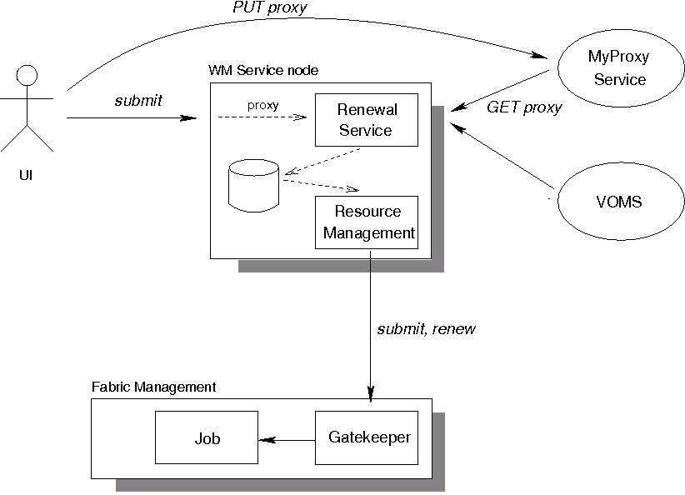
Proxy Renewal Service

Slide 7
Proxy Renewal Service
Ensures that jobs always have a valid short-time proxy
Users have full control over their proxies and renewal
  Using the MyProxy repository
Support for VOMS
All operations are logged
  allows an audit
Stolen credentials can't be renewed easily
  the WMS credential are necessary for renewal
An older (still valid) proxy must be available for renewal
  reduces the risk when services are compromised
Developed in EU Datagrid, in production use in EGEE

Slide 8
Long-term Data Transfers
EGEE applications often need to move large amount of data
The File Transfer Service (FTS) is used to handle such file movement requests
Similar problem as in the case of jobs
  the transfer can last long time, can be rescheduled etc.
FTS currently uses a password based retrieval from MyProxy
Support for renewal is currently being added
  based on routines from the renewal service

Slide 9
CA for Training (t-CA)
Effective training is crucial to get users on the Grid
  a training environment (t-Infrastructure) is necessary
Identity management is an issue in such an environment
  standard procedures by IGTF are too heavy
No special care about CAs for training so far
  very weak identity vetting procedures
  no formalized policy or auditable operation
  the users‘ are not educated since the very beginning
A well established and formalized CA for trainees is required
  trade-off between level of trust and ease to use
  not to replace current accreditation process but to fill in a gap

Slide 10
t-CA Using MyProxy
A controlled mechanism to provide trainees with certificates
  basis for identity management suitable for training events
  being prepared in VO for Central Europe (VOCE) t-Infrastructure
Based on the on-line CA mode of MyProxy
All actions performed by the CA are documented
  to help the relying parties to understand the process
  a formal policy will be available
    based on the SLCS profile by IGTF
  Proper logs for all operations done
    trainees are traceable
Only short-time certificates issued
  no need for CRLs handling

Slide 11
t-CA Operation
Trainee is registered after arriving to the event
  a random password is generated and handed over to her
  her email address is used as the username for all training services
  LDAP and Kerberos servers are updated with a new record
Registration is done by the event organizer
  must be properly educated for this job (Registration Authority)
Trainees generate their credential themselves
  at the beginning of each day
  the user machines have all necessary tools installed
  access to MyProxy based on LDAP and Kerberos credentials

Slide 12
MyProxy and Trust Establishment
Relationship between MyProxy and its client is crucial
  clients must be authorized to access the repository
So far trust based on a static configuration
  each service and client must be listed
  regular expressions aren‘t sufficient
  a subject name of a service must be added on each change or addition
VOMS support introduced recently
  generated by needs of EGEE
  allows to specify VOMS attributes (roles, groups) instead of specifying identity
  requires adding service certificates to VOMS machinery

Slide 13
Questions?

