Slide 1
MyProxy and NVO or
Web SSO for Grid Portals
GlobusWorld 2006
Washington, DC, USA
September 12, 2006
Mike Freemon
National Center for Supercomputing Applications
University of Illinois at Urbana-Champaign, IL, USA
mfreemon@ncsa.uiuc.edu

Slide 2

Acknowledgements

Slide 3
GRIDS Center
GRIDS Center
  NCSA, U. Wisconsin, USC, U. Chicago, SDSC
  http://www.grids-center.org
NSF Middleware Initiative (NMI)
  http://www.nsf-middleware.org
Mission
  Assist science projects to be successful in the use of grid technologies for doing science
Services
  Software Distributions, Build & Test, Training, Technical Support, Consulting

Slide 4
NVO
National Virtual Observatory
  NVO's objective is to enable new science by greatly enhancing access to data and computing resources. NVO makes it easy to locate, retrieve, and analyze data from archives and catalogs worldwide.
  http://www.us-vo.org
Ray Plante
  Radio Astronomer at NCSA
  Local PI for the NVO project
Related Astronomy Projects
  DES Dark Energy Survey
  LSST Large Synoptic Survey Telescope
  IVOA International Virtual Observatory Alliance

Slide 5
Organizational Landscape
Each major regional VO will run a User Authentication Server (UAS)
  UASs are CAs
  ~6 UAS’s worldwide
  Examples include NVO, EUR, China, S.America
Ten or more Portal Sites
  NVO, NCSA, NOAO, NRAO, STSCI, DES, LSST, etc.
Forty or more Resource Providers
  Web Services, GridFTP, GRAM

Slide 6
Authentication Requirements
Browser-based access
Use GSI, but hide details, X.509 credentials, etc.
Support multiple portal servers
Single Sign-On (SSO) across the portal servers
  Portal servers in different domains
Limit trust of portal servers
  Allow only short-term secrets/credentials to pass through portal server
Differentiate between two different types of credentials
  Support “weak accounts/certificates”, requiring only email verification to create
  Support “strong accounts/certificates”, requiring personal review by an security administrator before issuing
Preserve the ability for power users to retrieve GSI credentials for client-side applications
Authentication is handled by the UAS’s
Authorization is the responsibility of the Resource Providers
Individual portal applications need to access resources from multiple administrative domains (resource providers).

Slide 7
Introducing the Players
MyProxy
Pubcookie
PURSe

Slide 8
What is MyProxy?
An Online Certificate Authority
  Issues short-lived X.509 End Entity Certificates
  Avoid need for long-lived user keys
An Online Credential Repository
  Issues short-lived X.509 Proxy Certificates
  Long-lived private keys never leave the server
Supporting multiple authentication methods
  Passphrase, Certificate, PAM, SASL, Kerberos, Pubcookie, VOMS
Open Source Software
  Included in Globus Toolkit, UGE, NMI, VDT, and CoG Kits
  C, Java, Python, and Perl clients available
  Contributions from EDG, UVA, LBL, and others

Slide 9
What is Pubcookie?
Open-source software for intra-institutional* single sign-on web authentication
  University of Washington
  Part of the National Science Foundation Middleware Initiative (NMI) EDIT software release
  http://www.pubcookie.org
Limits the exposure of end-user passwords by ensuring they're only sent to a trusted login service
* Can be Inter-(DNS)domain
Implemented using HTTP cookies (intra-domain) and HTTP “redirects” (inter-domain)

Slide 10
Maintaining State Across DNS Domains
Pubcookie uses an HTML form that immediately POSTs to the target, passing the "cookie data" as request parameters.
<html>
<body onLoad="document.relay.submit()">
<form method=post action="https://pubcookie.ncsa.uiuc.edu/" name=relay>
<input type=hidden name=pubcookie_g_req
value="b25lPXNreTIuZmdpdC5vcmcmdHdvPS8mdWU9MSZmb3VyPWE1JmZpdm
U9R0VUJnNpeD1za3kyLmZnaXQub3JnJnNldmVuPS90ZXN0YXBwJmVp
ZXh0PSZob3N0bmFtZT1za3kyLmZnaXQub3JnJm5pbmU9MSZmaWxlPS
ZyZWZlcmVyPShudWxsKSZzZXNzX3JlPTAmcHJlX3Nlc3NfdG9rPTIw
NjM3MjQ2OTAmZmxhZz0w">
<input type=hidden name=post_stuff value="">
<input type=hidden name=relay_url
value="https://sky2.freemon.com/PubCookie.reply">
</form>
</html>

Slide 11
What is PURSe?
Portal-based User Registration System
  Part of the NMI GRIDS Center software release
  http://www.grids-center.org/solutions/purse
PURSe is a web-based system for registering and managing user registries for applications that use the Grid Security Infrastructure (GSI)
By leveraging the MyProxy certificate repository, PURSe shields web application users from the complexities of X.509 certificate management

Slide 12
Let’s Start with Standard Pubcookie…
Portal #1
Authn
Server
“redirect”
Pubcookie
Login Server
login page
Browser
“redirect”
Portal #2

Slide 13
Add Portal Access to GSI Credentials
(as described in the Martin, Basney, Humphrey 2005 paper – see references)
pubcookie granting
cookie
MyProxy
Server
Portal #1
Authn
Server
“redirect”
Pubcookie
Login Server
login page
Browser
“redirect”
Portal #2

Slide 14
Let’s Simplify Things for the
Portal Application Developer
Apache module
mod_myproxy
  http://grid.ncsa.uiuc.edu/myproxy/pubcookie/mod_myproxy.html
Intercepts HTTP request in Apache and automatically retrieves the GSI delegation for the authenticated user
Perl script
  Executed via mod_perl

Slide 15
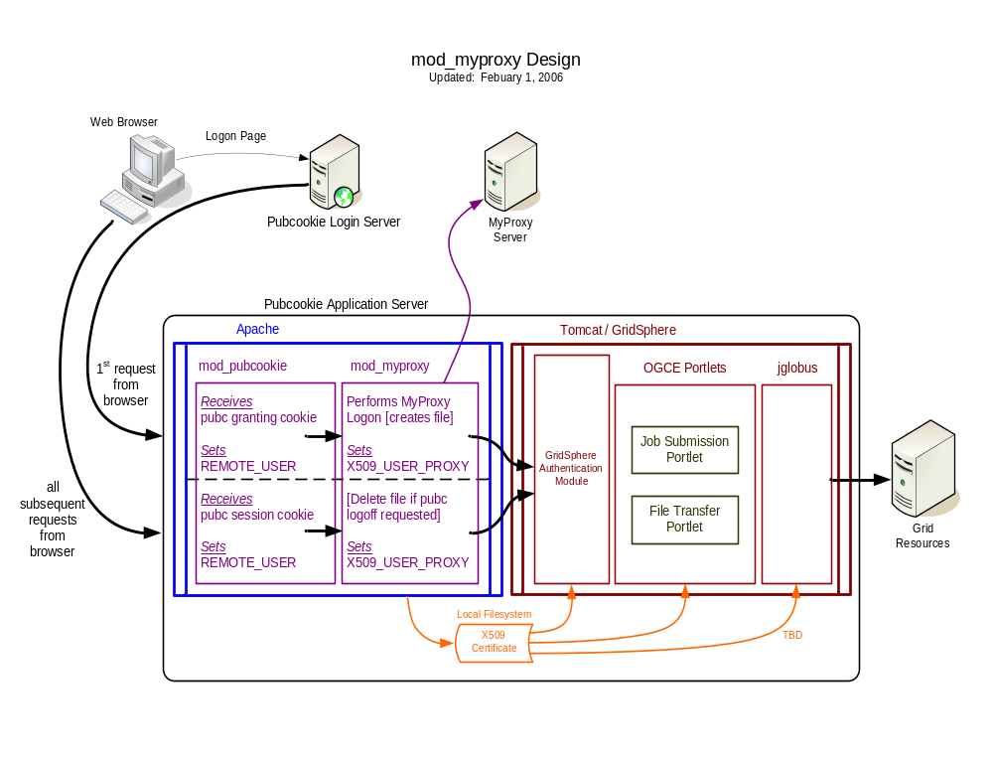

Slide 16
Why Not Use MyProxy for
Pubcookie Authentication?
pubcookie granting
cookie
MyProxy
Server
Portal #1
authn
“redirect”
Pubcookie
Login Server
login page
Browser
“redirect”
Portal #2

Slide 17
How is MyProxy initially populated?
inserts
(incl. pswd)
user
registration
request
PURSe
WebApp
User
DB
Portal #1
creates
credentials
get delegation
MyProxy
Server
redirect
Pubcookie
Login Server
login page
authn
Browser
redirect
Portal #2

Slide 18
Opportunities for Improvement
- or -
“Wouldn’t it be nice…”
…to have the user password in only one location?
  No need to keep passwords/passphrases “in-sync”, or to create administrative or support processes to reset passwords, etc.
…to make it easier to deal with “volatile” data in the X.509 certificate (such as SAML assertions)?
  Simply have the user logoff and logon again
…to not require a myproxy-init ?
…to simplify PURSE?
  PURSE is not responsible for creating any certificates, therefore it does not need SimpleCA and does not invoke any MyProxy client functionality

Slide 19
Deviations from a “Vanilla” Pubcookie/MyProxy/PURSe Implementation
Use Online CA functionality of MyProxy
MyProxy authenticates users using the PURSE database (RDBMS via PAM)
Remove SimpleCA and MyProxy processing from PURSE

Slide 20
The Design
user
registration
request
PURSe
WebApp
inserts
User
DB
Portal #1
get delegation
selects
MyProxy
Server
“redirect”
Pubcookie
Login Server
login page
authn
Browser
“redirect”
Limited Trust of Portals
Web SSO Across Grid Portals
Portal #2

Slide 21
Roadmap
Prototyping by VO projects under way
  NOAO Science Archive (NSA)
  National Optical Astronomy Observatory
Working system with NSA demo portal
  http://nvoapp1.ncsa.uiuc.edu – Portal Server
  http://nvologin.ncsa.uiuc.edu – Login Server
  CalTech has a portal server hooked in to this login server
Winter 2006 and Beyond
  Settle on main components of the standard
  User attributes via SAML in X.509 certificate
  Coexistence and interoperability with Shibboleth

Slide 22
Related Work
Apache 2.2 module (C code) that allows clients to authenticate against a MyProxy server
  http://grid.ncsa.uiuc.edu/myproxy/apache
The client's MyProxy username and passphrase are sent to the web server using HTTP basic authentication
The apache module will retrieve the delegation and store it locally on the web server
CGI scripts and other web applications can make use of this delegation to perform operations on the client's behalf

Slide 23
References
These Slides
  http://myproxy.ncsa.uiuc.edu/talks.html
Project Documentation
  http://wiki.ncsa.uiuc.edu/wiki/NVO_SSO
MyProxy/Pubcookie Integration Documentation
  http://grid.ncsa.uiuc.edu/myproxy/pubcookie
J. Martin, J. Basney, and M. Humphrey. Extending Existing Campus Trust Relationships to the Grid through the Integration of Pubcookie and MyProxy. 2005 International Conference on Computational Science (ICCS 2005), Emory University, Atlanta, GA, May 22-25, 2005.

Slide 24
Questions?
Mike Freemon
National Center for Supercomputing Applications
University of Illinois at Urbana-Champaign, IL, USA
mfreemon@ncsa.uiuc.edu

