Slide 1
OGSA-DAI Activities
OGSA-DAI for Developers
GridWorld 2006, Washington DC
11 September 2006

Slide 2
Outline
What are activities?
A new activity framework
How activities are processed
Monitoring

Slide 3
Activity Framework
The Activity Framework is a core component of OGSA-DAI
It is reponsible for performing operations (“activities”) and streaming data

Slide 4
Activities
Activities are specific processing tasks
Activities often interact with a data resource
Activities usually consume and produce data
Activities can be chained by connecting outputs and inputs

Slide 5
OGSA-DAI Activities
Many activities are shipped with the OGSA-DAI release
Mix and match activities to provide functionality you need
Or implement your own activities that meet specific requirements!

Slide 6
Example Activity Pipeline
DB Query
Produces data in blocks
Pipe
block
Stores and provides access to data blocks
block
Consumes data blocks
Delivery

Slide 7
Activity Processing (Current Release)
Processing of blocks (and therefore, activities) is controlled by the pipe – from outside the activity
  processBlock() is called many times until processing is completed
  Usually consumes and produces a single block per call

Slide 8
Activity Processing (Future)
Processing of blocks will be controlled by the activity
  process() is called exactly once
  Consumes and produces blocks as necessary
  Each activity in a pipeline processes within its own thread
  Pipes receive and may buffer blocks until they are requested

Slide 9
Current Release
Activity A
processBlock()
processBlock
Pipe
block
Called repeatedly
getBlock
block
processBlock
Activity B
processBlock()
Request
Processor

Slide 10
Future Release
Called Once
Activity A
process()
process
putBlock
Pipe
Processing
Service
initialise
block
getBlock
process
Activity B
process()

Slide 11
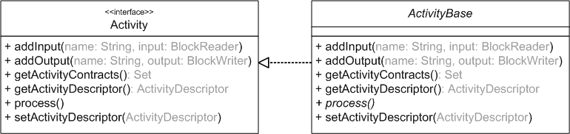
Activity Interface
All activities must implement the Activity interface
Activities may extend the abstract BaseActivity class which implements common functionality => only need to implement process()

Slide 12
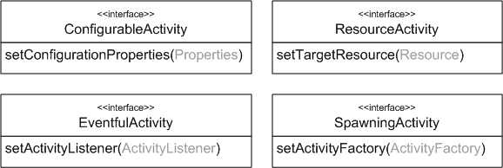
Activity Extension Interfaces
New interfaces extend the base activity to provide access to necessary information
  Activities that access data resources
  Activites that create new requests
  Activities that are configurable
  …

Slide 13
Monitoring
Monitoring Framework: Provides Listener interfaces
Activity Listeners: Receive activity events, for example
  Activity initialised
  Activity processing
  Error occurred
  Processing completed
  Custom events …

Slide 14
More Listeners
Pipe Listeners: Receive pipe events, for example
  Block produced
  Block consumed
Various listeners may be implemented to support logging, auditing, debugging etc.

Slide 15
Summary
The next release of OGSA-DAI will introduce a new Activity Framework
Improved pipeline processing
Simplified interfaces
A monitoring framework

Slide 16

The End
Questions?
http://www.ogsadai.org.uk

