Slide 1
OGSA-DAI Scenarios and Requirements
OGSA-DAI for Developers
GridWorld 2006, Washington DC
11 September 2006

Slide 2
Outline
Let’s talk to the users
  Who wants to use OGSA-DAI?
    What do they want to use it for?
    Why aren’t they using it right now?
  Who is using OGSA-DAI?
    What are they using it for?
    How could they use it more effectively?
  Who was using OGSA-DAI?
    Why aren’t they using it now?
How to use OGSA-DAI productively

Slide 3
Requirements – Why
Why?
  Learn more about the data access and integration challenges that other projects face
  Use this information to inform the future development of OGSA-DAI
  Associate requirements with projects and aid work prioritisation
    Do what we think most users want VS doing what specific users want
Notes:
Timescale – Nov 2005 to Jan 2006
Rather than guessing what projects want – go out ask and engage with them
Provide focus for the team – specific “customers”
See if there are common requirements spanning a number of projects that we could address

Slide 4
Requirements - What
What?
  Data
    Structure, quantity and types of data resource
  Queries
    Types of queries that are performed against this data, query languages, typical size of result sets
  Problems
    Data access and integration problems faced
  What can or could OGSA-DAI provide?

Slide 5
Requirements – who
AstroGrid
  (www.astrogrid.org) – distributed queries over large astronomy databases
Automed and ISpider
  (www.doc.ic.ac.uk/automed) and (www.ispider.man.ac.uk) – model-based data integration and Grid-based informatics platform for proteomics
CancerGrid
  (www.cancergrid.org) – storage and analysis of distributed data containing clinical trial and lab data
ESSC
  (www.nerc-essc.ac.uk) – environmental and atmospheric simulations
Gold
  (www.goldproject.ac.uk) – provides infrastructure for virtual organisations
NTRAC
  (www.ntrac.org.uk) – similar to CancerGrid

Slide 6
Users want…
Efficient bulk data transport
  Between heterogeneous data resources
  Required by application-level projects
  Benefits higher-level middleware (DQP, data federation, etc.)
Data federation and distributed query processing across heterogeneous data resources
Notes:
Currently focus of performance work and activity framework redesign
Currently working on swissSQL activity

Slide 7
… and …
Asynchronous query model
  Process large, long-running queries
  Client can poll or be notified of the query status
  Terminate queries at an intermediate stage
Data resource view creation and management
  Provide different views of data resources to different users in a secure, DBMS-independent manner
  Manage these views dynamically

Slide 8
…and also…
Security / certificate delegation
  Access data from other networks with role-based access rules
Usability
  Quick and easy installation, configuration and maintenance
  Support deployment as a WAR
  Reduce third-party dependencies or prerequisites
Notes:
Work on dynamic resource creation assists here a view can be viewed as a dynamic resource.
Now bundle many more third-party JARs to reduce download overheads

Slide 9
Now what…
Focus on high-priority requirements raised by projects
Continued scenario-driven development:
  Project has a specific well-defined data access or integration scenario
  Can OGSA-DAI support that scenario?
    Yes? Almost?
      What are OGSA-DAI’s limitations and how can these be addressed?
    No?
      What functionality is needed within OGSA-DAI?
  Can we spare a developer to work with this project?

Slide 10
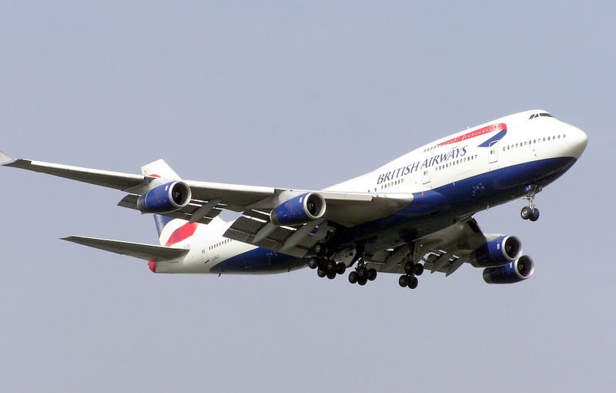

Usage scenarios
“I have a data-related problem and OGSA-DAI made things worse”
  OGSA-DAI is not a solution to every data access and integration problem in existence
“OGSA-DAI is not as fast as JDBC”
  Well, for starters OGSA-DAI uses JDBC…
  Different products for different requirements
Images from http://en.wikipedia.org/wiki/Boeing_747 and http://en.wikipedia.org/wiki/Panavia_Tornado
Notes:
Language independence at the client end - do not need to use Java.
Platform independence - do not have to worry about connection technology and drivers.
Lots of conversion to XML, extra steps between clients and data.
Can handle XML and file resources and aggregations/integrations.
Can embed additional functionality at the service end – activities - avoid unnecessary data movement.
Provision of metadata is powerful.
An occasional complaint.
But can you carry 100s of people in a F15 and where is the catering, TV, restroom, luggage space?
Scenarios from users provides a way of eliciting the effective, and less effective OGSA-DAI deployments.
Current scenarios are on the WWW site – I’ll present general ones. More specific ones e.g. for handling BLOBs are on the site.

Slide 11
OGSA-DAI is like any tool
  It has strengths and weaknesses
  There are scenarios where it will be helpful and where it will not
  We have elicited these in conjunction with our users
  We have begun to publish these on the WWW

Slide 12
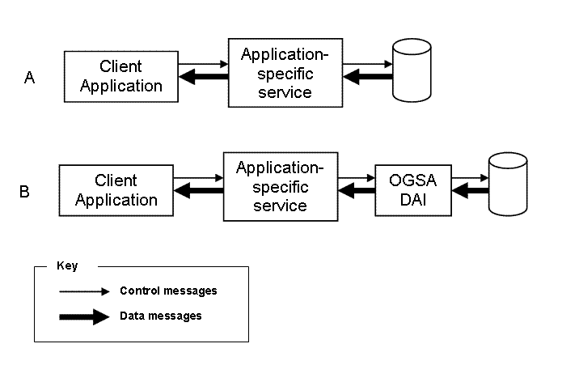
A naïve usage
Notes:
OGSA-DAI introduces an additional level of indirection to the data
This is good – location transparency and limited database transparency at the expense of performance. Benefits depend upon your priorities!
Additional transfer of data via SOAP over HTTP.

Slide 13
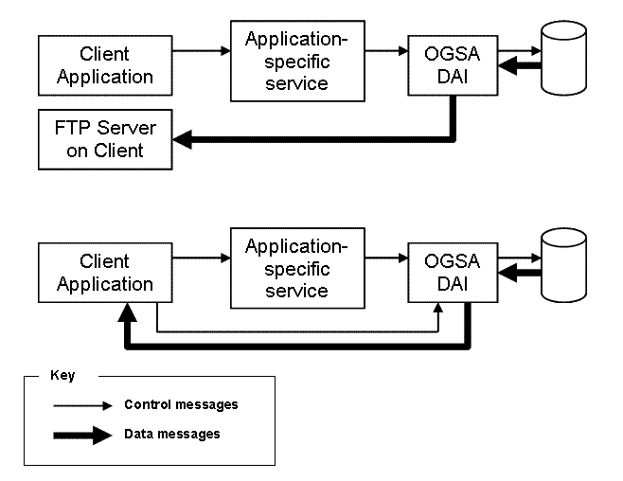
A more effective usage
Notes:
In the upper diagram OGSA-DAI's deliverToURL activity is being used to deliver the data a client's FTP server.
The data will therefore be written to a file in the client's own file space (push).
In the lower diagram OGSA-DAI deliverToStream activity delivers the data to a servlet from which the client can directly pull the data using HTTP (pull).
Two data-loaded SOAP trips are avoided and data no longer needs to pass through the application specific service.
The client is unaware of OGSA-DAI – it receives data at its FTP server or accesses a HTTP connection.

Slide 14
A more effective usage
As the data no longer flows back through the application-specific service
  Provide additional OGSA-DAI activities to do application-specific data processing
  Configure the OGSA-DAI service to support these activities
OGSA-DAI provides the delivery activities out-of-the-box
Overhead of developing application-specific data processing is reduced
  Especially if you wish to experiment
    Different delivery options
    Allowing clients to select the desired delivery option
Notes:
Move computation from the application to within OGSA-DAI – move the computation nearer to the data.

Slide 15
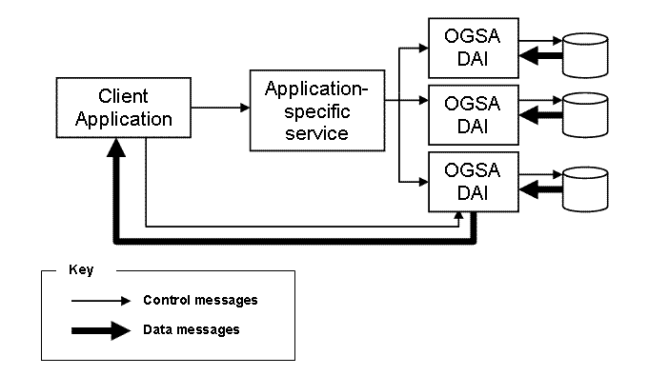
Multiple distributed resources
Notes:
Hides DBMS-specific details from the application-specific service.
Application manages the distributed resources.
Client and application-specific services only needs to know resource IDs not connection URLs or passwords.
Again data here goes from OGSA-DAI directly to the client removing an additional trip.
If the OGSA-DAI service is providing more functionality than simple access to a single data resource then its role is crucial.

Slide 16
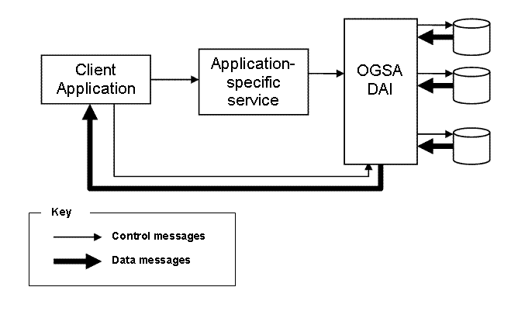
Data federation
Notes:
Again, drive functionality from the application to OGSA-DAI.
Relational multi resources, provided in release 2.2, provide support for a simple form of this style of deployment (for multiple relational resources) which, as application developers, you could customise.
A single resource performs the federation – the client and application-specific service is unaware of the individual federated resources.
Also possible, in future, to make the application-specific service explicitly aware of the resources – they manage the federation explicitly if additional control is needed. Midway point between previous slide with this one.

Slide 17
Exploiting OGSA-DAI activities
Preceding scenarios delegate much application-level functionality to OGSA-DAI so…
…why not implement all application-specific functionality as OGSA-DAI activities?
  Potentially moves computation closer to data
  Eliminates expensive data movement
  Improved range of delivery methods
  A customised OGSA-DAI service can expose only application-specific activities
Notes:
Relocate application-specific functionality from the application-specific service to OGSA-DAI.
Remove a server-side layer again.
Use OGSA-DAI client toolkit to construct our Perform document.
Raw data accessing activities such as as sqlQueryStatement do not have to be exposed to clients.

Slide 18
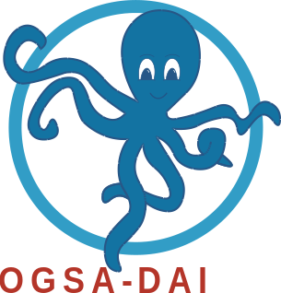
What are your requirements?
Do get in touch with the OGSA-DAI team
  Discuss OGSA-DAI matters
  Discuss requirements of a specific project
  Arrange visits and collaborations
  Contribute your own extensions
  Feedback and comments are always welcome!
Engage in discussions on OGSA-DAI user list
http://www.ogsadai.org.uk

