Slide 1
Monitoring and Discovery in a Web Services Framework:
Functionality and Performance of Globus Toolkit MDS4
Jennifer M. Schopf
Argonne National Laboratory
UK National eScience Centre (NeSC)
Sept 11, 2006

Slide 2
What is a Grid
Resource sharing
  Computers, storage, sensors, networks, …
  Sharing always conditional: issues of trust, policy, negotiation, payment, …
Coordinated problem solving
  Beyond client-server: distributed data analysis, computation, collaboration, …
Dynamic, multi-institutional virtual orgs
  Community overlays on classic org structures
  Large or small, static or dynamic

Slide 3
Why is this hard/different?
Lack of central control
  Where things run
  When they run
Shared resources
  Contention, variability
Communication
  Different sites implies different sys admins, users, institutional goals, and often “strong personalities”

Slide 4
So why do it?
Computations that need to be done with a time limit
Data that can’t fit on one site
Data owned by multiple sites
Applications that need to be run bigger, faster, more

Slide 5
What Is Grid Monitoring?
Sharing of community data between sites using a standard interface for querying and notification
  Data of interest to more than one site
  Data of interest to more than one person
  Summary data is possible to help scalability
Must deal with failures
  Both of information sources and servers
Data likely to be inaccurate
  Generally needs to be acceptable for data to be dated

Slide 6
Common Use Cases
Decide what resource to submit a job to, or to transfer a file from
Keep track of services and be warned of failures
Run common actions to track performance behavior
Validate sites meet a (configuration) guideline

Slide 7
OUTLINE
Grid Monitoring and Use Cases
MDS4
  Information Providers
  Higher level services
  WebMDS
Deployments
  Metascheduling data for TeraGrid
  Service failure warning for ESG
Performance Numbers
MDS For You!

Slide 8
What is MDS4?
Grid-level monitoring system used most often for resource selection and error notification
  Aid user/agent to identify host(s) on which to run an application
  Make sure that they are up and running correctly
Uses standard interfaces to provide publishing of data, discovery, and data access, including subscription/notification
  WS-ResourceProperties, WS-BaseNotification, WS-ServiceGroup
Functions as an hourglass to provide a common interface to lower-level monitoring tools

Slide 9
Information Users :
Schedulers, Portals, Warning Systems, etc.
WS standard interfaces for subscription, registration, notification
Standard Schemas
(GLUE schema, eg)
Cluster monitors
(Ganglia, Hawkeye,
Clumon, and
Nagios)
Queuing systems
(PBS, LSF, Torque)
Services
(GRAM, RFT, RLS)

Slide 10
Web Service
Resource Framework (WS-RF)
Defines standard interfaces and behaviors for distributed system integration, especially (for us):
  Standard XML-based service information model
  Standard interfaces for push and pull mode access to service data
    Notification and subscription

Slide 11
MDS4 Uses
Web Service Standards
WS-ResourceProperties
  Defines a mechanism by which Web Services can describe and publish resource properties, or sets of information about a resource
  Resource property types defined in service’s WSDL
  Resource properties can be retrieved using WS-ResourceProperties query operations
WS-BaseNotification
  Defines a subscription/notification interface for accessing resource property information
WS-ServiceGroup
  Defines a mechanism for grouping related resources and/or services together as service groups

Slide 12
MDS4 Components
Information providers
  Monitoring is a part of every WSRF service
  Non-WS services are also be used
Higher level services
  Index Service – a way to aggregate data
  Trigger Service – a way to be notified of changes
  Both built on common aggregator framework
Clients
  WebMDS
All of the tool are schema-agnostic, but interoperability needs a well-understood common language

Slide 13
Information Providers
Data sources for the higher-level services
Some are built into services
  Any WSRF-compliant service publishes some data automatically
  WS-RF gives us standard Query/Subscribe/Notify interfaces
  GT4 services: ServiceMetaDataInfo element includes start time, version, and service type name
  Most of them also publish additional useful information as resource properties

Slide 14
Information Providers:
GT4 Services
Reliable File Transfer Service (RFT)
  Service status data, number of active transfers, transfer status, information about the resource running the service
Community Authorization Service (CAS)
  Identifies the VO served by the service instance
Replica Location Service (RLS)
  Note: not a WS
  Location of replicas on physical storage systems (based on user registrations) for later queries

Slide 15
Information Providers (2)
Other sources of data
  Any executables
  Other (non-WS) services
  Interface to another archive or data store
  File scraping
Just need to produce a valid XML document

Slide 16
Information Providers:
Cluster and Queue Data
Interfaces to Hawkeye, Ganglia, CluMon, Nagios
  Basic host data (name, ID), processor information, memory size, OS name and version, file system data, processor load data
  Some condor/cluster specific data
  This can also be done for sub-clusters, not just at the host level
Interfaces to PBS, Torque, LSF
  Queue information, number of CPUs available and free, job count information, some memory statistics and host info for head node of cluster

Slide 17
Other Information Providers
File Scraping
  Mostly used for data you can’t find programmatically
  System downtime, contact info for sys admins, online help web pages, etc.
Others as contributed by the community!

Slide 18
Higher-Level Services
Index Service
  Caching registry
Trigger Service
  Warn on error conditions
All of these have common needs, and are built on a common framework

Slide 19
MDS4 Index Service
Index Service is both registry and cache
  Datatype and data provider info, like a registry (UDDI)
  Last value of data, like a cache
Subscribes to information providers
In memory default approach
  DB backing store currently being discussed to allow for very large indexes
Can be set up for a site or set of sites, a specific set of project data, or for user-specific data only
Can be a multi-rooted hierarchy
  No *global* index

Slide 20
MDS4 Trigger Service
Subscribe to a set of resource properties
Evaluate that data against a set of pre-configured conditions (triggers)
When a condition matches, action occurs
  Email is sent to pre-defined address
  Website updated

Slide 21
Common Aspects
1) Collect information from information providers
  Java class that implements an interface to collect XML-formatted data
  “Query” uses WS-ResourceProperty mechanisms to poll a WSRF service
  “Subscription” uses WS-Notification subscription/notification
  “Execution” executes an administrator-supplied program to collect information
2) Common interfaces to external services
  These should all have the standard WS-RF service interfaces

Slide 22
Common Aspects (2)
3) Common configuration mechanism
  Maintain information about which information providers to use and their associated parameters
  Specify what data to get, and from where
4) Services are self-cleaning
  Each registration has a lifetime
  If a registration expires without being refreshed, it and its associated data are removed from the server
5) Soft consistency model
  Flexible update rates from different IPs
  Published information is recent, but not guaranteed to be the absolute latest
  Load caused by information updates is reduced at the expense of having slightly older information
  Free disk space on a system 5 minutes ago rather than 2 seconds ago

Slide 23
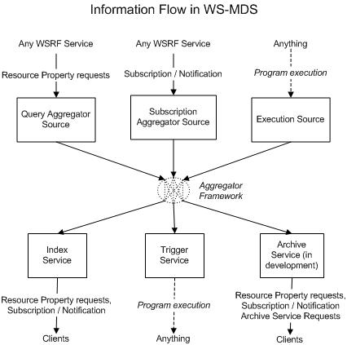
Aggregator Framework

Slide 24
Aggregator Framework is a General Service
This can be used for other higher-level services that want to
  Subscribe to Information Provider
  Do some action
  Present standard interfaces
Archive Service
  Subscribe to data, put it in a database, query to retrieve, currently in discussion for development
Prediction Service
  Subscribe to data, run a predictor on it, publish results
Compliance Service
  Subscribe to data, verify a software stack match to definition, publish yes or no

Slide 25
WebMDS User Interface
Web-based interface to WSRF resource property information
User-friendly front-end to Index Service
Uses standard resource property requests to query resource property data
XSLT transforms to format and display them
Customized pages are simply done by using HTML form options and creating your own XSLT transforms
Sample page:
  http://mds.globus.org:8080/webmds/webmds?info=indexinfo&xsl=servicegroupxsl

Slide 26
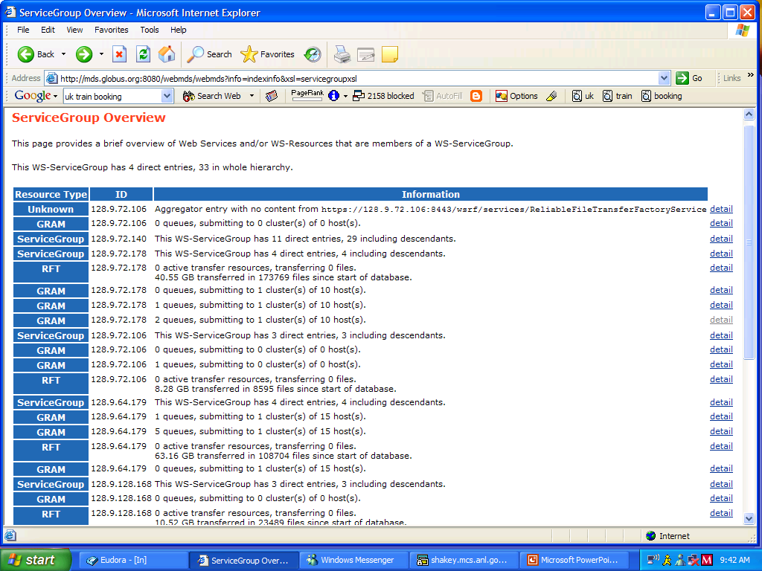
WebMDS Service

Slide 27
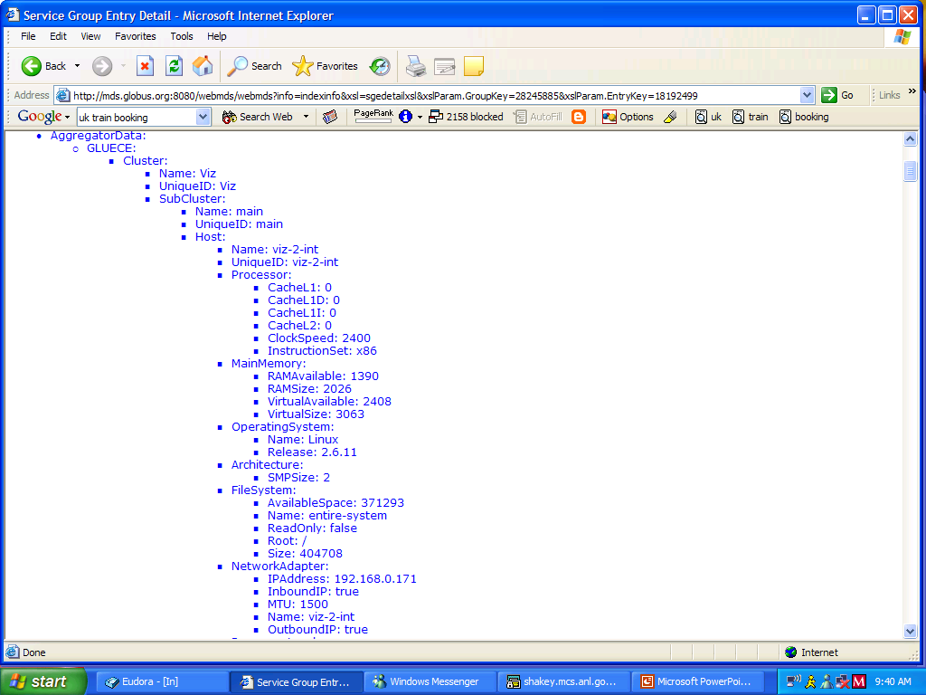

Slide 28
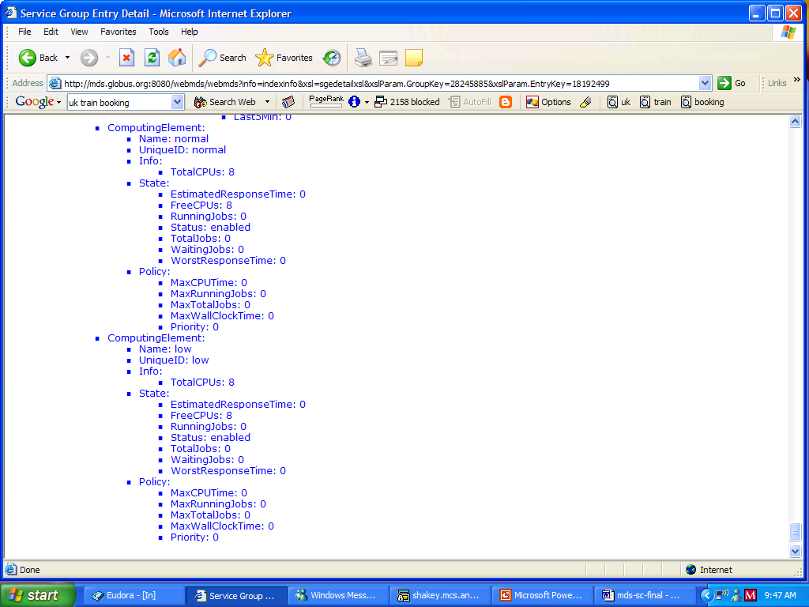

Slide 29
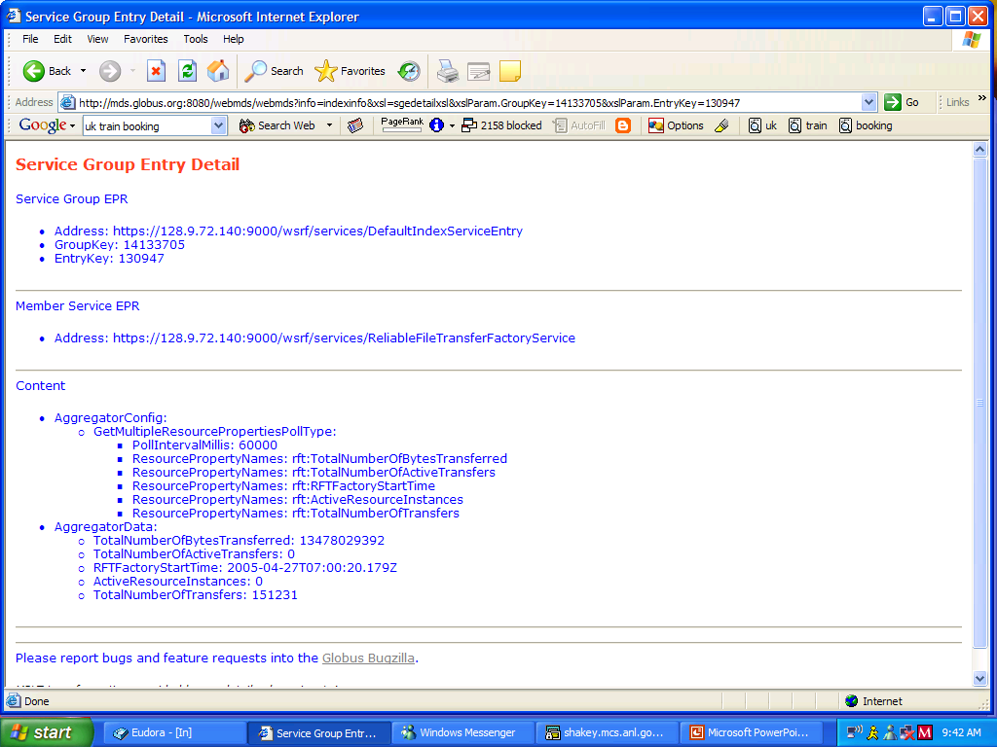

Slide 30
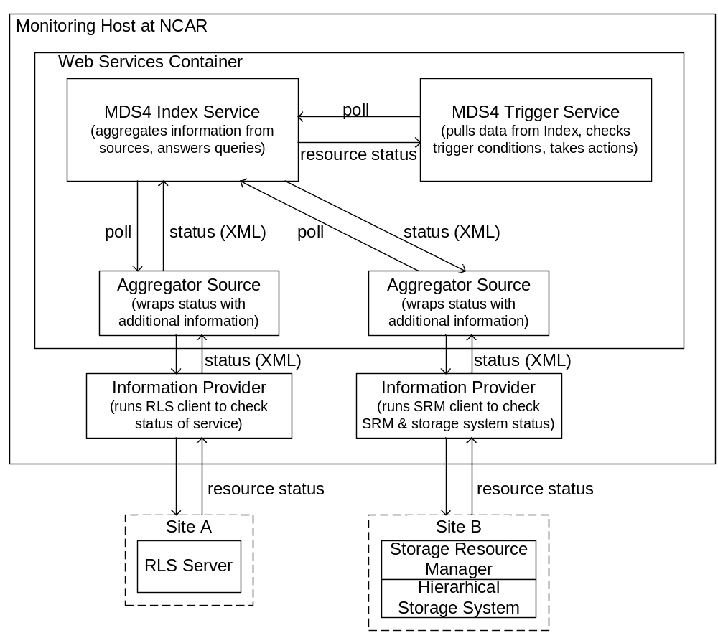

Slide 31
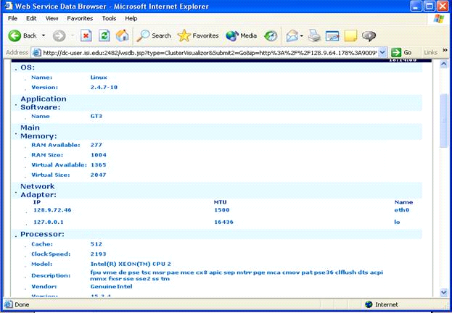
WebMDS
E
E
Trigger action
Site 1
A
A
Rsc
1.a
Site 1
Site 1
Site 1
Index
Index
Index
Rsc
Rsc
1.b
1.b
Site 3
Rsc
2.a
GRAM
GRAM
I
GRAM
Rsc
3.a
I
I
D
(PBS)
D
VO Index
(PBS)
(PBS)
C
C
Trigger
Site 3
Site 3
F
F
Service
Index
Ganglia/PBS
Index
Ganglia/PBS
Ganglia/PBS
West Coast
West Coast
Index
Index
Rsc
Rsc
1.c
1.c
App B
App B
B
Site 2
B
Site 2
Site 2
Index
Index
Index
Index
GRAM
Index
GRAM
I
GRAM
I
I
(LSF)
(LSF)
(LSF)
Rsc
Rsc
3.b
Rsc
2.b
3.b
Ganglia/LSF
Ganglia/LSF
Ganglia/LSF
GRAM
I
GRAM
I
I
I
Rsc
1.d
I
RFT
I
RFT
I
Hawkeye
Hawkeye
RLS
RLS

Slide 32
E
WebMDS
E
Trigger action
Site 1
A
A
Rsc
1.a
Rsc
2.a
Site 3
D
Rsc
3.a
D
VO Index
C
Trigger
C
Site 3
Site 1
Site 3
Site 1
Site 1
F
F
Service
Index
West Coast
Index
West Coast
Index
Index
Index
Index
Index
App B
App B
B
Site 2
B
Site 2
Site 2
Index
Index
Index
Index
Index
Rsc
Rsc
3.b
Rsc
2.b
3.b
Rsc
Rsc
1.b
1.b
GRAM
I
GRAM
I
I
I
I
Hawkeye
Hawkeye
RLS
GRAM
RLS
GRAM
I
GRAM
I
I
(PBS)
(PBS)
(PBS)
Container
Ganglia/PBS
Ganglia/PBS
Ganglia/PBS
Rsc
Rsc
1.c
1.c
Service
ABC
RFT
GRAM
GRAM
I
GRAM
I
I
(LSF)
(LSF)
(LSF)
I
Index
Ganglia/LSF
I
Ganglia/LSF
Ganglia/LSF
Registration
Rsc
1.d
RFT
I
RFT
I

Slide 33
WebMDS
E
E
Trigger action
Site 1
A
A
Rsc
1.a
Site 1
Site 1
Site 1
Index
Index
Index
Rsc
Rsc
1.b
1.b
Site 3
Rsc
2.a
GRAM
GRAM
I
GRAM
Rsc
3.a
I
I
D
(PBS)
D
VO Index
(PBS)
(PBS)
C
C
Trigger
Site 3
Site 3
F
F
Service
Index
Ganglia/PBS
Index
Ganglia/PBS
Ganglia/PBS
West Coast
West Coast
Index
Index
Rsc
Rsc
1.c
1.c
App B
App B
B
Site 2
B
Site 2
Site 2
Index
Index
Index
Index
GRAM
Index
GRAM
I
GRAM
I
I
(LSF)
(LSF)
(LSF)
Rsc
Rsc
3.b
Rsc
2.b
3.b
Ganglia/LSF
Ganglia/LSF
Ganglia/LSF
GRAM
I
GRAM
I
I
I
Rsc
1.d
I
RFT
I
RFT
I
Hawkeye
Hawkeye
RLS
RLS

Slide 34
WebMDS
E
E
Trigger action
Site 1
A
A
Rsc
1.a
Site 1
Site 1
Site 1
Index
Index
Index
Rsc
Rsc
1.b
1.b
Site 3
Rsc
2.a
GRAM
GRAM
I
GRAM
Rsc
3.a
I
I
D
(PBS)
D
VO Index
(PBS)
(PBS)
C
C
Trigger
Site 3
Site 3
F
F
Service
Index
Ganglia/PBS
Index
Ganglia/PBS
Ganglia/PBS
West Coast
West Coast
Index
Index
Rsc
Rsc
1.c
1.c
App B
App B
B
Site 2
B
Site 2
Site 2
Index
Index
Index
Index
GRAM
Index
GRAM
I
GRAM
I
I
(LSF)
(LSF)
(LSF)
Rsc
Rsc
3.b
Rsc
2.b
3.b
Ganglia/LSF
Ganglia/LSF
Ganglia/LSF
GRAM
I
GRAM
I
I
I
Rsc
1.d
I
RFT
I
RFT
I
Hawkeye
Hawkeye
RLS
RLS

Slide 35
WebMDS
E
E
Trigger action
Site 1
A
A
Rsc
1.a
Site 1
Site 1
Site 1
Index
Index
Index
Rsc
Rsc
1.b
1.b
Site 3
Rsc
2.a
GRAM
GRAM
I
GRAM
Rsc
3.a
I
I
D
(PBS)
D
VO Index
(PBS)
(PBS)
C
C
Trigger
Site 3
Site 3
F
F
Service
Index
Ganglia/PBS
Index
Ganglia/PBS
Ganglia/PBS
West Coast
West Coast
Index
Index
Rsc
Rsc
1.c
1.c
App B
App B
B
Site 2
B
Site 2
Site 2
Index
Index
Index
Index
GRAM
Index
GRAM
I
GRAM
I
I
(LSF)
(LSF)
(LSF)
Rsc
Rsc
3.b
Rsc
2.b
3.b
Ganglia/LSF
Ganglia/LSF
Ganglia/LSF
GRAM
I
GRAM
I
I
I
Rsc
1.d
I
RFT
I
RFT
I
Hawkeye
Hawkeye
RLS
RLS

Slide 36
Any questions before I walk through two current deployments?
Grid Monitoring and Use Cases
MDS4
  Information Providers
  Higher-level services
  WebMDS
Deployments
  Metascheduling Data for TeraGrid
  Service Failure warning for ESG
Performance Numbers
MDS for You!

Slide 37
Working with TeraGrid
Large US project across 9 different sites
  Different hardware, queuing systems and lower level monitoring packages
Starting to explore MetaScheduling approaches
  Currently evaluating almost 20 approaches
Need a common source of data with a standard interface for basic scheduling info

Slide 38
Cluster Data
Provide data at the subcluster level
  Sys admin defines a subcluster, we query one node of it to dynamically retrieve relevant data
Can also list per-host details
Interfaces to Ganglia, Hawkeye, CluMon, and Nagios available now
  Other cluster monitoring systems can write into a .html file that we then scrape

Slide 39
Cluster Info
UniqueID
Benchmark/Clock speed
Processor
MainMemory
OperatingSystem
Architecture
Number of nodes in a cluster/subcluster
StorageDevice
  Disk names, mount point, space available
TG specific Node properties

Slide 40
Data to collect: Queue info
Interface to PBS (Pro, Open, Torque), LSF
LRMSType
LRMSVersion
DefaultGRAMVersion and port and host
TotalCPUs
Status (up/down)
TotalJobs (in the queue)
RunningJobs
WaitingJobs
FreeCPUs
MaxWallClockTime
MaxCPUTime
MaxTotalJobs
MaxRunningJobs

Slide 41
How will the data be accessed?
Java and command line APIs to a common TG-wide Index server
  Alternatively each site can be queried directly
One common web page for TG
  http://mds.teragrid.org
Query page is next!

Slide 42
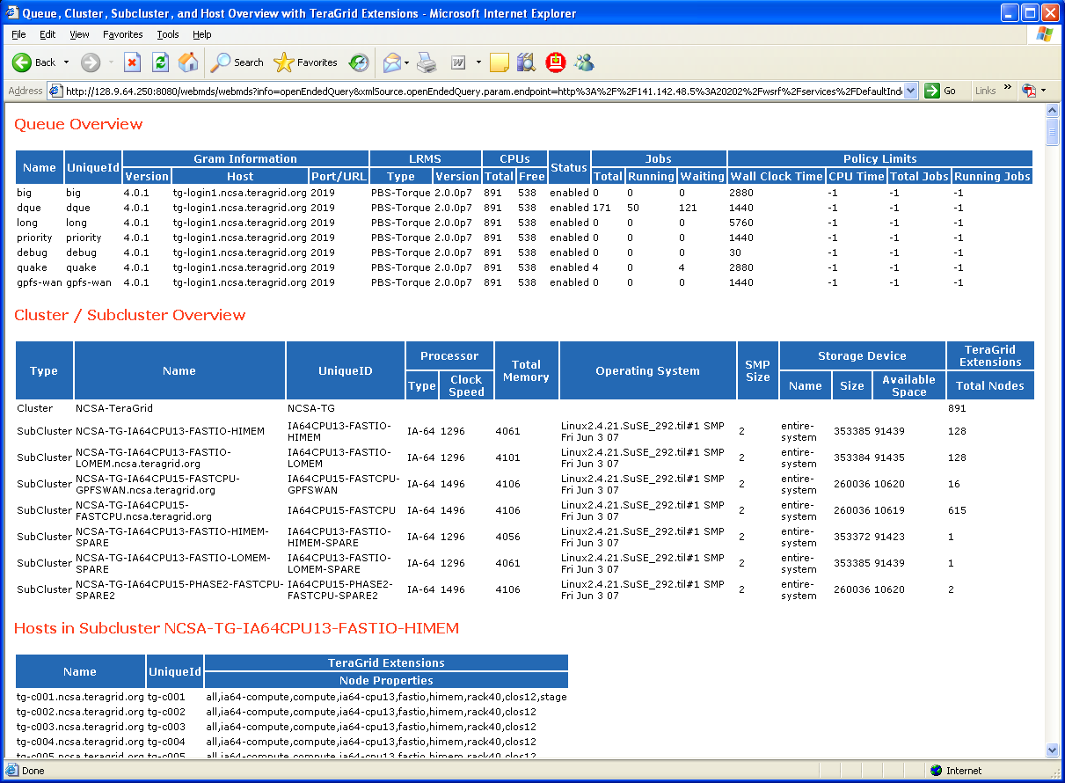

Slide 43
Status
Demo system running since Autumn ‘05
  Queuing data from SDSC and NCSA
  Cluster data using CluMon interface
All sites in process of deployment
  Queue data from 7 sites reporting in
  Cluster data still coming online

Slide 44
Earth Systems Grid Deployment
Supports the next generation of climate modeling research
Provides the infrastructure and services that allow climate scientists to publish and access key data sets generated from climate simulation models
Datasets including simulations generated using the Community Climate System Model (CCSM) and the Parallel Climate Model (PCM
Accessed by scientists throughout the world.

Slide 45
Who uses ESG?
In 2005
  ESG web portal issued 37,285 requests to download 10.25 terabytes of data
By the fourth quarter of 2005
  Approximately two terabytes of data downloaded per month
1881 registered users in 2005
Currently adding users at a rate of more than 150 per month

Slide 46
What are the ESG resources?
Resources at seven sites
  Argonne National Laboratory (ANL)
  Lawrence Berkeley National Laboratory (LBNL)
  Lawrence Livermore National Laboratory (LLNL)
  Los Alamos National Laboratory (LANL)
  National Center for Atmospheric Research (NCAR)
  Oak Ridge National Laboratory (ORNL)
  USC Information Sciences Institute (ISI)
Resources include
  Web portal
  HTTP data servers
  Hierarchical mass storage systems
  OPeNDAP system
  Storage Resource Manager (SRM)
  GridFTP data transfer service [
  Metadata and replica management catalogs

Slide 47
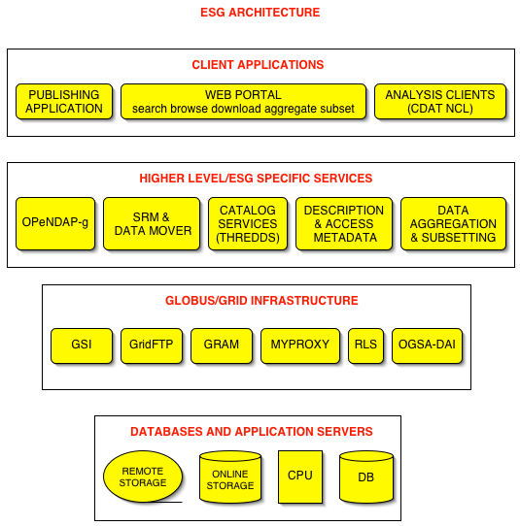

Slide 48
The Problem:
Users are 24/7
Administrative support was not!
Any failure of ESG components or services can severely disrupt the work of many scientists
The Solution
Detect failures quickly and minimize infrastructure downtime by deploying MDS4 for error notification

Slide 49
ESG Services Being Monitored
Service Being Monitored | ESG Location
GridFTP server | NCAR
OPeNDAP server | NCAR
Web Portal | NCAR
HTTP Dataserver | LANL, NCAR
Replica Location Service (RLS) servers | LANL , LBNL, LLNL, NCAR, ORNL
Storage Resource Managers | LANL, LBNL, NCAR, ORNL
Hierarchical Mass Storage Systems | LBNL, NCAR, ORNL

Slide 50
Index Service
Site-wide index service is queried by the ESG web portal
  Generate an overall picture of the state of ESG resources displayed on the Web

Slide 51
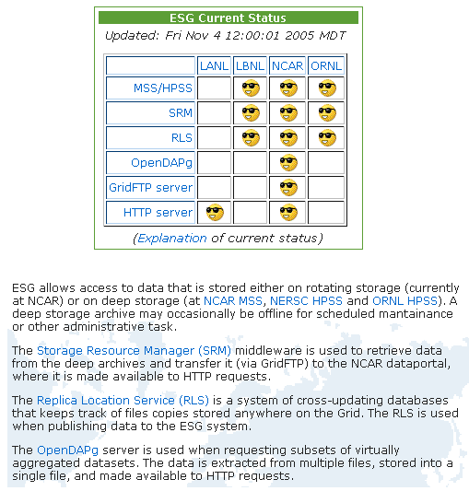

Slide 52
Trigger Service
Site-wide trigger service collects data and sends email upon errors
  Information providers are polled at pre-defined services
  Value must be matched for set number of intervals for trigger to occur to avoid false positives
  Trigger has a delay associated for vacillating values
  Used for offline debugging as well

Slide 53
1 Month of Error Messages
Total error messages for May 2006 | 47
Messages related to certificate and configuration problems at LANL | 38
Failure messages due to brief interruption in network service at ORNL on 5/13 | 2
HTTP data server failure at NCAR 5/17 | 1
RLS failure at LLNL 5/22 | 1
Simultaneous error messages for SRM services at NCAR, ORNL, LBNL on 5/23 | 3
RLS failure at ORNL 5/24 | 1
RLS failure at LBNL 5/31 | 1

Slide 54
1 Month of Error Messages
Total error messages for May 2006 | 47
Messages related to certificate and configuration problems at LANL | 38
Failure messages due to brief interruption in network service at ORNL on 5/13 | 2
HTTP data server failure at NCAR 5/17 | 1
RLS failure at LLNL 5/22 | 1
Simultaneous error messages for SRM services at NCAR, ORNL, LBNL on 5/23 | 3
RLS failure at ORNL 5/24 | 1
RLS failure at LBNL 5/31 | 1

Slide 55
For the month of May 2006, ESG’s deployment of MDS4 generated 47 failure messages that were sent to ESG system administrators. These are summarized in Table 3. The majority of these failure messages were caused by downtime throughout the month of services at LANL due to certificate expiration and service configuration problems. During this period, LANL staff members were not available to address these issues. Additional LANL failure messages would have been generated, except that we disabled the triggers from LANL during a two-week period when the responsible staff person was on vacation.
The remaining error messages indicate short-term service failures. Two failure messages were generated due to a network outage at ORNL on May 13th. Three error messages for Storage Resource Managers (SRMs) at different sites were generated on May 23rd. Since it is unlikely that all three of these services failed simultaneously, these messages were more likely due to a problem with the network, the monitoring services, or the client that checks the status of SRM services.

Slide 56
Benefits
Overview of current system state for users and system administrators
  At a glance info on resources and services availability
  Uniform interface to monitoring data
Failure notification
  System admins can identify and quickly address failed components and services
  Before this deployment, services would fail and might not be detected until a user tried to access an ESG dataset
Validation of new deployments
  Verify the correctness of the service configurations and deployment with the common trigger tests
Failure deduction
  A failure examined in isolation may not accurately reflect the state of the system or the actual cause of a failure
  System-wide monitoring data can show a pattern of failure messages that occur close together in time can be used to deduce a problem at a different level of the system
  Eg. 3 SRM failures
  EG. Use of MDS4 to evaluate file descriptor leak

Slide 57
OUTLINE
Grid Monitoring and Use Cases
MDS4
  Index Service
  Trigger Service
  Information Providers
Deployments
  Metascheduling Data for TeraGrid
  Service Failure warning for ESG
Performance Numbers
MDS for You!

Slide 58
Scalability Experiments
MDS index
  Dual 2.4GHz Xeon processors, 3.5 GB RAM
  Sizes: 1, 10, 25, 50, 100
Clients
  20 nodes also dual 2.6 GHz Xeon, 3.5 GB RAM
  1, 2, 3, 4, 5, 6, 7, 8, 16, 32, 64, 128, 256, 384, 512, 640, 768, 800
Nodes connected via 1Gb/s network
Each data point is average of 8 minutes
  Ran for 10 mins but first 2 spent getting clients up and running
  Error bars are SD over 8 mins
Experiments by Ioan Raicu, U of Chicago, using DiPerf

Slide 59
Size Comparison
In our current TeraGrid demo
  17 attributes from 10 queues at SDSC and NCSA
  Host data - 3 attributes for approx 900 nodes
  12 attributes of sub-cluster data for 7 subclusters
  ~3,000 attributes, ~1900 XML elements, ~192KB.
Tests here- 50 sample entries
  element count of 1113
  ~94KB in size

Slide 60
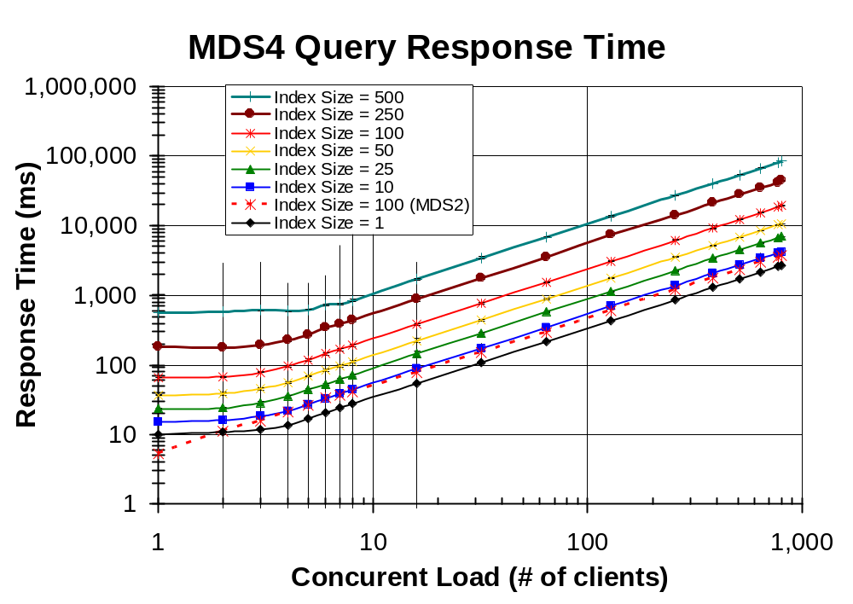

Slide 61
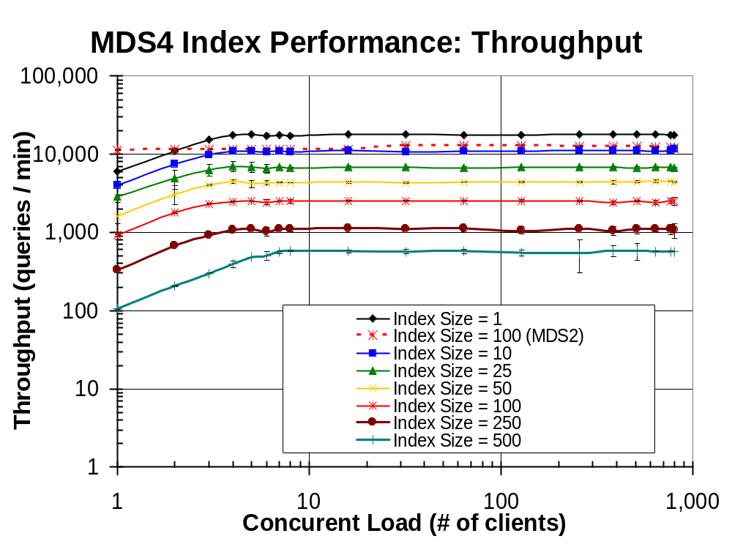

Slide 62
MDS4 Stability
Vers. | Index Size | Time up (Days) | Queries Processed | Query Per Sec. | Round-trip Time (ms)
4.0.1 | 25 | 66+ | 81,701,925 | 14 | 69
4.0.1 | 50 | 66+ | 49,306,104 | 8 | 115
4.0.1 | 100 | 33 | 14,686,638 | 5 | 194
4.0.0 | 1 | 14 | 93,890,248 | 76 | 13
4.0.0 | 1 | 96 | 623,395,877 | 74 | 13

Slide 63
Index Maximum Size
Heap Size (MB) | Approx. Max. Index Entries | Index Size (MB)
64 | 600 | 1.0
128 | 1275 | 2.2
256 | 2650 | 4.5
512 | 5400 | 9.1
1024 | 10800 | 17.7
1536 | 16200 | 26.18

Slide 64
Performance
Is this enough?
  We don’t know!
  Currently gathering up usage statistics to find out what people need
Bottleneck examination
  In the process of doing in depth performance analysis of what happens during a query
  MDS code, implementation of WS-N, WS-RP, etc

Slide 65
MDS For You
Grid Monitoring and Use Cases
MDS4
  Information Providers
  Higher-level services
  WebMDS
Deployments
  Metascheduling Data for TeraGrid
  Service Failure warning for ESG
Performance Numbers
MDS for You!

Slide 66
How Should You Deploy MDS4?
Ask: Do you need a Grid monitoring system?
Sharing of community data between sites using a standard interface for querying and notification
  Data of interest to more than one site
  Data of interest to more than one person
  Summary data is possible to help scalability

Slide 67
What does your project mean by monitoring?
Display site data to make resource selection decisions
Job tracking
Error notification
Site validation
Utilization statistics
Accounting data

Slide 68
What does your project mean by monitoring?
Display site data to make resource selection decisions
Job tracking
Error notification
Site validation
Utilization statistics
Accounting data
MDS4 a Good Choice!

Slide 69
What does your project mean by monitoring?
Display site data to make resource selection decisions
Job tracking – generally application specific
Error notification
Site validation
Utilization statistics – use local info
Accounting data- use local info and reliable messaging – AMIE from TG is one option
Think about
other tools

Slide 70
What data do you need
There is no generally agreed upon list of data every site should collect
Two possible examples
  What TG is deploying
    http://mds.teragrid.org/docs/mds4-TG-overview.pdf
  What GIN-Info is collecting
    http://forge.gridforum.org/sf/wiki/do/viewPage/projects.gin/wiki/GINInfoWiki
Make sure the data you want is actually theoretically possible to collect!
Worry about the schema later

Slide 71
Building your own info providers
See the developer session!
Some pointers…
List of new providers
  http://www.globus.org/toolkit/docs/development/4.2-drafts/info/providers/index.html
How to write info providers:
  http://www.globus.org/toolkit/docs/4.0/info/usefulrp/rpprovider-overview.html
  http://www-unix.mcs.anl.gov/~neillm/mds/rp-provider-documentation.html
  http://globus.org/toolkit/docs/4.0/info/index/WS_MDS_Index_HOWTO_Execution_Aggregator.html

Slide 72
How many Index Servers?
Generally one at each site, one for full project
Can be cross referenced and duplicated
Can also set them up for an application group or any subset

Slide 73
What Triggers?
What are your critical services?

Slide 74
What Interfaces?
Command line, Java, C, and Python come for free
WebMDS give you the simepl one out of the box
Can stylize- like TG and ESG did – very straight forward

Slide 75
What will you be able to do?
Decide what resource to submit a job to, or to transfer a file from
Keep track of services and be warned of failures
Run common actions to track performance behavior
Validate sites meet a (configuration) guideline

Slide 76
Summary
MDS4 is a WS-based Grid monitoring system that uses current standards for interfaces and mechanisms
Available as part of the GT4 release
  Currently in use for resource selection and fault notification
Initial performance results aren’t awful – we need to do more work to determine bottlenecks

Slide 77
Where do we go next?
Extend MDS4 information providers
  More data from GT4 services
  Interface to other data sources
    Inca, GRASP, PinGER Archive, NetLogger
Additional deployments
Additional scalability testing and development
  Database backend to Index service to allow for very large indexes
  Performance improvements to queries – partial result return

Slide 78
Other Possible Higher
Level Services
Archiving service
  The next high level service we’ll build
  Currently a design document internally, should be made external shortly
Site Validation Service (ala Inca)
Prediction service (ala NWS)
What else do you think we need? Contribute to the roadmap!
  http://bugzilla.globus.org

Slide 79
Other Ways To Contribute
Join the mailing lists and offer your thoughts!
  mds-dev@globus.org
  mds-user@globus.org
  mds-announce@globus.org
Offer to contribute your information providers, higher level service, or visualization system
If you’ve got a complementary monitoring system – think about being an Incubator project (contact incubator-commiters@globus.org, or come to the talk on Thursday)

Slide 80
Thanks
MDS4 Core Team: Mike D’Arcy (ISI), Laura Pearlman (ISI), Neill Miller (UC), Jennifer Schopf (ANL)
MDS4 Additional Development help: Eric Blau, John Bresnahan, Mike Link, Ioan Raicu, Xuehai Zhang
This work was supported in part by the Mathematical, Information, and Computational Sciences Division subprogram of the Office of Advanced Scientific Computing Research, U.S. Department of Energy, under contract W-31-109-Eng-38, and NSF NMI Award SCI-0438372. ESG work was supported by U.S. Depart­ment of Energy under the Scientific Discovery Through Advanced Computation (SciDAC) Program Grant DE-FC02-01ER25453. This work also supported by DOESG SciDAC Grant, iVDGL from NSF, and others.

Slide 81


Slide 82
For More Information
Jennifer Schopf
  jms@mcs.anl.gov
  http://www.mcs.anl.gov/~jms
Globus Toolkit MDS4
  http://www.globus.org/toolkit/mds
MDS-related events at GridWorld
  MDS for Developers
    Monday 4:00-5:30, 149 A/B
  MDS “Meet the Developers” session
    Tuesday 12:30-1:30, Globus Booth

