Slide 1
Using CAS to Manage
Role-Based VO Sub-Groups
Shane Canon (LBNL), Steve Chan (LBNL), Doug Olson (LBNL), Laura Pearlman (ISI), Craig Tull (LBNL), Von Welch (ANL)
CHEP 2003 - March 25, 2003
UCSD - La Jolla, CA

Slide 2
Outline
Introduction and Motivation
  CAS Overview & Architecture
  Rights Granularity
Prototype Project Description
  Goal of Prototype
  Installation & Setup
  Execution & Use
Summary, Analysis, and Conclusion
  Suitability of CAS
  Future Plans

Slide 3
A Quick Refresher
Grid Security Infrastructure (GSI) =
  X.509 (PKI certificate format)*
  + proxy certificates (single sign-on & delegation)
  + TLS/SSL (authentication & msg protection)*
  + delegation protocol (remote delegation)
* = Existing IETF standards
  Others are GGF & IETF drafts
A (X.509) proxy certificate is used by an entity to delegate all or part of its own authority.

Slide 4
Community Authorization Service
CAS is authorization product of Globus project.
In the CAS model, resource providers grant access to blocks of resources to a community as a whole, and the community uses a CAS server to perform fine-grained access control on those resources.
  Resource providers grant course-grained access to communities.
  Communities run CAS servers, which keep track of fine-grained access control information and grant restricted proxies to community members.
  The result is that a CAS user gets the intersection of the rights granted by resource provider to the community and the rights granted by the community to that user.

Slide 5
CAS Architecture in action
CAS Server
Gridftp Server
CAS DB
Users
Objects
Rights
gridftp server
(modified to
do CAS
authorization)
CAS Server
Response
Query
Authorization
Libraries
Assertion
Response
Request
Assertion
gridftp client
(unmodified)
cas-proxy-init
Proxy w/CAS
assertion
CAS architecture
in action
Normal User
Proxy
Assertion
User

Slide 6
CAS Proxy Format
DN: /C=US/CN=Some User/Proxy
Issuer: /C=US/CN=Some User
Expires: 11am March 26, 2003
Signature: 76A97….
…
Usual user proxy information
Non-critical extension:
Assertion
Assertion
Issuer: /C=US/CN=VO CAS
Signature: 76BE3…
(List of Object – Right)
/VO/Admingroup Member
/foo.edu/file Read
Notes:
Assertion has own signature – signed by the CAS that issued it.
Assertion includes CAS certificate for signature verification.
Assertion is really a separate thing from the certificate, it is just carried in the certificate as a matter of convenience

Slide 7
Rights granularity
Typical granularity of Grid rights architecture addresses 2 levels:
  Individual - immutable
  VO - 100s-1000s of individuals (entire experiment)
Experiments have intermediate granularities:
  Groups - Detector or Physics groups
  Roles - One or more individuals fulfilling a single role. Individuals may change over time.
    EG: Release Coordinator, Production Manager, etc.

Slide 8
Goal of Project
PPDG Project to test Globus Community Authorization Service
Standard usage of CAS
  Access to file resources (via GSIFTP)
Extension of CAS Resource Authorization
  Define Roles as Resource
  Demonstrate 1 individual (1 DN) assuming multiple different roles
  Demonstrate multiple individuals (different DNs) assuming the same role
  Demonstrate individual divesting role(s)

Slide 9
Policy Granularity:
Groups vs Capabilities
Capability assertion:
Expresses right completely
User can access resource
(e.g. file, CPU) X
Resource
X
Policy
Enforcement
point
Group Assertion:
Expresses an attribute.
Must be converted to right
by local policy.
Local Policy
Group Y can access
resource X
User is in
group Y
Local Domain
Notes:
The point here is that with a capability you don’t have any policy in the local domain. All policy is centralized in CAS.

Slide 10
Testbed Setup
Three nodes: pdsfgrid3, globicus, globzilla
CAS server: pdsfgrid3
Client: globzilla/globicus
Grid FTP server with CAS extensions: globicus
  Ran on alternate port
  Verified that IP filters and hosts.allow were correct
Grid3
CAS server
Globzilla
Client
Globicus
GridFTP server

Slide 11
CAS as a Role Manager
Installed patched version of CAS-enabled FTP server
Add the action “group” and the service “member” into the CAS database
Create objects for the various groups/roles
Grant member privileges to members of the various groups/roles
User request specific capabilities from the CAS server to determine role

Slide 12
CAS Authorization for Groups
1. Parse assertion
Gridftp
server
Authorization
Libraries
Assertion
List of groups
2. Map group to local accounts
Accounts
CAS DN
Group name
group
map
file
Account
3. Make sure
CAS can legally
map to local account
grid-
mapfile
Notes:
First, this slide is a little bit of a lie, what we actually do, is read the group-mapfile and then query the authorization libraries for each group to see if the user is a member. This is because the authz libraries are set up in a query/response semantic and not a “give me all the rights” semantic.
Step 1: Use existing authz libraries to parse assertion. Get list of groups user is a member of.
Step 2: Try groups in order, first one that matches (and is legal by step 3) is used.
Step 3: CAS DN must be allowed to map to account as returned by group-mapfile. This maintains grid-mapfile as ultimate authority for account mappings on the system.

Slide 13
Changes to Gridftp server
Normal gridftp server checks grid-mapfile to determine local account
Modified gridftp server to check for CAS assertion
  If present, check for group memberships
  If present, check for group memberships in local mapping file
  If present, check legality and use group mapping instead of grid-mapfile

Slide 14
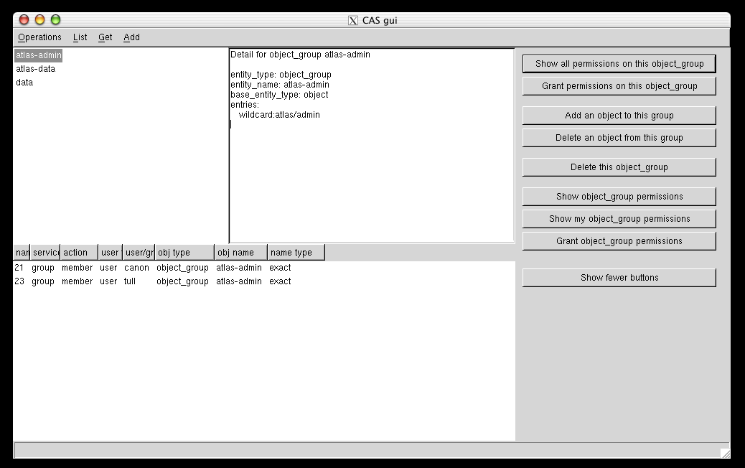
CASGUI
Privilege Groups
User with permissions

Slide 15
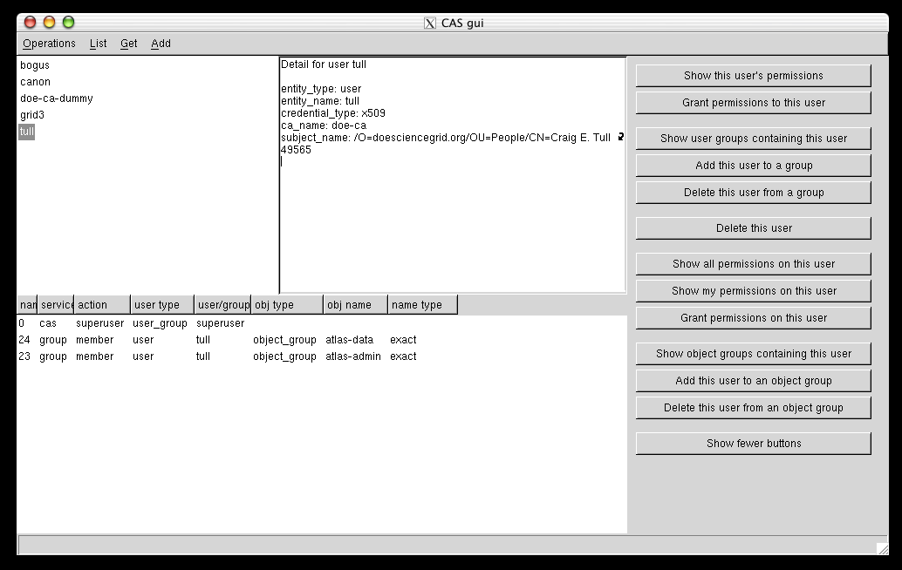
CASGUI
User List
User Details
(eg Cred)
atlas-data
Role
atlas-admin
Role

Slide 16
Prototype Experience
Extends standard CAS installation which is well documented although involved.
Installation was straight forward, even without full a GPT package
Sample CAS script to create objects would simplify things for first timers.
Some minor bugs found in CAS tools. Correction are being sent to developers.

Slide 17
CAS User Session
Initialize Grid certificate
  % grid-proxy-init
  Your identity: /O=doesciencegrid.org/OU=People/CN=Craig E. Tull 49565
  Enter GRID pass phrase for this identity:
  Creating proxy .................................................. Done
  Your proxy is valid until Wed Mar 19 20:30:53 2003
Initialize 1 CAS certificate for each Role
  % cas-proxy-init tull
  % cas-proxy-init -f admin admin
  % cas-proxy-init -f data data
Use Role Tag to connect
  % cas-wrap data gsincftp -P 2813 pdsfgrid3
  NcFTP 3.0.3 (April 15, 2001) by Mike Gleason (ncftp@ncftp.com).
  Connecting to 128.55.24.28...
  pdsfgrid3.nersc.gov FTP server (GridFTP Server 1.0 -- CAS enabled [GSI patch v0.5] wu-2.6.2(2) Wed Mar 5 17:42:41 PST 2003) ready.
Role Tag
# file containing Role privileges
group member atlas/admin wildcard
file read ftp://pdsfgrid3.nersc.gov/* wildcard
Role Tag
Command to wrap

Slide 18
Lessons Learned
Feature in CAS DB to allow for easy definition of different objects and actions works as planned.
Current CAS authorization API needs extensions to easily handle mapping of user to local accounts and/or groups
  Currently allows for queries of type “Is user in group X?”
  Need to allow for “What account should user be in?”, “What groups should user be in?”
  User may also specify an account, leading to query of form “Can user access account Y?”

Slide 19
Future Plans
Mainline CHEP demo code into CAS?
  Von - This is a question for you.
Extend Globus Gatekeeper for Job Submission
  Similar code extension to that for FTP server.
Standardize service assertion format.
  This would allow single Grid FTP server or Gatekeeper for CAS and other, similar tools (eg VOMS)
Exploration of CAS/Akenti cooperation
  Akenti for local resource authorization
  CAS for global (eg VO-wide) individual and role-based authorization

Slide 20

END OF PRESENTATION

