Slide 1
The Replica Location Service
Ann Chervenak
USC Information Sciences Institute
annc@isi.edu
Bob Schwartzkopf, bobs@isi.edu
Shishir Bharathi, shishir@isi.edu

Slide 2
Replica Management in Grids
Data intensive applications
  Produce Terabytes or Petabytes of data
Replicate data at multiple locations
  Fault tolerance
  Performance: avoid wide area data transfer latencies, achieve load balancing
Issues:
  Locating replicas of desired files
  Creating replicas and registering their locations
  Scalability
  Reliability

Slide 3
Talk Outline
The Replica Location Service
  Existing implementation in GT3.0
  Design Issues and implementation features
  Command line tools and APIs
File Copy and Registration Grid Service
Designing a Grid service RLS
  Based on OGSI Data Services
  Extending OGSI ServiceGroups

Slide 4
A Replica Location Service
A Replica Location Service (RLS) is a distributed registry service that records the locations of data copies and allows discovery of replicas
Maintains mappings between logical identifiers and target names
  Physical targets: Map to exact locations of replicated data
  Logical targets: Map to another layer of logical names, allowing storage systems to move data without informing the RLS
RLS was designed and implemented in a collaboration between the Globus project and the DataGrid project

Slide 5
Replica Location Indexes
RLI
RLI
LRC
LRC
LRC
LRC
LRC
Local Replica Catalogs
LRCs contain consistent information about logical-to-target mappings on a site
RLIs nodes aggregate information about LRCs
Soft state updates from LRCs to RLIs: relaxed consistency of index information, used to rebuild index after failures
Arbitrary levels of RLI hierarchy

Slide 6
A Flexible RLS Framework
Five elements:
1. Consistent Local State: Records mappings between logical names and target names and answers queries
2. Global State with relaxed consistency: Global index supports discovery of replicas at multiple sites; relaxed consistency
3. Soft state mechanisms for maintaining global state: LRCs send information about their mappings (state) to RLIs using soft state protocols
4. Compression of state updates (optional): reduce communication, CPU and storage overheads
5. Membership service: for location of participating LRCs and RLIs and dealing with changes in membership

Slide 7
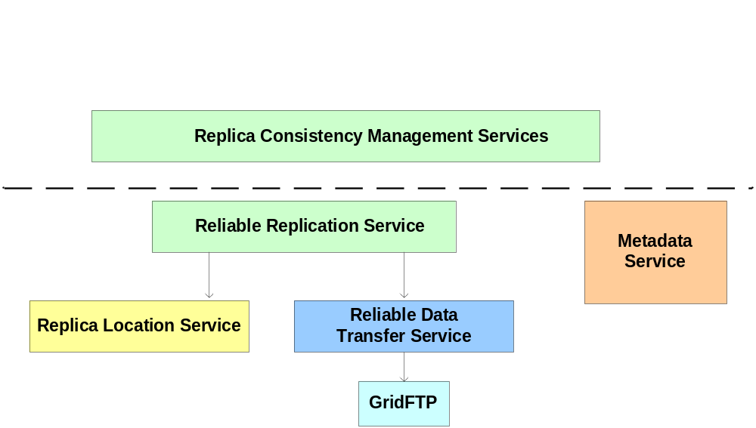
Replica Location Service In Context
The Replica Location Service is one component in a layered data management architecture
Provides a simple, distributed registry of mappings
Consistency management provided by higher-level services

Slide 8
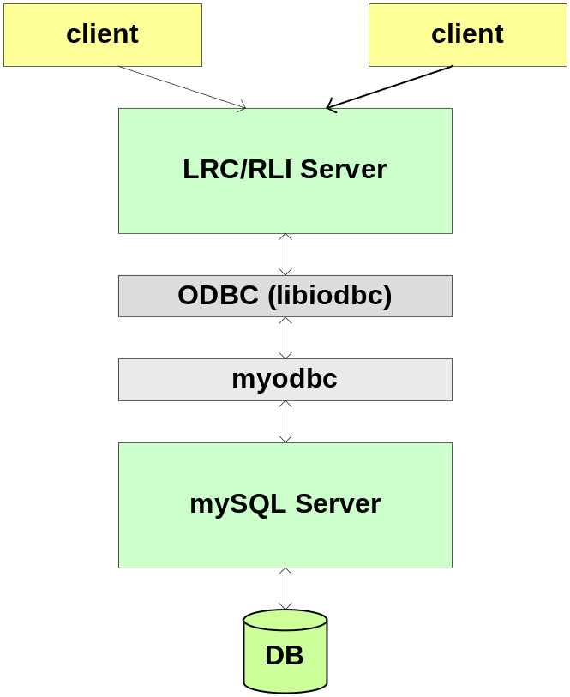
Components of RLS Implementation
Front-End Server
  Multi-threaded
  Supports GSI Authentication
  Common implementation for LRC and RLI
Back-end Server
  mySQL or PostgreSQL Relational Database
  Holds logical name to target name mappings
Client APIs: C and Java
Client Command line tool

Slide 9
RLS Implementation Features
Two types of soft state updates from LRCs to RLIs
  Complete list of logical names registered in LRC
  Bloom filter summaries of LRC
Immediate mode
  When active, sends updates of new entries after 30 seconds (default) or after 100 updates
User-defined attributes
  May be associated with logical or target names
Partitioning (without bloom filters)
  Divide LRC soft state updates among RLI index nodes using pattern matching of logical names
Currently, static membership configuration only

Slide 10
RLS Server Configuration
RLS server configuration
  Whether an LRC or RLI or both
  If LRC, configure
    Method of soft state update to send
    May send updates of different types to different RLIs
    Frequency of soft state updates
  If RLI, configure
    Method of soft state update to accept

Slide 11
Alternatives for Soft State
Update Configuration
LFN List
  Send list of Logical Names stored on LRC
  Can do exact and wildcard searches on RLI
  Soft state updates get increasingly expensive as number of LRC entries increases
    space, network transfer time, CPU time on RLI
  E.g., with 1 million entries, takes 20 minutes to update mySQL on dual-processor 2 GHz machine (CPU-limited)
Bloom filters
  Construct a summary of LRC state by hashing logical names, creating a bitmap
  Compression
  Updates much smaller, faster
  Supports higher query rate
  Small probability of false positives (lossy compression)
  Lose ability to do wildcard queries

Slide 12
Immediate Mode for
Soft State Updates
Immediate Mode
  Send updates after 30 seconds (configurable) or after fixed number (100 default) of updates
  Full updates are sent at a reduced rate
  Tradeoff depends on volatility of data/frequency of updates
  Immediate mode updates RLI quickly, reduces period of inconsistency between LRC and RLI content
Immediate mode usually sends less data
  Because of less frequent full updates
Usually advantageous
  An exception would be initially loading of large database

Slide 13
globus-rls-admin:
Command Line Administration Tool
globus-rls-admin option [ rli ] [ server ]
-p: verifies that server is responding
-A: add RLI to list of servers to which LRC sends updates
-s: shows list of servers to which updates are sent
-c all: retrieves all configuration options
-S: show statistics for RLS server
-e: clear LRC database

Slide 14
Examples of globus-rls-admin commands
% globus-rls-admin -p rls://smarty
ping rls://smarty: 0 seconds
% globus-rls-admin -s rls://smarty
rls://smarty.isi.edu:39281 all LFNs

Slide 15
% globus-rls-admin -S rls://smarty
Version: 2.0.9
Uptime: 383:27:39
LRC stats
update method: lfnlist
update method: bloomfilter
updates lfnlist: rls://smarty.isi.edu:39281 last 01/21/04 11:09:35
lfnlist update interval: 3600
bloomfilter update interval: 900
numlfn: 10719
numpfn: 33560
nummap: 33560
RLI stats
updated by: rls://smarty.isi.edu:39281 last 01/21/04 11:35:45
updated by: rls://sukhna.isi.edu:39281 last 01/20/04 17:33:17
updated via lfnlists
numlfn: 11384
numlrc: 2
nummap: 15363

Slide 16
globus-rls-cli:
Client Command Line Tool
globus-rls-cli [ -c ] [ -h ] [ -l reslimit ] [ -s ] [ -t timeout ] [ -u ] [ command ] rls-server
  If command is not specified, enters interactive mode
Create an initial mapping from a logical name to a target name:
globus-rls-cli create logicalName targetName1 rls://myrls.isi.edu
Add a mapping from same logical name to a second replica/target name:
globus-rls-cli add logicalName targetName2 rls://myrls.isi.edu

Slide 17
Examples of simple create, add and query operations
% globus-rls-cli create ln1 pn1 rls://smarty
% globus-rls-cli query lrc lfn ln1 rls://smarty
ln1: pn1
% globus-rls-cli add ln1 pn2 rls://smarty
% globus-rls-cli query lrc lfn ln1 rls://smarty
ln1: pn1
ln1: pn2

Slide 18
globus-rls-cli Attribute Functions
Attribute Functions
globus-rls-cli attribute add <object> <attr> <obj-type> <attr-type>
  Add an attribute to an object
  object should be the lfn or pfn name
  obj-type should be one of lfn or pfn
  attr-type should be one of date, float int, or string
attribute modify <object> <attr> <obj-type> <attr-type>
attribute query <object> <attr> <obj-type>

Slide 19
globus-rli-client Bulk Operations
bulk add <lfn> <pfn> [<lfn> <pfn>
  Bulk add lfn, pfn mappings
bulk delete <lfn> <pfn> [<lfn> <pfn>
  Bulk delete lfn, pfn mappings
bulk query lrc lfn [<lfn> ...]
  Bulk query lrc for lfns
bulk query lrc pfn [<pfn> ...]
  Bulk query lrc for pfns
bulk query rli lfn [<lfn> ...]
  Bulk query rli for lfns
Others bulk attribute adds, deletes, queries, etc.

Slide 20
Examples of Bulk Operations
% globus-rls-cli bulk create ln1 pn1 ln2 pn2 ln3 pn3 rls://smarty
% globus-rls-cli bulk query lrc lfn ln1 ln2 ln3 rls://smarty
ln3: pn3
ln2: pn2
ln1: pn1

Slide 21
Registering a mapping using C API
globus_module_activate(GLOBUS_RLS_CLIENT_MODULE)
globus_rls_client_connect (serverURL, serverHandle)
globus_rls_client_lrc_create (serverHandle, logicalName1, targetName1)
globus_rls_client_lrc_add (serverHandle, logicalName1, targetName2)
globus_rls_client_close (serverHandle)

Slide 22
Registering a mapping using Java API
RLSClient rls = new RLSClient(URLofServer);
RLSClient.LRC lrc = rls.getLRC();
lrc.create(logicalName1, targetName1);
lrc.add(logicalName1, targetName2);
rls.Close();

Slide 23
Status of RLS in GT
Continued development of RLS
  Code available as source and binary bundles at:
    www.globus.org/rls
RLS is part of the GT3.0 (but is not a Grid service)
New version (2.1.4) will be included in GT3.2
  Latest version supports hierarchy of RLIs

Slide 24
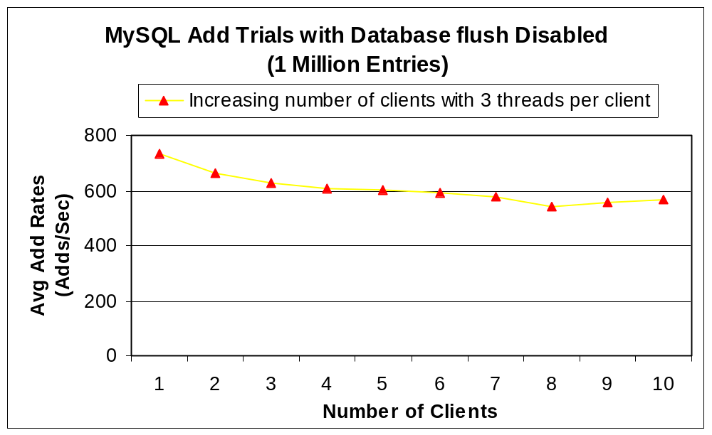
Add Rates to an LRC
(mySQL Back End)

Slide 25
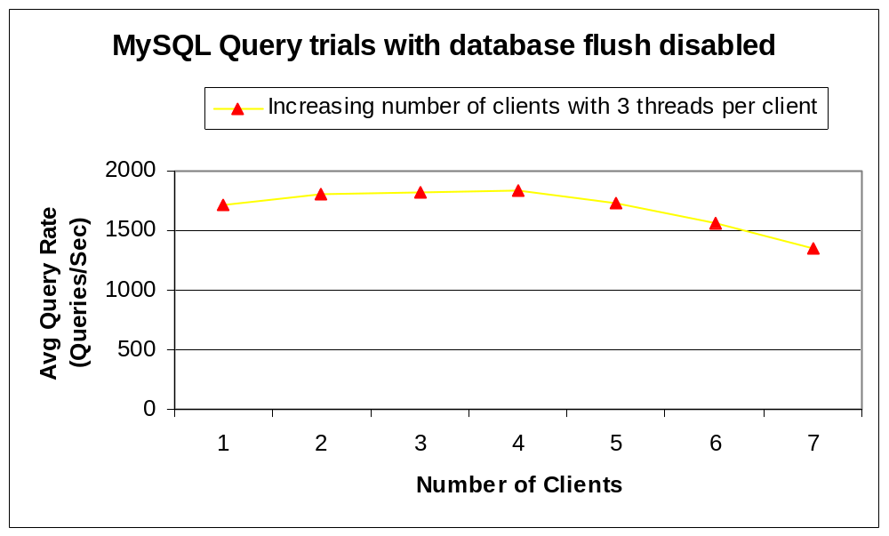
Query Rates to an LRC
(mySQL Back End)

Slide 26
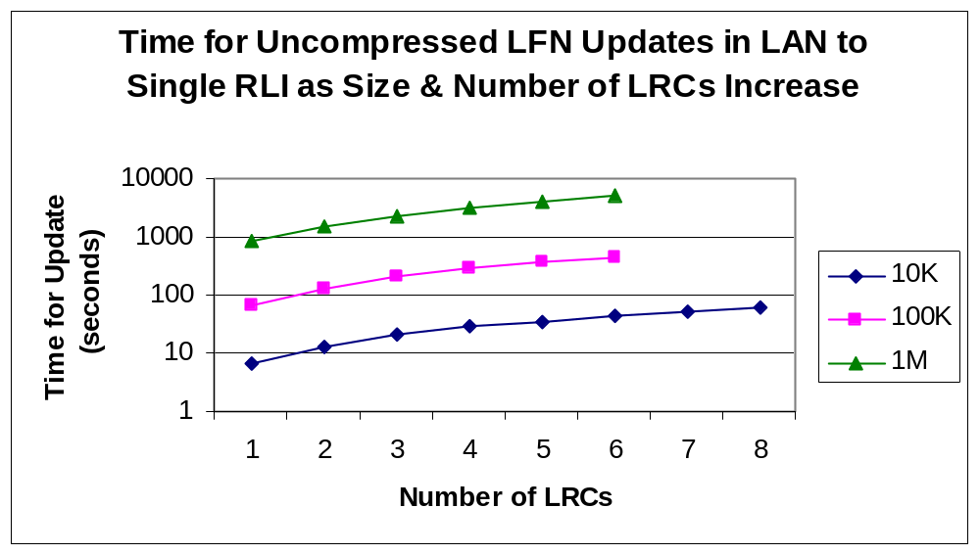
Uncompressed Soft State Updates: Performance Does Not Scale

Slide 27
Bloom Filter Performance:
Wide Area Soft State Updates
(Los Angeles to Chicago)
LRC Database Size | Avg. time to send soft state update (seconds) | Avg. time for initial bloom filter computation (seconds) | Size of bloom filter (bits)
100,000 entries | Less than 1 | 2 | 1 million
1 million entries | 2 | 24 | 10 million
5 million entries | 7 | 175 | 50 million

Slide 28
File Copy and
Registration Service (CAR)
Released in GTR (Grid Technology Repository)
  www.globus.org/gtr
Grid Service wrapper around existing RLS functionality
  LRC and RLI port types
Additional functionality for performing integrated file copy and registration
  Calls RFT to perform reliable file transfer
  Calls GridFTP to delete files
  Calls RLS servers to register/unregister replicas
Current implementation is not “reliable”
  Doesn’t maintain state about outstanding operations or rollback to consistent state
  Future implementation will provide reliability

Slide 29
Talk Outline
The Replica Location Service
  Existing implementation in GT3.0
  Design Issues and implementation features
  Command line tools and APIs
File Copy and Registration Grid Service
Designing a Grid service RLS
  Based on OGSI Data Services
  Extending OGSI ServiceGroups

Slide 30
Grid Service RLS and WS-RF
An OGSI Grid Service RLS
  Developed in last 9 months through GGF
This will evolve for WS-RF
OGSI Grid Services | WS-RF
Data service | Web service + stateful resource
Service data | Resource property
Service group | Service group
Grid service handle | WS-Addressing
Notification port type | Publication/ subscription

Slide 31
Designing a Grid Service RLS
For release in GT3.x, want more than simple wrappers around GT2-style services
Major redesign of RLS based on:
  Design of OGSI-compliant data services
  Want to associate and discover data services that are replicas according to some semantic definition
  Make use of existing GT3 aggregation and indexing infrastructure based on OGSI ServiceGroups
  Definition and enforcement of policies on authorization and replica semantics

Slide 32
OGSI-Compliant Data Services
Treat data objects as first-class OGSI-compliant services
A data service is an OGSI Grid service that represents and encapsulates a data virtualization, which is an abstract view of some data
Service data elements (SDEs) describe key parameters of the data virtualization
Support one or more interfaces:
  Inspection of SDEs
  Access the data
  Factory to derive new data virtualizations
  Management of data virtualizations

Slide 33
Important Aspects of Data Services
OGSI service data elements (SDEs) are used to describe aspects of a data service’s data virtualization and metadata
OGSI Grid Service Handles globally and uniquely identify data services
Data services inherit from OGSI Grid Servcies:
  Basic lifetime management capabilities
  Introspection of service data elements using FindServiceData
  Subscription/notification from the Notification portType
Data services created dynamically using data factories

Slide 34
Representing ReplicaSets as Services
Data items are Grid services
Replicated data items define an equivalence class
Want to expose these equivalence sets as services
Thus define a replicaSet Grid service as a virtualization of the set of replicas that make up an equivalence class
This equivalence class is globally and uniquely identified by a Grid Service Handle
Effectively, a replicaSet service provides a mapping from the locator (handle) of the equivalence set service to one or more locators for member data services

Slide 35
Representing ReplicaSets as Services (Continued)
Represent information about data services that are members of the replicaSet service as service data elements (SDEs) of the replicaSet service
ReplicaSet service data may include information about policies the replicaSet service supports
  Replicas are byte-to-byte copies, have matching checksum, consistency is or is not maintained, etc.
A client may use standard methods to obtain information about replicaSet members and policies
  Inspection
  Subscription/notification

Slide 36
Can Implement ReplicaSet
Services as ServiceGroups
ServiceGroups are Grid services that maintain information about a group of other Grid services
A ServiceGroup contains entries for member services
  Entries are represented as Service Data Elements (SDEs) of the ServiceGroup
ServiceGroups are used in GT3 to implement:
  service registries
  indexes, such as for information services
Extend the ServiceGroupRegistration port type’s add and remove methods for RLS

Slide 37
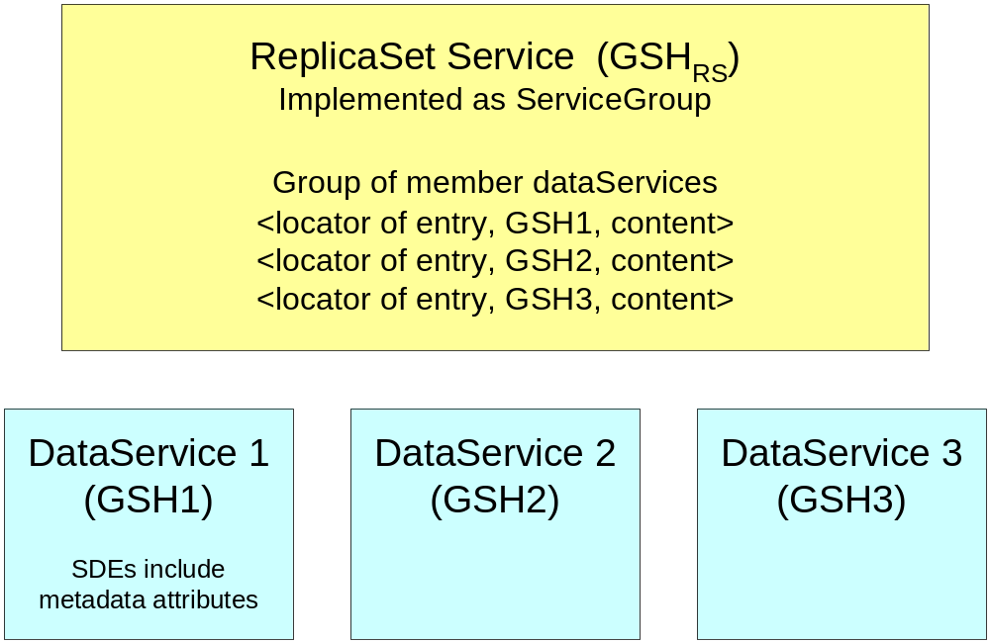
DataServices and ReplicaSet Services
Maps from GSH of ReplicaSet Service to GSHs of member replica DataServices

Slide 38
Optional Indexes for ReplicaSet Services
A client may directly inspect a replicaSet
  Responds to queries about its service data, including information about its members
Do not require separate Replica Location Service index services from a functionality perspective
Indexes may be useful for availability and performance reasons
  Aggregate information about data services that make up one or more replicaSet services
  Improve availability by answering queries about replicaSet members even if a particular replicaSet service is unavailable due to temporary failure
  Improve performance by allowing bulk query operations on indexes

Slide 39
Designing RLS Indexes
These could also be implemented as ServiceGroups
ServiceGroupEntries would include:
  locators to member replicaSet services
  content fields that include data services in corresponding replicaSet equivalence class

Slide 40
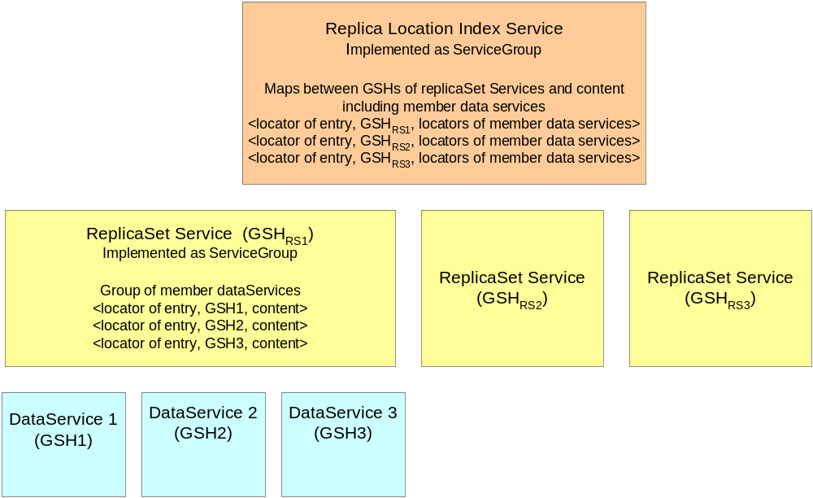
Replica Location Index Service

Slide 41
Scenario for Creating a New Replica and Adding it to a ReplicaSet
Client A invokes data factory port type on an existing data service to create a new derived data service that is a replica of the original
Client A invokes the add operation on the replicaSet
  The replicaSet enforces authorization, semantic and other policies
  If allowed, the new data service is added to the replicaSet service
The replicaSet service may send information about its membership to one or more aggregating indexes

Slide 42
Policies in ReplicaSet Services
A replicaSet service may assert and/or enforce policies about the equivalence set of replicas
  Access control policies determine who is allowed to add or remove data services as members
  Semantic policies specify the meaning of replication and which data services may be members of a replicaSet

Slide 43
Possible Standard Semantic
Policies for ReplicaSets
Byte-for-byte copy of data items, such as files
Data objects that contain the same information in different formats
Data objects that are equivalent to a specified degree
Data objects that are derived from a common parent
Versions of data objects
Replicas that have been synchronized within a specific time period
Partial replicas of data objects

Slide 44
Policy Enforcement in replicaSets
Extent to which policies are verified or enforced depend on the replicaSet service implementation
1. Enforce policy only at time member is added to replicaSet
2. Maintain policy relationships among members
  Use subscription to be notified of changes in the contents of member data services
  Propagate these changes among replicas according to a particular coherency scheme
3. Periodically enforce consistency
  Periodically introspect on members of the replicaSet to check coherence
  Remove non-complying members

Slide 45
replicaSet Factories
Used to create new equivalence classes for replicas
Extend the ServiceGroupFactory to support policy specification for authorization, replica semantics, etc.
  Relates to the Factory port type of OGSI specification
  Also to the Agreement Factory being specified through GRAAP Working Group of GGF
Policies may eventually be considered as part of the published agreement terms
SDEs specify assertions that instances created by the factory can support

Slide 46
replicaSet Factory (continued)
Different factory services may support different assertions, extensions and mechanisms
Examples:
  Byte for Byte Copy replicaSetFactory
  Versioning replicaSetFactory

Slide 47
replicaSet Service Data Elements
Each member service has an entry in SDEs of the replicaSet serviceGroup
  Includes content field that can reflect additional information about member services
  Open question: what content should be associated with replicaSet entries?
Also need SDEs that describe policies supported by the service
  authorization
  replica semantics
  others

Slide 48
replicaSet Methods
Inherit from ServiceGroup (service data only), ServiceGroupEntry and ServiceGroupRegistration port types:
  Publishes service group entries as service data elements
  Extend add, delete methods to enforce particular policies of replicaSet implementation
SDEs of replicaSets can be accessed:
  By query operations of the GridService port type such as FindServiceDataByName
  Using the Notification portType to support subscription and notification

Slide 49
Summary of
Replica Location Grid Service Design
Data items are exposed as Grid services called data services
  Data services are uniquely identified by Grid Service Handles (GSHs)
Replicated data services are effectively members of an equivalence class according to some semantic definition of equivalence
A replica set equivalence class should be exposed as a Grid service called a replicaSet service
The replicaSet service design should be based on and extend the OGSI ServiceGroup, which is a collection of Grid services

Slide 50
Summary of Replica Location
Grid Service Design (Continued)
The replicaSet service should be have associated policies for authorization and semantics (what constitutes a member of the equivalence class)
  Degree to which policies are verified or enforced depends on particular implementation
The RLS design may include additional indexes for aggregating information about multiple replicaSet ServiceGroups
  For availability and performance
  These indexes should also be designed as extensions of ServiceGroups

Slide 51
Status of RLS Grid Service
Prototype Implementation
  Extends ServiceGroup to implement replicaSet
  Add method: Enforces policy that new replica must have the same checksum as the members already added to the replicaSet
  SDEs: list of member services, checksum
  File-based implementation: File copied locally using RFT and checksum calculated (slow)
  Authorization policies for who is allowed to create new replicaSet or add a member to replicaSet based on standard gridmap files
Future plans: implement a variety of different policies for replica semantics

Slide 52
Higher-Level OGSA
Replication Services
Additional services for replicating data with various levels of consistency
  Subscription-based model
  Data Distribution Service (being proposed in GGF)
  Updates of data items must be propagated to all replicas according to highly configurable update policies
Standardize these through GGF OGSA Data Replication Services Working Group

Slide 53
Replica Location Service Summary
Existing implementation in GT3 Release
  Hierarchical design
  Local Replica Catalogs and Replica Location Indexes
  Performs and scales well with Bloom filter compression, immediate update mode
Copy and registration service (released in GTR)
Currently prototyping a grid service RLS, will evolve with WS-RF standards
  Based on OGSI data services and ServiceGroups
  replicaSets can enforce a variety of semantic and authorization policies
  Optional higher-level indexes of replicaSets

