Slide 1


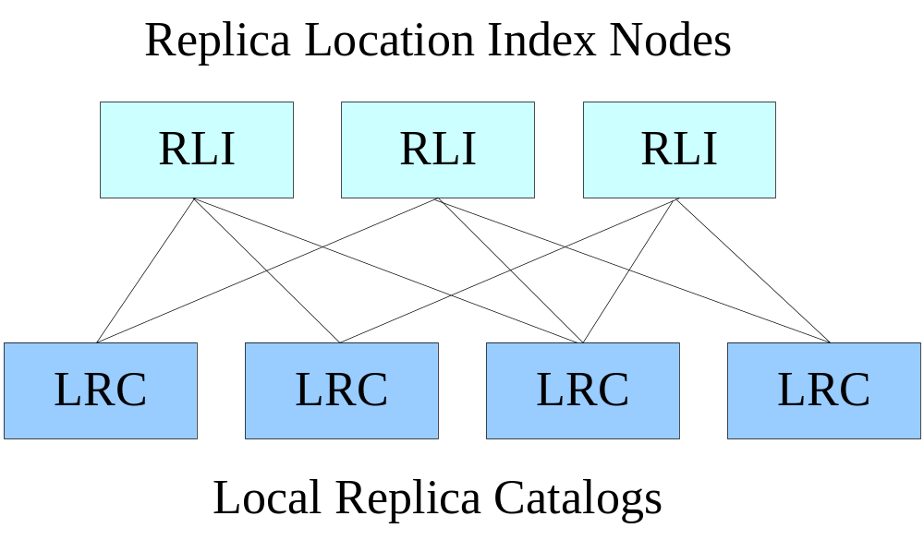
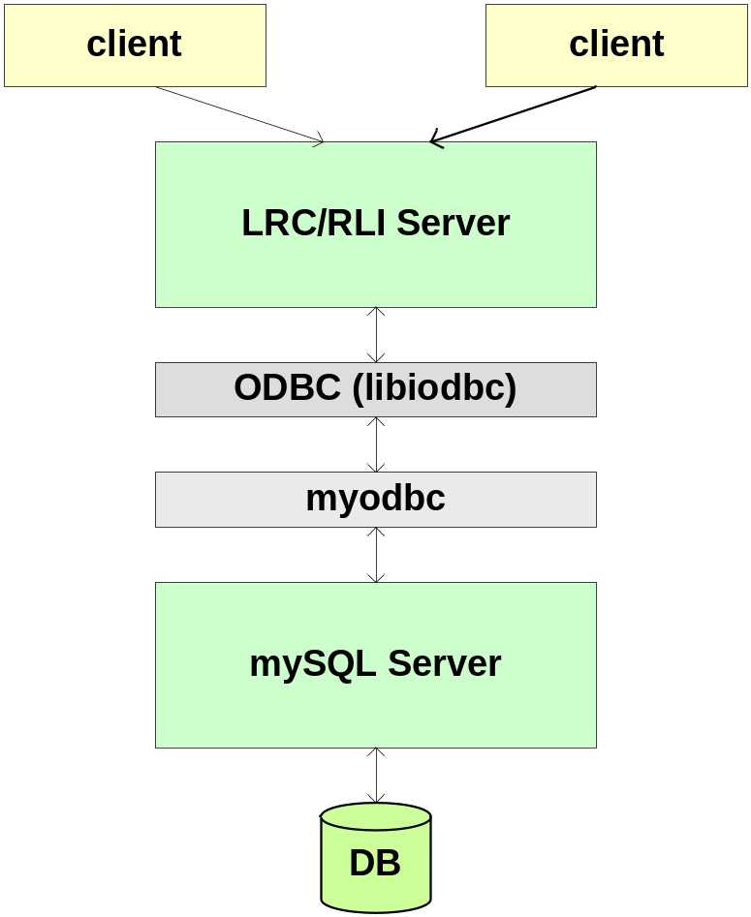
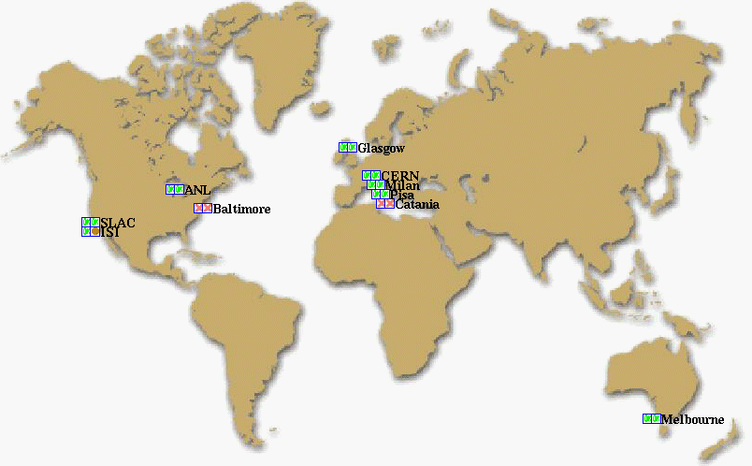
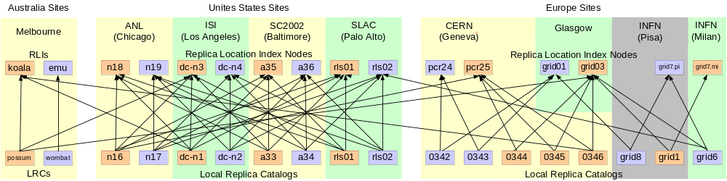







THE REPLICA LOCATION SERVICE
The Globus Project and the DataGrid Project
Replication in Data Grids
Large data sets are frequently replicated to:
  Reduce access latency
  Maintain local control over necessary data
  Improve reliability and load balancing
A Replica Location Service is a distributed registry service that records the locations of data copies and allows discovery of replicas
The Replica Location Service Architecture
Five Components of the RLS Architecture Framework
Consistent state maintained in Local Replica Catalogs (LRCs)
  Mappings between logical names (LFNs) and target names
Collective state with relaxed consistency in Replica Location Indices (RLIs)
  Each RLI contains mappings from LFNs to LRCs
  Variety of index structures can be created by varying number of RLIs,
  redundancy and partitioning
Soft state maintenance of RLI state
  LRCs send state information to RLIs using soft state protocols
  Information in RLIs times out and must be periodically refreshed
Optional compression of soft state updates
  Prototype implements Bloom filter compression
Membership service
  Keeps track of LRCs and RLIs and their soft state update patterns
  Prototype implements static configuration for RLS
The RLS Implementation
RLS Components
Implementation Features
Front-End Server
  Multi-threaded
  Supports GSI Authentication
  Common implementation for LRC and RLI
Back-end Server
  mySQL Relational Database
  Holds logical name to target name mappings
Client APIs: C and Java
Two types of soft state updates from LRCs to RLIs
  Complete list of logical names registered in LRC
  Bloom filter summaries of LRC
Bloom filter advantages
  Reduce size of soft state updates
  Reduce associated memory and network requirements
  Sending updates is faster and scales better with size of LRC
User-defined attributes
  May be associated with logical or target names
Partitioning
  Divide LRC soft state updates among RLI index nodes using pattern matching of logical names
Redundancy
  Send soft state updates to multiple RLIs
The RLS SC2002 Testbed
RLS Designers and Developers
RLS Sponsors and Testbed Participants
Globus Project:
www.globus.org/rls
  Shishir Bharathi, Ann Chervenak, Ewa Deelman, Ian Foster,
  Carl Kesselman, Matei Ripeanu, Bob Schwartzkopf, Mei-Hui Su
DataGrid Project:
http://cern.ch/grid-data-management
  Leanne Guy, Peter Kunszt, Heinz Stockinger, Kurt Stockinger

