Slide 1
Giggle: A Framework for Constructing Scalable Replica Location Services
Ann Chervenak, Ewa Deelman, Ian Foster, Leanne Guy, Wolfgang Hoschekk, Adriana Iamnitchi, Carl Kesselman, Peter Kunszt, Matei Ripeanu, Robert Schwartzkopf, Heinz Stockinger, Kurt Stockinger, Brian Tierney

Slide 2
Replica Management in Grids
Data intensive applications
  Terabytes or Petabytes of data
  Shared by users around the world
Replicate data at multiple locations
  Fault tolerance
  Performance: avoid wide area data transfer latencies, achieve load balancing
Issues:
  Locating replicas of desired files
  Creating new replicas
  Scalability
  Reliability

Slide 3
A Replica Location Service
A Replica Location Service (RLS) is a distributed registry service that records the locations of data copies and allows discovery of replicas
Maintains mappings between logical identifiers and target names
  Physical targets: Map to exact locations of replicated data
  Logical targets: Map to another layer of logical names, allowing storage systems to move data without informing the RLS
RLS was designed and implemented in a collaboration between the Globus project and the DataGrid project

Slide 4
Outline
Replica Location Service
  Five main components of RLS framework
  The RLS as one component of a data grid architecture
Implementation
Future plans

Slide 5
Replica Location Indexes
RLI
RLI
LRC
LRC
LRC
LRC
LRC
Local Replica Catalogs
LRCs contain consistent information about logical-to-target mappings on a site
RLIs nodes aggregate information about LRCs
Arbitrary levels of RLI hierarchy

Slide 6
Giggle: A Replica Location
Service Framework
We define a flexible RLS framework
Allows users to make tradeoffs among:
  consistency
  space overhead
  reliability
  update costs
  query costs
By different combinations of 5 essential elements, the framework supports a variety of RLS designs

Slide 7
A Flexible RLS Framework
Five elements:
1. Consistent Local State
2. Global State with relaxed consistency
3. Soft state mechanisms for maintaining global state
4. Compression of state updates
5. Membership protocol

Slide 8
1. Reliable Local State:
Local Replica Catalog
Maintains consistent information about replicas at a single replica site (may aggregate multiple storage resources)
Contains mappings between logical names and target names
Answers queries:
  What target names are associated with a logical name?
  What logical names are associated with a target name?
Associates user-defined attributes with logical and target names and mappings
Sends soft state updates describing LRC mappings to global index nodes

Slide 9
2. Global State with Relaxed Consistency: Replica Location Index
Require a global index to support discovery of replicas at multiple sites
Consists of set of one or more Replica Location Index Nodes (RLIs)
Each RLI must:
  Contain mappings between logical names and LRCs
  Accept periodic state updates from LRCs
  Answer queries for mappings associated with a logical name
  Implement time outs of information stored in index
Global index has relaxed consistency
RLIs are not required to maintain persistent state

Slide 10
2. The Replica Location
Index (Cont.)
Can construct a wide range of index configurations by varying framework parameters:
Number of RLIs
Redundancy of RLIs
  Can guarantee that all LRCs send soft state updates to at least n RLIs
Partitioning of RLIs
  Divide logical file namespace or stroage systems among RLIs

Slide 11
An RLS with No Redundancy,
Partitioning of Index by Storage Sites
Replica Location Indexes
RLI
RLI
LRC
LRC
LRC
LRC
LRC
Local Replica Catalogs

Slide 12
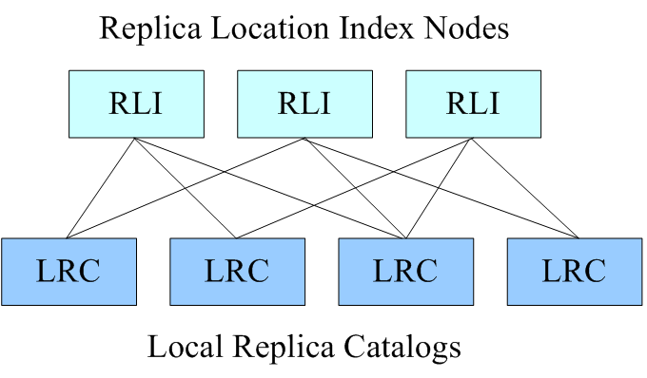
An RLS with Redundancy

Slide 13
3. Soft State Mechanisms for Maintaining Global State
LRCs send information about their mappings (state) to RLIs using soft state protocols
  Soft state: information times out and must be periodically refreshed
Advantages of soft state mechanisms:
  Stale information in RLIs removed implicitly via timeouts
  RLIs need not maintain persistent state: can reconstruct state from soft state updates
Some delay in propagating changes in LRC state to RLIs
  Provides relaxed consistency
Soft state update strategies:
  Complete state or incremental updates
  Send immediately after LRC state changes or periodically

Slide 14
4. Compression of State Updates
Optional mechanism for reducing:
  communication requirements for state updates
  storage system requirements on RLIs
Compression options:
  Hash digest techniques (e.g., Bloom filters)
  Use structural or semantic information in logical names (e.g., logical collection names)
  Others
Lossy compression:
  May lose accuracy about mappings
  E.g., bloom filters:
  Small probability of false positives on RLI queries
  Lose ability to do wildcard searches on logical names in RLIs

Slide 15
5. Membership Service
Used for the following:
Locating participating LRCs and RLIs
Keeping track of which servers sends and receives soft state updates from one another
Dealing with changes in membership (RLI leaves or joins):
  Membership service notifies LRCs of change in RLI(s) to which they send state
  May repartition LFNs among set of RLIs

Slide 16
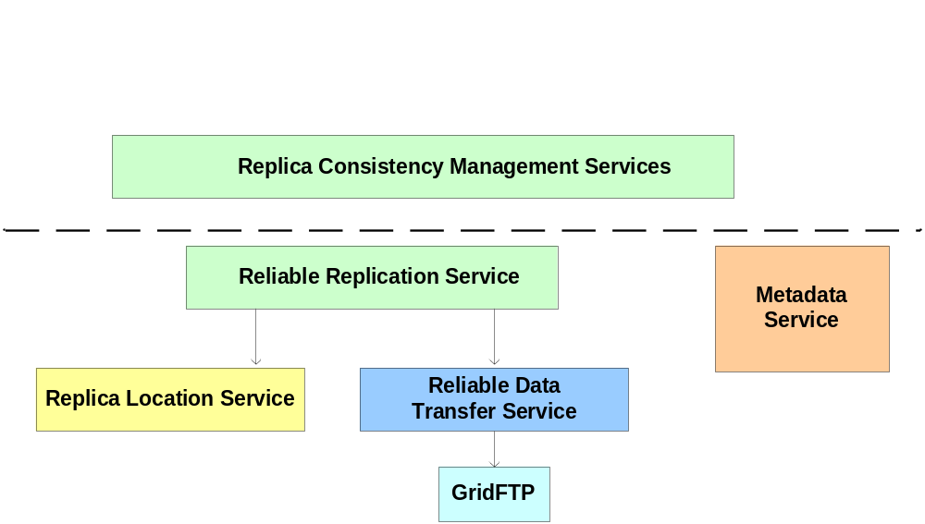
Replica Location Service In Context
The Replica Location Service is one component in a layered data grid architecture
Provides a simple, distributed registry of mappings
Consistency management provided by higher-level services

Slide 17
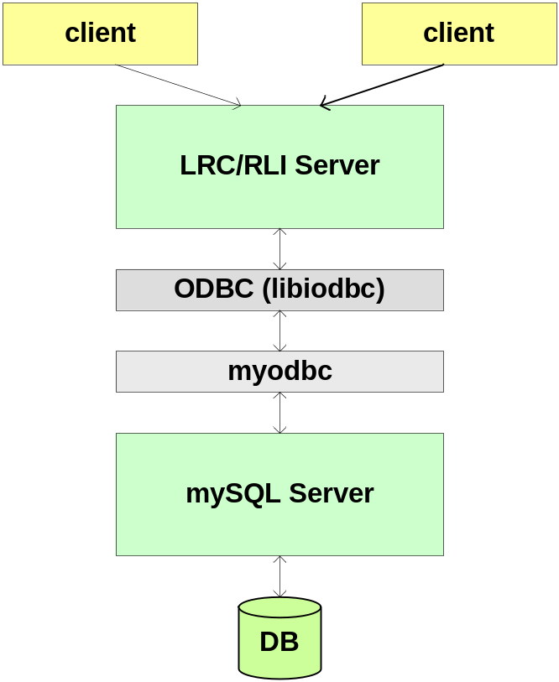
Components of RLS Implementation
Front-End Server
  Multi-threaded
  Supports GSI Authentication
  Common implementation for LRC and RLI
Back-end Server
  mySQL Relational Database
  Holds logical name to target name mappings
Client APIs: C and Java

Slide 18
Implementation Features
Two types of soft state updates from LRCs to RLIs
  Complete list of logical names registered in LRC
  Bloom filter summaries of LRC
User-defined attributes
  May be associated with logical or target names
Partitioning
  Divide LRC soft state updates among RLI index nodes using pattern matching of logical names
Membership service
  Static configuration only
  Eventually use OGSA registration techniques

Slide 19
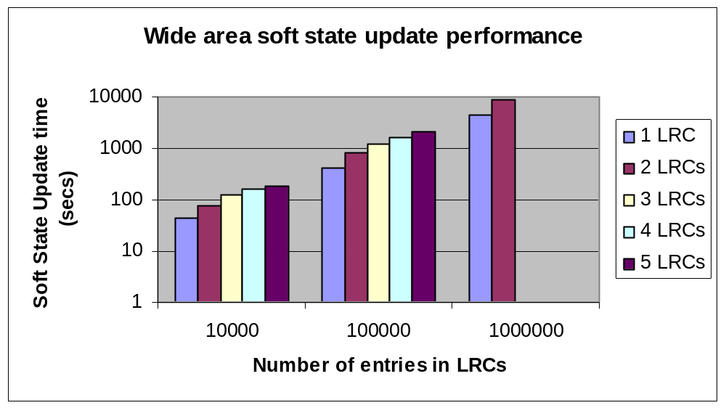
Wide Area Complete
Soft State Update Performance
LRCs in Geneva and Pisa updating RLI at Glasgow
Full soft state updates quite slow for large databases, dominated by update costs on RLI database
Performance does not scale as LRCs grow: need compression of soft state updates

Slide 20
Soft State Performance
With Bloom Filters
Sending bloom filter bitmap summarizing 1 million LRC mapping entries
  Store bloom filters in RLI memory
  Takes less than 1 millisecond to send updates on LAN
  Currently measuring wide area performance
Bloom filter advantages
  Reduce size of soft state updates
  Reduce associated storage overheds and network requirements
  Sending updates is faster and scales better with size of LRC

Slide 21
Future Work
Continued development of RLS
  Invite users:
    www.globus.org/rls
    http://cern.ch/grid-data-management
Reliable replication service
  Replicate data objects and register them in RLS
  Provide fault tolerance
RLS is currently part of Globus Toolkit
  Used in several demonstrations at SC2002
  Shown today in Argonne National Laboratory booth
RLS will become an OGSA grid service
  Replica location grid service specification will be standardized through Global Grid Forum

Slide 22









RLS Sponsors and Testbed Participants

