Slide 1


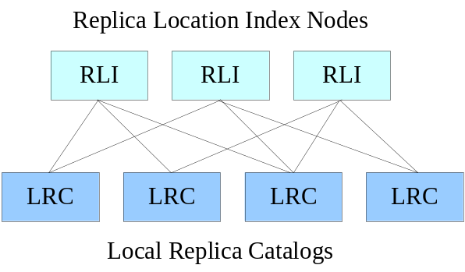
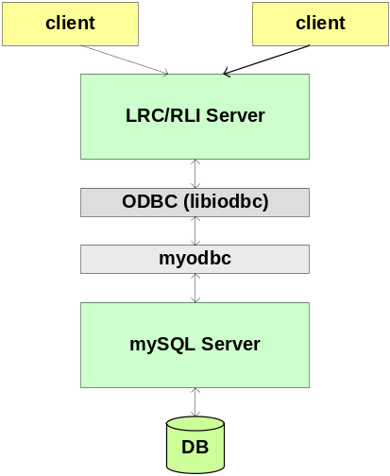
The Replica Location Service
In wide area computing systems, it is often desirable to create copies (replicas) of data objects. Replication can be used to reduce access latency, improve data locality, and increase robustness, scalability and performance for distributed applications.
The Replica Location Service (RLS) is a distributed registry that maintains information about the physical locations of copies and allows discovery of replicas.
The RLS was designed and implemented in a collaboration between the Globus project and the DataGrid project. The distributed RLS is intended eventually to replace the centralized Globus replica catalog, providing higher performance, reliability and scalability.
The RLS architecture includes five components:
Consistent state maintained in Local Replica Catalogs (LRCs): Local catalogs maintain mappings between logical names for data items and target names (either physical or logical).
Collective state with relaxed consistency maintained in Replica Location Indices (RLIs): An RLI aggregates state information contained in one or more LRCs. A variety of index structures may be created by varying the number of RLIs, the amount of redundancy and the parititioning of LRC updates among RLIs.
Soft state maintenance of RLI state: LRCs send summaries of their state to RLIs using soft state update protocols. Information in RLIs times out and must be periodically refreshed.
Optional compression of soft state updates: An RLS may include compression to reduce network requirements and RLI storage overheads. The RLS implements optional Bloom filter compression.
Membership service: A membership service keeps track of the LRCs and RLIs that make up the distributed registry and their soft state update patterns. The current implementation maintains a static configuration for RLS.
The RLS implementation consists of a multi-threaded front-end server that implements GSI authentication and a back-end server consisting of a mySQL relational database. There are two client APIs for the RLS written in C and Java. Features of the implementation include two types of soft state updates, the ability to associate user-defined attributes with logical or target names, and the ability to partition soft state updates among RLI index nodes using pattern matching of logical names.
For more information on RLS:
www.globus.org/rls
http://grid-data-management.web.cern.ch/grid-data-management/replica-location-service/index.html

Slide 2
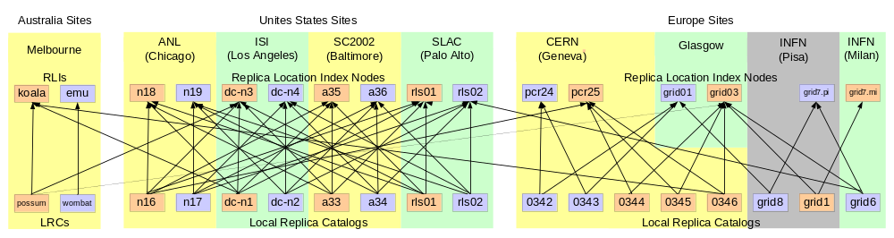
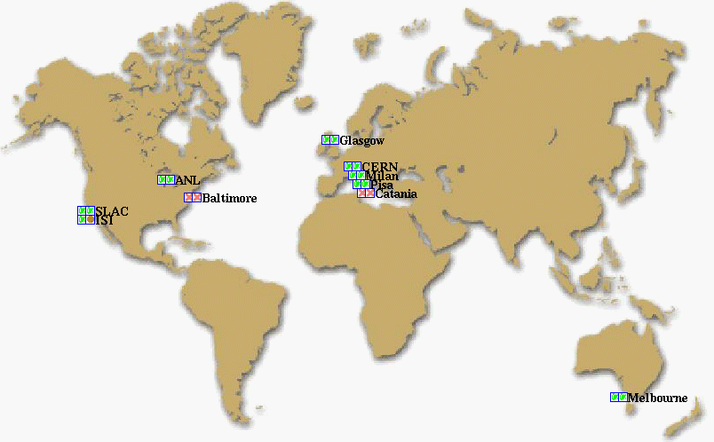






The SC2002 RLS Demo
The RLS demonstration testbed for SC2002 consists of over 25 servers on three continents. The testbed contains local replica catalogs (LRCs) and replica location index nodes (RLIs) of two types: those that exchange soft state updates containing bloom filter summaries of LRC content and those that exchange lists of logical names registered in LRCs.
As shown in the topology picture below, some portions of the RLS distributed registry are highly connected, while in other portions, LRCs send state summaries to relatively few RLIs. This shows the flexibility of the RLS design, which allows tradeoffs between the amount of soft state update information that is exchanged and the level of redundancy and load balancing provided by the distributed registry. The testbed configuration limits the number and size (by using bloom filters) of soft state updates that are exchanged among continents.
RLS Sponsors and Testbed Participants

