Slide 1
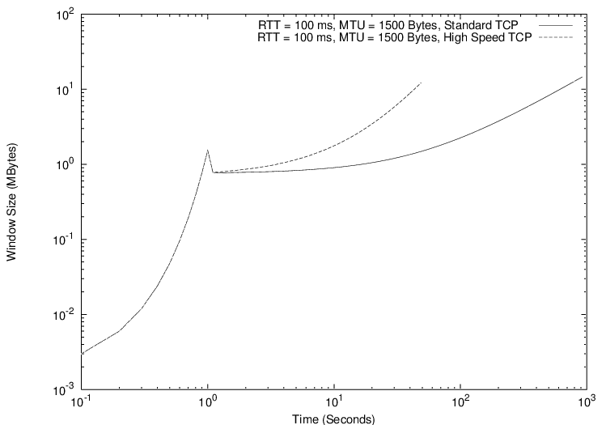
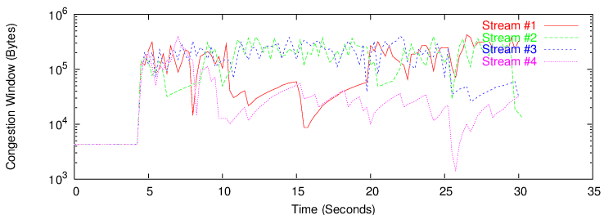
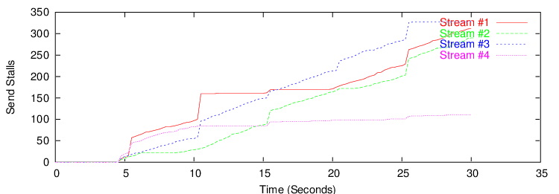
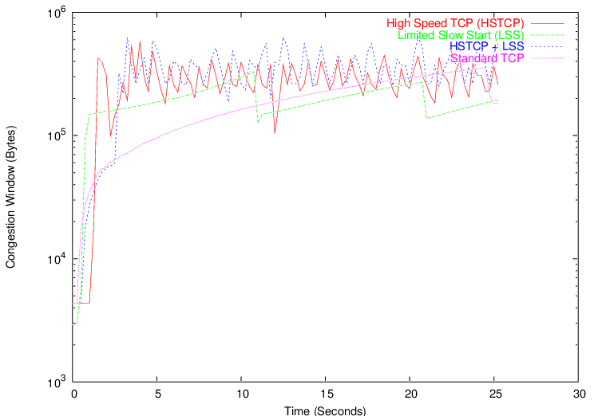
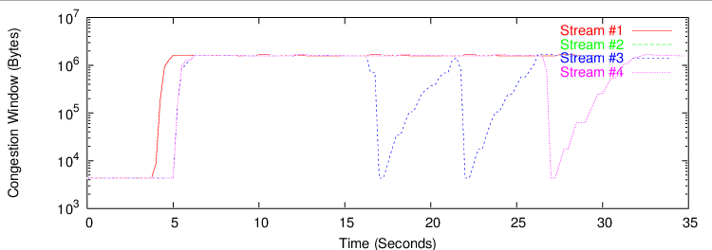
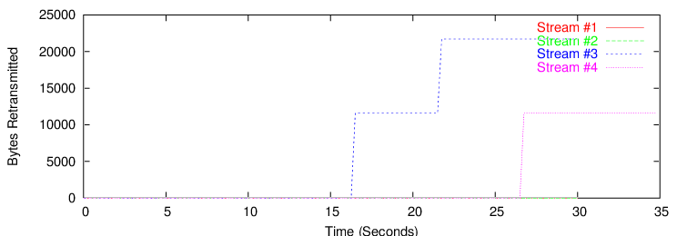
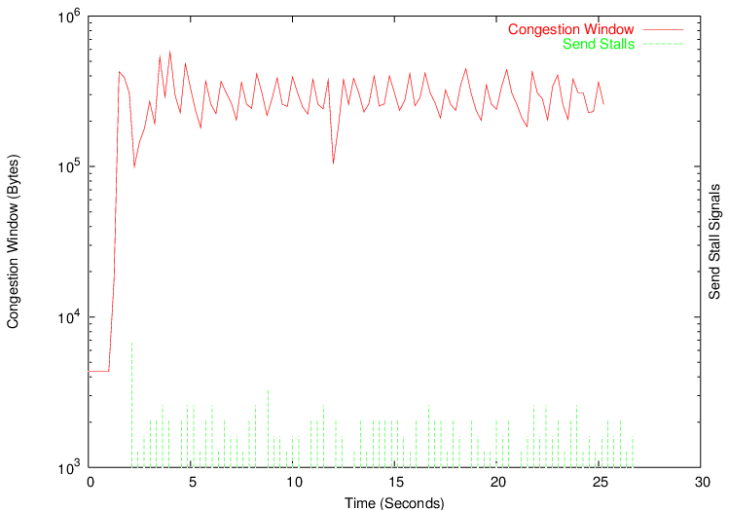
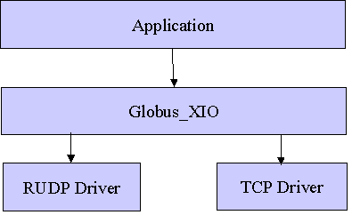
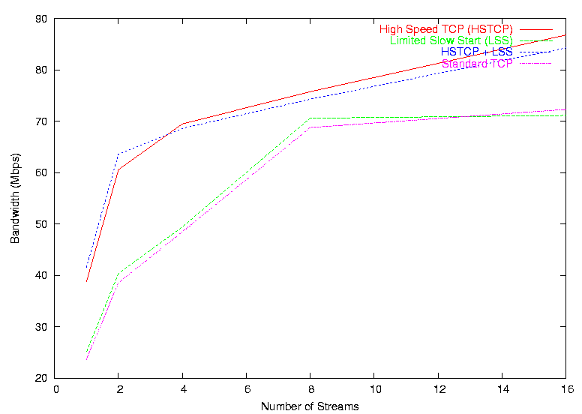
Appropriateness of Transport Mechanisms in Data Grid Middleware
Rajkumar Kettimuthu^{1,3}, Sanjay Hegde^{1,2}, William Allcock¹, John Bresnahan¹
¹Mathematics and Computer Science Division, Argonne National Laboratory, ²Department of Computer Science, Illinois Institute of Technology, ³Department of Computer and Information Science, The Ohio State University
    Introduction
Bulk data transfer has become one of the key requirements in many Grid applications
GridFTP has been widely deployed for high-speed data transport services
These services normally require reliable data transfer resulting in TCP as the preferred common base protocol
Unfortunately TCP performs sub optimally in achieving maximum throughput on the currently available “long fat networks” over the Internet
This work involves two phases of investigation on the impact of transport protocol on bulk data transfer:
  Appropriate instrumentation and study of standard Linux TCP stack, incorporating the recently proposed modifications for high-speed transport
  Evaluation the non-TCP based reliable transport mechanisms such as NETBLT, Tsunami from Indiana University, RBUDP from the Electronic Visualization Lab at University of Illinois - Chicago
Web100
Improves TCP instrumentation by providing a simple but elegant means of understanding the underlying operation of TCP within a host.
Includes tools for measuring performance and network diagnosis to get a dynamic view of the behavior of the TCP sessions
Provides foundation for TCP autotuning performed in process-level code and the process-level tools designed to locate bottlenecks
Helped identify the cause of extreme round-trip time variance in a recent bulk data transfer experiment
Helped identify the various possible reasons for drop in the congestion window
Does not provide information about the process id for a TCP stream; dropped packets are not instrumented
Reference: http://web100.org
Figure 1: Comparison of the congestion window variation in standard TCP and high-speed TCP
With the modified values for the AIMD, the high-speed TCP is able to reach the bandwidth delay product much faster than the standard TCP
Figure 5: Interaction of multiple streams for high speed TCP with send stalls
Note that some of the streams are not able to achieve a higher congestion
window
Congestion Control in TCP
TCP uses two algorithm for congestion control: slow start and congestion avoidance
Maximum data in flight is min(congestion window, advertised window)
Slow start: Congestion window is initialized to one segment. Each time an acknowledgment is received, the congestion window is increased by one segment
Congestion avoidance: increase in congestion window should be at most one segment each round-trip time (regardless of the number of acknowledgments that are received in that round-trip time)
Slow-start threshold is used to switch between slow-start and congestion avoidance. Exit slow-start and enter congestion avoidance when the congestion window goes above slow- start threshold
Fast retransmit and recovery are proposed to improve the performance of TCP by retransmitting without waiting for the retransmit timer to expire
References: RFC 2001, RFC 2581, RFC 2582, RFC 2914
Figure 2: Comparison of the congestion window variation for various schemes
High-speed TCP schemes achieve higher congestion window than the other schemes
Figure 6: Interaction of multiple streams for high-speed TCP with no send stalls
Globus XIO
Limited Slow-Start
The Problem:
  The current slow-start procedure effectively doubles the congestion window in the absence of delayed acknowledgments.
  For TCP connections that are able to use congestion windows of thousands of segments, such an increase can easily result in thousands of packets being dropped in one round-trip time.
  This is often counterproductive for the TCP flow itself and is also hard on the rest of the traffic sharing the congested link.
The Solution – Limited Slow-Start:
  Limits the number of segments by which the congestion window is increased during slow-start, in order to improve performance for TCP connections with large congestion windows.
  Introduces another threshold called “limited slow start threshold”
    Enter limited slow-start when the congestion window goes above this threshold
    During limited slow-start, the congestion window is increased by at most half of the maximum segment size for each arriving acknowledgment
    Exit limited slow-start and enter congestion avoidance when the congestion window goes above the “slow-start threshold”
Reference: Internet draft draft-floyd-tcp-slow-start-01.txt
Provides a standard API for the applications
Drivers are responsible for all file access and data transporting
Figure 3: Effect of send stalls on the congestion window for high-speed TCP
Even though there is no congestion in the network, Linux TCP treats the local
resource stalls as congestion signals
    Other Transport Protocols
NETBLT (NETwork BLock Transfer):
  Transfer the data in a series of large data aggregates called “buffers”. The sending NETBLT must inform the receiving NETBLT of the transfer size during connection setup
RUDP (Reliable UDP)
  Layered on UDP/IP protocols and provides reliable in-order delivery. EACK is used to specify the out-of-order segments received and unlike TCP the receiver RUDP receiver cannot discard the out-of-order segments
RBUDP (Reliable Blast UDP)
  UDP augmented with aggregated acknowledgements to provide reliable bulk data transmission. Acknowledgements are delivered at the end of the transmission phase using a bit vector
Tsunami
  A hybrid TCP/UDP based file transfer protocol. It uses UDP for payload and TCP for signaling including request for retransmission
High Speed TCP
Current standard TCP places a serious constraint on the congestion windows that can be achieved by TCP in realistic environments
High-speed TCP is a modification to TCP's current congestion control mechanism for high-delay, bandwidth networks
It introduces a threshold value. If the congestion window is less than the threshold, it uses the normal AIMD algorithm where the additive value is 1 and the decrease factor is 0.5
If the congestion window is greater than the threshold, it uses High Speed response function to calculate alternate values for AIMD
Benefits:
  Achieves high per connection throughput without requiring unrealistically low packet loss rates
  Reaches high throughput without long delays when recovering from multiple retransmit timeouts
The proposed change to the AIMD algorithm may impose a certain degree of unfairness as it does not reduce its transfer rate as much as standard TCP
Reference: Internet draft draft-floyd-tcp-highspeed-01.txt
  Conclusion
Web 100 is a useful tool for TCP instrumentation and trouble shooting
Current TCP is not suitable for long fat networks.
High Speed provides better throughput than the standard TCP but the fairness of it needs to be evaluated
Local resource stalls imposed by Linux adds additional constrains on throughput
Figure 4: Variation of bandwidth with parallel streams for different schemes
High-speed TCP schemes outperform the other schemes

