Slide 1
TeraGrid's GRAM Auditing & Accounting, & its Integration with the LEAD Science Gateway
Stuart Martin
Computation Institute, University of Chicago & Argonne National Lab
Marcus Christie
Indiana University
TeraGrid 2007
Madison, WI

Slide 2
Contributors / Collaborators
UC/ANL
  Ian Foster
  Peter Lane (Formerly UC/ANL)
  Joe Bester
  Ravi Madduri
  Martin Feller
  Rachana Ananthakrishnan
Ally Hume (EPCC)
JP Navarro (TG GIG)
TG Gateway Working Group

Slide 3
TG Gateways
Lower the barrier for scientists and their applications to use TeraGrid resources
Provide an application or domain-specific interface that a scientist can easily understand
Each gateway may have 100s or 1000s of users accessing TG resources
Must be efficient and scale

Slide 4
Use Cases
Group Access
  For efficiency, a “community” credential is used to multiplex many users over a single ID
Query Job Accounting
  Gateways need a remote interface to obtain the TG units charged for their user’s jobs
Auditing
  Grid services provide access to resources
  TG Resource Providers need a record of actions performed by services

Slide 5
Requirements From Use Cases
Grid Job Identifier
Remote client interface to auditing and accounting information
Creation of service audit and accounting information
Access to remote LRM accounting information from the audit service
Scalability in storing information/records
Secure access (authentication and authorization) to audit and accounting information

Slide 6
Grid Job Identifier
Uniquely identifies a job
Shared between the client (Gateway) and service (TG RP)
Obtained in the normal service interaction/protocol
In GRAM4 it’s the EPR converted
In GRAM2 it’s the job contact (as is)
GRAM4 Example >>>

Slide 7
GRAM4 EPR:
<ns1:managedJobEndpoint xmlns:ns1=
"http://www.globus.org/namespaces/2004/10/gram/job">
<ns2:Address xmlns:ns2=
"http://schemas.xmlsoap.org/ws/2004/03/addressing">
https://127.0.0.1:8443/wsrf/services/ManagedExecutableJobService
</ns2:Address>
<ns3:ReferenceProperties xmlns:ns3=
"http://schemas.xmlsoap.org/ws/2004/03/addressing">
<ns1:ResourceID cca8169a-c65f-11da-a61c-000d61215ff0
</ns1:ResourceID>
</ns3:ReferenceProperties>
<ns4:ReferenceParameters
xmlns:ns4="http://schemas.xmlsoap.org/ws/2004/03/addressing"/>
</ns1:managedJobEndpoint>
Grid Job ID:
https://127.0.0.1:8443/wsrf/services/ManagedExecutableJobService?QQDzjbFVYImtVg8

Slide 8
Remote Client Interface
Flexible query interface to retrieve audit and accounting records
Define an operation “getChargeForJob” to return the units consumed by a Grid Job ID
Keep audit service interface separate from GRAM service to allow flexible deployment scenarios
  Allow a single audit service for multiple GRAM services
  Same client interface could be used for other services, for example, charging for data storage or transfers
OGSA-DAI satisfies these requirements

Slide 9
Creation of Service Auditing Information
Added GRAM audit record creation upon job termination
  Record fields: Job_grid_id, local_job_id, submission_job_id, subject_name, username, creation_time, queued_time, stage_in_gid, stage_out_gid, clean_up_gid, gt_verison, rm_type, job_description, success_flag
  Gerson Galang (APAC) contribution for GRAM4 audit record creation at beginning of job, update after LRM submission, and final update upon termination
  Records are needed soon after job termination
Accounting information is created by the local resource managers

Slide 10
Access to LRM Accounting Information
TeraGrid uploads all LRM accounting information from each TG site to a central DB (TGCDB)
The OGSA-DAI service can be configured to access the remote TGCDB

Slide 11
Scalability in Storing Information/Records
Estimated that system should handle 100,000+ records
GRAM service inserts records directly into audit DB
Audit DB must be local to GRAM service to assure reliability
Implemented to use either postgress or MySQL

Slide 12
Secure access
Standard authentication and authorization methods should be used to limit access to the audit and accounting information
  Clients must present a valid X.509 certificate
  Access can be controlled based on a range of policies
Current policy is to allow access iff the DN of the requestor matches the DN in the audit record

Slide 13
GT4 Java Container
Resource Provider Site
Delegation
RFT Audit
Table
Compute Cluster
RFT
Resource
Manager
LEAD
Gateway
1, 2
WS GRAM
3
5
7
4
GRAM Audit
Table
RM
Accounting
8
OGSA DAI
9
AMIE
6
TG Central
Accounting
DB

Slide 14
Sequence Description
Gateway submits job and gets an EPR on the reply
Gateway controls and monitors job with EPR
GRAM submits and monitors job in RM
GRAM inserts audit record at end of job
RM writes job accounting record
AMIE uploads RM accounting records to TGCDB. The RM accounting record is converted to TG accounting units.
Gateway locally converts EPR to GJID
Gateway calls OGSA-DAI getChargeForJob with GJID and gets the job usage on the reply
OGSA-DAI processes remote join between GRAM audit and TGCDB

Slide 15
LEAD Project Integration
LEAD – Linked Environments for Atmospheric Discover, NSF funded, 5 year large ITR research project
Application codes wrapped as web services (“Application Services”)
Workflows executed by a WS-BPEL compliant workflow engine
Applications, workflow engine, other components communicate via pub/sub notification system

Slide 16
LEAD Architecture + Auditing
LEAD Portal
2. Portal submits
workflow
GPEL Workflow
Engine
3. WF engine invokes
app services
App Service
1. Portal registers
workflow
4. Launch GRAM jobs
App Service
GRAM
Gatekeeper
App Service
Auditing
Service
6. Queries for charge
5. Audit notifs
Notification Broker

Slide 17
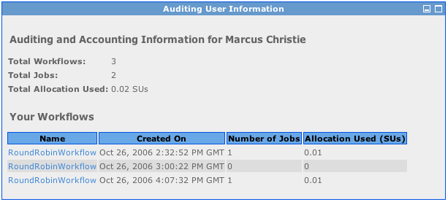
Auditing Portlet

Slide 18
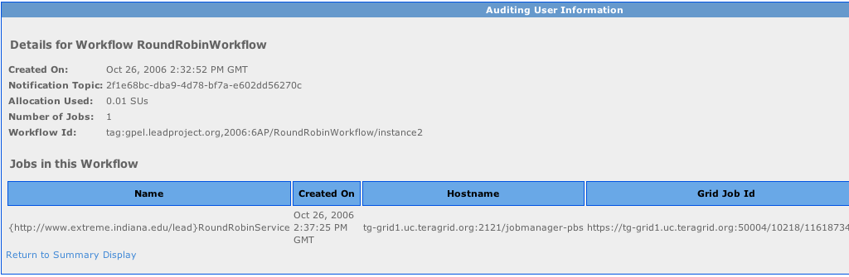
Auditing Portlet – Detail Screen

