Slide 1
GT4 Security Review:
Delegation Service
Sam Meder
12/16/2004

Slide 2
Overview
Service that stores delegated credentials as WS-Resources
  Makes these resources available to co-located services
Uses WS-Trust for protocol
Delegated credentials are based on delegation service key pair
  key pair never leaves hosting environment
Lifetime of resource = lifetime of credential

Slide 3
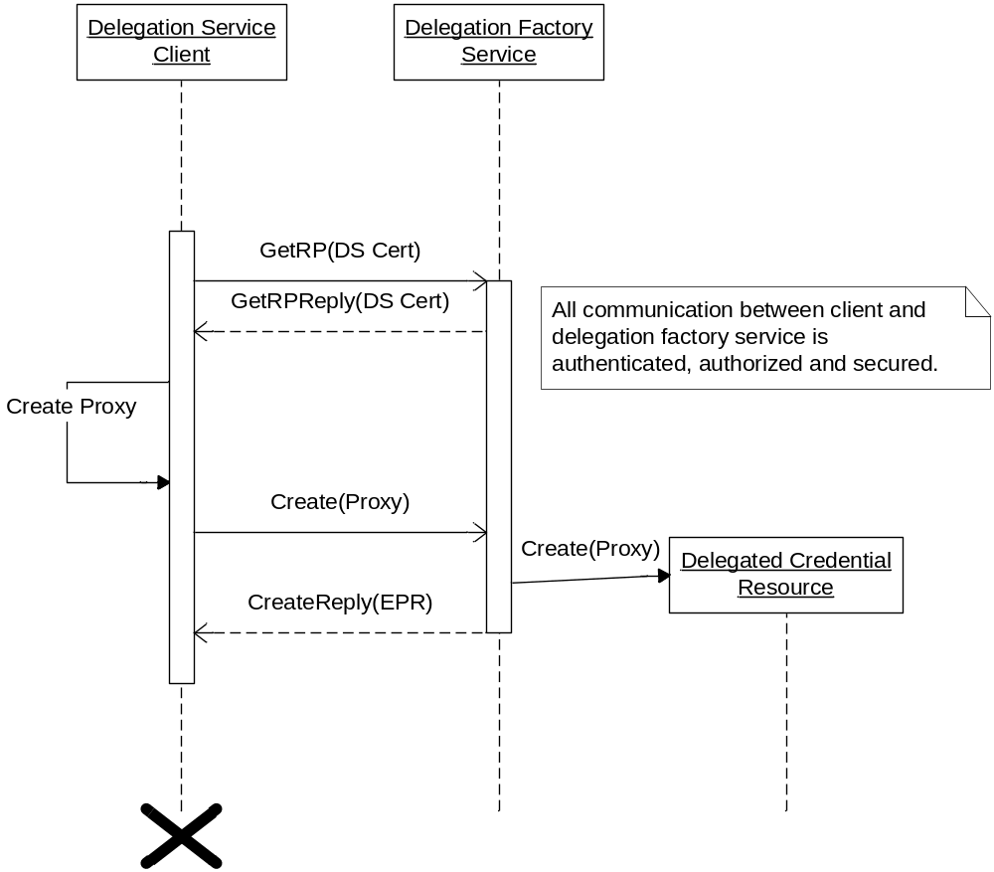
Create

Slide 4
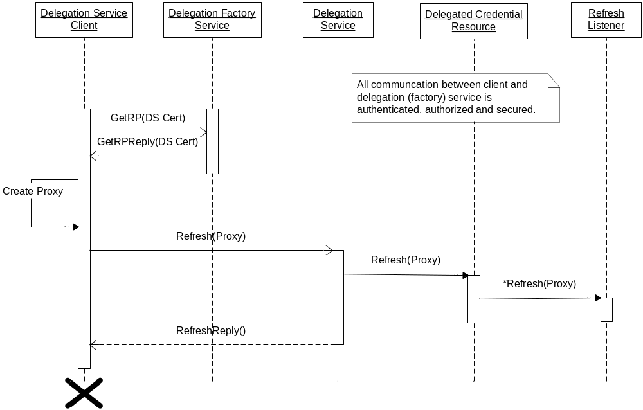
Renew

Slide 5
Access to Delegated Credentials
Access is handled via gridmap on delegation service resource
  Populated with creator DN by default
Both API calls and WS calls use this for authorization
  API calls trust calling service to assert correct identity

