Slide 1
Globus XIO
  The Globus Project™
  Argonne National Laboratory
  USC Information Sciences Institute
  http://www.globus.org/
  Copyright (c) 2002 University of Chicago and The University of Southern California. All Rights Reserved. This presentation is licensed for use under the terms of the Globus Toolkit Public License.
  See http://www.globus.org/toolkit/download/license.html for the full text of this license.
Notes:
SJT: Updated title

Slide 2
Globus XIO
eXtensible Input Output library
Overview
  Motivation
  Basic Architecture
Globus XIO User API
  Data Types
  Example usage
Driver Development
  Framework support
  Interface Functions
Notes:
This lays out what we will talk about
Portable between different flavours of unfix, windows, threads, system configurations, etch…

Slide 3
Grid IO
Geographically Disperse Resources
  Super Computers / Clusters
  Large Data Stores
  Specialized Scientific Devices
    APS, Telescopes, Environmental Sensors
  Collaborative Sessions
    AccessGrid
Varying Network Protocols
  GridFTP, HTTP, etc.

Slide 4

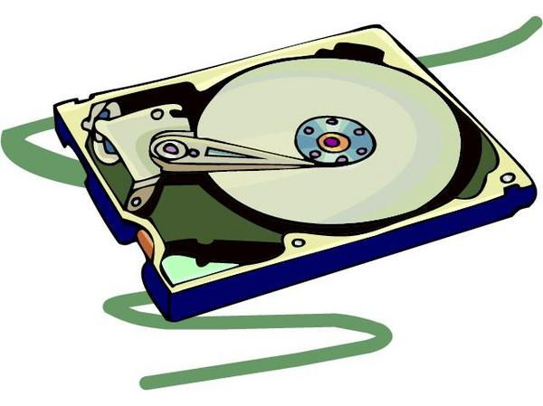
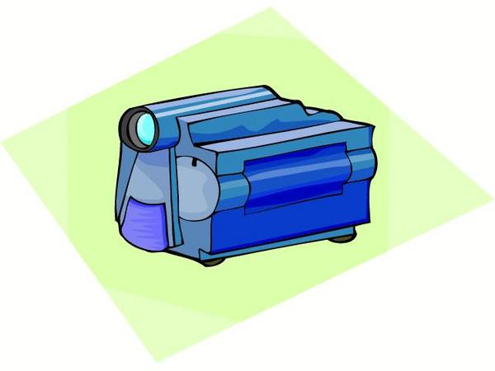
Typical Approach
Network Protocol
Protocol API
Network Protocol
Network Protocol
Application
POSIX IO
Disk
Proprietary API
Special Device

Slide 5
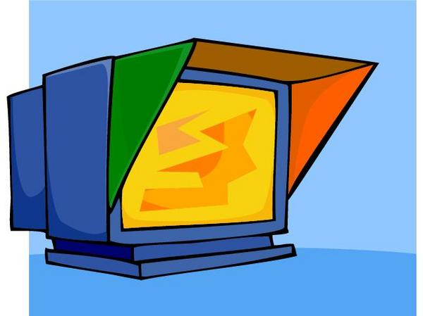
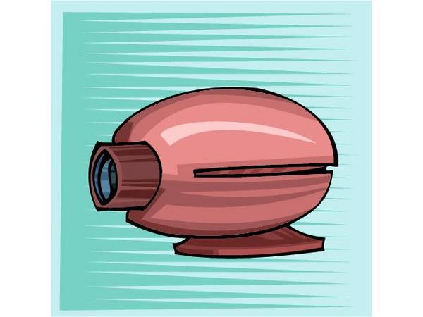
Example Application
Remote Compute Nodes
Collaborative Display
Grid FTP Client Library
Proprietary API
Application
HPSS Client Library
Proprietary API
Video Input Stream
HPSS

Slide 6
Problems
Development Time
  Application must learn to use many different APIs.
    Proprietary APIs can be complex
  Each API has its own semantics (and bugs).
    Asynchronous/Synchronous
    Threaded/non-thread
    Different programming models in the same application.
Scalability and Compatibility
  New devices or protocols
    Application must be modified to work with new devices
    Application must keep up with orthogonal research issues.

Slide 7
Observations
Data Stream IO Abstraction
  Many Grid IO needs can be treated as a streams of bytes.
  open/close/read/write functionality satisfies most requirements.
Protocol details
  Rarely does the application need (or want) to deal with protocol details.
  Most needs can be satisfied at initialization time.

Slide 8
Solution
Globus XIO user API
  Single API/Single Set of semantics.
  Simple open/close/read/write API
Driver Abstraction
  Hides protocol details
  Allows for extensibility
  Drivers can be selected at runtime

Slide 9
Globus XIO Approach
Network Protocol
Driver
Network Protocol
Network Protocol
Application
Globus XIO
Driver
Disk
Driver
Special Device

Slide 10
Example Application With Globus XIO
Remote Compute Nodes
Collaborative Display
Globus XIO
(display driver)
Globus XIO
(GridFTP driver)
Application
Globus XIO
(HPSS Driver)
Globus XIO
(video capture driver)
Video Input Stream
HPSS

Slide 11
Drivers
Make 1 API do many types of IO
Specific drivers for specific protocols/devices
Transform
  Manipulate or examine data
  Do not move data outside of process space
  Compression, Security, Logging
Transport
  Moves data across a wire
  TCP, UDP, File IO, Device IO
  Typically move data outside of process space

Slide 12
Stack
Transport
  Exactly one per stack
  Must be on the bottom
Transform
  Zero or many per stack
Control flows from user to the top of the stack, to the transport driver.
Example Driver Stack
Compression
Logging
TCP

Slide 13
Handles
Associated with a single stack
  When a handle is opened it is bound to a specific immutable stack.
  Handle is bound to stack at runtime.
Used in all user IO operations
  open/close/read/write
  Contains the state of the connection
Initialization
  Driver specific options.

Slide 14
Example Handle Use
Handle is bound to the stack.
User performs data operations on the handle.
The data operation is passed down the stack.
  The data is compressed by the first driver.
  The logging driver logs the exchange in syslog.
  The TCP driver sends the compressed data across the wire.
User
Handle
Driver Stack
Compression
Logging
TCP

Slide 15
Example 1
Build a stack
Initialize a handle
  Show driver specific options
Read and write data
Change the driver stack at runtime
Notes:
This lays out what we will talk about
Portable between different flavours of unfix, windows, threads, system configurations, etch…

Slide 16
Globus XIO Framework
Moves the data from user to driver stack.
Manages the interactions between drivers.
Assist in the creation of drivers.
  Asynchronous support.
  Close and EOF Barriers.
  Error checking
  Internal API for passing operations down the stack.
User API
Driver Stack
Transform
Framework
Transform
Transport
Notes:
This lays out what we will talk about
Portable between different flavors of unix, windows, threads, system configurations, etc…

Slide 17
Driver Development Warning
For power users only
  Assumption is you know what you are doing
  Weaker error reporting
    For the sake of efficiency.
  Possible to trip assertions.
    If the internal API is misused.
Notes:
This lays out what we will talk about
Portable between different flavors of unix, windows, threads, system configurations, etc…

Slide 18
Interface functions
A set function signatures
  Implemented by the driver
  Registered with Globus XIO
Semantics
  Globus XIO makes calls to these functions expecting specific behaviour
    Ex: the read() interface function should produce some data, and the write() interface function should consume data.
Notes:
This lays out what we will talk about
Portable between different flavors of unix, windows, threads, system configurations, etc…

Slide 19
Existing Drivers
Transport
  TCP, UDP, File
Transform
  GSI, HTTP
Advanced
  SABUL
Coming Soon
  GridFTP, Mode E, GSSAPI_FTP
Notes:
This lays out what we will talk about
Portable between different flavors of unix, windows, threads, system configurations, etc…

Slide 20
Summary
User API
  Simple open/close/read/write
  An abstraction to drivers
  Runtime configurable stacks
Drivers
  Drivers do all the work
  Transport and Transform
More information:
  http://www-unix.globus.org/developer/xio/

